Slide 1


Measuring Ground State Energy of Molecules Using VQE
Group 28A
Sourav Datta, Karleen Tur, Binabrata Das, Karthik Rajagopalan

Slide 2
Agenda
Overview of the method
Solution for H₂ molecule
Solution for LiH and H₂O molecules and challenges
Results
Conclusions and Future Investigations
Q&A

Slide 3
Overview of the method
Hamiltonian H is the total energy (kinetic + potential) of the system
Eigen values of the Hamiltonian give us the energy states of the system. We would like to solve the equation H|E_{i}> = E_{i}|E_{i}> and find out the lowest value of E_{i} = E_{gs}. Here E_{i} and |E_{i}> are eigen values and eigen vectors of the Hamiltonian respectively
For a state of the system |Ψ>, we can measure M = < Ψ | H | Ψ> to determine one of the possible energy states (E_{i}) of the system. We also know that M has a lower bound E_{gs} such that M >= E_{gs} .

Slide 4
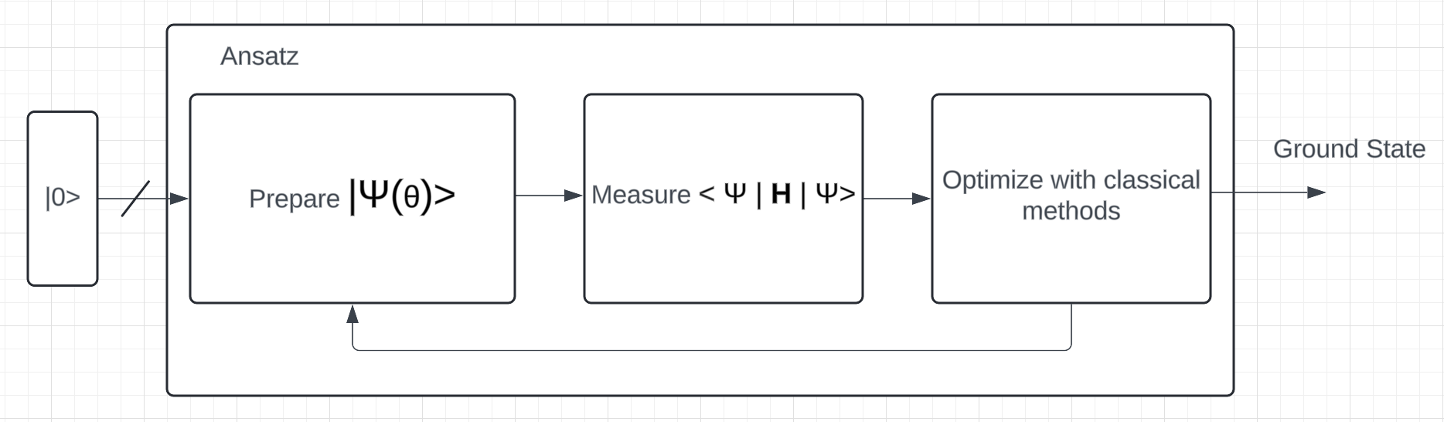
Overview of the method
Hence our problem becomes a minimization problem
We can use a variational circuit or Ansatz to solve the problem

Slide 5
Overview of the method
Hamiltonian H of a molecule is given as
H = T_{nuc} + T_{elec} + V_{elec-elec} + V_{nuc-nuc} + V_{nuc-elec} [where T and V are Kinetic and Potenital energies w.r.t nucleus and electrons]
After applying Born-Oppenheimer approximation (treating nucleus as classical point particles), first quantization, Hartree-Fock approximation and second quantization we get the following definition of H
H = ∑_{ij} h_{ij} C⁺_{i}C_{j} + ∑_{ijkl} v_{ijkl} C⁺_{i}C⁺_{j}C_{k}C_{l}
The values of the coefficients can be determined from experiments and the C⁺_{i} and C_{i} operators can be converted into quantum gates via strings of Pauli Matrices

Slide 6
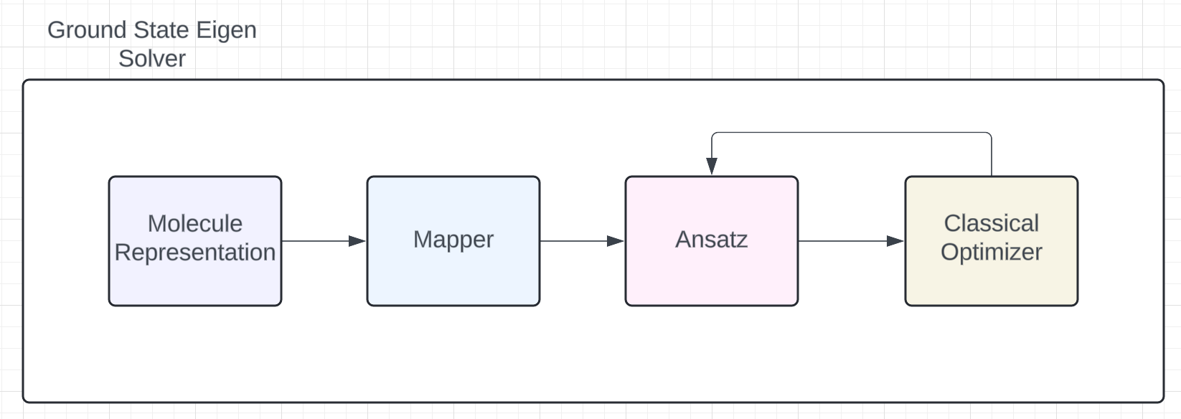
Solution for H2 molecule
Basic structure of the algorithm
Represent the molecule as a string
Spatial coordinates
Z matrix coordinates
Use PySCFDriver to find its coefficients (h_{ij} and v_{ijkl})
Use a Mapper to find Pauli strings for C⁺_{i} and C_{i} operators
Jordan Wigner
Bravyi Kitaev
Use an ansatz (UCCSD)
Use a classical optimizer (SLSQP, COBYLA)
Wrap all into a minimum state solver to find the result (VQE and GroundStateEigenSolver)
Compare with exact eigensolver to match the results (NumPyMinimumEigensolver)

Slide 7
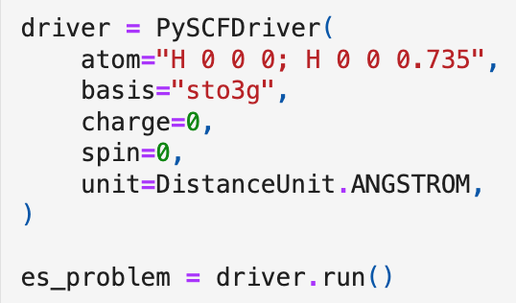
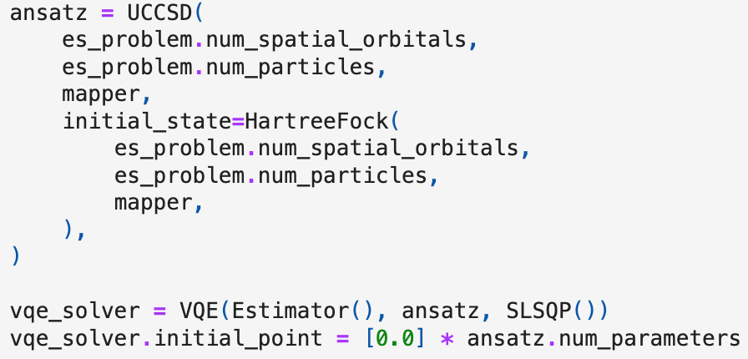

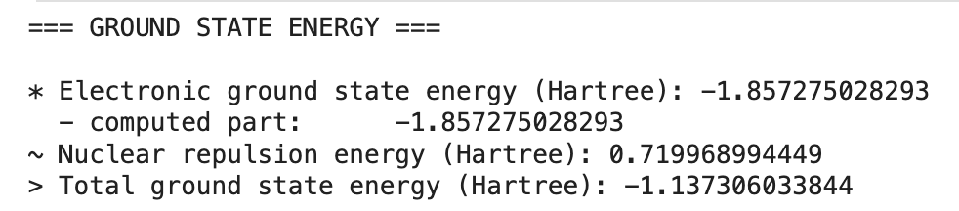
Solution for H2 molecule (code fragments)

Slide 8
Solution for LiH and H2O molecules and challenges
With latest version of Qiskit and qiskit_nature, calculation takes very long to finish for molecules like LiH and H₂O
Used an older version of Qiskit (v0.28.0) which finished within reasonable amount of time locally. It ran faster on an AWS EC2 instance t2large. Also used Parity mapping instead of Jordan Wigner
Another solution was to use Classiq (https://platform.classiq.io)
Classiq simulator provided in cloud
SDK in Python quite similar to Qiskit
Jobs executed has graphical results viewer
Ran faster for LiH and H₂O molecules

Slide 9
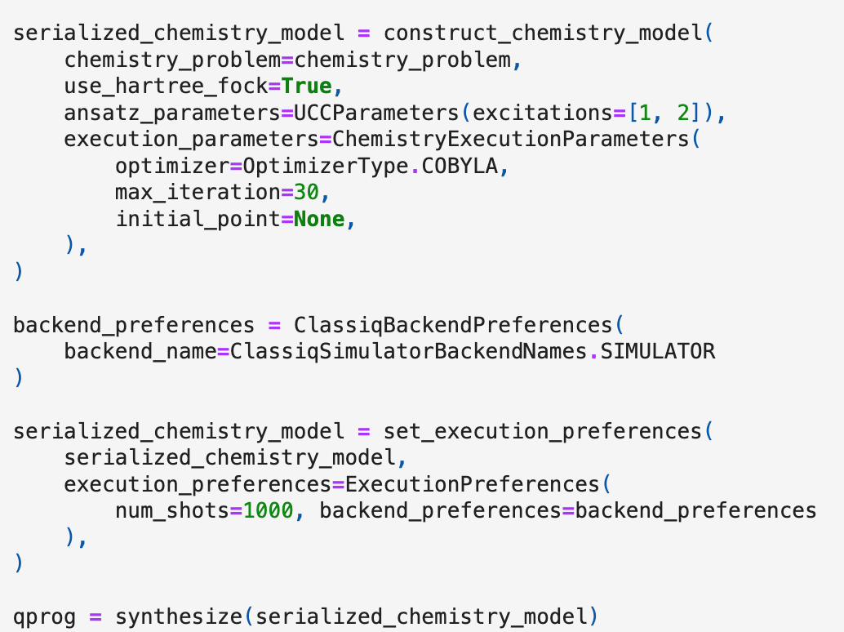
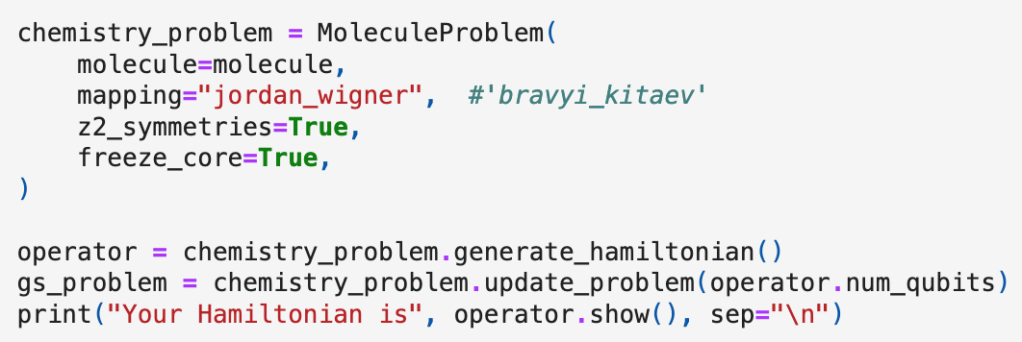
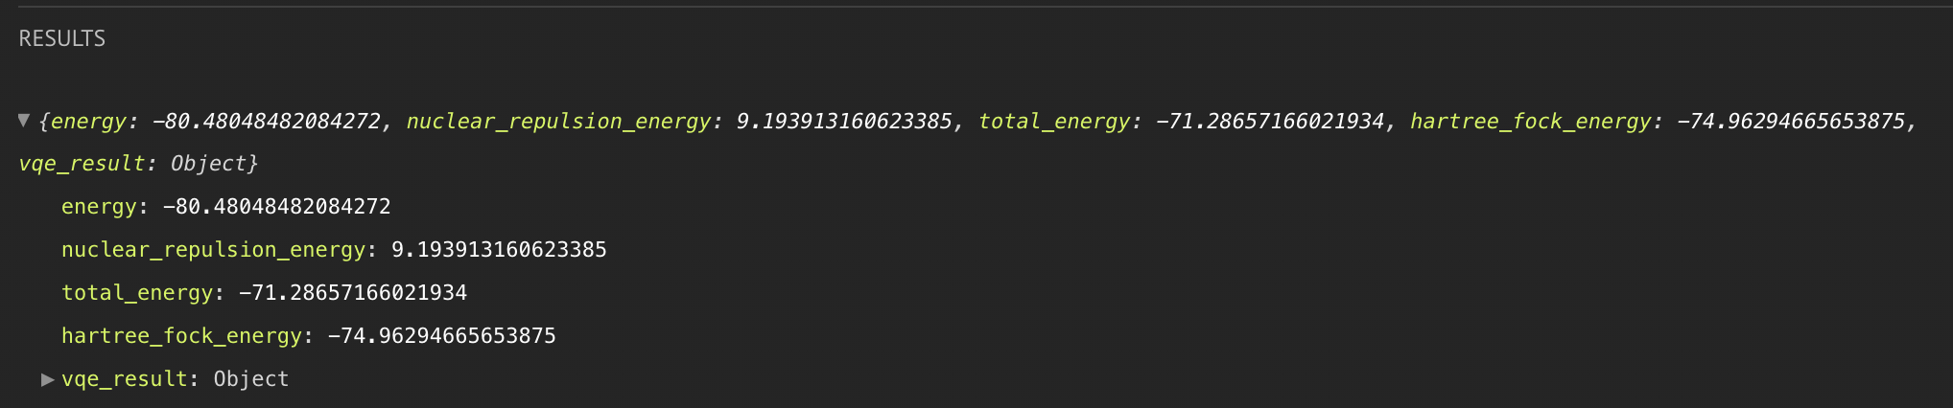
Solution for LiH and H2O molecules and challenges (with Classiq)
H₂O molecule simulation with Classiq

Slide 10
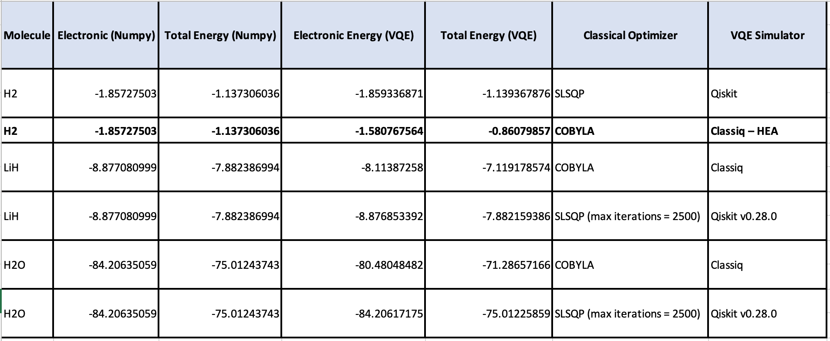
Results
Measurements of molecules and comparison with classical eigen solver (Numpy)

Slide 11
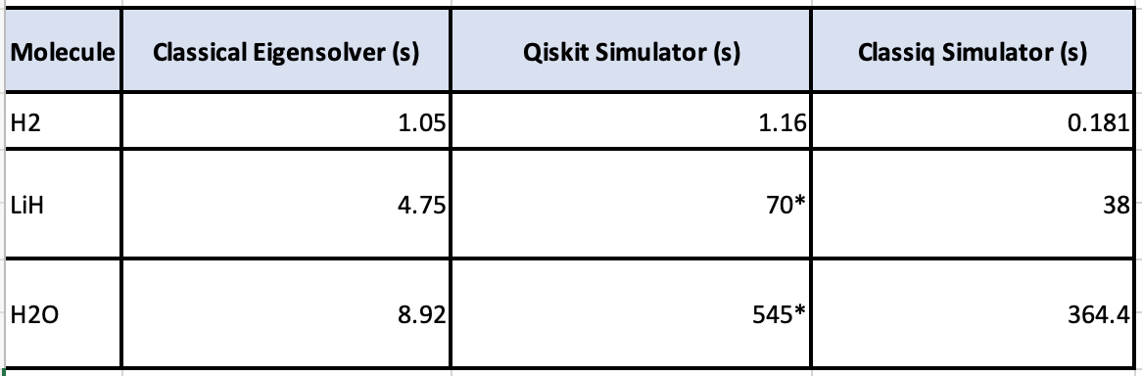
Results
Time comparisons on Qiskit and Classiq simulators

Slide 12
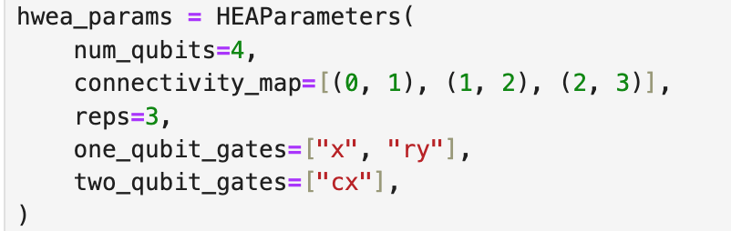
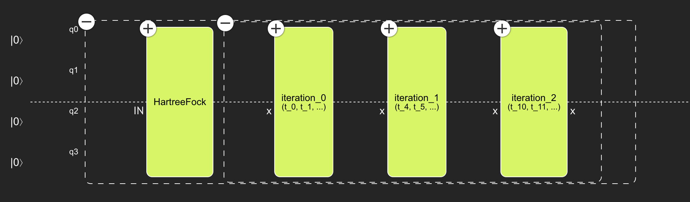
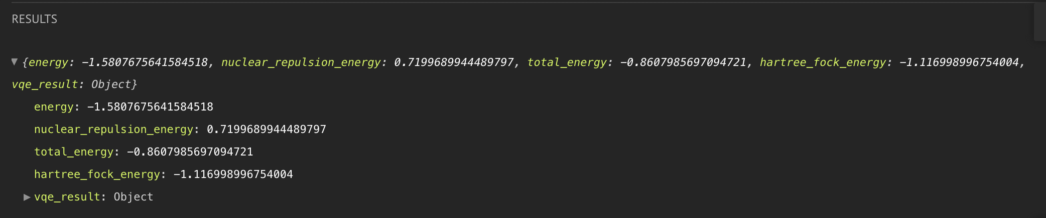
Results
HEA – Hardware Efficient Ansatz is a fixed structure ansatz that is used to fit a specific quantum hardware where the VQE algorithm will be running. It is sometimes suggested over UCCSD.
Used Classiq’s simulator to run a H₂ molecule specific simulation with HEA

Slide 13
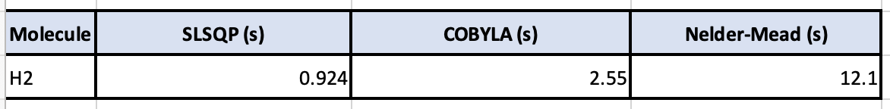
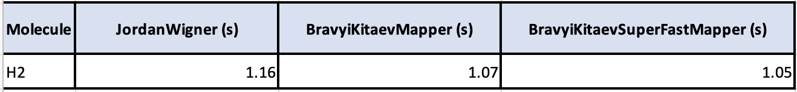
Results
Comparison between classical optimizers (Gradient-based vs Gradient-free)
Comparison between different mappers
With qiskit simulators, Parity mapping worked relatively better than Jordan Wigner mapping for LiH and H₂O. The execution times were faster. With the other mappings it took a long time to finish and in case of H₂O the process did not complete within 2 hours.

Slide 14
Conclusions
For simple molecule like H₂ the selection of Ansatz configuration did not change much
For complex molecules, when simulated classically, we saw better performance with Parity mapping, SLSQP and UCCSD
Gradient free optimizers performed relatively slowly on average
No quantum hardware were used so the results may not reflect exactly how it will behave in the actual hardware
Hardware-efficient Ansatz perform relatively faster (for H₂) but the results were off from the classical counterpart and simulated VQEs. Again, unable to test it on real hardware, we cannot conclude if this would be the case there too.

Slide 15
Areas of future investigation
Understand active areas of research in Ansatz architecture
Learn about Adaptive structure ansatz
Learn more about k-UpCCGSD based ansatz as they promise to be very efficient and linearly scalable
Implement and run VQE circuits on real hardware
Understand noise reduction and error correction in VQE circuits

Slide 16
Code
All code can be found in the Github repository
https://github.com/souravdatta/qcml_project

Slide 17

Q&A

Slide 18
Thank you!

