Slide 1

Khulna University of Engineering and Technology
Course Title : Project/Thesis
Course no : CSE 4000
Optimizing Real-Time Urban Navigation Under Dynamic Traffic & Road Disturbances
Date:15/12/2025
Supervised By
Presented By
Dr. Muhammad Aminul Haque Akhand Professor Dept. of CSE, KUET
Sourav Debnath Roll No: 2007109
1/23
CSE 4000 :PROJECT/THESIS

Slide 2

Outline
Introduction
Problem Statement
Related Works
Objectives
Methodology
Experimental Studies
Conclusion
2/23
CSE 4000 :PROJECT/THESIS

Slide 3
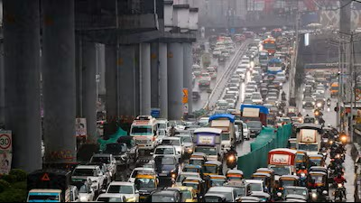
Introduction
Vehicles exceed road capacity limits.
Real-time traffic flow breaks down.
Accidents, weather, events trigger gridlock.
Economic productivity and mobility decline.
3/23
CSE 4000 :PROJECT/THESIS

Slide 4

Incident response is delayed or absent.
Problem Statement
Static models lack real-time adaptability.
Incident response is delayed or absent.
Adapts dynamically, avoids congestion efficiently.
Improves air quality, saves time.
4/23
CSE 4000 :PROJECT/THESIS

Slide 5
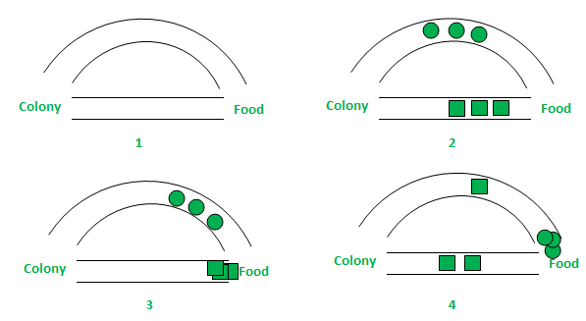
Why ACO?
ACO adapts quickly to dynamic traffic conditions
Finds near-optimal routes efficiently in real-time
Balances traffic load across multiple viable paths
Outperforms static algorithms like A* and Dijkstra
.
5/23
CSE 4000 :PROJECT/THESIS

Slide 6
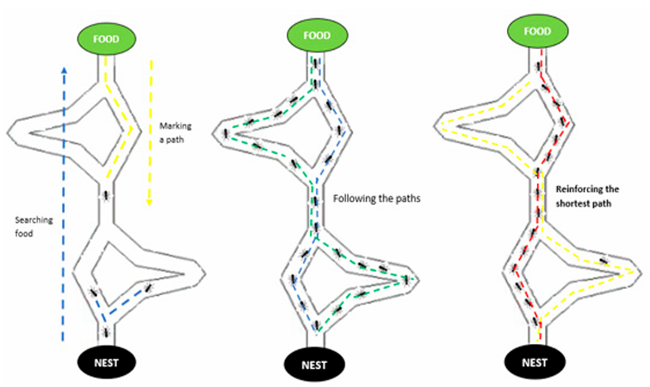
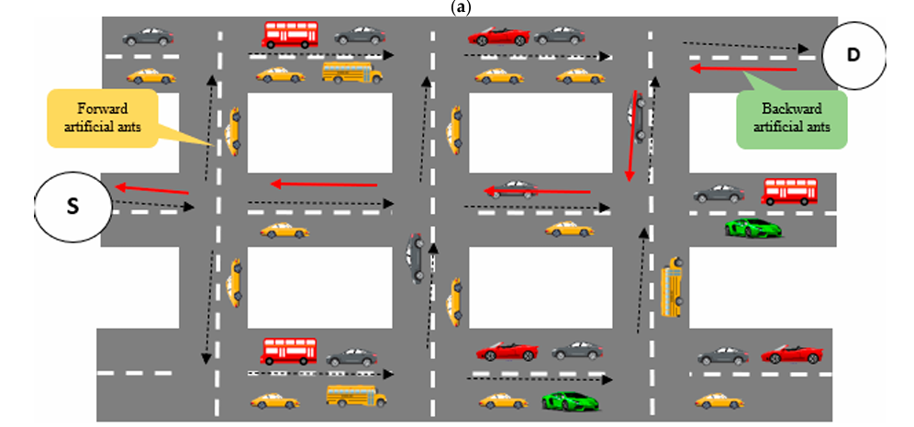
Visual Representation of ACO in Urban Routing
Fig 1 : Process of ant‑colony optimization[5]
Fig 2 : Vehicles following the ACO process to select the optimal route[5]
6/23
CSE 4000 :PROJECT/THESIS

Slide 7
Related Works
Table 1 :Related works
Article | Dataset and Results | Methods | Shortcomings
Wang [1] | Cold chain logistics simulation High accuracy and correlation (Solomon Dataset) | I-ACO with DTW Chaos theory integration | Large network scalability issues Limited application scope
Wu et al. [2] | Beijing traffic simulation Reduced congestion significantly (Eil51 dataset) | PSO-ACO hybrid Road condition factors | Static factors only Extensive parameter tuning needed
Liu and Wu [3] | Tourism route optimization Fast convergence, low error (Eil51 dataset) | GA-PSACO Smoothing factors | No real-time traffic handling Limited urban scalability
Zhu et al. [4] | Multi-city distribution simulation Improved path length/iterations (Synthetic data) | RA-GA-ACO hybrid | No emergency consideration Limited real-world validation
7/23
CSE 4000 :PROJECT/THESIS

Slide 8
Objectives
Global objectives
Develop improved ACO for real-time congestion-aware routing.
Specific objectives
Integrate multi-factor road attributes
Apply chaos-based initialization techniques
Implement DTW pattern recognition
Optimize parameters using PSO/GA
Validate using Solomon/VRPTW datasets
8/23
CSE 4000 :PROJECT/THESIS

Slide 9

Proposed Methodology
9/23
CSE 4000 :PROJECT/THESIS

Slide 10
Proposed Methodology(Contd.)
1
2
3
4
Data Preparation and modeling
Solomon & vrptw dataset
Cost Modeling & Baseline Algorithms
Improved ACO Model
(Proposed Model)
Simulation ,Evaluation& Scenerio Testing
Simulation(OD Pairs)
Optimized
Path
&
Performance
Metrices
Congestion Aware Cost
(time,Density,Capacity)
Data Preprocess
(Extraction,
Conversion,
Normalization)
Chaos based Theory
Congestion Cost
DTW Patterns
PSO/GA Parameter Tuning
Dynamic Pheromone Update
Evaluation
Travel time
Distance
Convergence
Baselines
(Classical ACO,
Dijkstra,A*,
Hybrid)
Robustness Testing
Accidents
Closures
Simulated Traffic Factors
(Density,
Congestion)
Fig 3 : Framework of the Proposed Improved ACO Methodology
10/23
CSE 4000 :PROJECT/THESIS

Slide 11
Proposed Methodology For Congestion Aware Path Planning
Prepare datasets and traffic factors
Model graph and congestion costs
Develop improved congestion-aware ACO
Apply DTW and parameter tuning
Simulate, evaluate, and optimize routes
11/23
CSE 4000 :PROJECT/THESIS

Slide 12
1
2
3
4
Improved ACO Model
(Proposed Model)
Chaos based Theory
Congestion Cost
DTW Patterns
PSO/GA Parameter Tuning
Dynamic Pheromone Update
I Will work on this Sector
Fig 4 : Research Scope - Proposed ACO Enhancement Components
12/23
CSE 4000 :PROJECT/THESIS

Slide 13
Proposed Methodology(Contd.)
Start
DTW Traffic Pattern Analysis
Initialize Parameters
(Chaos Based)
Calculate Congestion Cost
State Trasistion Rule
Local & Global Pheromone
Update
PSO/GA Parameter Tuning
No
Output
Termination Condition
Yes
Fig 5 : Framework of the Proposed Improved ACO Methodology
13/23
CSE 4000 :PROJECT/THESIS

Slide 14
Flowchart of Improved ACO algorithm
1. Chaos-based initialization enhances solution diversity
2. DTW analyzes real-time traffic patterns
3. Congestion cost calculated using density,time,capacity
4. Pheromone updates guide path selection
5. PSO/GA tunes parameters until convergence
14/23
CSE 4000 :PROJECT/THESIS

Slide 15

Contributions
Multi-factor ACO framework with congestion integration
Chaos initialization and DTW improve performance
Dynamic pheromone updates for real-time routing
Superior results vs classical ACO validated
15/23
CSE 4000 :PROJECT/THESIS

Slide 16

Experimental Studies
16/23
CSE 4000 :PROJECT/THESIS

Slide 17

Dataset Description
Table 2 : Solomon Benchmark Dataset (VRPTW)
Dataset | Problem Type | Customers | Depot | Time Windows | Demand | Service Time | Distance Metric | Application
Solomon VRPTW | Vehicle Routing with Time Windows | 100 per instance | 1 | Yes | Known | Fixed | Euclidean | Congestion-aware routing evaluation
Table 3 : VRPTW / TSPLIB (Eil51) Dataset
Dataset | Source | Nodes | Customers | Coordinates | Time Windows | Demand | Distance Metric | Application
Eil51 | TSPLIB | 51 | 50 | 2D Euclidean | Extended | Uniform / Predefined | Euclidean | Algorithm benchmark & validation
17/23
CSE 4000 :PROJECT/THESIS

Slide 18
Experimental Setup & Simulation Environment
Simulation Platform(Expected):
MATLAB/Python(scikit-learn, matplotlib, pandas) simulation environment
Custom ACO framework with multi-factor cost modelling
Key Parameters: (Expected) :
Number of ants: 50–100
Pheromone decay: 0.1–0.6
Iterations: 500–1000
Traffic intensity: Low/Medium/High congestion
18/23
CSE 4000 :PROJECT/THESIS

Slide 19

Expected Results Analysis
Table 4 :Expected vs. Baseline Algorithm Performance Metrics
Algorithm | Avg. Travel Time (min) | Route Distance (km) | Convergence Iterations | Congestion Exposure
Proposed I-ACO (Expected) | 85.2 (Expected) | 92.5 (Expected) | 78 (Expected) | Low (Expected)
Classical ACO | 112.4 | 118.3 | 240 | Medium
GA-PSACO | 96.8 | 104.7 | 120 | Medium
Dijkstra/A* | 124.6 | 132.5 | N/A | High
We have to calculate Accuracy,precision,F1 score to compare performance of our proposed model with existing models
19/23
CSE 4000 :PROJECT/THESIS

Slide 20
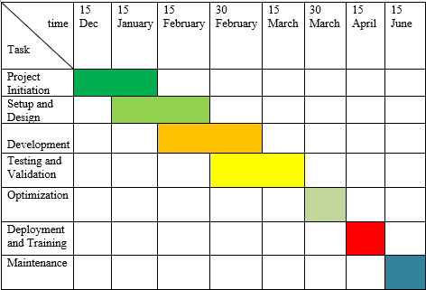
Gantt Chart for Future workflow
Fig 6 :Gantt chart for future Work
20/23
CSE 4000 :PROJECT/THESIS

Slide 21

Conclusion
Expected to develop improved congestion-aware
ACO framework successfully
Expected to achieve better dynamic routing
performance results
Computational overhead higher than classical ACO
Parameter tuning requires extensive optimization efforts
21/23
CSE 4000 :PROJECT/THESIS

Slide 22
References
[1] H. Wang, “Dynamic path optimization of cold chain logistics based on improved ant colony algorithm from a low-carbon perspective,” Sustainable Operations and Computers, vol. 6, pp. 297–305, 2025, doi: 10.1016/j.susoc.2025.10.001.
[2] C. Wu, S. Zhou, and L. Xiao, “Dynamic path planning based on improved ant colony algorithm in traffic congestion,” IEEE Access, vol. 8, pp. 180773–180783, 2020, doi: 10.1109/ACCESS.2020.3028467.
[3] S. Liu and H. Wu, “Analysis of the application of path finding system based on efficiency improvement in smart tourism,” Intelligent Systems with Applications, vol. 20, p. 200265, 2023, doi: 10.1016/j.iswa.2023.200265.
[4] W. Zhu, W. Cai, and H. Kong, “Optimal path planning based on ACO in intelligent transportation,” International Journal of Cognitive Computing in Engineering, vol. 6, pp. 441–450, 2025, doi: 10.1016/j.ijcce.2025.02.006.
[5] N. Melaouene, A. Razaque, and R. Rahal, “Heterogeneous algorithm for efficient-path detection and congestion avoidance for a vehicular-management system,” Sensors, vol. 23, no. 12, p. 5471, Jun. 2023, doi: 10.3390/s23125471
22/23
CSE 4000 :PROJECT/THESIS

Slide 23
Thank you
23/23
CSE 4000 :PROJECT/THESIS

