Slide 1
Route Optimization for Emergency Vehicles Analyzing Spatial and Temporal Dependencies using Graph Convolutional Network
Presented by:
Faria Sultana
Roll:1707023
Sadia Mubasshira Rahman
Roll: 1707042
Supervised by:
Prof. Dr. Md. Aminul Haque Akhand
Professor
Dept. of Computer Science and Engineering
Khulna University of Engineering & Technology,Khulna

Slide 2
Outline
Introduction
Purpose
Background
Objectives
Case Study
Prelimineries
Proposed Methodology
Contributions
Experimental Results and Analysis
Conclusions

Slide 3
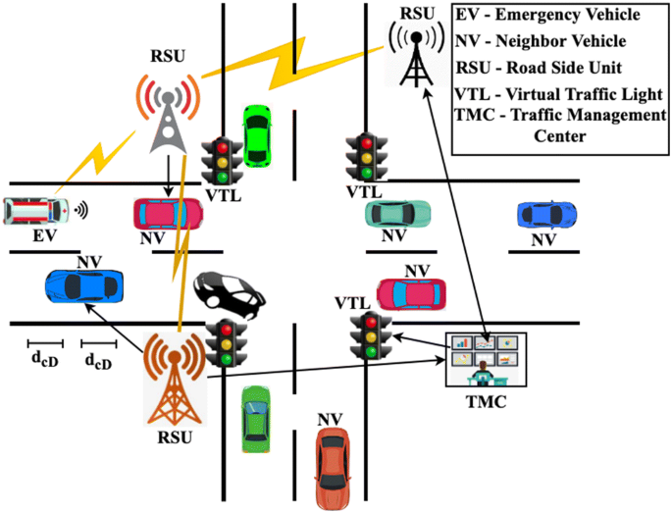
Introduction
3
Emergency vehicle routing refers to the process of determining the optimal path for emergency vehicles.
An well established emergency vehicle routing system can ensure necessary services to the accident locations
Figure 1 : A four point intersection of tracks

Slide 4
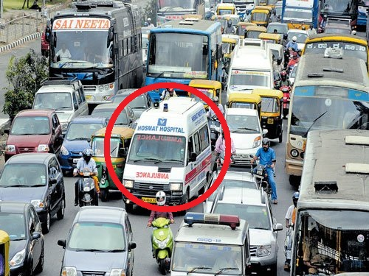
Purpose
Reducing the response time of emergency vehicle is the main purpose
Our cities are congested causing vehicles failing to reach in time.
The response time of emergency vehicle immensely effects the fatality rate.
Figure 2 : A picture of traffics on the road

Slide 5

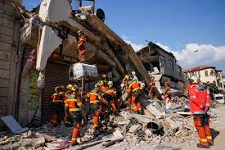
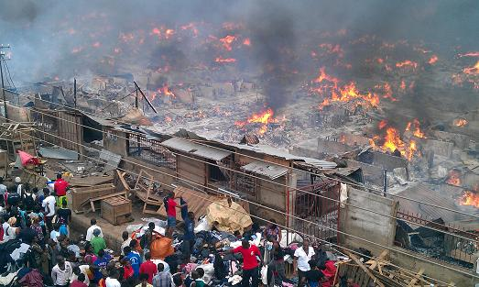
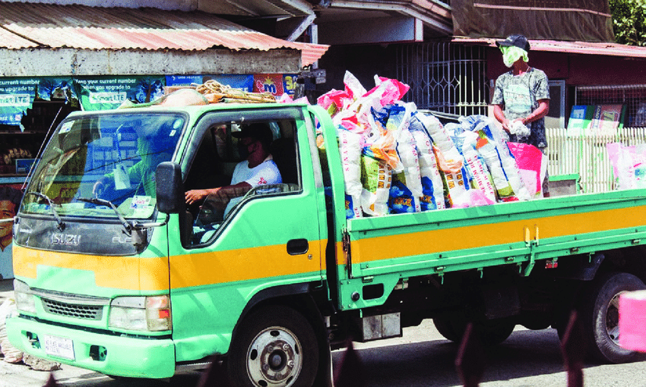
Purpose (Contd.)
Crime Scenes
Natural Disasters
Fire
Outbreaks
Relief Goods

Slide 6
Background
6
Guarantees a safe and secure road network
Sometimes even if the ambulance arrives in time, the delay to reach to the hospital might also cause damage
Damages caused by fire are more severe and increases rapidly.
Minimum Response Time
Routing is
necessary for EV
Increased Safety
Enhanced situational awareness
Figure 3 : Necessities of emergency vehicle routing

Slide 7
Background Studies
7
Vehicle Speed
Traffic Density
Vehicle
Size
Parameters
that have previously been considered
Time of the day
Connceting Vehicles
Connecting Roads
Figure 4 : Factors considered for emergency vehicle routing

Slide 8
zz
Background Studies (Contd.)
8
Accurate and adaptable
Predicting the road situation ahead of time
HighD dataset
Informing the other vehicles to clear the road when needed [1]
Needs an entire system
Beneficial in limited resources
Loading maximum causalties on the vehicle [2]
Locating EVs and dynamically rerouting based on real-time data [3]
Continuous supervision
Figure 5 : Various approaches taken in other studies

Slide 9
Objectives
9
The objectives of our study are:
Find the path with minimum travel time from given source to given destination
Avoiding path with congestions
Taking path to reach the destination without hampering normal traffic flow
Ensuring zero to minimum detours

Slide 10
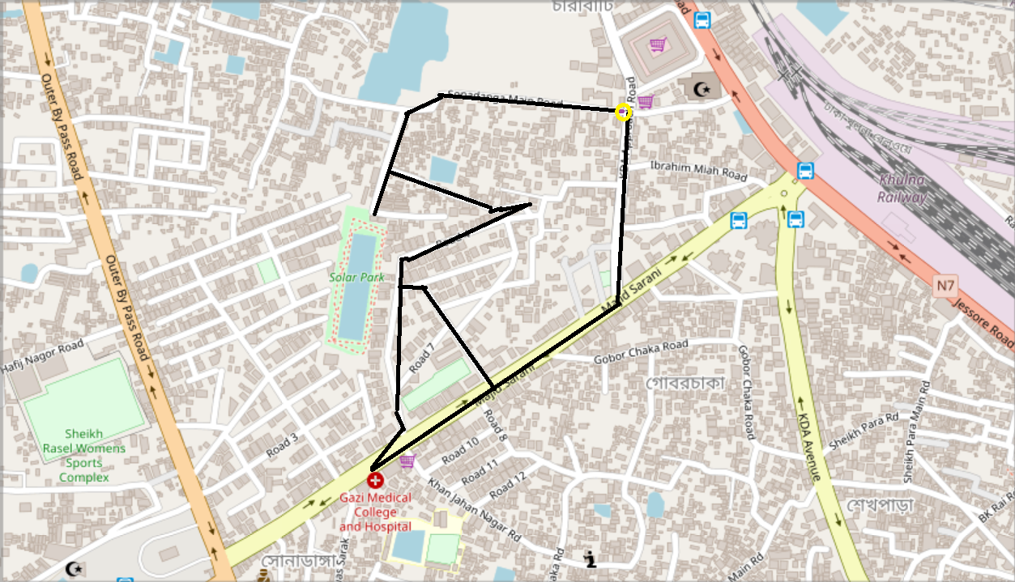
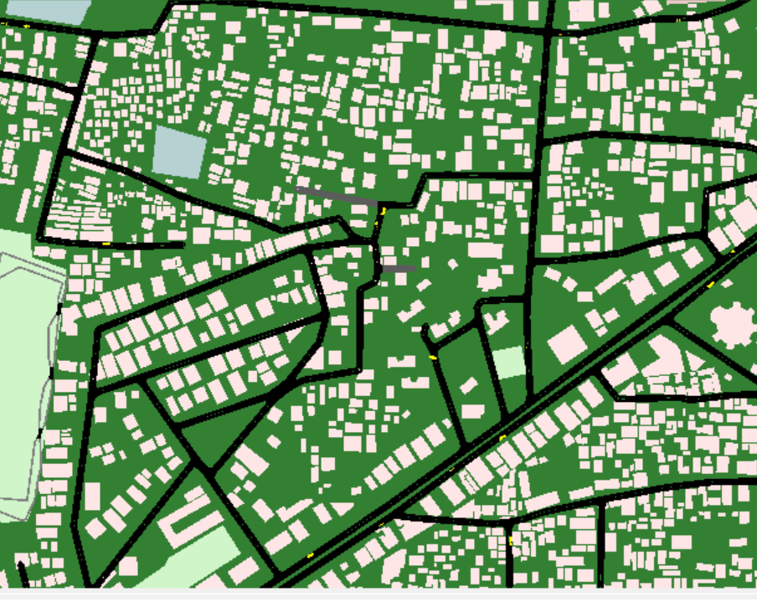
Case Study
10
A road network of Khulna, Bangladesh is shown
both the destination and source are specified
(a)
(b)
Figure 6: Case study (a) Map of a road network in Khulna City (b) Simulation in SUMO of existing traffic

Slide 11
Prelimineries
11
GCN: Graph Convolutional Network (GCN) is a type of neural network which operates on graph structure and node features.
GraphSAGE: Graph Convolutional Networks with Self-Attention Generative Adversarial Networks is a neural network architecture to effectively learn from graph data while being scalable to large graphs.
Dijkstra: Dijkstra is an algorith to find the shortest path in a weighted graph.
A* search: A graph traversal path search algorithm.

Slide 12
Prelimineries (Contd.)
12
Mean Absolute Error (MAE): Calculation of average error of paired observations.
Mean Square Error (MSE): Measures error by using the average squared difference between observed and predicted values.
Z-score normalization or standardization: A z-score, or standard score, is used for standardizing scores.
R-squared : Statistical measure that represents the proportion of the variance for a dependent variable .

Slide 13
Proposed Methodology
13
Step 5:
Optimal Route Generation Based on Predicted Time
Step 4:
Time Prediction
Step 3:
Road Network to Graph Construction
Step 2:
Preprocessing
Step 1:
Data Acquisition

Slide 14
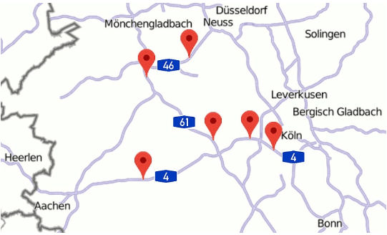
Proposed Methodology (Data acquisition)
14
German HighD Dataset [4]
Data of six different locations
Figure 7 : Locations from which traffic data are collected

Slide 15
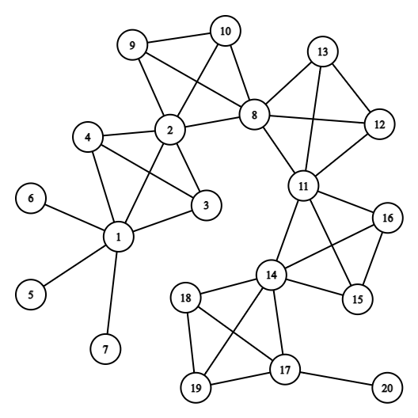
Proposed Methodology (Graph construction)
15
Road network is represented as a graph.
Each track is considered as the node of the graph
The connectivity between tracks are considered as edges
Time is predicted for passing each track(node), not edge, in variying conditions of traffic
Figure 8: Graph representation of road network

Slide 16
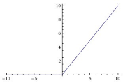
Proposed Methodology(Time Prediction)
16
Proposed Graph Convolutional Network(GCN) architecture:
4 GCNConv layers
ReLU activation function
1 linear layer
1 output layer
Dropout 1
ReLU
100 x 16
4 x 100
Dropout 1
GCNConv layer
linear layer
(4 x 4)
output layer
(4 x 1)
16 x 8
8 x 4
Figure 9: Architecture of the proposed GCN model

Slide 17
Proposed Methodology(Time Prediction)
17
Proposed GraphSAGE model architecture:
4 SAGEConv layers
ReLU activation function
1 linear layer
1 output layer
Dropout 1
ReLU
4 x 100
100 x 16
16 x 8
8 x 4
SAGEConv layer
linear layer
(4 x 4)
output layer
(4 x 1)
Figure 10 : Architecture of the proposed GraphSAGE model

Slide 18


Proposed Methodology (contd)
18
Optimal Route Generation:
Multiple path for a source to a particular destination
Dijkstra and A* algorithm
Average of predicted time for each track are assigned as weights
Only the optimal route is selected
8
2
11
14
17
Figure 11 : Generation of optimal route

Slide 19
Proposed Methodology (contd)
Kula, U., Tozanli, O., & Tarakcio, S. (2012). Emergency vehicle routing in disaster response operations. In 23rd annual conference on production and operation management society.
19
Making predictions using GCN
Preprocessing
Graph Construction
Evaluation on test data
Making predictions using GraphSAGE
Performance comparison
Dataset Collection
Assign the predicted time as weights
Shortest path algorithm
(Dijkstra and A*)
Which model performs better?
Optimal route generation
GraphSAGE
Figure 12 : Workflow diagram of the proposed system

Slide 20
Dataset
Contributions
2
The German HighD (Highway Density) dataset
Includes 60 recordings of six different locations
A large-scale dataset , contains 1,10,500 vehicles , 44,500 driven kilometers and 147 driven hours
Node features of graph: driving direction, distance, velocity, acceleration
This is a graph based approach different from the traditional methods that relied on heuristics or hand-engineered features.
Improves routing and navigation systems for emergency vehicles.
Reduces response time and improves efficiency.
This contribution is novel in that it combines the strengths of both machine learning and shortest path algorithms to provide a new solution.

Slide 21
Experimental Results and Analysis
Experimental Setup
Performance
Analysis on Training Data
Performance Analysis on Test Data
Dataset

Slide 22
Experimental Setup
Required Software:
Operating System: Windows 10
Programming Language: Python 3.8.10
Environment: Google Colaboratory
Libraries:
Pytorch 1.13.1+cu116, Pytorch Geometric 2.2.0,
Numpy 1.21.6, Pandas 1.3.5,
Scikitlearn 1.0.2, Matplotlib 3.2.2
Required Hardware:
Processor : intel(R) core(TM) i5-7200U CPU @ 2.50GHz – 2.71GHz
RAM : 8.00GB

Slide 23
Dataset
23
The German HighD (Highway Density) dataset
Includes 60 recordings of six different locations
A large-scale dataset , contains 1,10,500 vehicles , 44,500 driven kilometers and 147 driven hours
Node features of graph: driving direction, distance, velocity, acceleration

Slide 24
Performance Analysis on Training Data
Figure 13 : loss vs epoch curve of (a) location 2 with MAE loss (b) location 6 with MSE loss
Figure 14 : Comparison between R-squared values of GCN and GraphSAGE models
(a) Loss function MAE (b) Loss function MSE

Slide 25
Performance Analysis on Test Data
(a)
(b)
Figure 15 : Prediction error on test set of (a) MAE Loss (b) MSE Loss
Prediction results are achieved from time calculated in the test data and the time predicted from the models

Slide 26
Table 1: Overall performance comparison between GCN and GraphSAGE models
26
 | GCN |  |  |  | GraphSAGE
 | Evaluation on Train set |  | Evaluation on Test set |  | Evaluation on Train set |  | Evaluation on Test set
Locationid | R-squared (in MAE) | R-squared (in MSE) | Mean Absolute Error (MAE) | Mean Squared Error (MSE) | R-squared (in MAE) | R-squared (in MSE) | Mean Absolute Error (MAE) | Mean Squared Error (MSE)
1 | 0.7049 | 0.7081 | 1.9557 | 4.7964 | 0.7384 | 0.7627 | 0.8757 | 1.4554
2 | 0.5685 | 0.5779 | 2.0789 | 6.5515 | 0.9188 | 0.8226 | 0.5761 | 2.1331
3 | 0.5280 | 0.5280 | 1.9302 | 5.4685 | 0.9336 | 0.9336 | 0.4975 | 0.6774
4 | 0.6558 | 0.6558 | 1.8130 | 5.3080 | 0.9400 | 0.9400 | 0.4572 | 0.5532
5 | 0.7134 | 0.7134 | 1.7397 | 5.2710 | 0.9468 | 0.9468 | 0.4812 | 0.6770
6 | 0.5106 | 0.5106 | 2.1282 | 8.4290 | 0.8766 | 0.8766 | 0.5953 | 1.3561
Findings from the table: GraphSAGE performs better

Slide 27
Analysis on Khulna City
27
Table 2: A case study of Khulna city road network in GCN and GraphSAGE models
GCN |  |  |  | GraphSAGE
Evaluation on Train set |  | Evaluation on Test set |  | Evaluation on Train set |  | Evaluation on Test set
R-squared (in MAE) | R-squared (in MSE) | Mean Absolute Error (MAE) | Mean Squared Error (MSE) | R-squared (in MAE) | R-squared (in MSE) | Mean Absolute Error (MAE) | Mean Squared Error (MSE)
0.4881 | 0.0014 | 2.0431 | 8.7733 | 0.9298 | 0.9338 | 0.6038 | 0.6267
Findings : GraphSAGE performs a lot better than GCN

Slide 28
Conclusions and Future Works
The aim was to find a path that is safe, efficient and reaches the destination quickly.
For this, a graph-based approach was proposed.
A shortest path algorithm generated the optimal route considering the time needed to travel from one node to another.
The proposed system was capable of finding the optimal route in a reasonable amount of time.

Slide 29
Conclusion and Future Works (Contd.)
Limitation includes constraints of dataset.
The proposed model is network specific.
Incorporating real-time traffic data and dynamic rerouting capabilities can be done future research directions.
Research is needed in terms of its generalizability (can be extented to other countries as well).

Slide 30
Kula, U., Tozanli, O., & Tarakcio, S. (2012). Emergency vehicle routing in disaster response operations. In 23rd annual conference on production and operation management society.
References
[1] Wu, J., Kulcsár, B., Ahn, S., & Qu, X. (2020). Emergency vehicle lane pre-clearing: from microscopic cooperation to routing decision making. Transportation research part B: methodological, 141, 223-239.
[2] Kula, U., Tozanli, O., & Tarakcio, S. (2012). Emergency vehicle routing in disaster response operations. In 23rd annual conference on production and operation management society.
[3] Rathore, N., Jain, P. K., & Parida, M. (2018, July). A routing model for emergency vehicles using the real time traffic data. In 2018 IEEE International Conference on Service Operations and Logistics, and Informatics (SOLI) (pp. 175-179). IEEE.
[4] Krajewski, R., Bock, J., Kloeker, L., & Eckstein, L. (2018, November). The highd dataset: A drone dataset of naturalistic vehicle trajectories on german highways for validation of highly automated driving systems. In 2018 21st International Conference on Intelligent Transportation Systems (ITSC) (pp. 2118-2125). IEEE.

Slide 31
THANK YOU

Slide 32

Methodology (Preprocessing)
Standardization: to scale a feature to a standard scale.
$Z= \frac{(X − µ)}{σ}$
Z = standardized feature
X = original feature
μ = the feature's mean
σ = the standard deviation of the feature.
Inference of missing values: The mean values of each column were used to fill in any missing values

