Slide 1

Khulna University of Engineering & Technology
Department of Computer Science and Engineering
CSE 4000: Project/Thesis
MULTI-AGENT SCHEDULING USING NON-COOPERATIVE
GAME THEORY
Supervised By
Presented By
Dr. Muhammad Aminul Haque Akhand Professor Dept. of CSE, KUET
Tirtho Mondal Roll No: 2007117

Slide 2
Outline
Introduction
Problem Statement
Literature Review
Objectives
Background Study
Proposed Methodology
Work Plan
Limitations
Conclusion
References

Slide 3
Introduction
Agent
Conflicting goals arise in multi-agent scheduling
Traditional algorithms struggle with large, complex search spaces
Dynamic changes frequently disrupt schedules
No unified equilibrium-based solution exists
Shared Resources
Agent
Agent
Agent
Figure 1: Multi-Agent System with Shared Resources

Slide 4

Problem statement
Focus on one NP-hard scheduling problem (e.g., UCS, CVRP, or NRP)
Scheduling involves conflicts among multiple agents
Goal: Find an efficient, fair, and stable solution using game theory

Slide 5
Literature Review
Review:
Traditional methods (GA, SA, PSO) are centralized and struggle with large NP-hard problems.
Multi-agent scheduling improves scalability but often lacks stability.
Game-theoretic approaches mostly handle static or limited cases.
Evolutionary game-based methods aid real-time and efficient scheduling.
NRP and similar problems(CVRP, UCSP) are studied separately without a unified approach.
Research Gap:
No existing solution uses non-cooperative game theory to achieve stable, conflict-free scheduling.

Slide 6

Objectives
Global Objective:
Develop a multi-agent scheduling solution
Specific Objectives:
Model the problem as a non-cooperative game
Define strategies & payoffs
Find Nash Equilibrium

Slide 7

Background Study

Slide 8
What is Multi-Agent Scheduling?
Agent
Scheduling tasks among multiple independent agents
Each agent has its own goals and preferences
Conflicts arise when resources are shared
Conflict arises
Shared Resources
Agent
Agent
Agent
Figure 2: Multi-Agent Resource Competition Model

Slide 9
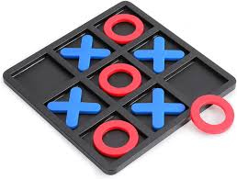
What is Game Theory?
Strategic decision-making among multiple agents
Outcome depends on choices of all players
Each player tries to maximize their own benefit
Used to predict and analyze conflicts and cooperation

Slide 10
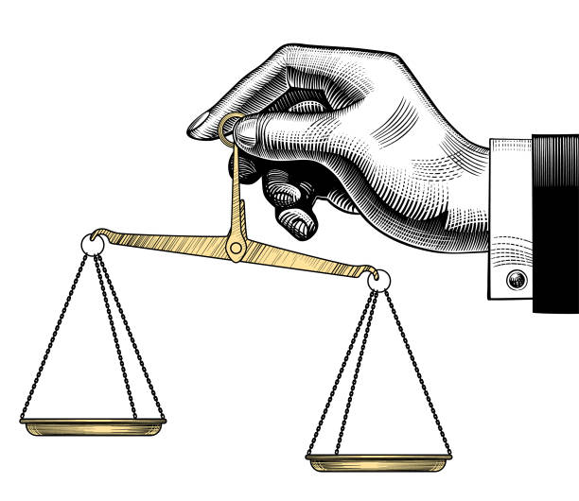
Strategies & Payoffs
Strategy: Plan of action a player can choose.
Payoff: Reward/outcome based on all players’ choices.

Slide 11
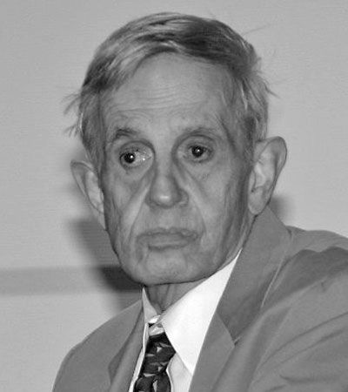
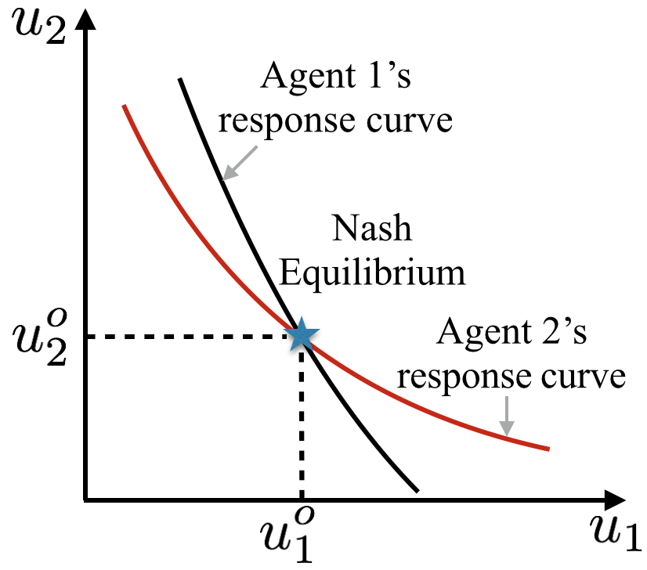
Nash Equilibrium
A situation in a game where no player can improve their payoff by changing their strategy alone
Every player’s choice is optimal given the choices of others
Represents a stable state in multi-agent interactions
Figure 3:Nash Equilibrium Diagram

Slide 12
Non-Cooperative Game
Players act independently to maximize their own payoff
No binding agreements or collaboration between players
Focus is on strategic behavior and competition
Useful in situations where agents compete for shared resources
profits (in $ millions) |  | Company A
 |  | Build New | NO
Company B | Build New | 16,16 | 20,15
 | No | 15,20 | 18,18

Slide 13

Scheduling Problems
Three NP-hard problems considered are:
Nurse Rostering Problem (NRP)
University Class Scheduling Problem (UCSP)
Capacitated Vehicle Routing Problem (CVRP)

Slide 14

NRP
Objective | Assign nurses to shifts efficiently
Components | Nurses, Shifts, Days, Departments
Constraints | Max/min working hours, rest periods, skill coverage
Soft Rules | Nurse preferences, balanced workload
Goals | Feasible, fair, and preference-satisfying roster

Slide 15
UCSP
Objective | Assign courses, teachers, and students to time slots & rooms conflict-free
Components | Courses, Teachers, Students, Rooms, Time Slots
Hard Constraints | No overlaps, room capacity, specific room requirements
Soft Constraints | Preferred time slots, minimize gaps, spread courses evenly, department rules
Goals | Conflict-free timetable, preference satisfaction, efficient resource use

Slide 16
CVRP
Objective | Optimize vehicle routes to serve all customers efficiently
Components | Vehicles, Customers, Depot, Demand, Vehicle capacity
Hard Constraints | Capacity limits, each customer visited once, routes start/end at depot
Soft Constraints | Minimize distance, balance workload, preferred routes
Goals | Efficient, cost-effective, timely deliveries

Slide 17

Proposed Methodology

Slide 18
Multi-Agent Architecture
Preferences
Decision-making
Strategy update
Equilibrium computation
Stable
Schedule
Constraints
Output
Input
Figure 4 : Multi-Agent Game-Theoretic Scheduling Architecture

Slide 19
Methodology
Strategy update
Agent 1
Strategy 1
Calculate
Agent 2
Strategy 2
Conflicts
Payoffs
Nash Equilibrium
.
.
.
.
.
.
.
.
U
G
Agent n
Strategy s
A
S
Figure 5: Nash Equilibrium Convergence Methodology

Slide 20

Game Formulation
Agents (A):$\{a_{1},a_{2},…,a_{n}\}$
Strategy Space (Sᵢ): All feasible actions for agent i
e.g., time-slot + room, route option, shift assignment
Game Definition:
$$G=\left\langle A,{\left(S_{i}\right)}_{i∈A},{\left(U_{i}\right)}_{i∈A}\right\rangle$$
Joint Strategy Profile:
$$S=\left(s_{1},s_{2},…,s_{n}\right)$$

Slide 21
Payoff Function
Measures how beneficial a strategy is for agent i.
$$U_{i}\left(s_{i},s_{−i}\right)=R_{i}\left(s_{i}\right)−C_{i}\left(s_{i},s_{−i}\right)−P_{i}\left(s_{i}\right)$$
Higher score for preferred slot/route/shift
Negative payoff for resource clashes
Hard Constraint
(Large Penalty)
Soft Constraint
(Small Penalty)
Preference Reward
Conflict Penalty
Constraint Penalty

Slide 22



Nash Equilibrium
A strategy profile $S^{∗}$ where:
$$∀i∈N,∀s_{i}^{′}∈S_{i}: u_{i}\left(s_{i}^{∗},s_{−i}^{∗}\right)≥u_{i}\left(s_{i}^{′},s_{−i}^{∗}\right)$$
Best Response of agent i
$$\text{B}{\text{R}}_{\text{i}}\left(s_{−i}\right)=\arg{\max_{s_{i}∈S_{i}}{u_{i}}}\left(s_{i},s_{−i}\right)$$
Update Strategy
$$s_{i}\left(t+1\right)=\text{B}{\text{R}}_{\text{i}}\left(s_{−i}\left(t\right)\right) \text{if} u_{i}\left(\text{B}{\text{R}}_{\text{i}}\left(s_{−i}\left(t\right)\right),s_{−i}\left(t\right)\right)>u_{i}\left(s_{i}\left(t\right),s_{−i}\left(t\right)\right), \text{otherwise} s_{i}\left(t\right)$$
Repeat until convergence to s∗
$$s^{∗}=\left(s_{1}^{∗},s_{2}^{∗},…,s_{n}^{∗}\right)$$
No agent can improve its payoff by changing alone
Produces a stable, conflict-free schedule

Slide 23
NRP as Game
Agents
. . . . .
Choose
Agent | Nurses (each nurse acts as a self-interested agent)
Strategies | Choice of shifts to work or swap
Constraints | Max/min working hours, skill requirements, shift coverage, rest periods
Payoffs | Satisfaction of preferences, fair workload, minimal penalties for violations
Solution | Nash Equilibrium – no nurse can improve satisfaction by changing shifts unilaterally
Strategies
. . . .
Compete for
Resources
Update
Evaluate
Payoffs
Nash Equilibrium
Stable
Schedule
Figure 6 :Game-Theoretic NRP Solution Process

Slide 24
UCSP as Game
Agents
. . . . .
Choose
Agents | Courses (classes) acting as players
Strategies | Selection of time-slot & room
Constraints | No overlaps room limits equipment requirements preferred slots
Payoffs | Reward for conflict-free schedule penalty for conflicts
Solution | Nash Equilibrium → no course can improve payoff alone
Strategies
. . . .
Compete for
Resources
Update
Evaluate
Payoffs
Nash Equilibrium
Stable
Schedule
Figure 7 :Game-Theoretic UCSP Solution Process

Slide 25
CVRP as Game
Agents
. . . . .
Choose
Strategies
Agent | Vehicles (each acts independently)
Strategies | Choice of customer sequence/routes
Constraints | Vehicle capacity, each customer visited once, routes start/end at depot
Payoffs | Minimize individual route cost/distance
Solution | Nash Equilibrium – no vehicle can improve its route unilaterally
. . . .
Compete for
Resources
Update
Evaluate
Payoffs
Nash Equilibrium
Optimal
Route
Figure 8 :Game-Theoretic CVRP Solution Process

Slide 26
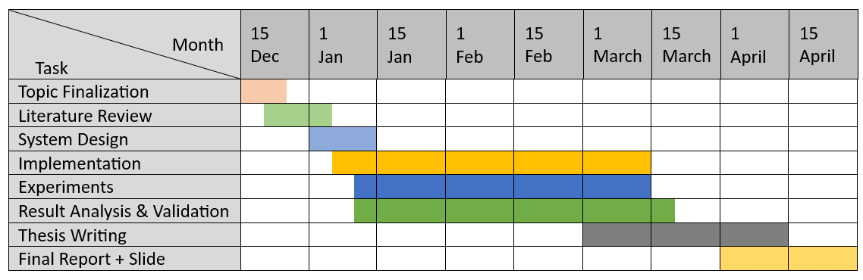
Work Plan
Figure 9: Research Work Plan Gantt Chart

Slide 27
Limitations & Conclusion
Limitations
Equilibrium may be suboptimal
High computational cost
Multiple equilibria possible
Convergence slow for large systems
Conclusion
Game-theoretic approach enables stable multi-agent scheduling
Effective for NP-hard scheduling problems
Achieved conflict-free, stable schedules via Nash equilibrium

Slide 28
References
[1] L. Wei, J. He, Z. Guo, and Z. Hu, “A multi-objective migrating birds optimization algorithm based on game theory for dynamic flexible job shop scheduling problem,” Expert Systems with Applications, vol. 227, p. 120268, 2023, doi: 10.1016/j.eswa.2023.120268.
[2] J. Wang, Y. Liu, S. Ren, C. Wang, and W. Wang, “Evolutionary game based real-time scheduling for energy-efficient distributed and flexible job shop,” Journal of Cleaner Production, vol. 293, p. 126093, 2021, doi: 10.1016/j.jclepro.2021.126093.
[3] V. Fischer, M. Pacheco Paneque, A. Legrain, and R. Bürgy, “A capacitated multi-vehicle covering tour problem on a road network and its application to waste collection,” European Journal of Operational Research, vol. 315, no. 1, pp. 338–353, 2024, doi: 10.1016/j.ejor.2023.11.040.
[4] S. Ceschia, L. Di Gaspero, V. Mazzaracchio, G. Policante, and A. Schaerf, “Solving a real-world nurse rostering problem by Simulated Annealing,” Operations Research for Health Care, vol. 36, p. 100379, 2023, doi: 10.1016/j.orhc.2023.100379.
[5] M. Davison, A. Kheiri, and K. G. Zografos, “Modelling and solving the university course timetabling problem with hybrid teaching considerations,” Journal of Scheduling, vol. 28, no. 2, pp. 195–215, 2025, doi: 10.1007/s10951-024-00817-w.

Slide 29


