Slide 1
Summery
Roll:2007109

Slide 2
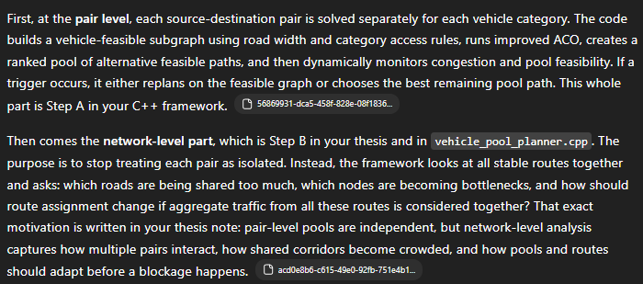

Vehicle_pool_planner.cpp

Slide 3
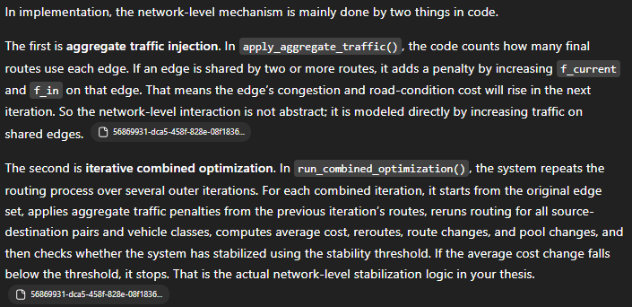



Slide 4
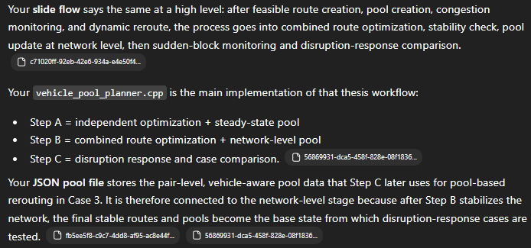

Slide 5
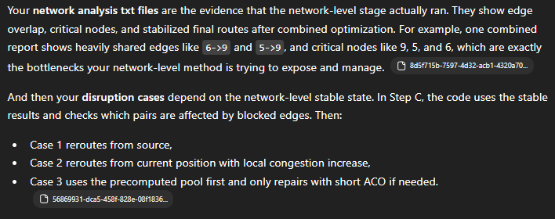

Slide 6
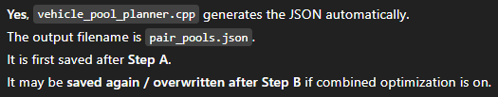

Slide 7
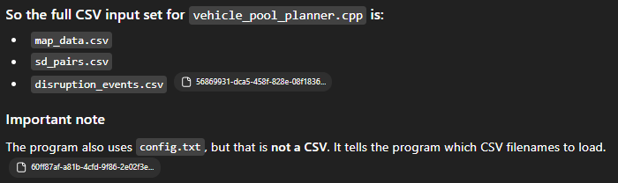

Slide 8
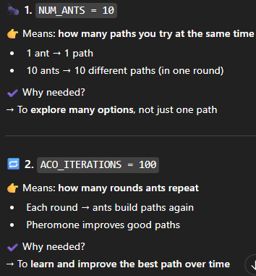
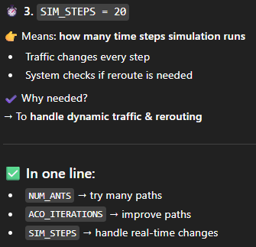
1 ant = 1 path?

Slide 9
Step A visualization:
// Step A main function
// run_single_pair_vehicle(...)
// Work:
// This is the main Step A function.
// It does everything for one source-destination pair + one vehicle type:
// builds feasible graph
// runs ACO
// makes pool
// monitors traffic
// reroutes if needed
// saves final result

Slide 10
// Functions used inside Step A
// build_feasible_edge_set(...)
// Work:
// Checks which roads a vehicle can use.
// Example: truck cannot use narrow roads.
// build_feasible_adjacency(...)
// Work:
// Builds the vehicle-specific graph using only allowed roads.

Slide 11
// run_aco(...)
// Work:
// Finds the best path using ACO.
// This gives the initial best route.
// generate_pool(...)
// Work:
// Creates multiple alternative paths, not just one path.
// This is the path pool.

Slide 12
// update_traffic(...)
// Work:
// Changes traffic values during simulation.
// So road conditions become dynamic over time.
// compute_full_path_cost(...)
// Work:
// Calculates total cost of a whole path.

Slide 13
// path_cost_from(...)
// Work:
// Calculates remaining cost from current node to destination on a path.
// is_path_feasible(...)
// Work:
// Checks if a path is still valid for that vehicle.
Very short flow

Slide 14
Work of A with functions sequence
// Step A uses:
// build_feasible_edge_set()
// build_feasible_adjacency()
// run_aco()
// generate_pool()
// update_traffic()
// is_path_feasible()
// path_cost_from() / compute_full_path_cost()
// run_single_pair_vehicle() controls all of them

Slide 15
Functions used inside step B
apply_aggregate_traffic(...) Work: Finds roads used by many routes Increases congestion on those roads Simple idea: “Shared roads = more traffic penalty”
run_combined_optimization(...) Work: Runs routing for all pairs and vehicles Applies shared-road congestion Repeats multiple times Stops when results become stable Simple idea: “Run Step A again and again with updated traffic”

Slide 16
run_single_pair_vehicle(...) (used inside Step B) Work: Does full routing for one pair (ACO + pool + reroute) Simple idea: “Core engine reused from Step A”
Overall flow run_combined_optimization() → main controller calls apply_aggregate_traffic() → add network congestion calls run_single_pair_vehicle() → recompute routes

Slide 17
Step B simplified:
Step A: Each vehicle finds its best path Everyone chooses shortest/fastest road Problem: Many vehicles choose the same roadStep B idea (VERY SIMPLE) City checks: “Which roads are too crowded?” Now what Step B actually does Step 1 All vehicles choose routes (Step A) Step 2 Check: Which roads are used by many vehicles Step 3 Make those roads more expensive (more traffic)

Slide 18
Step 4 Now again: Vehicles choose routes again BUT this time: crowded roads look worse so some vehicles choose different roads Step 5 Repeat: check crowded roads increase traffic choose routes again Step 6 (Stop) When routes stop changing much Stop What that confusing sentence means “Run Step A again and again with updated traffic” Means: First route → then increase traffic → then route again → repeat One line (very easy) Step B = Fix traffic → reroute → fix traffic → reroute (until balanced)

Slide 19
Step C When disruption happens, Step C finds a new route and compares which method works better.
Step C work
Step C handles disruption situations.
It checks:
if a road gets blocked
which routes are affected
how to reroute them
Then it compares 3 rerouting cases:
Source-based reroute
Current-position reroute
Pool-based reroute (proposed method)

Slide 20
Think like a story Step A: Each vehicle finds its best path Everyone chooses shortest/fastest road Problem: Many vehicles choose the same road Main Step C function run_disruption_case(...) Work: This is the main Step C function. It: takes one case number (1, 2, or 3) checks affected routes reroutes them based on that case measures success, cost, time, and iterations

Slide 21
Functions in step c
is_edge_blocked(...) Work: Checks whether a road/edge is blocked by a disruption event. build_feasible_edge_set(...) Work: Builds allowed roads for that vehicle type. build_feasible_adjacency(...) Work: Builds the vehicle-specific usable graph after removing blocked roads.

Slide 22
run_aco(...) Work: Used in Case 1 and Case 2 to find a new reroute path. Also used as a small repair step in Case 3 if pool fails. compute_full_path_cost(...) Work: Calculates total cost of the reroute path. path_to_string() / path_to_csv() Work: Used for saving/outputting reroute paths in logs and CSV files.

Slide 23
Case-wise meaning in Step C
Case 1: Source-based reroute
blocked road removed
reroute starts again from source
uses full ACO again
Case 2: Current-position reroute
reroute starts from the node before blockage
nearby roads also become more congested
uses ACO again
Case 3: Pool-based reroute
checks precomputed pool paths
picks the best feasible one
if no pool path works, uses small repair ACO
this is your proposed method

Slide 24
Input files
Input files (used by code) These files are read by the program: config.txt → settings (parameters) map_data.csv → road network + traffic + constraints sd_pairs.csv → source-destination pairs disruption_events.csv → blocked roads / disruptions

Slide 25
Output files (generated by code) These files are created by the program:
Step A outputs pair_stable_routes.csv pair_pools.json pair_metadata.csv
Step B output network_pool_analysis.txt

Slide 26
Step C outputs case1_results.csv case2_results.csv case3_results.csv case_comparison_summary.csv
Log files reroute_log.txt reroute_log_case1.txt reroute_log_case2.txt reroute_log_case3.txt reroute_log_combined.txt
One-line summary Input = map + pairs + disruption + config Output = routes + pools + analysis + case comparison + logs

