Slide 1

EpiScope
A Big-Data Prototype for District Disease Surveillance, Forecasting, and Response Planning in Bangladesh
CSE 4345 · Big Data Analytics · Premier University, Chattogram
Submitted to
Rokan Uddin Faruqui
Professor, Computer Science & Engineering,
University of Chittagong
Submitted By:
Sourav Dev (0222220005101033)
Md Sakib (0222220005101019)
Aritra Chowdhury (0222220005101024)
Fariha Rashid Noha (0222220005101035)
Notes:
Introduce EpiScope as a prototype that connects disease surveillance data, analytical methods, forecasting, and response planning at district level. Make clear from the start that the execution results are synthetic.

Slide 2




02
THE CHALLENGE
District surveillance is hard to coordinate
Operational decisions depend on data that arrives incomplete, inconsistent, and at different speeds.
Messy inputs
Different sources may contain missing values, duplicates, or errors.
Patterns move
Unusual patterns require continuous analysis across districts.
Context changes
Weather and seasonal changes can affect disease trends.
Resources are limited
Plan signals against the capacity available for response.
Notes:
Frame the problem as coordination rather than a single data defect. The prototype is designed to bring processing, analysis, forecasting, and planning into one workflow.

Slide 3
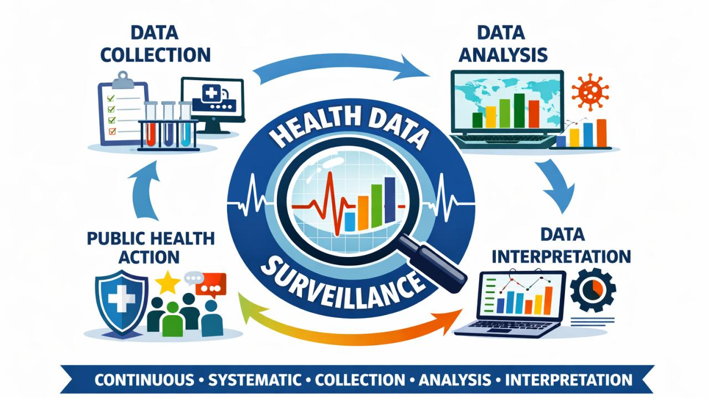



03
THE RESPONSE
EpiScope connects the surveillance workflow
One prototype links data preparation, quality controls, analytics, forecasting, and response planning.
Understand
Act
Prepare
Generate, clean, validate, protect, and aggregate disease data.
Detect unusual patterns and explore weather-aware forecasting.
Serve planners, district administrators, analysts, and researchers.
Notes:
Use this as the transition from motivation to system design. EpiScope is a connected workflow, not a dashboard added at the end.

Slide 4
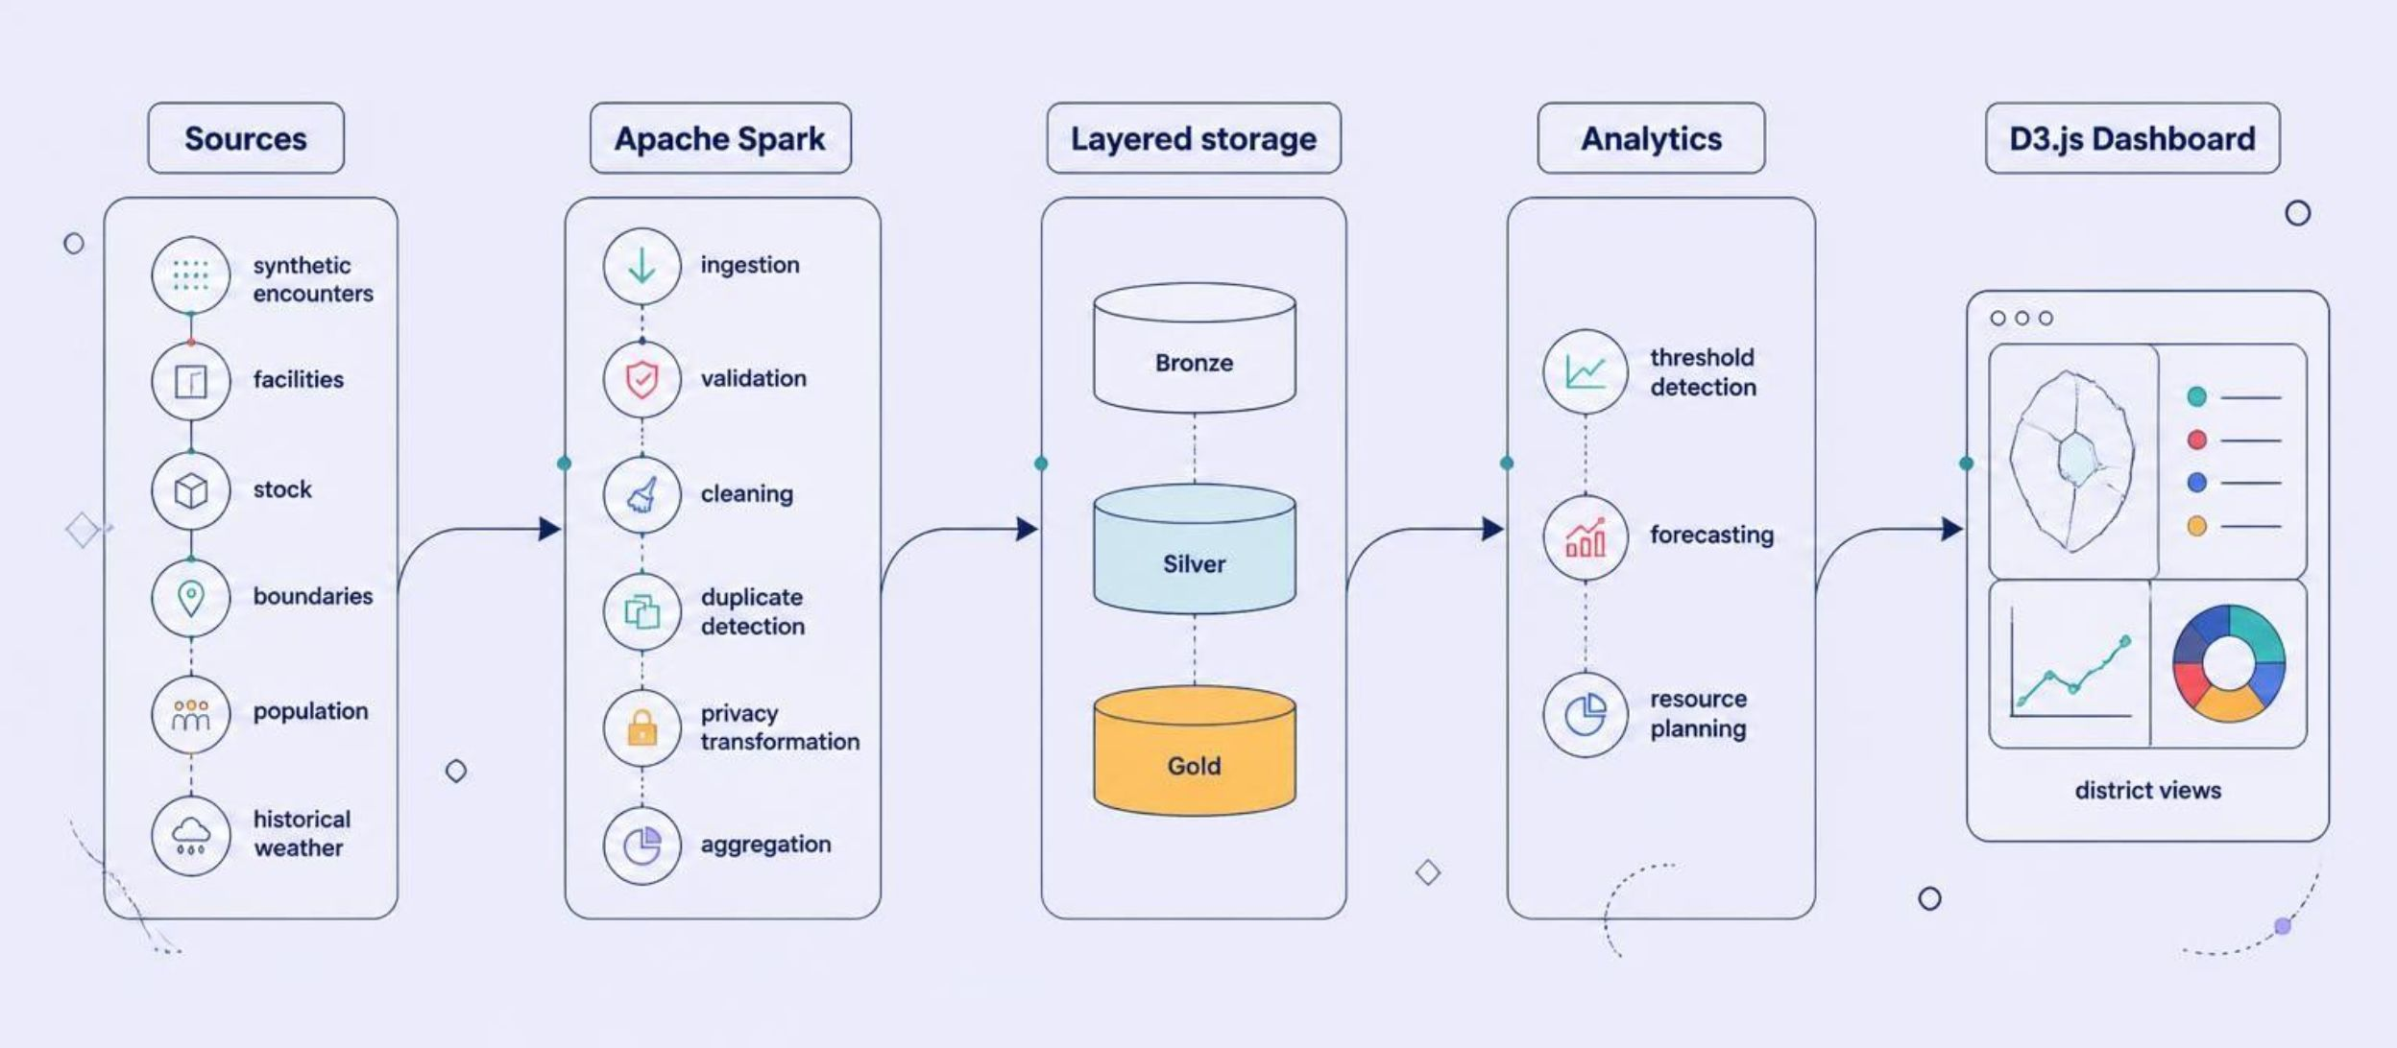
04
ARCHITECTURE
From raw records to decision support
Context enters the pipeline from multiple sources.
Notes:
Walk left to right. Emphasize the Bronze, Silver, and Gold layers as the storage progression, then show how the analytical layer feeds the dashboard rather than replacing the underlying pipeline.

Slide 5
05
PIPELINE
The pipeline turns synthetic inputs into weekly district views
01
02
Generate
Validate
Generate or acquire input data.
Load and validate records.
03
04
Protect
Aggregate
Detect duplicates and apply privacy transformations.
Aggregate by district, disease, and week.
05
Export
Store in Parquet and export dashboard-ready results.
Technology: Python · PySpark · Parquet · JSON · D3.js
Notes:
Describe the pipeline as a sequence of transformations. The final output is not a raw record dump: it is a weekly district view that can be inspected and consumed by the dashboard.

Slide 6


06
TRUST LAYER
Quality checks protect the analytical layer
Before records reach Silver, EpiScope checks whether they are usable and whether they should be transformed or suppressed.
Data quality
Privacy
Missing values and duplicate encounter IDs
Invalid dates and age or sex ranges
ICD-10 codes, facility references, and district references
Salted and hashed identifiers before Silver
Direct identifiers remain Bronze-only
Age groups, district-week aggregation, and suppression of selected counts 1–4
Notes:
Separate validity from privacy. Quality checks decide whether the record is structurally usable. Privacy transformations decide what detail should remain available as the data moves into analytical layers.

Slide 7



07
ANALYTICS
Analytics flags unusual patterns and explores forecasts
The prototype combines a simple alerting rule with a weather-aware forecasting path and a transparent fallback.
Threshold detection
Forecasting
Fallback
Compare recent observations with a trailing 8-week average and recent standard deviation.
Use previous cases plus lagged rainfall, humidity, and temperature in a ridge-style approach.
When weather is unavailable, continue with recent disease patterns and seasonality.
Initial threshold: 2.5σ
Prototype methods only
Exceedances are flagged for review.
Weather-aware exploration
Predictive performance has not yet been validated.
Notes:
Explain that the methods are deliberately inspectable. Threshold detection gives the prototype a first alerting mechanism, while forecasting remains an exploratory path until performance evaluation is complete.

Slide 8
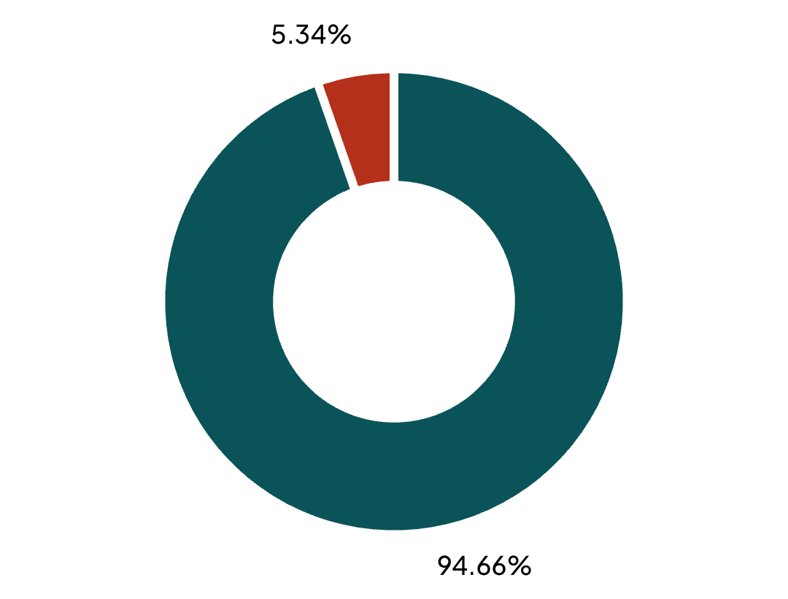
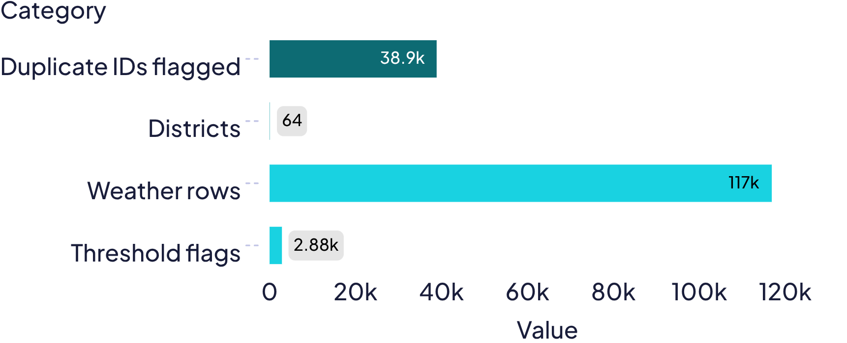
08
SAMPLE EXECUTION · SYNTHETIC
Sample execution processed one million synthetic encounters
RECORD DISPOSITION
EXECUTION OUTPUTS
94.66% retained · 5.34% quarantined
All figures are synthetic prototype execution results, not Bangladesh disease statistics.
Notes:
Lead with the scale: one million synthetic encounters. The donut shows retained versus quarantined records. The bar chart carries the remaining supplied execution outputs without turning them into public-health claims.

Slide 9
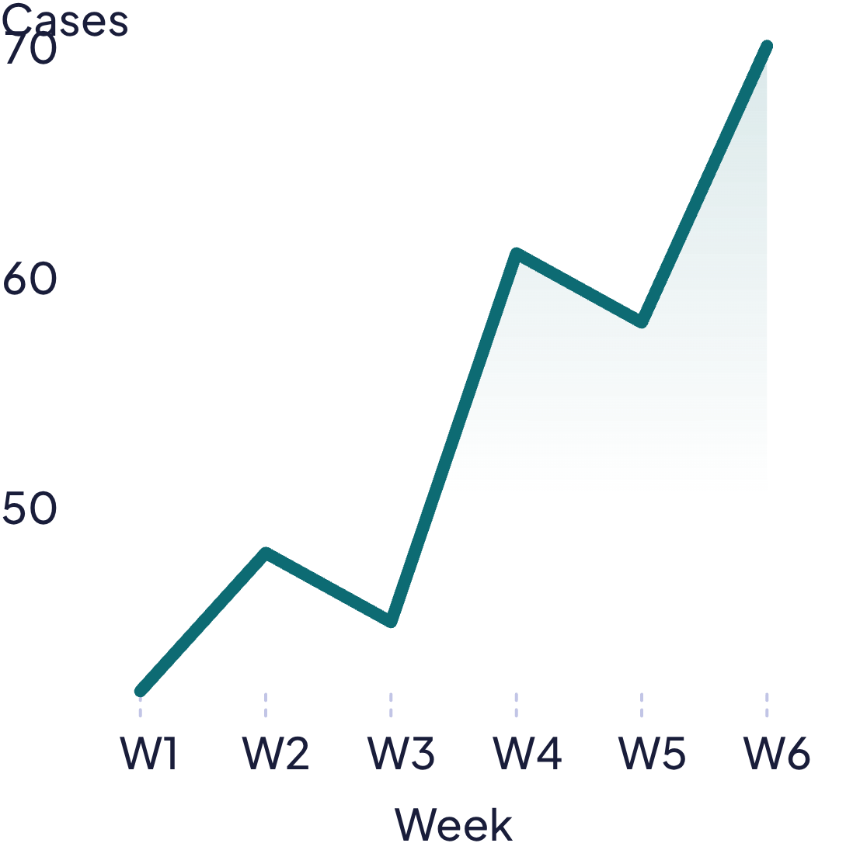
09
INSPECTION SURFACE
The dashboard makes the pipeline inspectable
Each view exposes a different question, from where patterns appear to what data quality issues remain.
Disease trend
Alerts
Bangladesh district view
District | Flag
District A | High
District B | Review
District C | Watch
Map area · district selection · quality status
BANGLADESH
District map area
Selected district: inspectable, not live
Resource planning
Supplies · facilities · staffing signals
Seasonal heatmap
Disease × week · forecast overlay
PROTOTYPE
Notes:
Present the dashboard as an inspection surface, not a live deployment. The map, trend, heatmap, resource table, alert ranking, and quality filters give different users a way to inspect the same pipeline outputs.

Slide 10
WHAT COMES NEXT
The workflow is implemented;
performance evaluation remains.
Implemented
Synthetic generation, Spark processing, validation, cleaning, privacy transformations, district-week aggregation, threshold flags, forecasting pipeline, and dashboard visualization.
Pending
Evaluation is needed to assess accuracy, reliability, and practical
usefulness.
Sensitivity, false alerts per district-year, detection delay, MAE/RMSE, prediction interval coverage, resource allocation performance, scale benchmarks, and usability testing.
Notes:
Close by separating what exists from what remains to be tested. The prototype demonstrates an end-to-end workflow, but evaluation is required before making claims about accuracy, reliability, or practical usefulness.

Slide 11
02
NEXT WORK
Next work moves EpiScope toward governed validation
Connect governed real-world health data sources
Measure forecasting and disease-detection performance
Improve resource allocation with Linear Programming
Strengthen privacy, suppression, and Spark-scale processing
Test dashboard usability with public-health experts
Current limits
Synthetic data, unvalidated alerts and forecasts, illustrative resource planning, no live national connection, and further security work required.Close the technical story by naming what comes next and being explicit about the current limits: the data is synthetic, alerts and forecasts are not yet validated, and no live national connection exists.
Notes:
Frame the problem as coordination rather than a single data defect. The prototype is designed to bring processing, analysis, forecasting, and planning into one workflow.

Slide 12
CLOSING
EpiScope is a foundation for further study
Spark-based processing pipeline
Data-quality and privacy transformations
District-level aggregation and statistical threshold detection
Weather-aware forecasting pipeline
Interactive analytical dashboard
EpiScope demonstrates a path for exploring how big-data analytics can support disease monitoring and public-health planning.

Slide 13


