Slide 1



CircuitSeer: RTL Post-PnR Delay Prediction via Coupling Functional and Structural Representation
Sanjay Gandham¹, Joe Walston², Sourav Samanta², Linxiang Yin¹, Hao Zheng¹, Mingjie Lin¹, Stelios Diamantidis​²
¹ University of Central Florida ² Synopsys

Slide 2
Outline
Background and Motivation​
Traditional Flow for Delay Evaluation and Shortcomings​
Prior Work and Limitations
CircuitSeer​
Evaluation​

Slide 3
Background and Motivation​
With the end of Dennard scaling and decline of Moore’s law, performance improvement comes at a cost.

Slide 4
Background and Motivation​
With the end of Dennard scaling and decline of Moore’s law, performance improvement comes at a cost.
Power, Performance, Area (PPA) is becoming increasingly important during the hardware design process.

Slide 5
Background and Motivation​
With the end of Dennard scaling and decline of Moore’s law, performance improvement comes at a cost.
Power, Performance, Area (PPA) is becoming increasingly important during the hardware design process.
However, traditional RTL design is primarily functionality-oriented

Slide 6
Background and Motivation​
With the end of Dennard scaling and decline of Moore’s law, performance improvement comes at a cost.
How can we enable PPA-oriented RTL Design?
Power, Performance, Area (PPA) is becoming increasingly important during the hardware design process.
However, traditional RTL design is primarily functionality-oriented

Slide 7


Traditional Flow for Delay Evaluation
Digital Designer
Spec

Slide 8
Traditional Flow for Delay Evaluation
Digital Designer
Spec
RTL

Slide 9
Traditional Flow for Delay Evaluation
Logic Synthesis
Elaboration
Digital Designer
Spec
RTL
Boolean Minimization
Netlist
Technology Mapping
Technology Dependent Optimization

Slide 10
Traditional Flow for Delay Evaluation
Logic Synthesis
Elaboration
Digital Designer
Spec
RTL
Boolean Minimization
Netlist
Technology Mapping
Technology Dependent Optimization
Post-
Synthesis
Delay

Slide 11
Traditional Flow for Delay Evaluation
Logic Synthesis
Elaboration
Digital Designer
Spec
RTL
Boolean Minimization
Netlist
Technology Mapping
Technology Dependent Optimization
Post-
Synthesis
Delay
Missing wirelength information leading to inaccurate delay estimates

Slide 12
Traditional Flow for Delay Evaluation
Logic Synthesis
Elaboration
Digital Designer
Spec
RTL
Boolean Minimization
Netlist
Technology Mapping
Technology Dependent Optimization
Post-
Synthesis
Delay

Slide 13
Traditional Flow for Delay Evaluation
Logic Synthesis
Elaboration
Physical Design
Digital Designer
Partitioning
Spec
RTL
Boolean Minimization
Netlist
Layout
Floor Planning
Technology Mapping
Placement
Technology Dependent Optimization
Routing
Post-
Synthesis
Delay

Slide 14
Traditional Flow for Delay Evaluation
Logic Synthesis
Elaboration
Physical Design
Digital Designer
Partitioning
Spec
RTL
Boolean Minimization
Netlist
Layout
Floor Planning
Technology Mapping
Placement
Technology Dependent Optimization
Routing
Post-
Synthesis
Delay
Post-
Place and Route
Delay

Slide 15
Traditional Flow for Delay Evaluation
Long Logic Synthesis and Physical Design runtime
Logic Synthesis
Elaboration
Physical Design
Digital Designer
Partitioning
Spec
RTL
Boolean Minimization
Netlist
Layout
Floor Planning
Technology Mapping
Placement
Technology Dependent Optimization
Routing
Post-
Synthesis
Delay
Post-
Place and Route
Delay

Slide 16
Traditional Flow for Delay Evaluation
Logic Synthesis
Elaboration
Physical Design
Accurate delay estimates are inaccessible early in the RTL design process
Digital Designer
Partitioning
Spec
RTL
Boolean Minimization
Netlist
Layout
Floor Planning
Technology Mapping
Placement
Technology Dependent Optimization
Routing
Post-
Synthesis
Delay
Post-
Place and Route
Delay

Slide 17
Prior Work: AI/ML-Based Delay Predictor
Functionality Preserving Transformations
Netlist Structure Dependent Operations
RTL
Netlist
Layout
Logic Synthesis
Physical Design

Slide 18
Prior Work: AI/ML-Based Delay Predictor
Functionality Preserving Transformations
Netlist Structure Dependent Operations
RTL
Netlist
Layout
Logic Synthesis
Physical Design
Post-Synthesis Delay
From RTL
[1, 2, 3]
[1] Ceyu Xu et al. Sns’s not a synthesizer: a deep- learning-based synthesis predictor. In Proc. of ISCA, 2022.
[2] Prianka Sengupta et al. How good is your verilog rtl code? a quick answer from machine learning. In Proc. of ICCAD, 2022.
[3] Wenji Fang et al. Masterrtl: A pre-synthesis ppa estimation framework for any rtl design. In Proc of ICCAD, 2023.

Slide 19
Prior Work: AI/ML-Based Delay Predictor
Functionality Preserving Transformations
Netlist Structure Dependent Operations
RTL
Netlist
Layout
Logic Synthesis
Physical Design
Post-Synthesis Delay
From RTL
[1, 2, 3]
Transformer and Machine Learning Models for Functional Representation Learning
[1] Ceyu Xu et al. Sns’s not a synthesizer: a deep- learning-based synthesis predictor. In Proc. of ISCA, 2022.
[2] Prianka Sengupta et al. How good is your verilog rtl code? a quick answer from machine learning. In Proc. of ICCAD, 2022.
[3] Wenji Fang et al. Masterrtl: A pre-synthesis ppa estimation framework for any rtl design. In Proc. of ICCAD, 2023.

Slide 20
Prior Work: AI/ML-Based Delay Predictor
Functionality Preserving Transformations
Netlist Structure Dependent Operations
RTL
Netlist
Layout
Logic Synthesis
Physical Design
Post-Synthesis Delay
From RTL
Post-PnR Delay
From Netlist
[1, 2, 3]
[4]
[4] Ahmed Agiza et al. Graphsym: Graph physical synthesis model. In Proc. of ICCAD, 2023.

Slide 21
Prior Work: AI/ML-Based Delay Predictor
Functionality Preserving Transformations
Netlist Structure Dependent Operations
RTL
Netlist
Layout
Logic Synthesis
Physical Design
Post-Synthesis Delay
From RTL
Post-PnR Delay
From Netlist
[1, 2, 3]
[4]
Graph Neural Network Model
For Structural Representation Learning
[4] Ahmed Agiza et al. Graphsym: Graph physical synthesis model. In Proc. of ICCAD, 2023.

Slide 22
Prior Work: AI/ML-Based Delay Predictor
Functionality Preserving Transformations
Netlist Structure Dependent Operations
RTL
Netlist
Layout
Logic Synthesis
Physical Design
Post-Synthesis Delay
From RTL
Post-PnR Delay
From Netlist
[1, 2, 3]
[4]
Post-PnR Delay
From RTL
(This Work)

Slide 23
Prior Work: AI/ML-Based Delay Predictor
Functionality Preserving Transformations
Netlist Structure Dependent Operations
RTL
Netlist
Layout
Logic Synthesis
Physical Design
Post-Synthesis Delay
From RTL
Post-PnR Delay
From Netlist
Couple Functional and Structural Representation Learning
[1, 2, 3]
[4]
Post-PnR Delay
From RTL
(This Work)

Slide 24
Challenges with Post-PnR Delay Prediction
Functionality Preserving Transformations
Netlist Structure Dependent Operations
RTL
Netlist
Layout
Logic Synthesis
Physical Design

Slide 25
Challenges with Post-PnR Delay Prediction
Functionality Preserving Transformations
Netlist Structure Dependent Operations
RTL
Netlist
Layout
Logic Synthesis
Physical Design
Logic Synthesis significantly modifies the circuit structure.

Slide 26
Challenges with Post-PnR Delay Prediction
Functionality Preserving Transformations
Netlist Structure Dependent Operations
RTL
Netlist
Layout
Logic Synthesis
Physical Design
Logic Synthesis significantly modifies the circuit structure.
The initial circuit representation is structurally dissimilar to the netlist

Slide 27
Challenges with Post-PnR Delay Prediction
Functionality Preserving Transformations
Netlist Structure Dependent Operations
RTL
Netlist
Layout
Logic Synthesis
Physical Design
Logic Synthesis significantly modifies the circuit structure.
The initial circuit representation is structurally dissimilar to the netlist
Extract Synthesis-invariant topological Information from RTL for structural learning

Slide 28
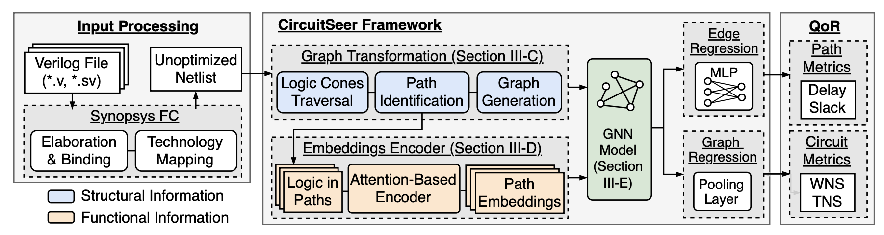
CircuitSeer: Prediction Flow

Slide 29
CircuitSeer: Prediction Flow
Generate Initial Circuit Representation (Unoptimized Netlist)

Slide 30
CircuitSeer: Prediction Flow
Generate Initial Circuit Representation (Unoptimized Netlist)
Graph Transformation to extract synthesis-invariant topological information

Slide 31
CircuitSeer: Prediction Flow
Generate Initial Circuit Representation (Unoptimized Netlist)
Graph Transformation to extract synthesis-invariant topological information
Functional learning from logic cells of a path

Slide 32
CircuitSeer: Prediction Flow
Generate Initial Circuit Representation (Unoptimized Netlist)
Graph Transformation to extract synthesis-invariant topological information
Functional learning from logic cells of a path
Structural learning using the transformed graph

Slide 33
CircuitSeer: Prediction Flow
Generate Initial Circuit Representation (Unoptimized Netlist)
Graph Transformation to extract synthesis-invariant topological information
Functional learning from logic cells of a path
Structural learning using the transformed graph
Delay Prediction using learned circuit representation

Slide 34
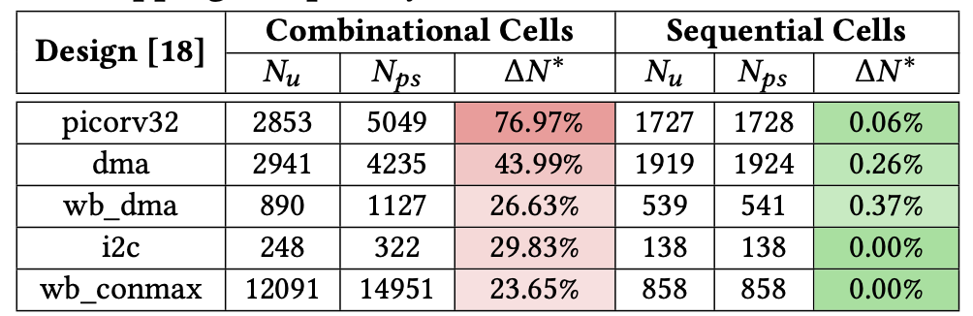
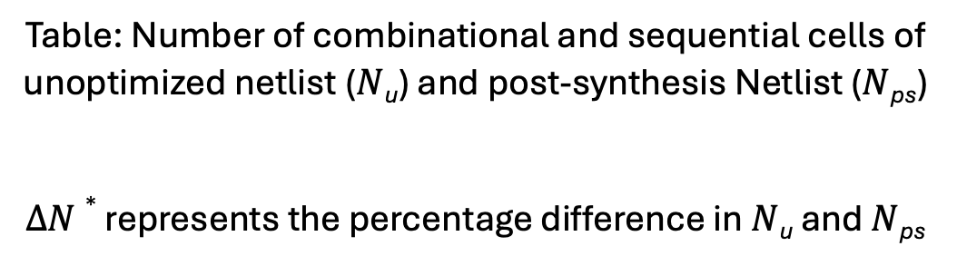
CircuitSeer: Unoptimized Netlist
Table: Number of combinational and sequential cells of unoptimized netlist ($N$_{u}) and post-synthesis Netlist ($N$_{ps})
$∆N∗$ represents the percentage difference in $N$_{u} and $N$_{ps}

Slide 35
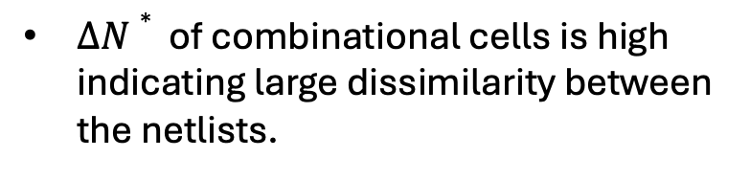
CircuitSeer: Unoptimized Netlist
$∆N∗$ of combinational cells is high indicating large dissimilarity between the netlists.
Table: Number of combinational and sequential cells of unoptimized netlist ($N$_{u}) and post-synthesis Netlist ($N$_{ps})
$∆N∗$ represents the percentage difference in $N$_{u} and $N$_{ps}

Slide 36
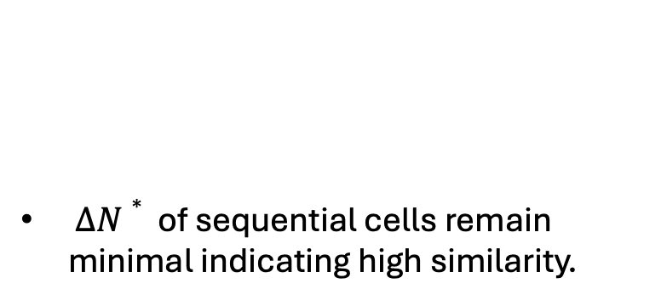
CircuitSeer: Unoptimized Netlist
$∆N∗$ of sequential cells remain minimal indicating high similarity.
$∆N∗$ of combinational cells is high indicating large dissimilarity between the netlists.
Table: Number of combinational and sequential cells of unoptimized netlist ($N$_{u}) and post-synthesis Netlist ($N$_{ps})
$∆N∗$ represents the percentage difference in $N$_{u} and $N$_{ps}

Slide 37
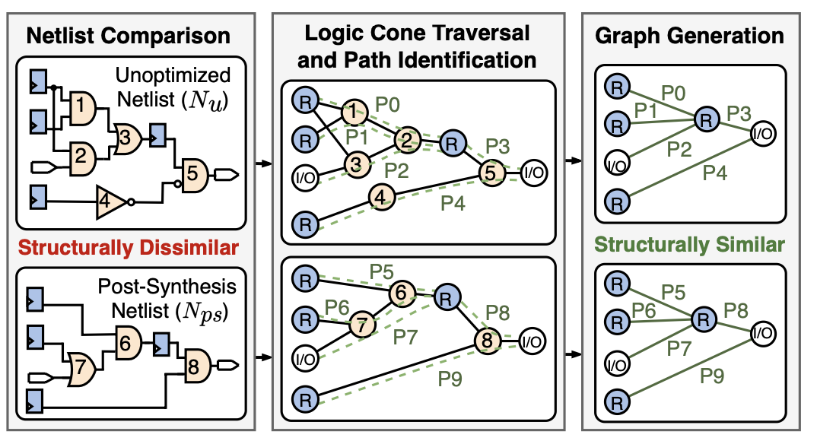
CircuitSeer: Graph Transformation

Slide 38
CircuitSeer: Graph Transformation
Unoptimized Netlist and Post Synthesis Netlist are structurally dissimilar.

Slide 39
CircuitSeer: Graph Transformation
Unoptimized Netlist and Post Synthesis Netlist are structurally dissimilar.
Traversing logic cones to identify the path relations between timing endpoints.

Slide 40
CircuitSeer: Graph Transformation
Unoptimized Netlist and Post Synthesis Netlist are structurally dissimilar.
Traversing logic cones to identify the path relations between timing endpoints.
Generate graph based on the identified paths.

Slide 41
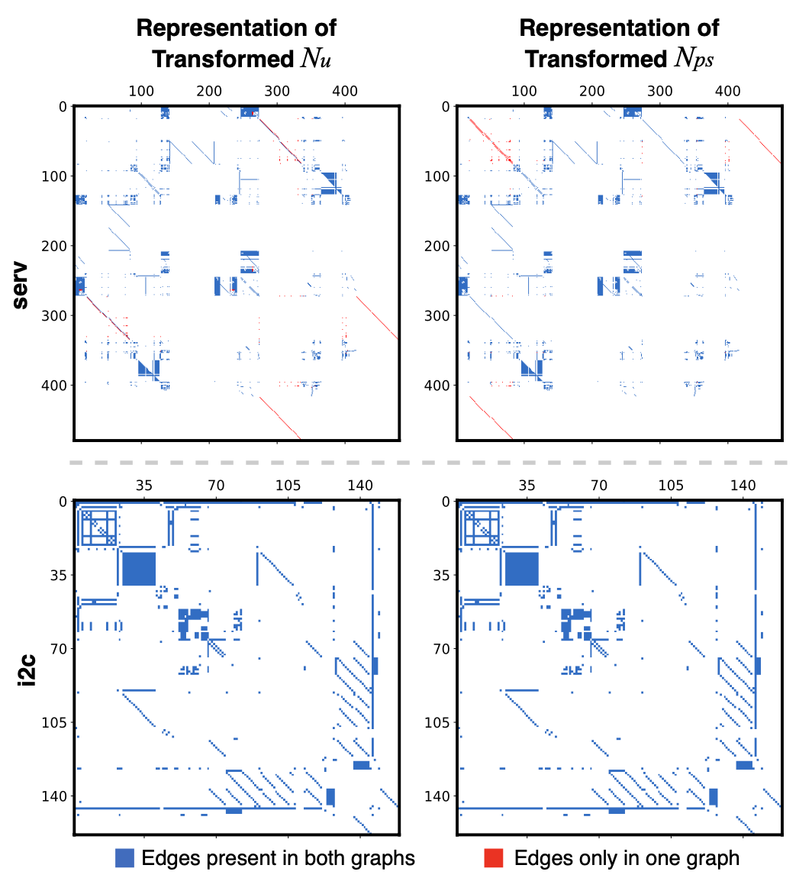
CircuitSeer: Graph Transformation
Figure: Adjacency matrices of transformed unoptimized netlist and transformed post-synthesis Netlist

Slide 42
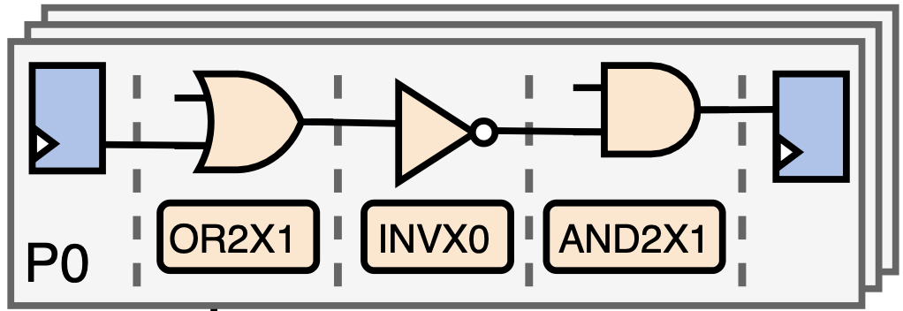
CircuitSeer: Inference Flow
From Graph Traversal

Slide 43
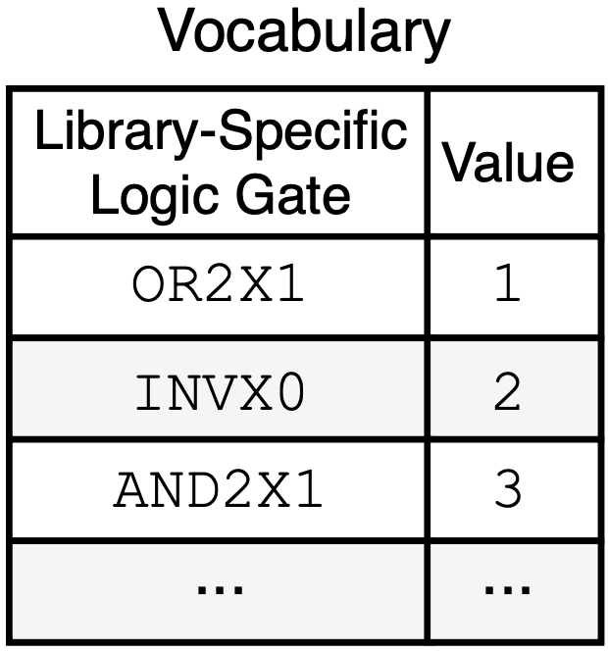
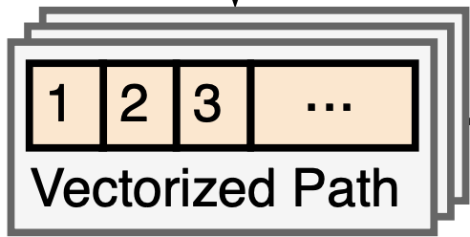
CircuitSeer: Inference Flow
From Graph Traversal

Slide 44
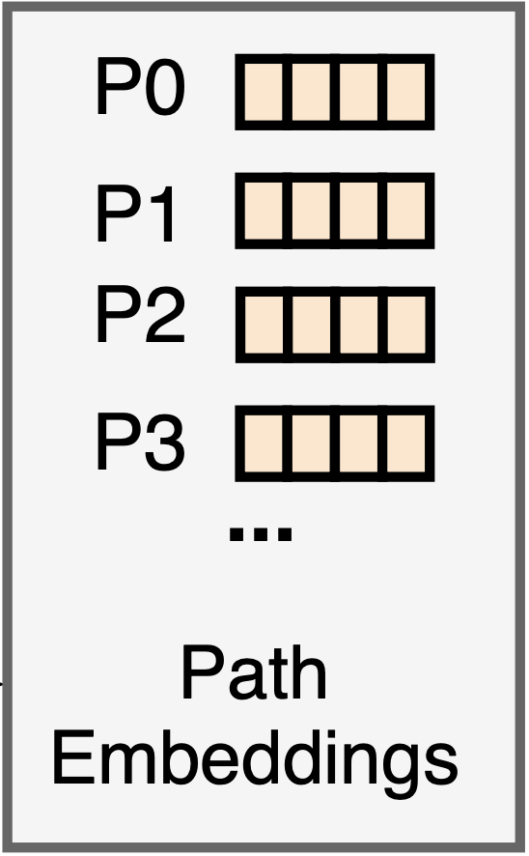
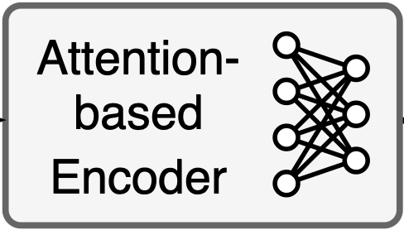
CircuitSeer: Inference Flow
From Graph Traversal

Slide 45
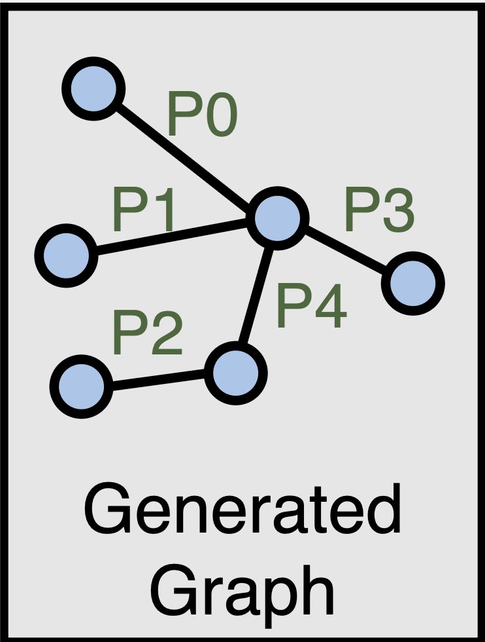
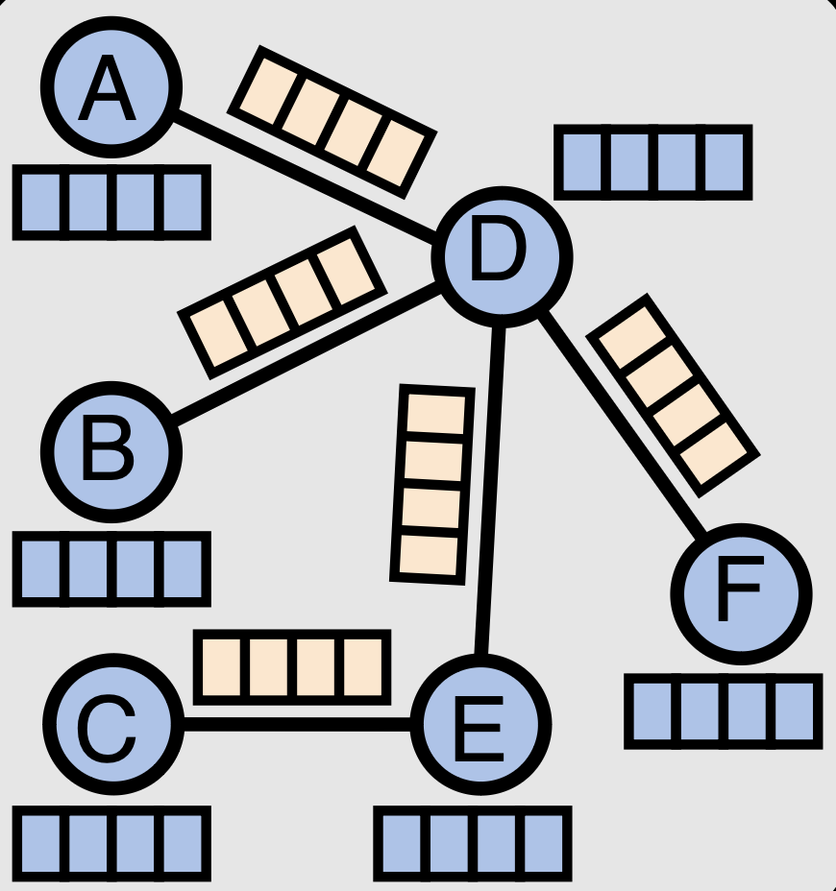
CircuitSeer: Inference Flow
From Graph Traversal
From Graph Generation
GNN Model

Slide 46

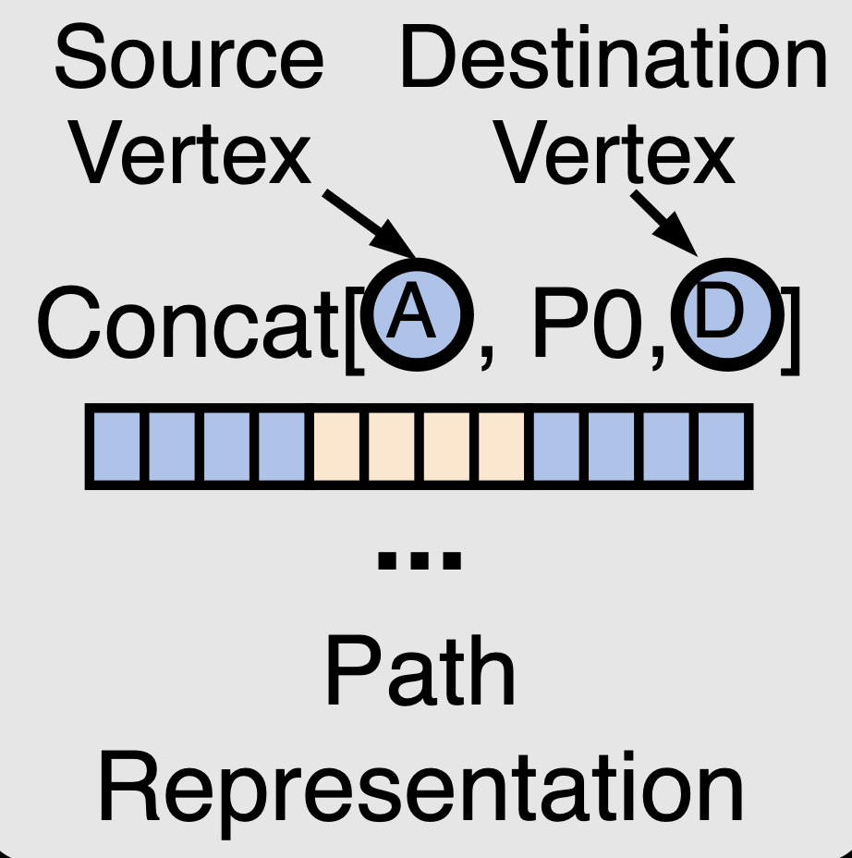

CircuitSeer: Inference Flow
From Graph Traversal
From Graph Generation
GNN Model
Edge Regression

Slide 47
Evaluation: Implementation and Baselines
CircuitSeer Implementation
Implemented in Python using Pytorch Geometric and the Hugging face library
ASIC Implementation
Employed Synopsys Fusion Compiler using the compile_fusion flow to perform ASIC implementation
Constrained hardware to near-maximum operational frequency.
Implemented using SAED32 nm tech library
Baselines
Transformer [1]
XGBoost [2]
[1] Ceyu Xu et al. Sns’s not a synthesizer: a deep- learning-based synthesis predictor. In Proc. of ISCA, 2022.
[2] Prianka Sengupta et al. How good is your verilog rtl code? a quick answer from machine learning. In Proc. of ICCAD, 2022.

Slide 48
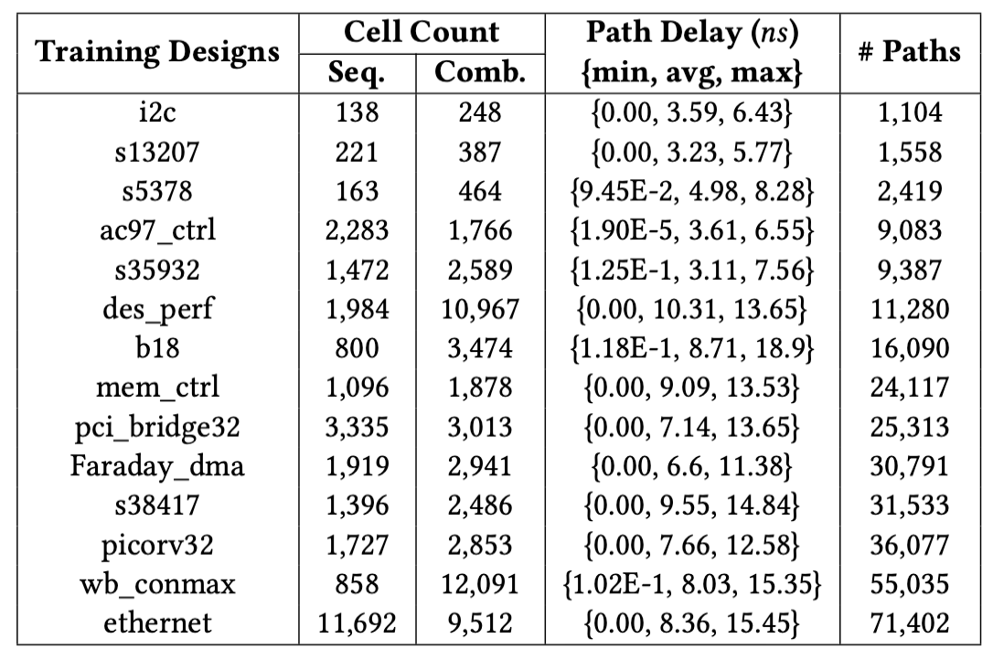
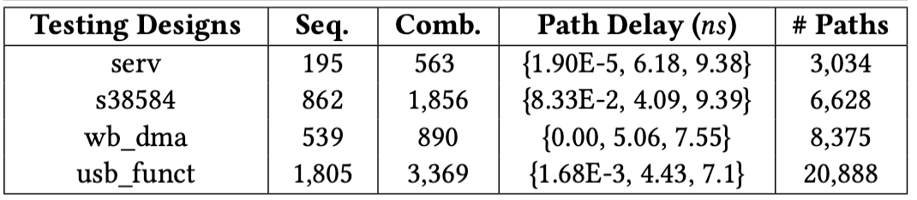
Evaluation: Hardware Designs
Collected from ITC’99[1], IWLS’05[2], OpenCores[3] and RISC-V cores.
14 Training designs with 364k paths.
4 Testing designs with 39k paths.

Slide 49
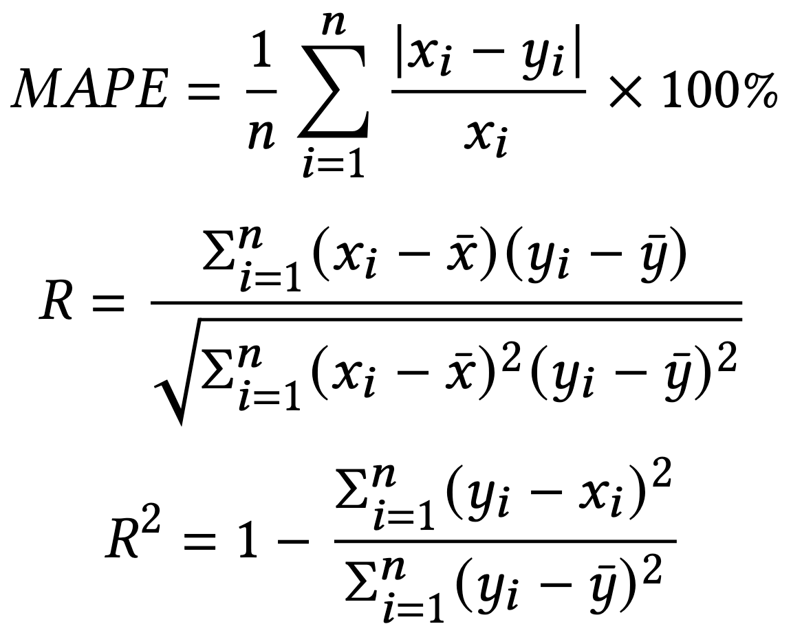
Evaluation: Metrics
MAPE: Mean Average Error Percentage
MAPE K: MAPE for longest K% paths
R: Correlation coefficient
R²: Determination coefficient

Slide 50
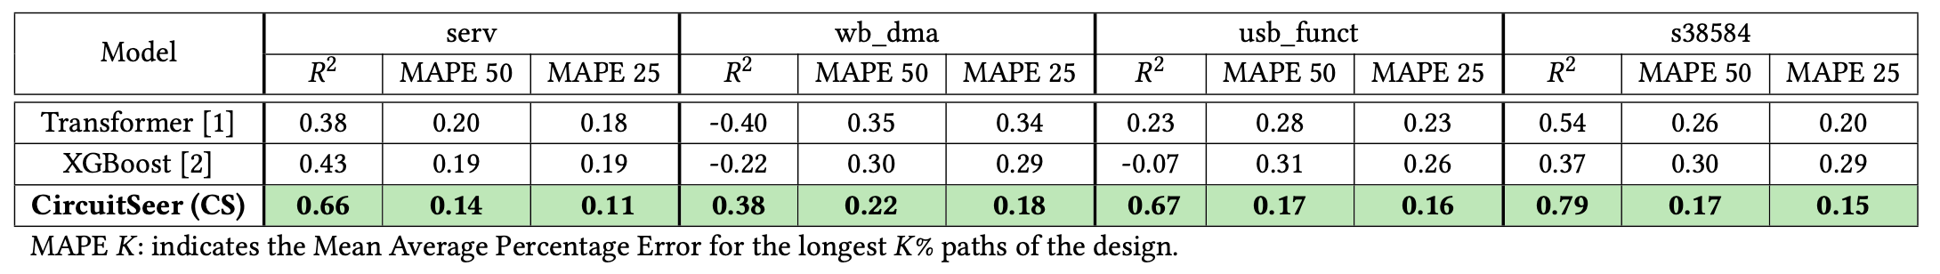
Evaluation: MAPE

Slide 51
Evaluation: MAPE
CircuitSeer shows an average 𝑅² correlation of 0.625, compared to 0.1875 and 0.1275 achieved by Transformer and XGBoost
CircuitSeers shows a lower average MAPE 50 of 17.5% compared to 27.3% and 27.5% of baselines.

Slide 52
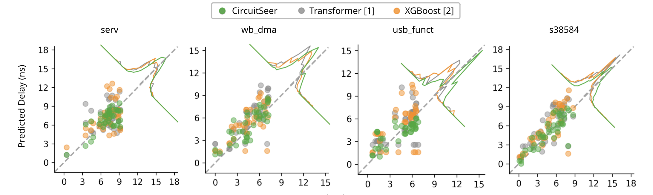

Evaluation: Scatter Plot

Slide 53
Evaluation: Scatter Plot
Histogram showing higher peaks closer to the diagonal

Slide 54
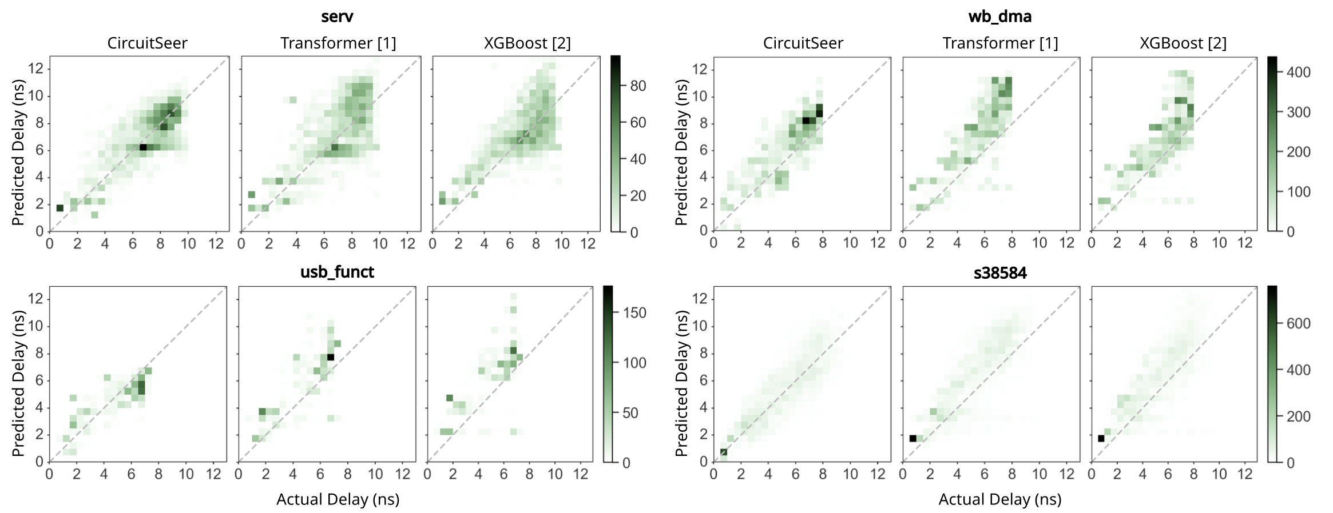
Evaluation: Heatmap
Metrics

Slide 55
Evaluation: Heatmap
Metrics
CircuitSeer shows tighter clustering, especially at the critical paths

Slide 56
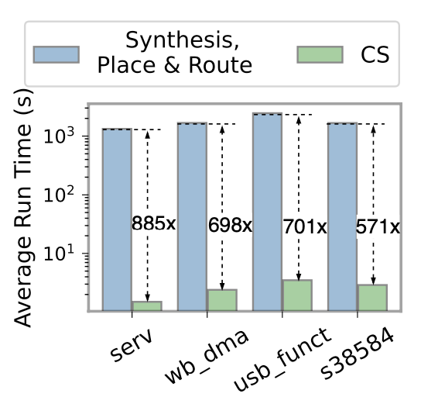
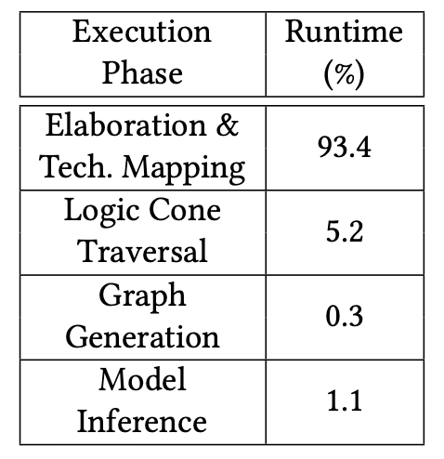
Evaluation: Runtime Evaluation
Figure: Average path delay Inference runtime comparison
Figure: Breakdown of CircuitSeer inference time

Slide 57
Evaluation: Runtime Evaluation
CircuitSeer inference model is at a per-path granularity leading to significant speedup
CircuitSeer shows an average speedup of 713 times compared to Fusion Compiler Synthesis run
Figure: Average path delay Inference runtime comparison
Figure: Breakdown of CircuitSeer inference time

Slide 58
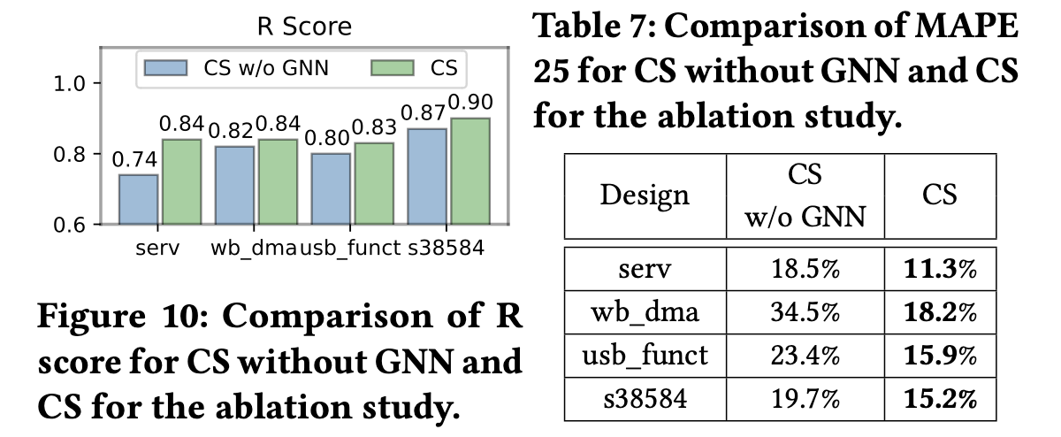
Evaluation: Ablation Study
Figure: R score comparison
Table: MAPE for top 25% longest paths

Slide 59
Evaluation: Ablation Study
Figure: R score comparison
Table: MAPE for top 25% longest paths
Comparing CircuitSeer (CS) with CircuitSeer without GNN (CS w/o GNN)
Average R score improves by 0.45
Average MAPE 25 reduces by 8.8%

Slide 60
Conclusion
In this work, we
We present CircuitSeer, the first pre-synthesis delay prediction framework to accurately estimate the post-PnR metrics.
We propose graph transformations to extract synthesis-invariant structural information from the initial circuit representation
Introduced structural and functional characteristics to the model
Achieved lower error and higher correlation compared to SOTA models

Slide 61
Thank You Questions?
Contact Information
Sanjay Gandham: sanjay.gandham@ucf.edu

