Slide 1

Quick Accident Response
Presented By:
Sourav Jaiswal
Raunak Gupta
Poulomi Sen
Sukanya Saha
Team Name : Raspberry
Representing Dept. of IT ,
RCC Institute Of Information Technology

Slide 2
Our understanding of the challenge
PROBLEM STATEMENT
To detect accidents by distinguishing the high decibel perceptive events such as , sound of a car crashing , metal screeching , opening of air bags , etc.
Alerting the PCR about the accident spot at the earliest possible juncture , which would in-turn inform the nearest hospital about the urgent situation..
Quick Accident Response: The solution should be able on road. The solution needs to be real time and
to distinguish “impact” sounds when vehicle ram into each other
the nearest PCR van should be alerted so that precious life can be saved.
We have carefully analyzed each of the problems and devised the best possible solution of the same.
Each part of solution will be extensively explained in the following slides.
On Examining the Statement thoroughly,
We inferred that there are
TWO parts of the problem

Slide 3
Objective
Motivation
To validate the use of sound and jerk sensors in detecting the occurrence of accident.
To use an Aurdino setup for sending the current coordinates of the accident location to the Police Control Room (PCR).
To intimate nearby hospitals from the PCR through the APP.
To enable nearby hospitals to accept request as per their availability. Simultaneously the system will make sure that only one hospital is assigned , based on some suitability factors resolved by a conflict resolution algorithm.
To use Google MAPS to find the best optimal route from hospital to the accident location and vice-versa.
According to information available in ZEE news , a central road ministry research in 2016 says:
400 people die due to road accident everyday.
17 people die in average every hour out of 55 road accident.
Indian road accidents :- 480652
Total deaths:- 150785
Injured very seriously:- 494624
During a real time market survey conducted by our team, we interviewed some of the ambulance drivers they informed that most of the accident victims suffer to death due to delay in receiving initial treatment. Late intimation and transition delay due to road congestion are two main reasons behind delayed transit of accident victims to hospitals.
Quick Ambulance Service System(QASS) have the potential of reducing the time between the occurrence of accidents and the notification of emergency medical services .

Slide 4
Proposed Solution
Solution Name: Quick Ambulance Service System (QASS)
Our solution to this problem statement can be broken into Three phase :
Detecting Phase: This phase deals with the detection of an accident , we would use Sound and Jerk sensors to detect Accidents.
Transmission Phase: This phase deals with extracting the current location of the accident and sending it to the Police Control Room, we would achieve this with the help of an Aurdino setup.
Receiving Phase: This phase will have an optimal algorithm to find the nearest available hospital and the best route through which ambulance can reach the Accident location. We would try to minimize the time taken for victims to reach hospital which will increase the chances of saving their life.

Slide 5
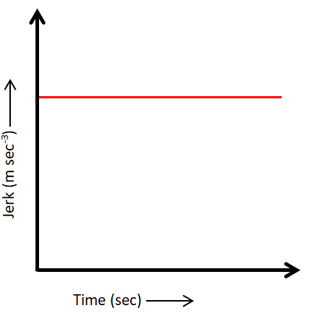
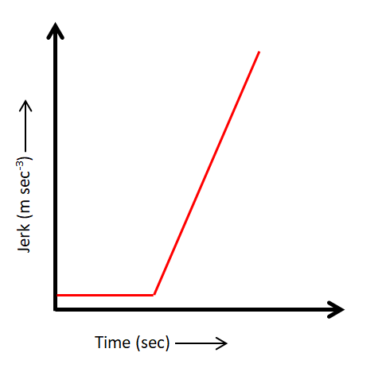
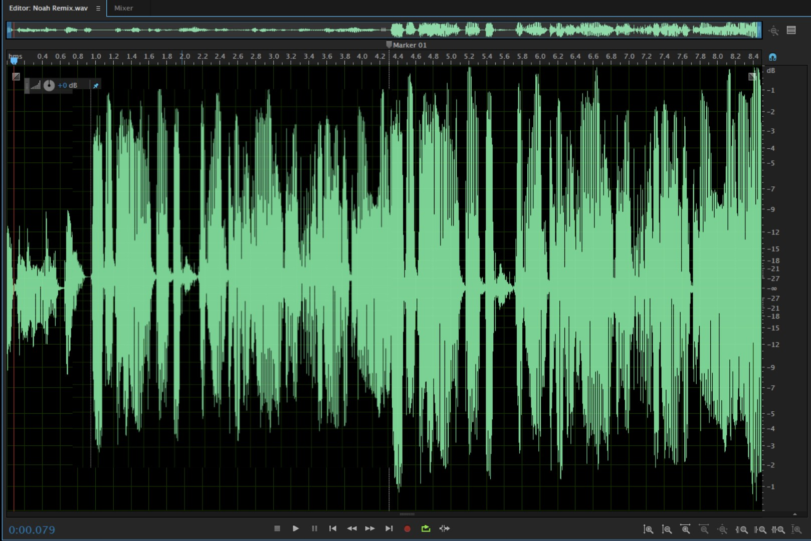
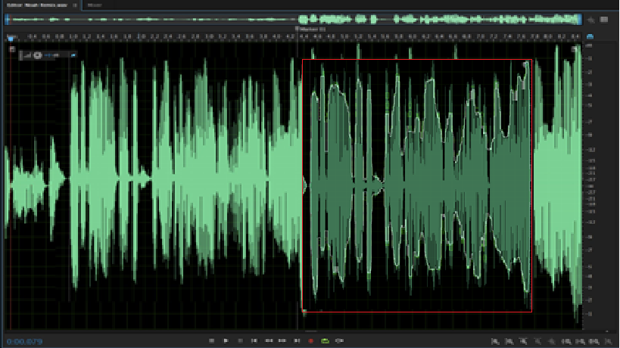
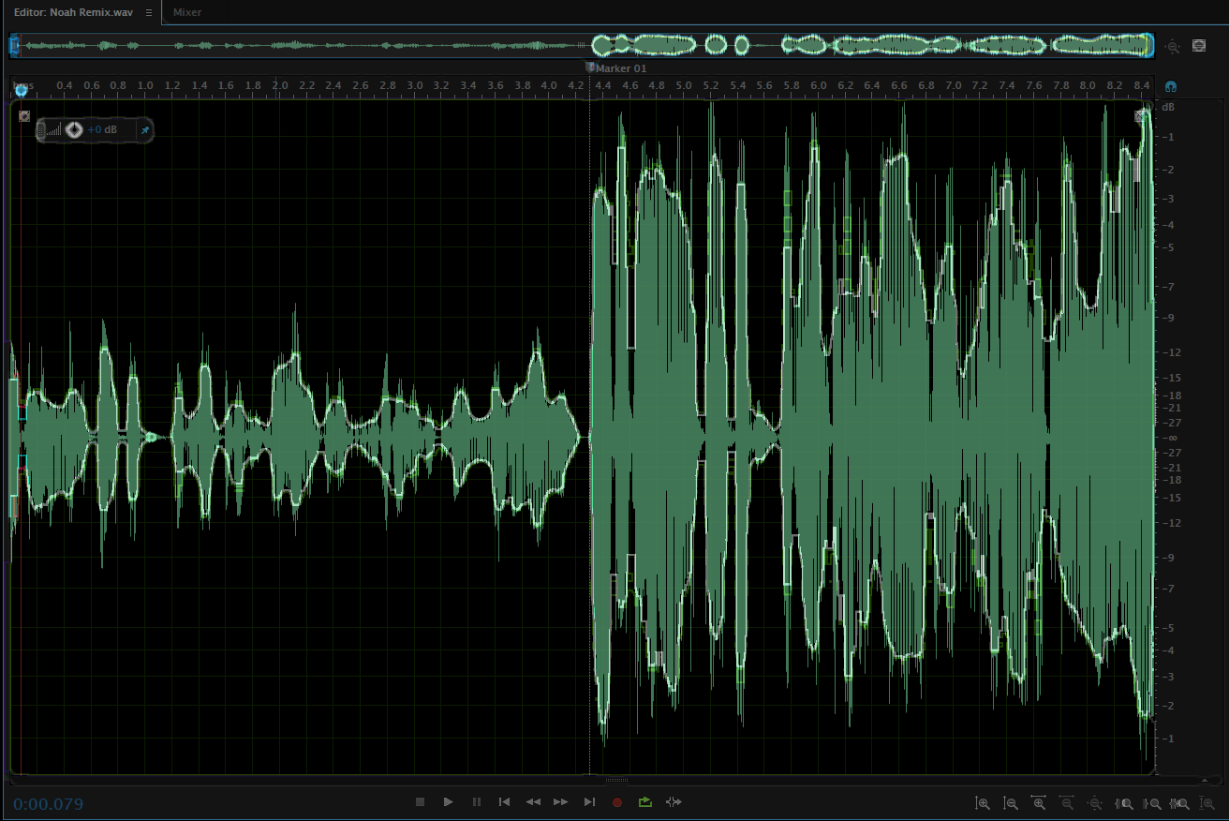
Detection Phase
Threshold limit of jerk and an in-built frequencies of sound.
Sensors detecting accident
Threshold jerk limit:
Exceeded
AND
Frequency spectral :
Match Found
Detection of Accident : A sound and a jerk sensor will be used here.
The sound sensor will get activated upon receiving sound frequencies that will match the sensor’s in-built sampling pattern of different types of sounds that occurs during an accident.
The jerk sensor will have a threshold limit beyond which it will activate during an accident.
Activation of both sensor will lead to the activation of the module.
Jerk and sound frequency produced during accident:
Once the sensor gets activated it will in-turn activate the Aurdino set-up which will trigger the next phase(communication phase) of our solution.
We can increase the efficiency of sensors overtime collecting necessary data from accidents and implementing a Machine Learning algorithm to train these sensor. The errors in-built Limits will get more and more rectified by the collected data which will make the unit more accurate.

Slide 6
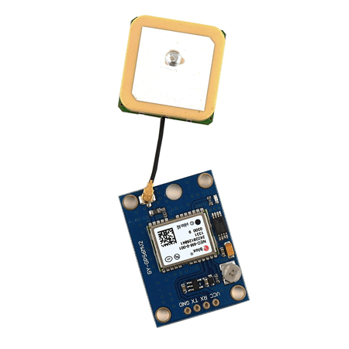
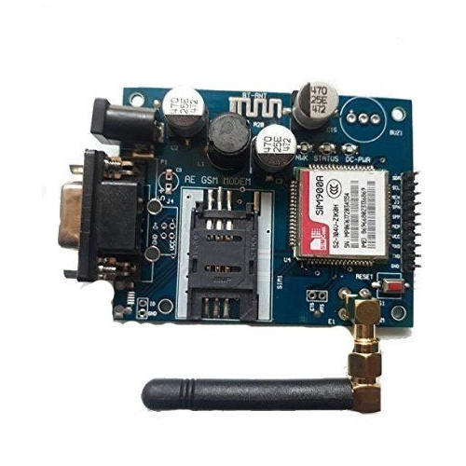
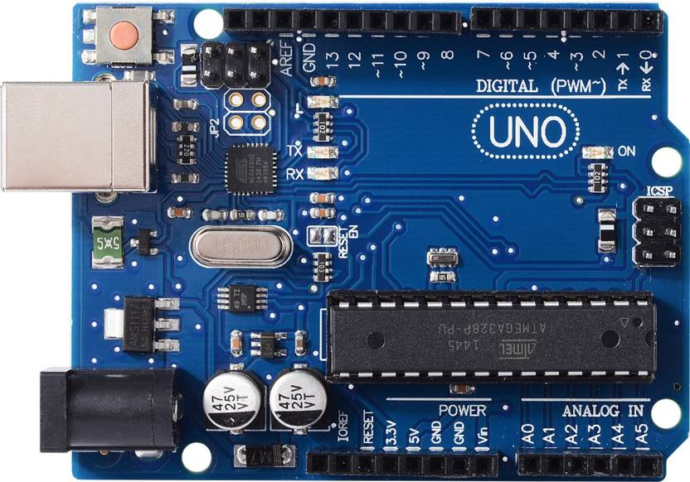
Transmission Phase
The Transmission Phase will be carried out by an Aurdino Setup.
The Aurdino Setup is made up of three components:
1. GPS Module
2. GSM Module
3. Aurdino UNO Board
Ublox NEO6m GPS Module
Sim900a GSM Module
Aurdino UNO Board

Slide 7
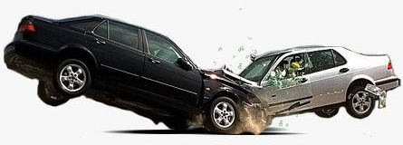

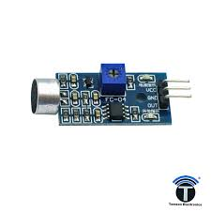
Transmission Phase
Step 1: As soon as the sound and jerk Sensor detects an Accident it will Initiate the Aurdino board.
Step 2: The initialized Aurdino will boot-up GPS Module and GSM Module.
Step 3: The GPS Module will send out current location in forms of Latitude and Longitude.
Step 4: This Data will be converted into Location URL by Aurdino board
Step 5: This Location URL will be sent to GSM Module.
Step 5: The GSM Module will send this URL as message to main PCR.
How will this Setup work?
Aurdino Being Initialised
The GPS Module will provide the exact location of the accident.
(in form of latitude and longitude coordinates)
This is an Example Output data of GPS Module:
maps.google.com/maps?q=01122,08822.06535
Sensors detect accident and starts to initialize Aurdino
Accident Occurs
$GPRMC ,,A,2235.01122,N,08822.06535,E,,,,A*7d
GPS Module
GSM Module

Slide 8

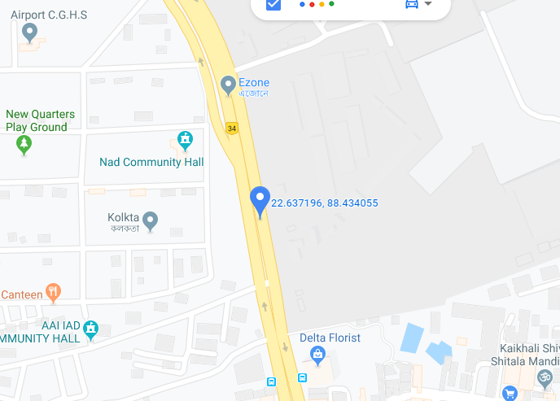
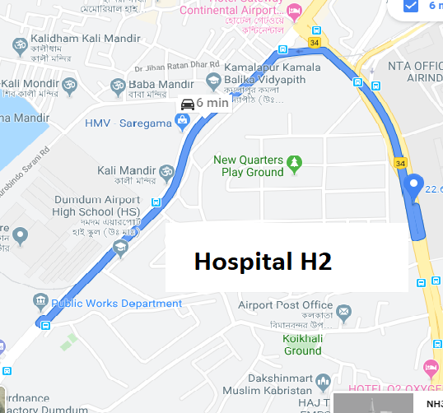
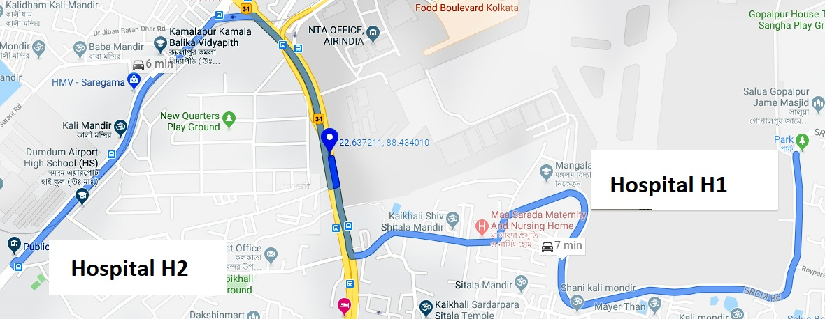
Receiving Phase
As soon as PCR will receive the Accident message , the Receiving Phase will start:
The Accident Alert containing the coordinates of the Accident will be displayed
The nearest Hospital from the accident area will be searched.
As soon as the nearest hospital is found a notification will be sent to this hospitals.
As soon as any of the hospital accept request it will dispatch its ambulance to the accident area.
Shortest route will be decided via Google maps.
All the sergeants will be informed so that the road of the transit can be vacated
An Accident ALERT has been received!!
2 Hospitals Found..
Sending Notification..
Hospital H2 Accepted
Locating nearby hospitals…

Slide 9

Quick Functional Flow of our Solution.
Accident occurred
Finding Nearby Hospital and sending requests
Sensor Activation
Initialization of Aurdino Setup
Police Control Room
Aurdino UNO
< Live Location >
Hospital 1
(1 km)
Selected
Hospital
Hospital ID →
Distance From Accident →
Hospital 2
(1.4 Km)
Hospital 3
(1.9 Km)
Hospital Number N
GPS Module
GSM Module
$$∎∎∎∎∎∎∎∎$$
Hospitals Available For Treatment will accept request.
< Output Location >
In case multiple requests get accepted PCR will select the hospital nearest to the accident location.
The selected hospital will send in the ambulance to the accident location.
Sergeants will try to minimize traffic of that particular route for the ease of ambulance transmit

Slide 10
Solution Architecture
LED
+vcc
OUT
AURDINO
UNO
BOARD
GPS
MODULE
+vcc
SOUND SENSOR
TX RX
RX TX
Pin 1
OUT
GND
GND
+vcc
GSM
MODULE
+vcc
TX’ RX’
RX TX
VIBRATIONAL SENSOR
Pin 2
OUT
GND
GND

Slide 11
Unique Selling Point(USP)
Our system alerts the Police Control Room and nearest hospitals by sharing the live location of the accident without any time delay.
We can collect data from accident overtime and train sensors to be more accurate using Machine Learning algorithm.
While sending accident location to PCRs we could also send the notification to victim’s acquaintance.
The unit being small can be easily fitted inside the vehicle.
The GPS module of the system will also help in easy tracking of the vehicle.
Unsubsidized commercial cost of the product will be around ₹1500.

Slide 12
Risk, Issues and Mitigation plan
We have realized that there are some risks involved in these concepts . We have listed some of them with it’s mitigation plan .
Sensors might break during accident – To solve this problem we can use a series of circuit (depending upon the size of the vehicle) which will work on feedback system.
Availability of ambulance – If there are more people injured than the available capacity of hospital then multiple hospitals can be engaged to manage the situation.
Time delay in ambulance to reach- In very remote scenario where an ambulance will take a lot of time to reach the accident location, a sergeant can deploy any other car to transport the victim to nearest location.
Road block - If for some reason there is a road block and Google Maps have not been updated about the situation , then the sergeant present at that road will pre-notify the situation so that the ambulance can avail alternative path.

Slide 13
Revenue Model
A tentative costs of the components are :
Sound & Vibration sensor | ₹300
Aurdino Board | ₹500
GPS Module | ₹100
GSM Module | ₹600
API for Google Maps | Free
Total cost : | ₹1500
It can be vended to customers for ₹2000 thus generating revenue.
Thus generating a profit of ₹500 per vehicle
Government can mandated this setup to be installed with every car registering under different RTOs.
Promotions at various fuel refilling stations will be made to install this system in the old cars.
This product can also be an USP for any vehicle model and vehicle manufacturer can promote this installation as an added safety measure.

Slide 14
Thank You

