Slide 1
Netflix India Content Analysis

Slide 2
Introduction
To analyze Netflix’s India catalog (Movies + TV Shows) and uncover insights into content trends, genres, and audience targeting.
Netflix Titles (from Kaggle) filtered to include content produced in India.
Microsoft Power BI (for visualization & dashboard creation).
To identify key patterns in Netflix India’s content strategy and highlight areas for growth (e.g., TV shows, kids/family titles, regional content).

Slide 3
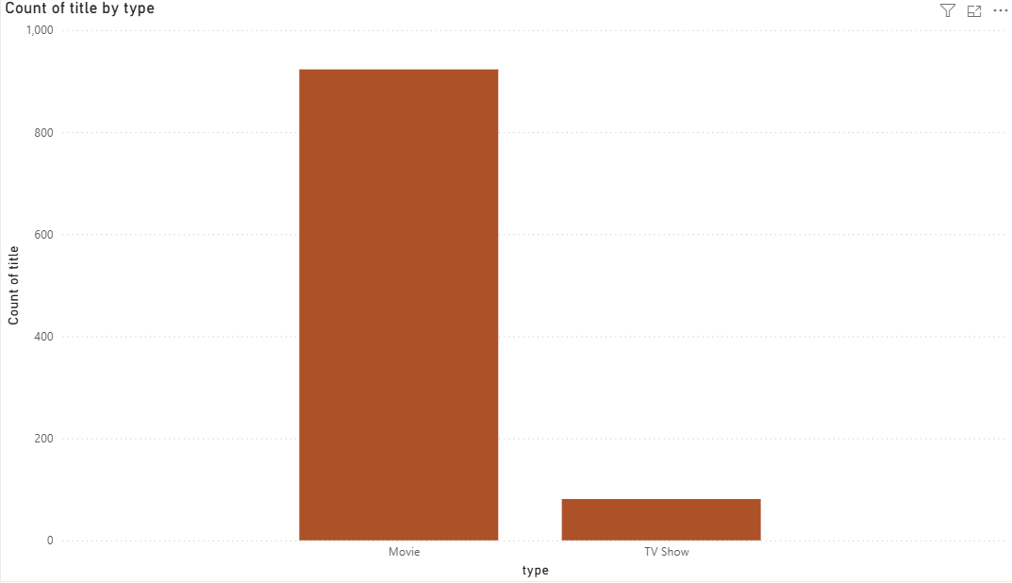
Movies vs TV Shows
The bar for Movies is significantly higher than for TV Shows.
This means Netflix’s India library is heavily skewed towards movies.

Slide 4
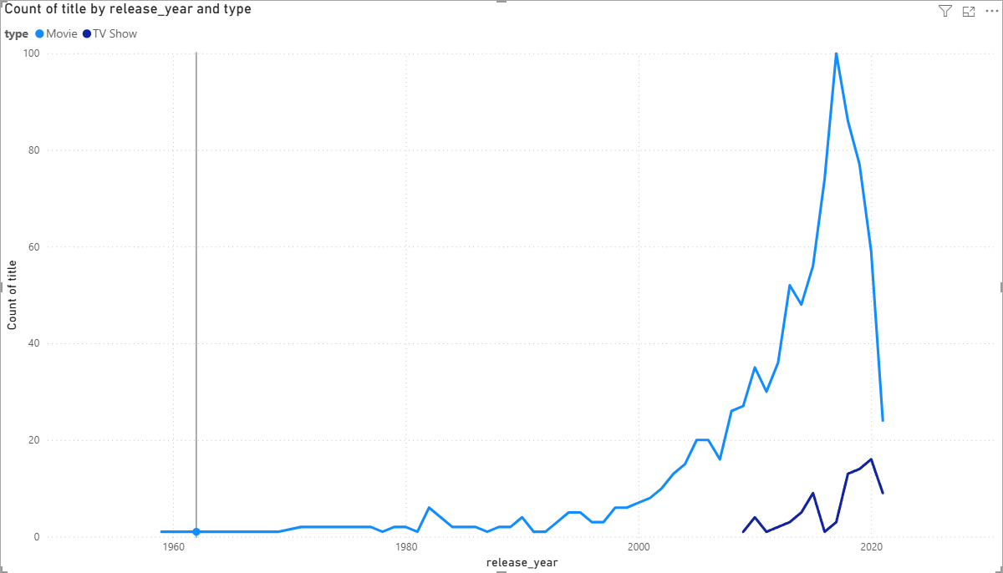
Releases Over Time
There’s a big spike between 2015 – 2019, especially in Movies.
The COVID-19 pandemic (2020–21) slowed film productions worldwide.
TV Shows from India appear only around 2015 onwards

Slide 5
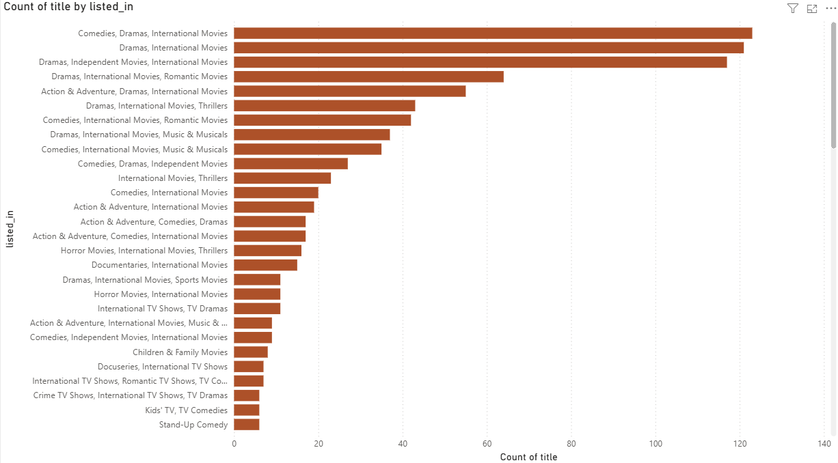
Top Genres
Netflix India focuses heavily on Drama + Romance + Comedy + International Movies.
This shows that Drama and International content dominate Netflix India’s catalog.
However, Kids/Family content, Crime/Thrillers, and Original TV Series are underrepresented categories.

Slide 6
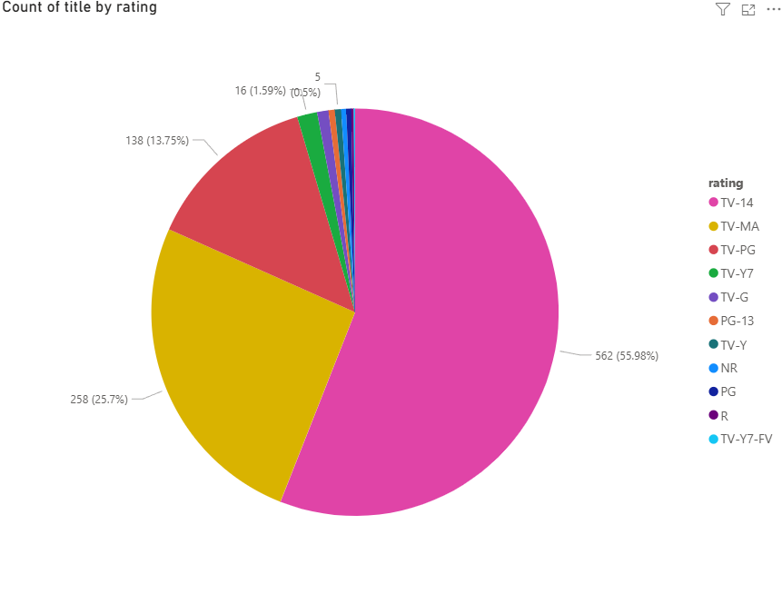
Audience Ratings Distribution
This shows that most of Netflix India’s titles are aimed at teens and adults, with a strong adult skew.
Limited content that appeals to children an opportunity in animation, family films, kids’ shows, and regional-language children’s content.

Slide 7
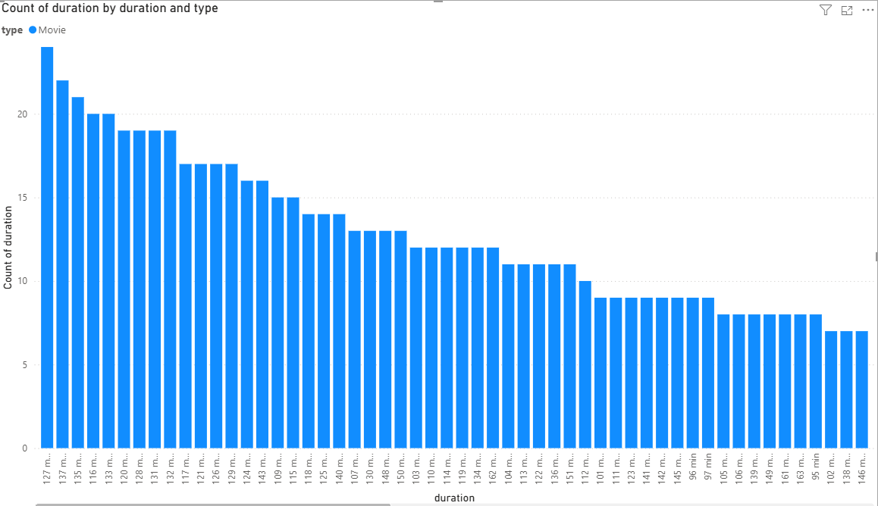
Duration Analysis for MOvies
The highest counts are for movies in the range about 2 hours.
This matches the standard Bollywood “feature film” length.
This would also position Netflix differently from theatrical Bollywood content.

Slide 8
Storytelling
1. Movies vs TV Shows (Catalog Split)
The Netflix India catalog is dominated by Movies (~90%), with far fewer TV Shows (~10%).
This indicates Netflix has built its India presence mainly through films, while serial content is comparatively limited.
2. Release Year Trend
Content growth exploded after 2015, aligning with Netflix’s entry into India and the global rollout of Netflix Originals.
Movies grew rapidly, whereas TV Shows only picked up after 2016 and remain fewer in number.
Insight: Tremendous opportunity to expand local Indian TV series, especially regional-language dramas.

Slide 9
3. The catalog is heavily skewed to Dramas, Romance, Comedies, and International Movies.
Genres like Kids/Family, Crime, Documentaries, and Stand-up Comedy are underrepresented.
Insight: Netflix could diversify its portfolio by investing in Kids, Thriller/Crime, and Regional Stories.
4. Duration Analysis (Movies)
Most Indian movies on Netflix cluster around 120–130 minutes, reflecting Bollywood’s traditional full-length film style.
Very few short films (<90 mins) exist.
Insight: Netflix could experiment with shorter, digital-friendly formats (60–90 mins mini-movies) to appeal to time-conscious, OTT-focused audiences.

