Slide 1
GROUP 1
TOPIC: WEBSITE ON CYBERBULLYING
GROUP MEMBERS:
AJEESH M S
MAYA MB
SOURAV K M

Slide 2
INTRODUCTION
Cyberbullying is bullying that takes place over digital devices like cell phones, computers, and tablets. Cyberbullying can occur through SMS, Text, and apps, or online in social media, forums, or gaming where people can view, participate in, or share content. Cyberbullying includes sending, posting, or sharing negative, harmful, false, or mean content about someone else. It can include sharing personal or private information about someone else causing embarrassment or humiliation. Some cyberbullying crosses the line into unlawful or criminal behaviour.We aim to build a website with services that can provide a platform for awareness and reporting such crimes anonymously.
To create a website where people can report their complaints anonymously and can share their trauma with helpline.This site will also provide an awareness about the acts that can be seen as cyberbullying.

Slide 3
EXISTING SYSTEM
There are no such existing system that can be compared to the proposed system. Eventhough there are few sites that provide the above services,they don’t provide anonymity or encrypted data.Even government websites treat them just as part of cybercrime and doesn’t provide a proper method.

Slide 4
PROPOSED SYSTEM
The proposed system would have encrypted database to make sure the data of victims can only be accessed with their consent.This website can give enough guidance to people in overcoming their trauma and also basic criminal procedure.It also provide a platform to test their knowledge.

Slide 5
HARDWARE REQUIREMENTS
DEFAULT SYSTEM
NO SPECIFIC REQUIREMENTS NEEDED

Slide 6
SOFTWARE REQUIREMENTS
Operating system : Default operating system
Technology used : Laravel
IDE : VS Code
Database : MYSQL

Slide 7
MODULES
1.Admin
Login: Admin can login into his account using id and password.
View Complaints:Admin can view and manage complaints.
View Blogs:Admin can view the contents of the blog posted by user and decide if it need to be published.
Add Quiz:Admin can add new quiz.
Add Resources:Admin can add new resources.
View Quiz Results:Admin can view the results of the quiz.
Update Password:Admin can update his password.

Slide 8
2.User
Make complaint:User can make complaints here.
View complaint:User can view his complaints here.
Update Password:User can change his passwords here.

Slide 9
3.Guest
Home:First page and contains a small introduction about website.
Contact:Visitor can contain the admin or the members related with running the website.
Login:User or the admin can login here.
Signup/Registration:A new victim can register here.
Resources:This page contains resources like images,videos related to cyberbullying awareness and document about rules related to it.
Quiz:Visitors can attend the quiz to test their knowledge.
Blog:Victims can share theirs stories overcoming their trauma.
About us:Contains details about the the site.

Slide 10
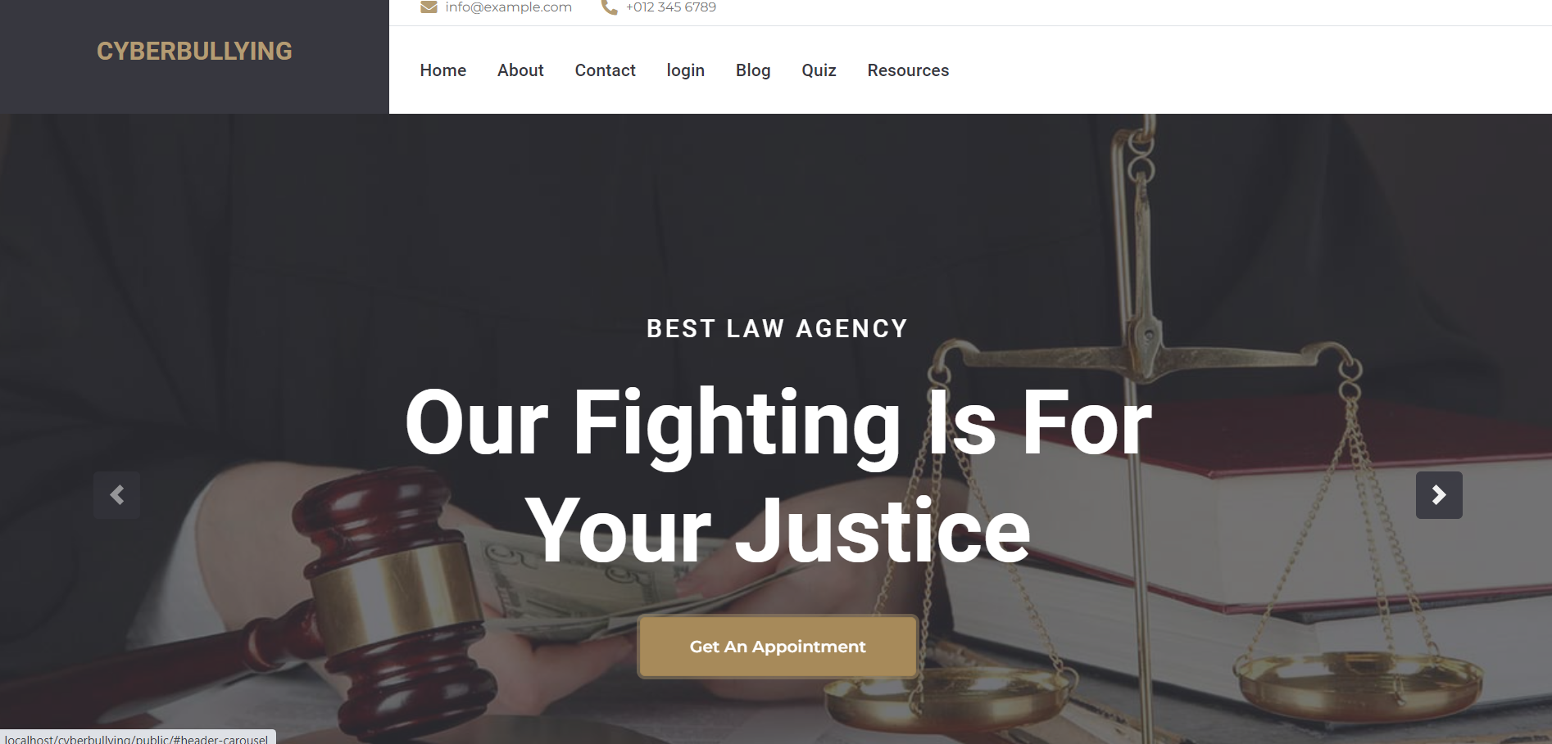

Slide 11
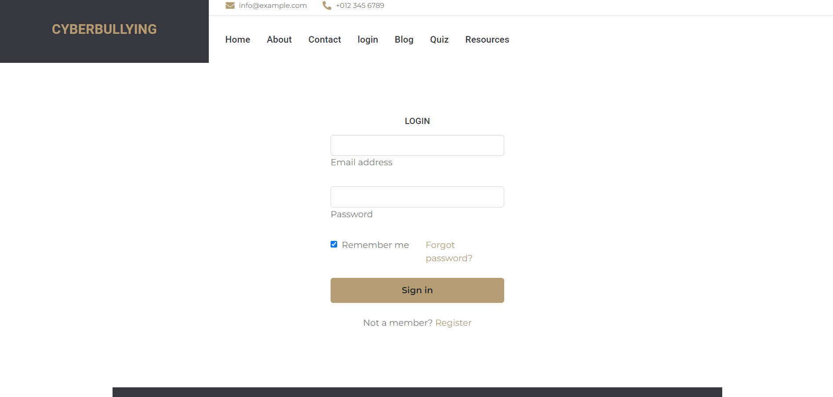
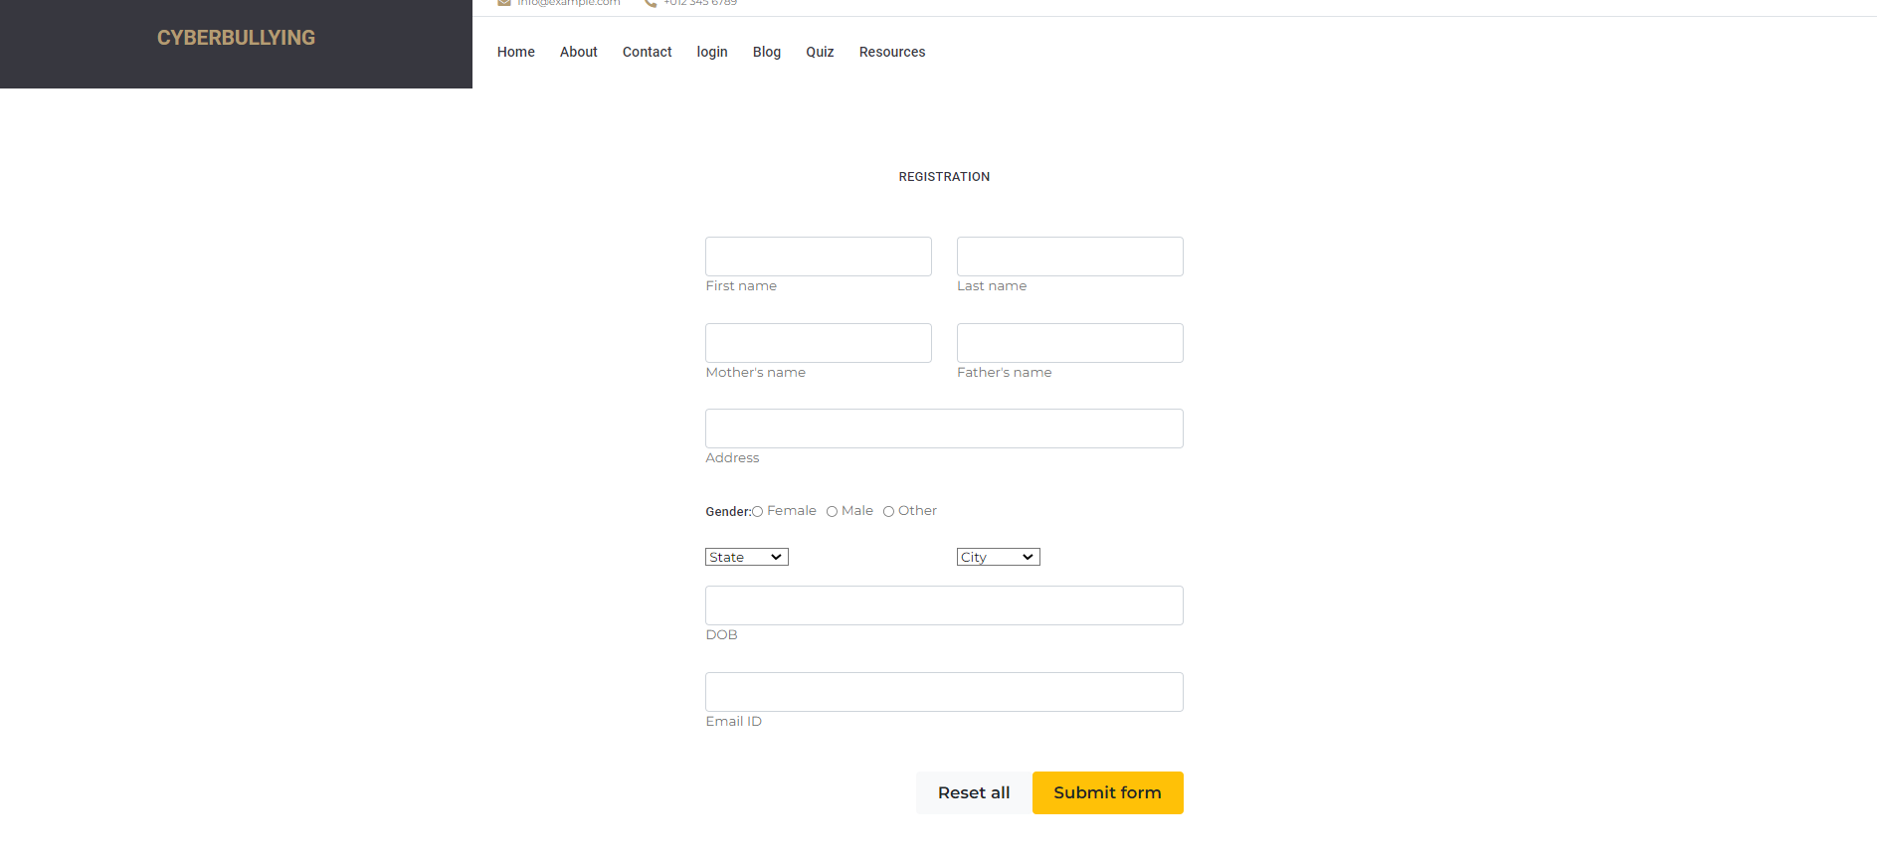

Slide 12
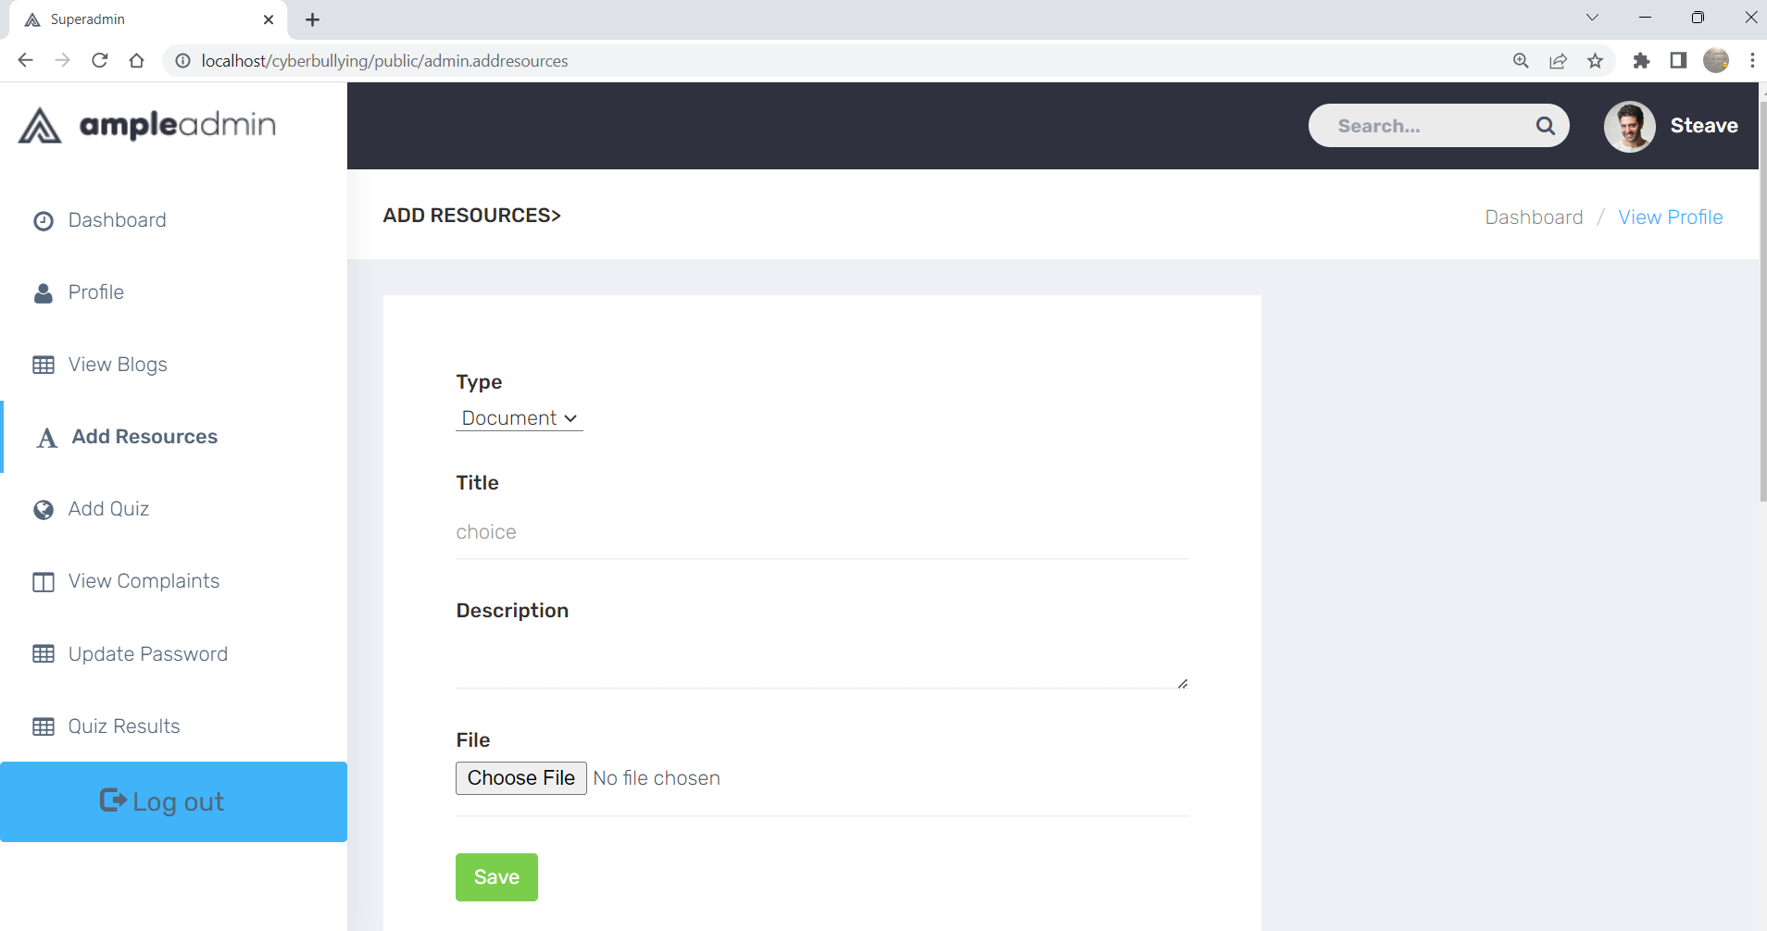
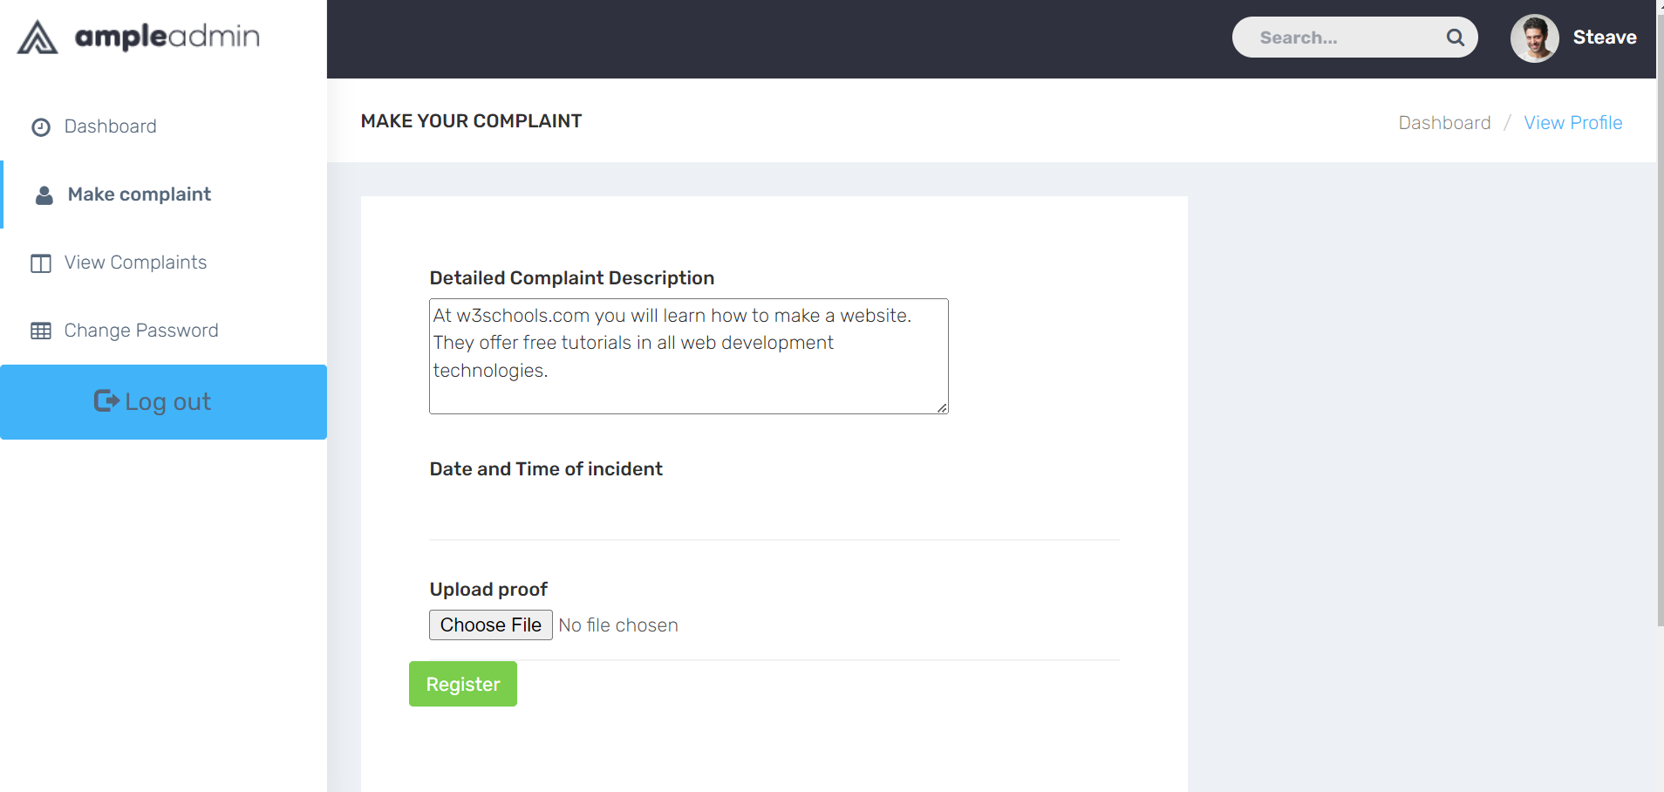

Slide 13
DFD LEVEL 0
ADMIN
RESOURCES
CYBERBULLYING
REPORT
QUIZ AND BLOG

Slide 14
DFD LEVEL 1
ADMIN LOGIN
USER LOGIN
VIEW REPORT
cyberbullying
ADD RESOURCES
VIEW QUIZ
VIEW BLOG
ADD QUIZ
ADD BLOG

Slide 15
DFD LEVEL 2
USER
LOGIN
VIEW STATUS
ADD COMPLAINT
REGISTER

Slide 16
MANAGE COMPLAINTS
ADMIN
LOGIN TO SYSTEM
MANAGE BLOG
MANAGE MODULES
FORGOT PASSWORD
CHECK CREDENTIALS
MANAGE QUIZ
SEND E MAIL
MANAGE RESOURCES

Slide 17
DATABASE
TABLES:
USER : contain user info;columns:id,user_type,name,email,email verified at,password,remember token,created at,updated at
VICTIMS : contain victim info;columns:id, user id,address,dob,state,city,state,gender,created at,updated at
COMPLAINTS : contain complaint info;columns:id,victim id,description,complaint_date,reply,reply_date, created at,updated at
RESOURCES : contain resources info;columns:id,resource_type,title,document,created at,updated at
BLOGS : contain blog info;columns:id,name,comments,status,rating,created at,updated at
QUIZ QUESTION : contain quiz questions;columns:id, question,choice1,choice2,choice3,choice4,answer,created at,updated at
QUIZ RESULTS : contain quiz results;columns:id,userid,questionid,answer,quiz_date,created at,updated at

