Slide 1
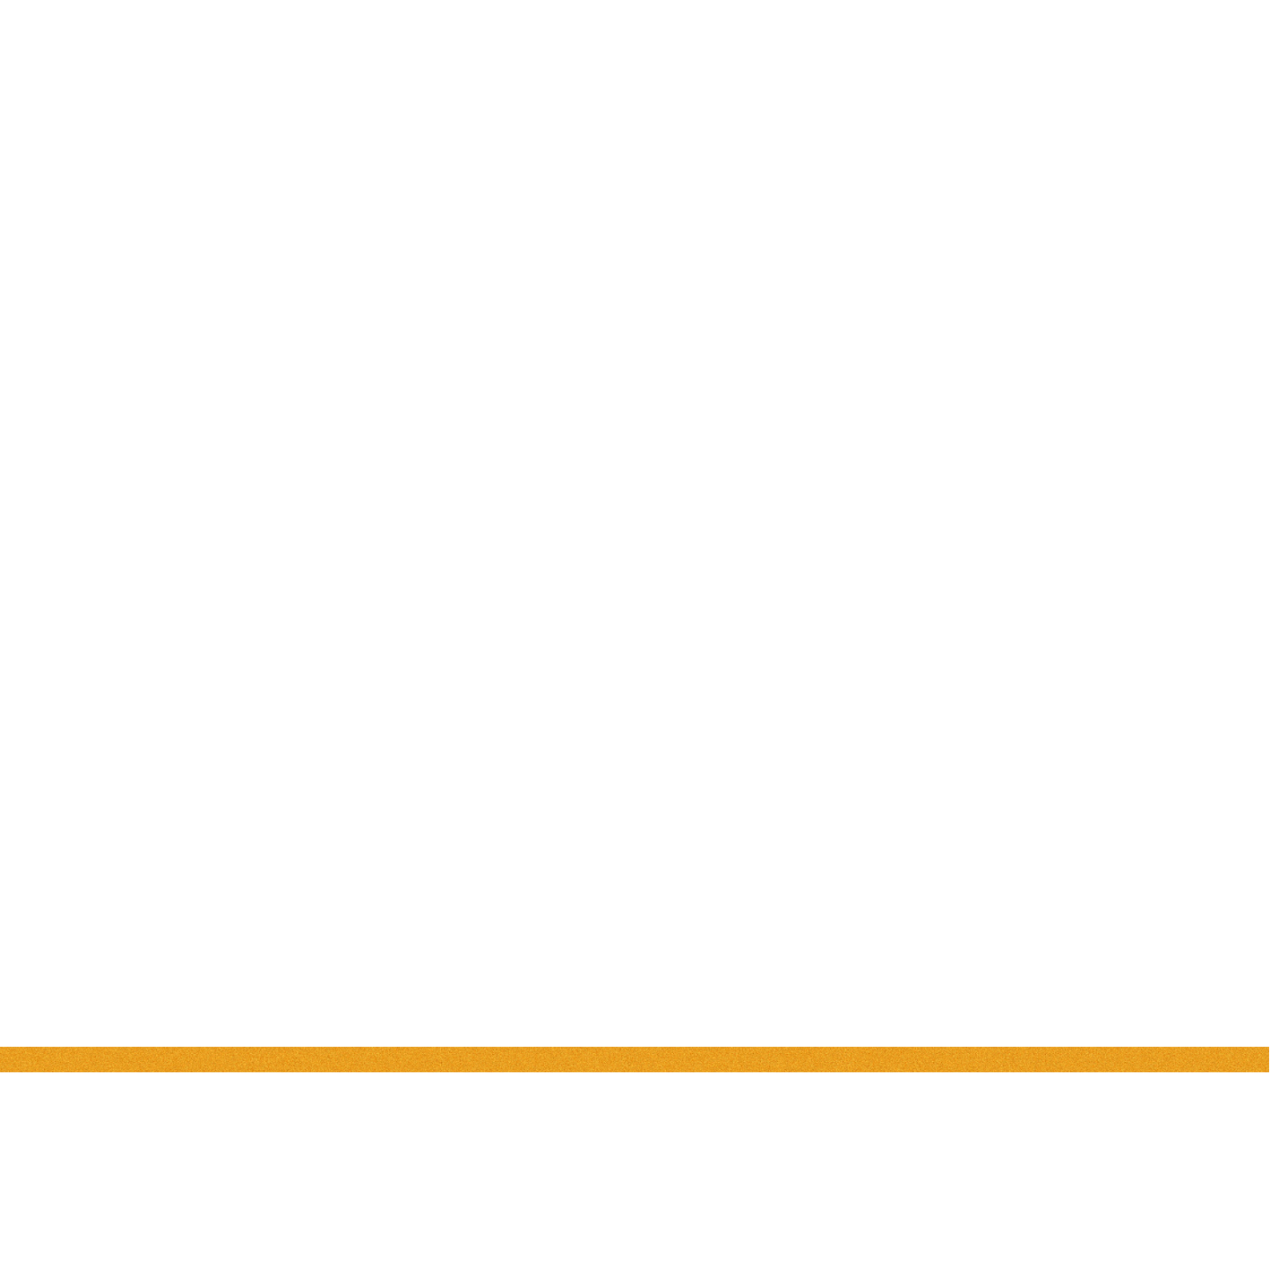
HIGH LEVEL DESING
H I G H L E V E L D E S I GN
DATA VISUALIZATION OF
BIRD STRIKES BETWEEN
2000 - 2011
2023/2024
BY
SOURAV KUMAR PANIGRAHI

Slide 2
HIGH LEVEL DESING
TABLE OF
CONTENTS
1 Introduction
1.1 Why this High-Level Design Document?
1.2 Scope
2. General Description
2.1 Product Perspective & Problem Statement
2.2 Tools Used
3. Design Detail
4. KPI

Slide 3
HIGH LEVEL DESING
1. Introduction
1.1 Why this High-Level Design Document?
This High-Level Design (HLD) document's goal is to provide the current project
description with the extra depth it needs to reflect an appropriate coding model. This paper can be used as a reference guide to understand how the modules work at a high level and to help find conflicts before coding.
THE HLD WILL
Present all of the design aspects and define them in detail
Describe the user interface being implemented
Describe the hardware and software interfaces
Describe the performance requirements
Include design features and the architecture of the project
List and describe the non-functional attributes like:
-Security
-Reliability
-Maintainability
-Portability
-Reusability
-Application compatibility
-Resource utilization
-Serviceability
1.2 The Scope
The HLD documentation outlines the system's architecture, including the
technology architecture, application architecture (layers), application flow, and database architecture. The HLD employs simple to somewhat complex concepts that system administrators should be able to understand.

Slide 4


2 General Description
2.1 Product Perspective & Problem Statement
HIGH LEVEL DESING
This Project aims to Analyze bird strikes from 2000 to 2011 to know more in-depth
information about several aspects of data like cost to company in repairing damages, loss of life , injury , changes occurred due to strike etc.
3. TOOLS USED

Slide 5
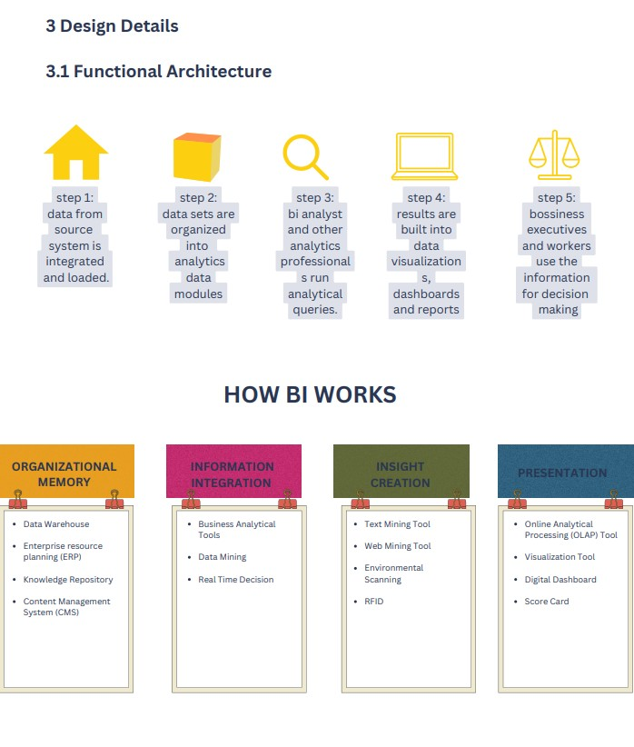
3 Design Details
3.1 Functional Architecture
HIGH LEVEL DESING

Slide 6
3.2 Optimization
1. Your data strategy drives performance
Minimize the number of fields
HIGH LEVEL DESING
Minimize the number of records
Optimize extracts to speed up future queries by materializing calculations,
removing columns and the use of accelerated views
2. Reduce the marks (data points) in your view
Practice guided analytics.
There’s no need to fit everything you plan to show in a single view. Compile
related views and connect them with action filters to travel from overview to highly-granular views at the speed of thought.
Remove unneeded dimensions from the detail shelf. Explore. Try displaying your
data in different types of views.
3. Limit your filters by number and type
Reduce the number of filters in use. Excessive filters on a view will create a more
complex query, which takes longer to return results. Double-check your filters and remove any that aren’t necessary.
Use an include filter. Exclude filters load the entire domain of a dimension while
including filters do not. An include filter runs much faster than an exclude filter, especially for dimensions with many members.
Use a continuous date filter. Continuous date filters (relative and range-of-date
filters) can take advantage of the indexing properties in your database and are faster than discrete data filters.
Use Boolean or numeric filters. Computers process integers and Booleans (t/f)
much faster than strings.

Slide 7
4. Optimize and materialize your calculations
Perform calculations in the database
HIGH LEVEL DESING
Reduce the number of nested calculations.
Reduce the granularity of LOD or table calculations in the view. The more granular
the calculation, the longer it takes.
LODs - Look at the number of unique dimension members in the calculation.
Table Calculations - the more marks in the view, the longer it will take to calculate.
Where possible, use MIN or MAX instead of AVG. AVG requires more processing
than MIN or MAX. Often rows will be duplicated and display the same result with
MIN, MAX, or AVG
4. KPI
Dashboards will be implemented to display and indicate certain KPIs and relevant
indicators for the disease.
As and when the system starts to capture the historical/periodic data for a user,
the dashboards will be included to display charts over time with progress on various indicators or factors

Slide 8
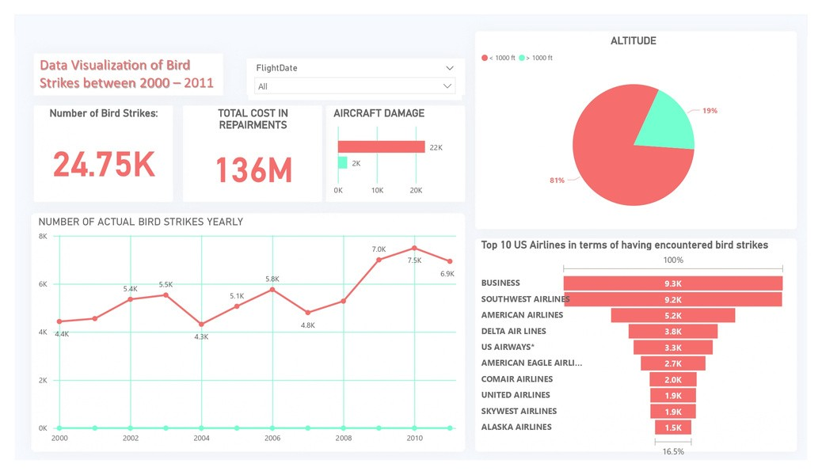
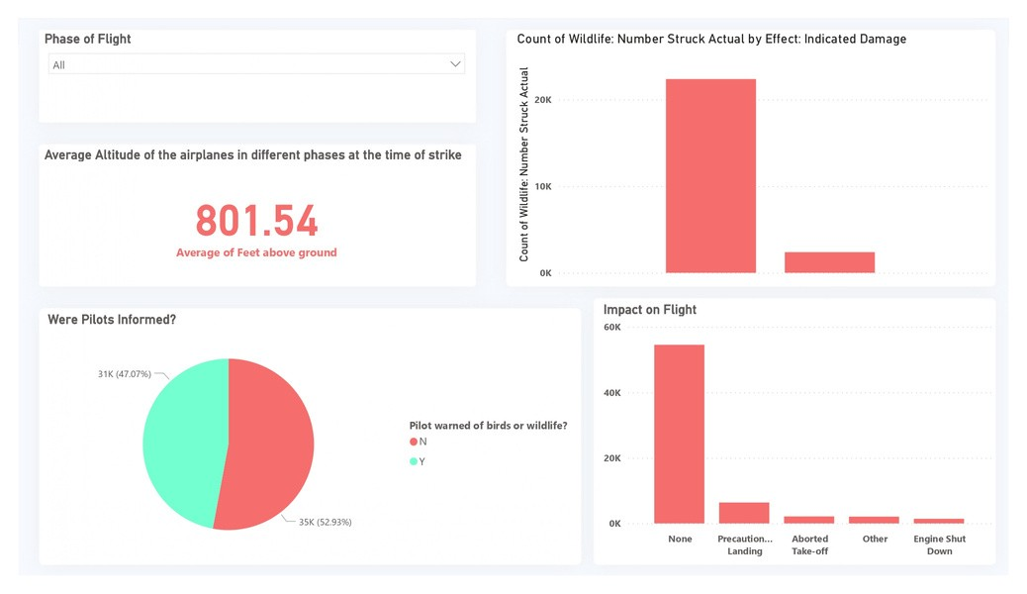
HIGH LEVEL DESING

Slide 9
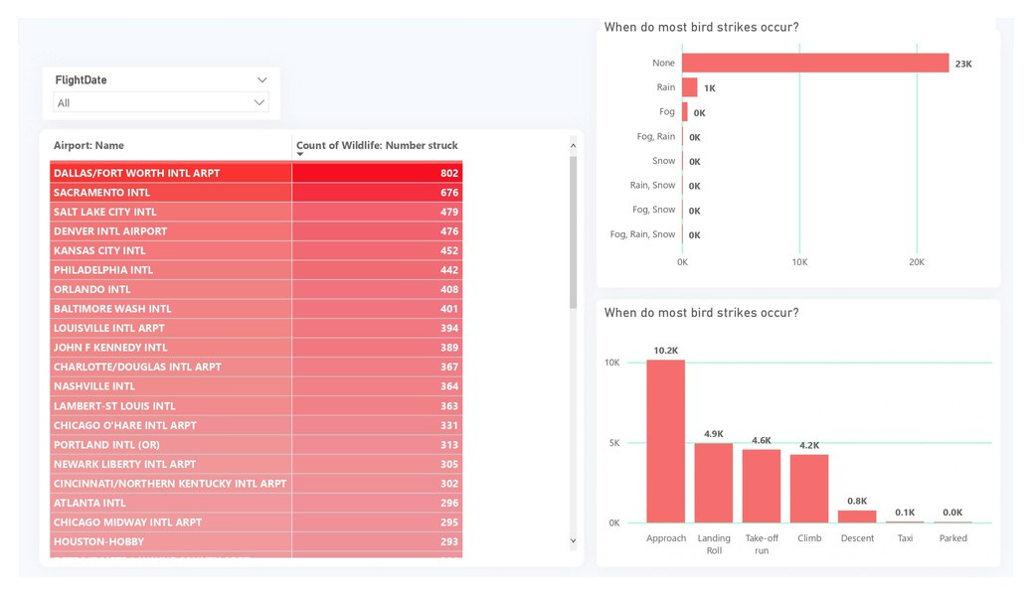
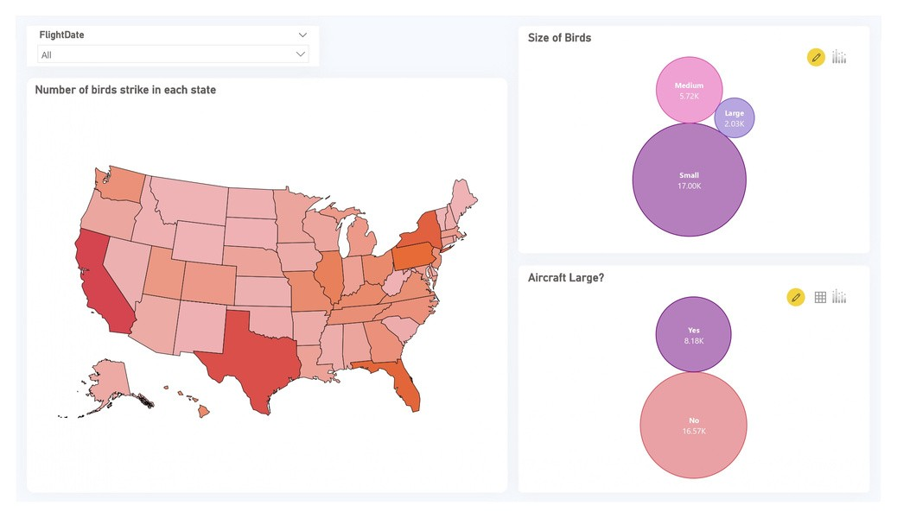
HIGH LEVEL DESING

Slide 10
HIGH LEVEL DESING
H I G H
L E V E L
D E S I GN
THANK YOU
BY
SOURAV KUMAR PANIGRAHI

