Slide 1
I N E U R O N O C T O B E R 2 7
LOW LEVEL DESIGN (LLD)
LOW-LEVEL
DESIGN (LLD)
DATA VISUALIZATION OF BIRD STRIKES BETWEEN 2000 – 2011
PRESENTED BY
SOURAV KUMAR PANIGRAHI

Slide 2

TABLE OF
LOW LEVEL DESIGN (LLD)
CONTENTS
1.INTRODUCTION
3
1.1 INTRODUCTION : What is a low level document
4
1.2 INTRODUCTION : Scope
6
1.3 INTRODUCTION : Project introduction
7
2. PROBLEM STATMENT
8
3. DATABASE INFORMATION
9
4. ARCHITECTURE
11
4.1 Architecture Description
12

Slide 3
1. Introduction
1.1 What is Low-Level Design Document?
The goal of the Low-level design document (LLDD) is to give the internal logic design of the actual
program code for the Sales Analysis dashboard. LLDD describes the class diagrams with the
methods and relations between classes and programs specs. It describes the modules so that the
programmer can directly code the program from the document.
1.2 What is Scope?
Low-level design (LLD) is a component-level design process that follows a step-by-step
refinement process. The process can be used for designing data structures, required software
architecture, source code and ultimately, performance algorithms. Overall, the data organization
may be defined during requirement analysis and then refined during data design work.
1.3 Project Introduction
LOW LEVEL DESIGN (LLD)
Transport and communication is one of the crucial domain in field of analytics.
Environmental impacts and safety are, nowadays, two major concerns of the scientific
community with respect to transport scenarios and to the ever-growing urban areas.
These issues gain more importance due to the increasing amount of vehicles and people.
Seeking for new solutions is reaching a point where available technologies and artificial
intelligence, especially MAS, are being recognized as ways to cope and tackle these
kinds of problems in a distributed and more appropriate way.
A bird strike is strictly defined as a collision between a bird and an aircraft which is in
flight or on a take-off or landing roll. The term is often expanded to cover other wildlife
strikes - with bats or ground animals. Bird Strike is common and can be a significant
threat to aircraft safety. For smaller aircraft, significant damage may be caused to the
aircraft structure and all aircraft, especially jet-engine ones, are vulnerable to the loss of
thrust which can follow the ingestion of birds into engine air intakes. This has resulted in
several fatal accidents. Bird strikes may occur during any phase of flight, but are most
likely during the take-off, initial climb, approach and landing phases due to the greater
numbers of birds in flight at lower levels. To have a closer look the following document
visually depicts the data collected on Bird Strikes by FAA between 2000-2011.

Slide 4
2. Problem Statement
A bird strike is strictly defined as a collision between a bird and an aircraft which is in
flight or on a take-off or landing roll. The term is often expanded to cover other wildlife
strikes - with bats or ground animals. Bird Strike is common and can be a significant
threat to aircraft safety. For smaller aircraft, significant damage may be caused to the
aircraft structure and all aircraft, especially jet-engine ones, are vulnerable to the loss of
thrust which can follow the ingestion of birds into engine air intakes. This has resulted in
several fatal accidents. Bird strikes may occur during any phase of flight, but are most
likely during the take-off, initial climb, approach and landing phases due to the greater
numbers of birds in flight at lower levels. To have a closer look the following document
visually depicts the data collected on Bird Strikes by FAA between 2000-2011.
3. Dataset Information
Record ID
Aircraft: Type
LOW LEVEL DESIGN (LLD)
Record ID
Aircraft: Type
Airport: Name
Altitude bin
Aircraft: Make/Model Wildlife:
Number struck Wildlife:
Number Struck Actual Effect:
Impact to flight
Flight Date
Effect: Indicated Damage
Aircraft: Airline/Operator
Origin State
When: Phase of flight
Conditions: Precipitation
Cost: Total $
Number of people injured
Pilot warned of birds or wildlife?

Slide 5
4. Architecture description
1. Raw Data Collection
The Dataset was taken from iNeuron’s Provided Project Description Document
https://drive.google.com/drive/folders/1hLkL5HO4xG9rIjL8XeS6q-
uAjwbTDSX6?usp=sharing
2. Data Pre-Processing
Before building any model, it is crucial to perform data pre-processing to feed the correct data to
the model to learn and predict. Model performance depends on the quality of data fed to the
model to train. This Process includes a) Handling Null/Missing Values b) Handling Skewed Data c)
Outliers Detection and Removal
3. Data Cleaning
Data cleaning is the process of fixing or removing incorrect, corrupted, incorrectly formatted, duplicate, or incomplete data within a dataset. a) Remove duplicate or irrelevant observations b) Filter unwanted outliers c) Renaming required attributes
LOW LEVEL DESIGN (LLD)
4. Exploratory Data Analysis (EDA)
Exploratory Data Analysis refers to the critical process of performing initial investigations on data
to discover patterns, spot anomalies, test hypothesized check assumptions with the help of
summary statistics and graphical representations.
5. Reporting
Reporting is a most important and underrated skill of a data analytics field. Because being a Data
Analyst you should be good in the easy and self explanatory report because your model will be
used by many stakeholders who are not from a technical background.
a) High-Level Design Document (HLD)
b) Low-Level Design Document (LLD)
c) Architecture
d) Wireframe
e) Detailed Project Report
f) PowerPoint Presentation
5. Reporting

Slide 6
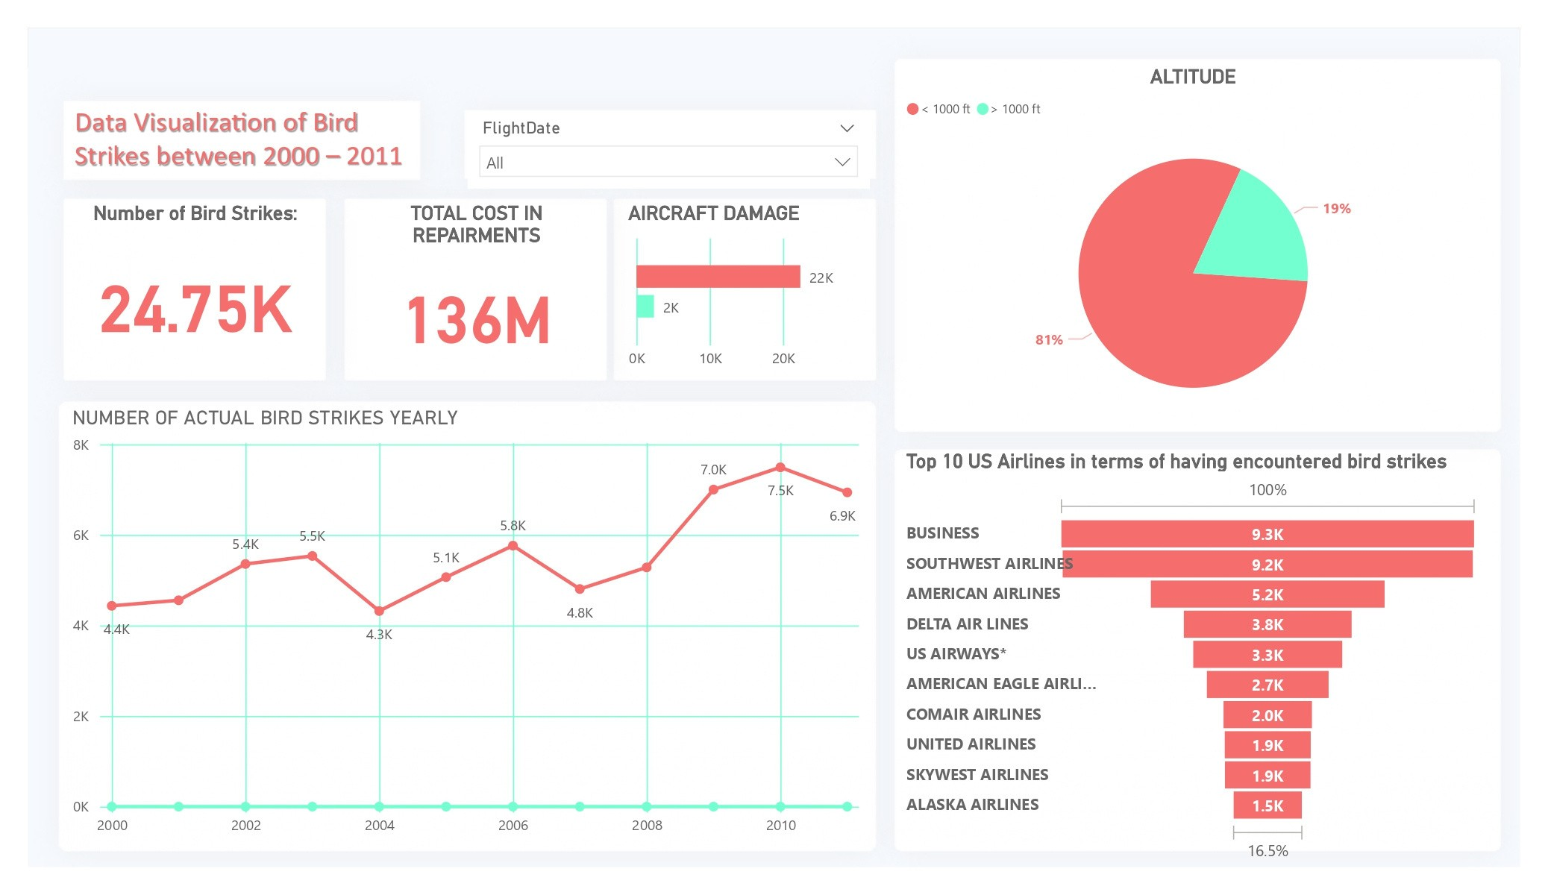
6. Modelling
Data Modelling is the process of analyzing the data objects and their relationship to the other
objects. It is used to analyze the data requirements that are required for the business processes.
The data models are created to store the data in a database. The Data Model's main focus is on
what data is needed and how we have to organize data rather than what operations we have to
perform.
7. Deployment
Dashboard created on Power Bi

