Slide 1


EMPLOYEE
MANAGEMENT
SYSTEM
PRESENTED BY: Sourav Kumar Sahu
Lokesh Gilakathula
Sai Kumar Kassetty
BATCH NO – 403
INNOMATICS RESEARCH LABS, DILSUKHNAGAR, HYDERABAD

Slide 2
INTRODUCTION
The Employee Management System (EMS) is designed to simplify and organize the management of employee-related information within an organization. This project uses a relational database model to efficiently handle various aspects of employee data, including personal details, job roles, departmental structures, payroll processing, qualifications, and leave records. By integrating these modules, the system ensures smooth HR operations, better data consistency, and easy reporting.

Slide 3
OBJECTIVE
Employee Demographics & Compensation: To offer a clear overview of the employee base by tracking key metrics like the number of unique employees, departmental headcounts, and total salary expenditure.
Job Role & Departmental Analysis: To enable detailed analysis of job roles and departments, including the number of different roles per department, average salary ranges, and the identification of high-paying positions and high-cost departments.
Workforce Skills & Qualifications: To provide a comprehensive view of the company's talent pool by tracking employee qualifications and skills, identifying the most qualified individuals and the positions with the highest skill requirements.
Leave and Absence Management: To monitor and analyze leave patterns to identify trends, calculate average leave days per department, and understand the correlation between employee absences and payroll.
Payroll Processing: To automate and streamline the calculation of the total monthly payroll, ensuring accurate and timely compensation analysis.

Slide 4
TABLE DETAILS
The database consists of six interrelated tables:
Job Department Stores job roles, department details, and salary ranges.
Salary Bonus Manages salary, annual pay, and bonuses linked to job roles.
Employee - Maintains employee details, including demographics, contact information, and job assignments.
Qualification Tracks employee qualifications, skills, and requirements for specific roles.
Leaves - Records employee leave history with reasons and dates.
Payroll Integrates employee, job, salary, and leave data to calculate net payments.

Slide 5
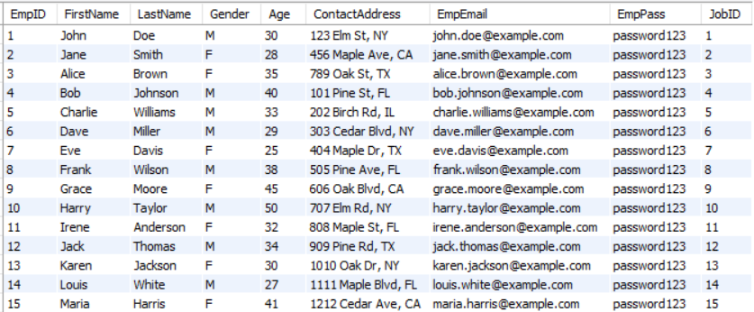
Employee Table

Slide 6
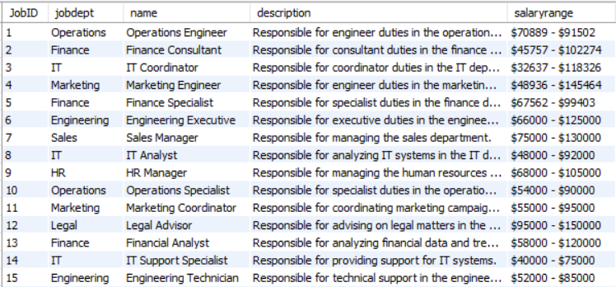
Job Department

Slide 7
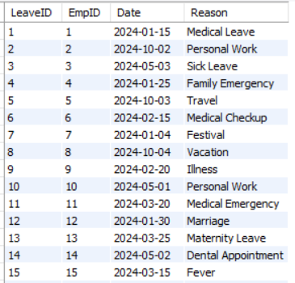
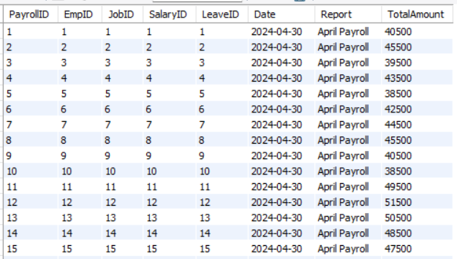
Leaves
Payroll

Slide 8
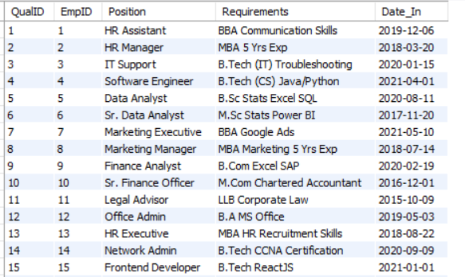
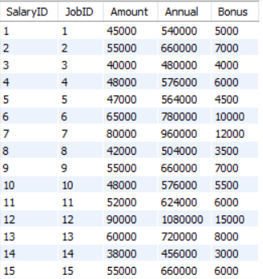
Qualification
Salary

Slide 9
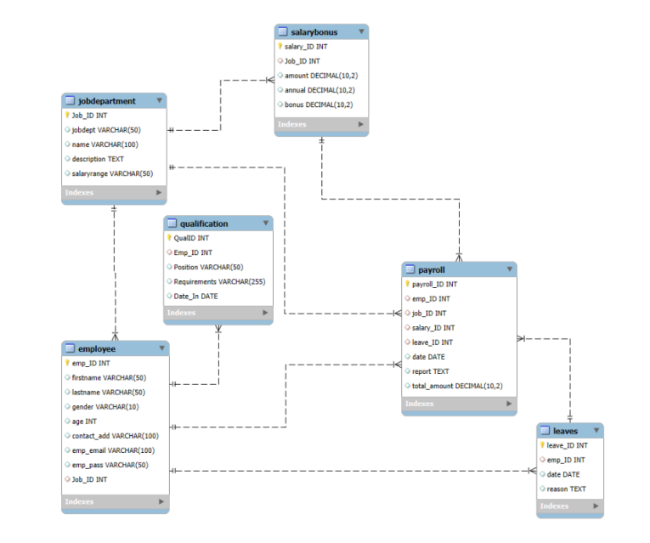
ER DIAGRAM

Slide 10
Problem Statement
The Employee Management System (EMS) is designed to efficiently manage employee information, job roles, departments, payroll, qualifications, and leaves within an organization. The system ensures data integrity through relational tables with foreign keys and cascading actions. It also supports analytical queries to provide insights into workforce distribution, salaries, bonuses, leave patterns, and payroll expenses-streamlining HR operations and decision-making.

Slide 11


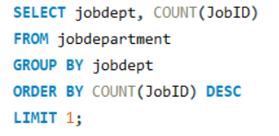

1. How many unique employees are currently in the system?
2. Which departments have the highest number of employees?

Slide 12
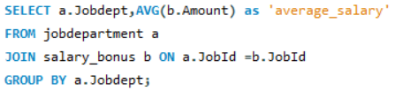
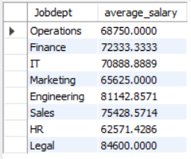
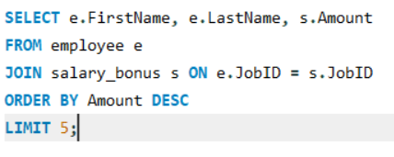
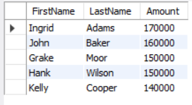
3. What is the average salary per department?
4. Who are the top 5 highest-paid employees?

Slide 13


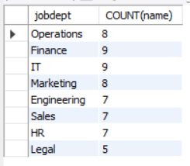
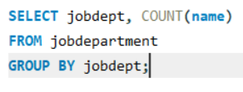
5. What is the total salary expenditure across the company?
6. How many different job roles exist in each department?

Slide 14
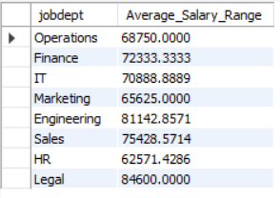
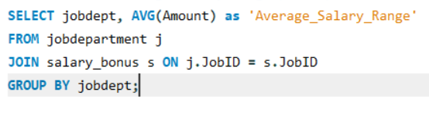
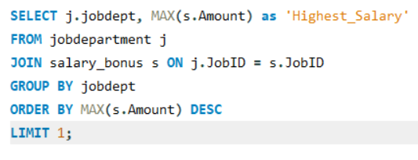

7. What is the average salary range per department?
8. Which job roles offer the highest salary?

Slide 15
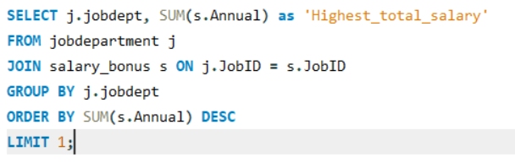

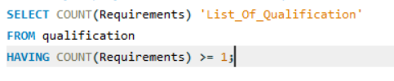

9. Which departments have the highest total salary allocation?
10. How many employees have at least one qualification listed?

Slide 16
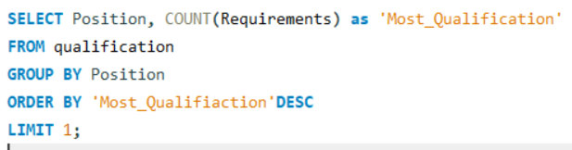

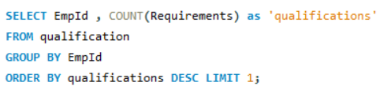

11. Which positions require the most qualifications?
12. Which employees have the highest number of qualifications?

Slide 17


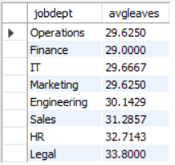
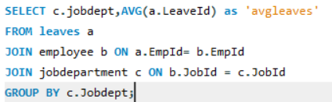
13. Which year had the most employees taking leaves?
14. What is the average number of leave days taken by its employees per department?

Slide 18
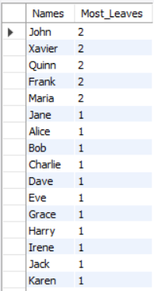
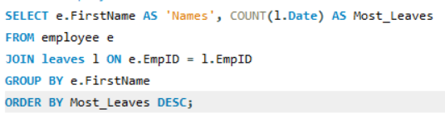


15. Which employees have taken the most leaves?
16. What is the total number of leave days taken company-wide?

Slide 19
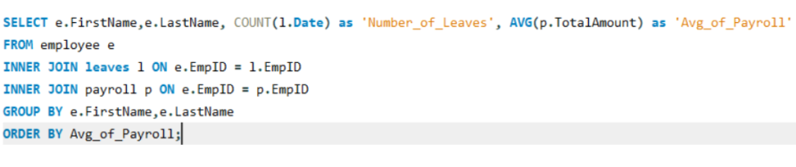
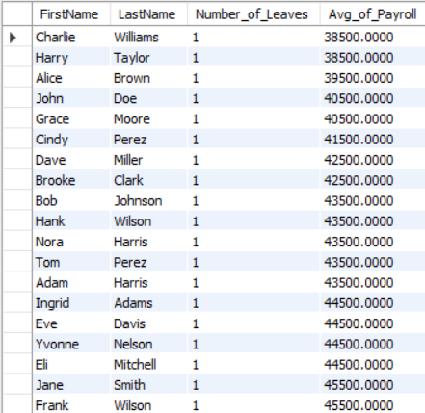
17. How do leave days correlate with payroll amounts?

Slide 20
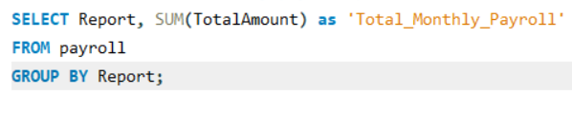

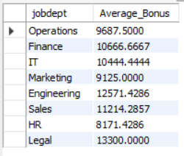
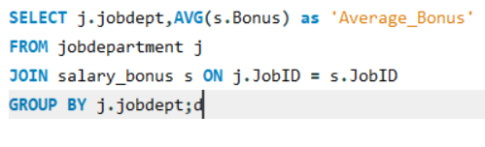
18. What is the total monthly payroll processed?
19. What is the average bonus given per department?

Slide 21
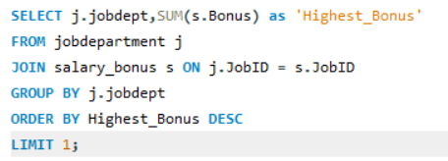

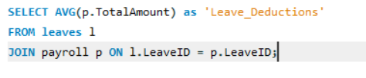

20. Which department receives the highest total bonuses?
21. What is the average value of total amount after considering leave deductions?

Slide 22
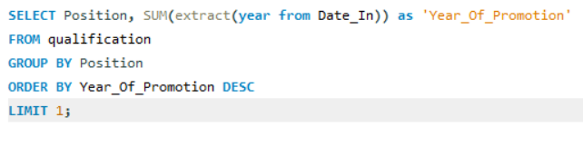

22. Which year had the highest number of employee promotions?

Slide 23
CHALLENGES FACED
1. Complex Payroll Integration - Managing salaries, bonuses, and leave deductions across multiple tables.
2.Scalability & Performance - Querying large datasets (payroll, leaves, promotions) may slow down without optimization.
3. Change Management - Handling promotions, transfers, and updates while maintaining historical accuracy.

Slide 24
CONCLUSION
The Employee Management System Database (EMSDB) is a centralized platform for managing employee details, payroll, leaves, and qualifications efficiently. It ensures data consistency and provides meaningful insights for HR and management decision-making. The system streamlines employee-related processes, improving accuracy and productivity. Future enhancements include automation, web application development, and cloud integration for scalability.

Slide 25

THANK YOU

