Slide 1
INDIA SUPPLY CHAIN
EXECUTIVE PERFORMANCE REVIEV
Sales . Demand . Network . Logistics . Service
FEB 2024 - JAN 2028
10,000 transactions analyzed
MANAGEMENT EDITION

Slide 2
Performance at a Glance
A concise view of demand realization, cost and service execution.
SALES
FORECAST
ATTAINMENT
TRANSPORT
LEAD TIME
72.70 M
77.35 M
94.0%
₹222.14 M
15.6 d
Units
Units
of forecast
Total s
actual average
EXECUTIVE MESSAGE
Sales trail forecast by 4,650,234 units.
Delivery runs+1.5 days above the planned baseline.
60.1% of transactions exceed planned lead time.
Average transport cost: ₹3.06 per sold unit.

Slide 3
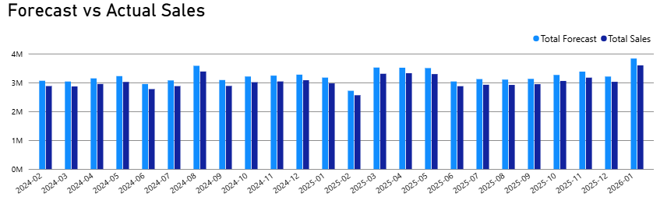
Demand Realization
Sales are consistently below the forecast.
WHAT TO DO
Improve the forecast accuracy.
Check the Sales–Forecast gap by product, distributor and month. Find out whether the gap is caused by low demand, stock availability, or delivery problems.
Sales achieved 94.0% of forecast

Slide 4
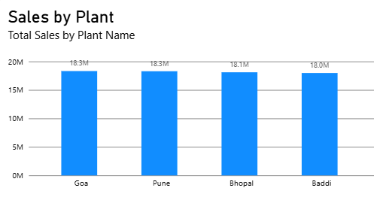
Plant Economics
Compare plant sales with transportation costs to find the most efficient plants.
Plant | Sales | Transport
Goa | 18.32 M | ₹59.85 M
Pune | 18.29 M | ₹53.69 M
Bhopal | 18.11 M | ₹44.97 M
Baddi | 17.98 M | ₹63.63 M

Slide 5
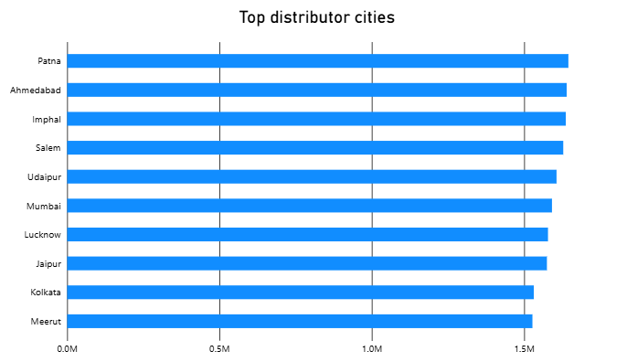
Distributor Concentration
Focus inventory and service improvements on the highest-volume cities.
PRIORITY NODES
Inventory availability
Service-level monitoring
Demand sensing
Lane / transport review

Slide 6
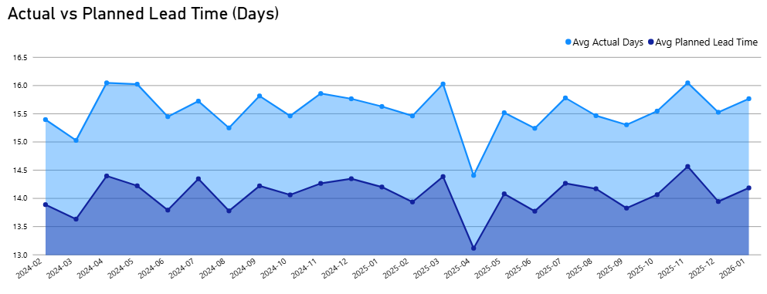
Service Reliability
Lead-time variance indicates a network-wide execution opportunity.
DELIVERY TIME GAP
+1.5 days
DELAY RATE
60.1%

Slide 7
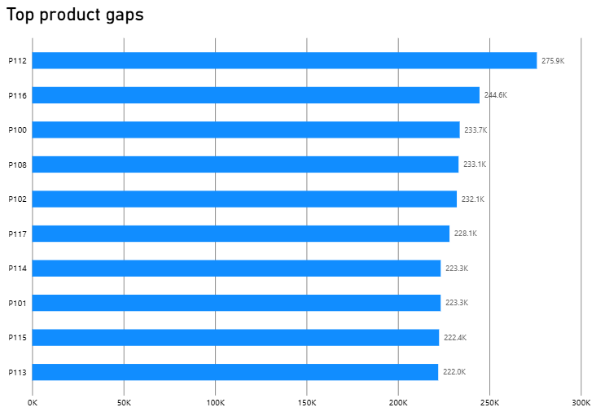
Forecast Exception Queue
Start with the products showing the biggest Sales–Forecast gaps.
ROOT-CAUSE CHECK
Check product availability
Check pricing and promotions
Check channel coverage
Review forecast assumptions
A large gap is a warning. Check the cause before taking action.

Slide 8
90-Day Management Plan
Focus on the key actions needed to improve forecast, service, cost and network performance.
01 | Forecast | Review forecast accuracy every month and identify the main Sales–Forecast gaps.
02 | Service | Focus on the routes, plants and carriers with the highest delivery delays.
03 | Cost | Track transport cost per unit and identify expensive routes.
04 | Network | Keep enough stock at high-volume distributor locations.
05 | Governance | Set clear limits, assign owners and review performance regularly.

Slide 9
Key Decisions
1 | Improve forecast accuracy and reduce the gap between Sales and Forecast.
2 | Reduce delivery delays by improving problem routes and plants.
3 | Reduce transport costs while maintaining good delivery service.
Next Step
Track these measures in the Power BI dashboard, with clear targets and responsible owners.

