Slide 1
AETHON TECHNOLOGIES
Monthly Pipeline Review
February 1, 2026 · Covering December 2025 / January snapshot
Prepared by Diane Whitfield, Sales Operations
Distribution Priya Raman (VP Sales) · Marcus Chen (CFO) · Leo Tanaka (FP&A)

Slide 2
SECTION 01 / 08
Scorecard
REVENUE CLOSED
PIPELINE (OPEN)
WIN RATE
AVG DEAL SIZE
HEADCOUNT
$574K
$2.8M
32%
$82K
12
▼ vs $600K target
1.75× vs 3× target
▲ vs 30%
▲ vs $75K
● 12 planned
2

Slide 3
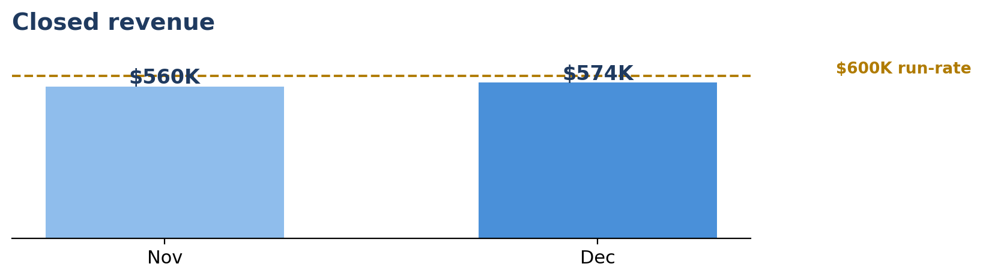
SECTION 02 / 08
Revenue Performance
02
▪ December closed $574K across 7 deals — slightly below the $600K monthly run rate, within range.
▪ Revenue mix: new-logo 65% ($373K); expansion / renewal 35% ($201K).
▪ By rep: Felix closed $340K (4 deals, enterprise); Ana closed $234K (3 deals, mid-market).
▪ Both reps on track for Q1 quota (team $2.4M; Felix $1.4M, Ana $1.0M).
Revenue Performance
$574K
closed · 7 deals
Aethon · Monthly Pipeline Review
3

Slide 4
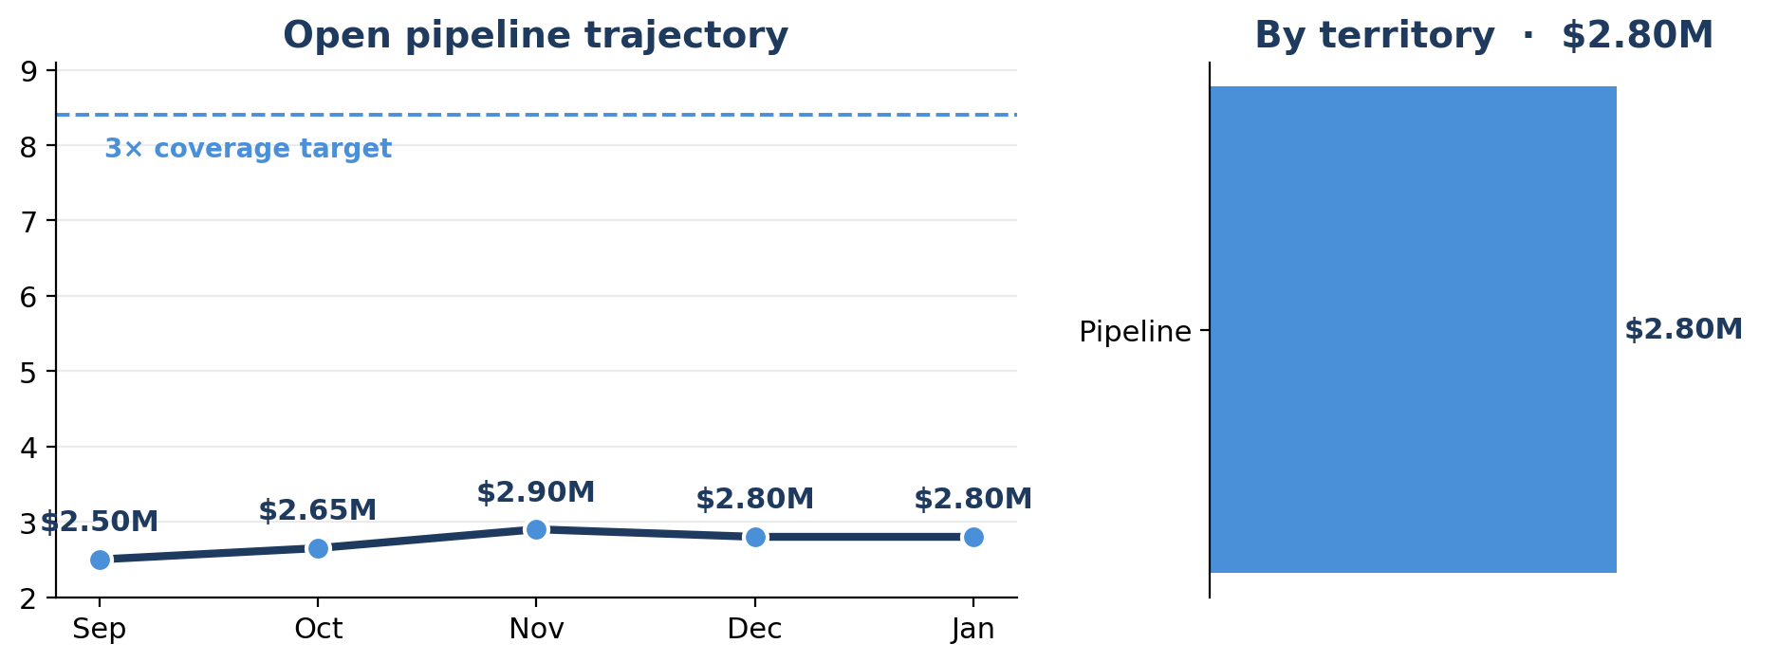
SECTION 03 / 08
Pipeline Health
03
▪ Open pipeline $2.8M across 22 deals; coverage ratio 1.75× vs the 3× target.
▪ January pipeline creation was soft; addressing with increased outbound.
▪ Territory: Felix covers East + West enterprise; Ana covers West mid-market.
Pipeline Health
$2.8M
open · 22 deals
Aethon · Monthly Pipeline Review
4

Slide 5
SECTION 04 / 08
Forecast
04
▪ Commit: $680K (Pinnacle Industries $340K + two mid-size deals).
▪ Best case: $1.1M (Pinnacle, Summit, and three mid-market opportunities).
▪ Pinnacle Industries ($340K) is the largest commit deal — verbal commitment received from VP Procurement; contract expected by end of February.
Forecast
$680K
commit
Aethon · Monthly Pipeline Review
5

Slide 6
SECTION 05 / 08
Win/Loss Analysis
05
▪ Win rate held steady at 32% in December.
▪ One loss to Meridian Platform noted; monitoring competitive activity, but no pattern yet.
Win/Loss Analysis
32%
win rate
Aethon · Monthly Pipeline Review
6

Slide 7
SECTION 06 / 08
Marketing & Lead Source
06
▪ Marketing-sourced pipeline was 36% of total in December.
▪ The Q1 Workforce Analytics Webinar campaign launched mid-month; early results promising.
Marketing & Lead Source
36%
marketing-sourced
Aethon · Monthly Pipeline Review
7

Slide 8
SECTION 07 / 08
Asks & Blockers
07
▪ Pipeline coverage is thin — requesting marketing increase LinkedIn spend for Q1.
▪ Sales-tool evaluation underway — decision expected by mid-February.
Asks & Blockers
2
open asks
Aethon · Monthly Pipeline Review
8

Slide 9
SECTION 08 / 08
Risks
08
▪ Pipeline coverage below 3× target. If January creation doesn't improve, Q1 quota attainment is at risk.
▪ One competitive loss to Meridian Platform. Not yet a pattern, but worth watching.
Risks
2
tracked risks
Aethon · Monthly Pipeline Review
9

