Slide 1
Neurosat
A GNN-based predictor for SAT problem
www.mun.ca

Slide 2
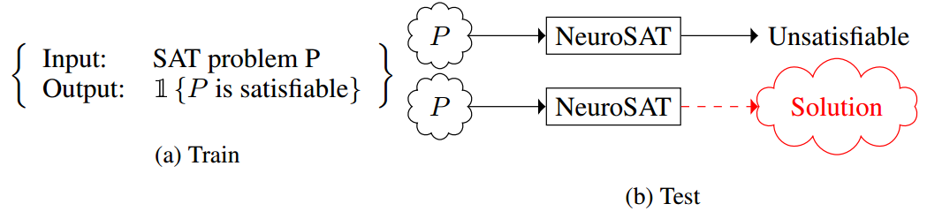
Goal and Challenges
Train a neural network to predict satisfiability.
Designing the architecture.
www.mun.ca

Slide 3
Why GNN?
SAT problems are like character strings and use standard sequence model.
But, many invariances for satisfiablity logic:
Permutation invariant
literals, clauses and literals within a clause
Negation invariant

Slide 4
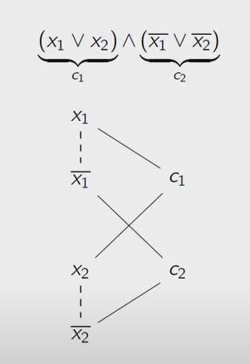
Graph representation
Construct undirected graph.
Node for every literal and clause
One type of edge between literals and clauses.
Dotted edge for the literals and its compliments.
Basic Idea of Model:
Maintain vector embedding for every node.
Iteratively pass messages along the edges of the graph.
Map literals after T time steps into scalar votes and compute logit by averaging the votes.

Slide 5
Prediction
After T iterations of message passing
Compute a scalar vote for each literal with a multi-layer perceptron
These votes represent how confident the literal is that the formula is satisfiable (if the vote >0) or unsatisfiable (if the vote <0).
Use average of the votes to predict satisfiability.

Slide 6
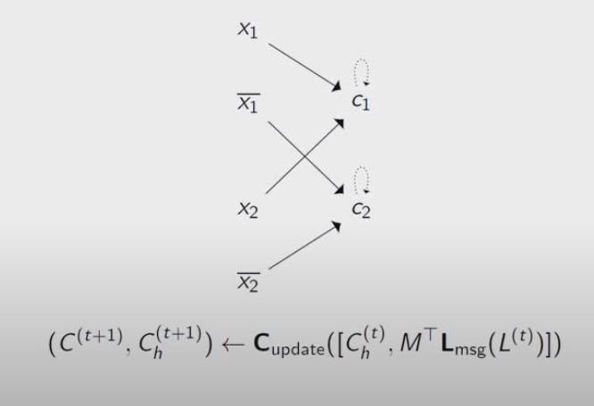
Message Passing
Stage1: Literals pass messages to the clauses within T iterations

Slide 7
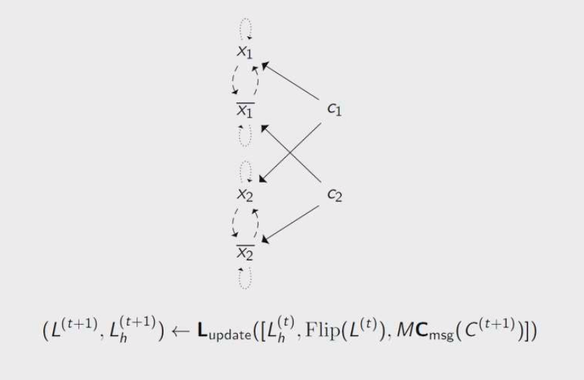
Message Passing
Stage2: Clauses pass messages to the literals.
Only difference here is that literals get messages from clauses
And literals get their old state and also different kind of messages from its compliments.

Slide 8
Datasets & Training the model
Chose a somewhat unusual way to generate their training set.
So, the distribution is: Similar Uniform random SAT problem.
The problem comes in pair:
SAT
UNSAT
This pair differ by negating a single literal in a single clause.

Slide 9
Sampling the datasets
To Sample a pair of problems:
Start with n variables and no clause.
Keep adding uniformly distributed clauses and verify the satisfiablity with minisat.
If satisfiable, keep adding more clauses until unsat.
Flip a single literal in the latest added clause to make it sat.
Return the pair before and after flipping the literal.

Slide 10
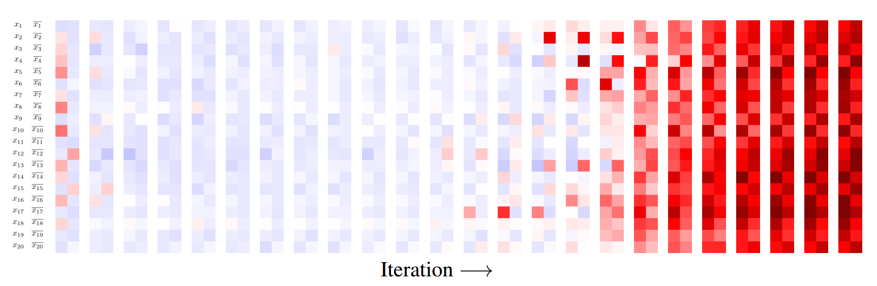
Experiment
Matrix of Scalar literal vote at each timestamp for 20 * 2.
Red = Satisfiable, Blue = Unsatisfiable & While = Neutral.
Surprisingly, after certain iteration, all the literals start voting SAT with high confidence.
NeuroSAT developers think in last iteration, there might be the satisfying assignment in the encoding of the last iteration.

Slide 11
Experiment
They read that encoding to check if its a satisfying assignment.
And it turns out that it can usually decode satisfying assignment.
But it is unreliable way to decode the solutions.

Slide 12
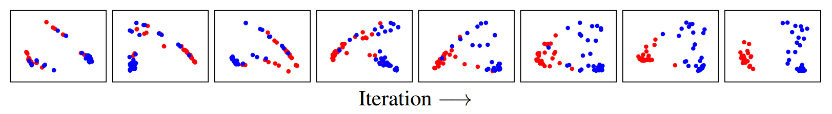
Decoding the solutions
Cluster Analysis: Two Clustering
It has seen that higher dimensional literal embeddings cluster according to the satisfying assignment.
In 128 dimensional space, literals get clustered based on true and false.
In the previous picture, the last iteration projects the clustering.

Slide 13
Our experiments - 1
k = 3, n= 5 & 10, m in range [2n,5n] & [10,25,1] : 18 instances.
With 512 iterations & execution time is 46.62 seconds.
But the result might vary in every testing time.
Otherwise it only find assignment in between 10 to 15 clauses.
We have found that neuroSAT has a tendency to find assignment in m & n pairs.

Slide 14
Our experiments - 2
k = 3, n = 5 & 10, m in range [10,25,1]
We made pair with n & m and got 150 instances.
With 512 iterations & execution time is 209.56 seconds.
It almost always finds satisfying assignment for k = 3 n = 5 and m = 10 to 13
Occasionally finds assignment for k = 3 n = 5 and m = 14 to 17.
Rarely finds assignment k = 3 n = 5 and m = 18 to 21.
Never finds when m is more than 21.

Slide 15
Thank you

Slide 16
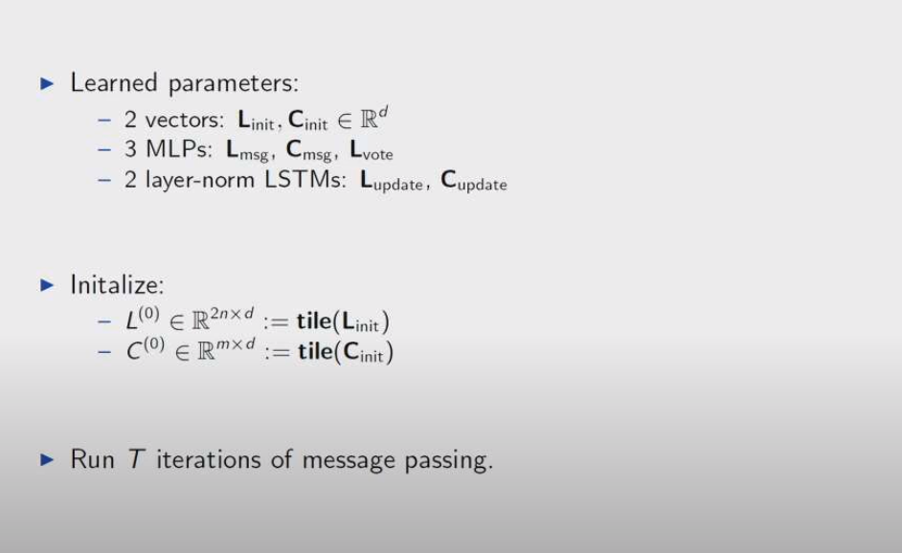
NeuroSAT Model

Slide 17
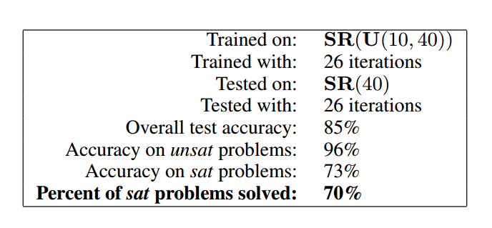
Experiment
SR = The Distribution
U = Uniform (optional, because it will be harder for bigger problem)
SR(U(10, 40)) = Sampling the number of variables from the uniform distribution between 10 and 40
SR(40) = 40 variables, 200 clauses, 1000 literals.
To treat every literal symmetrically, all of the clauses here, are uniformly random.

