Slide 1
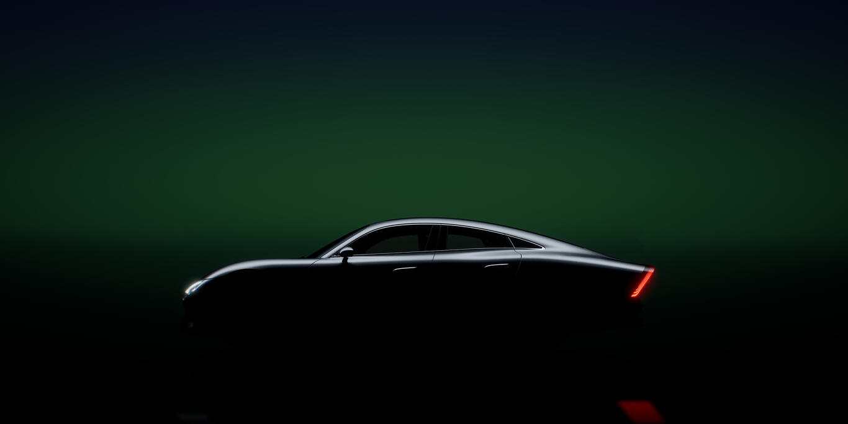
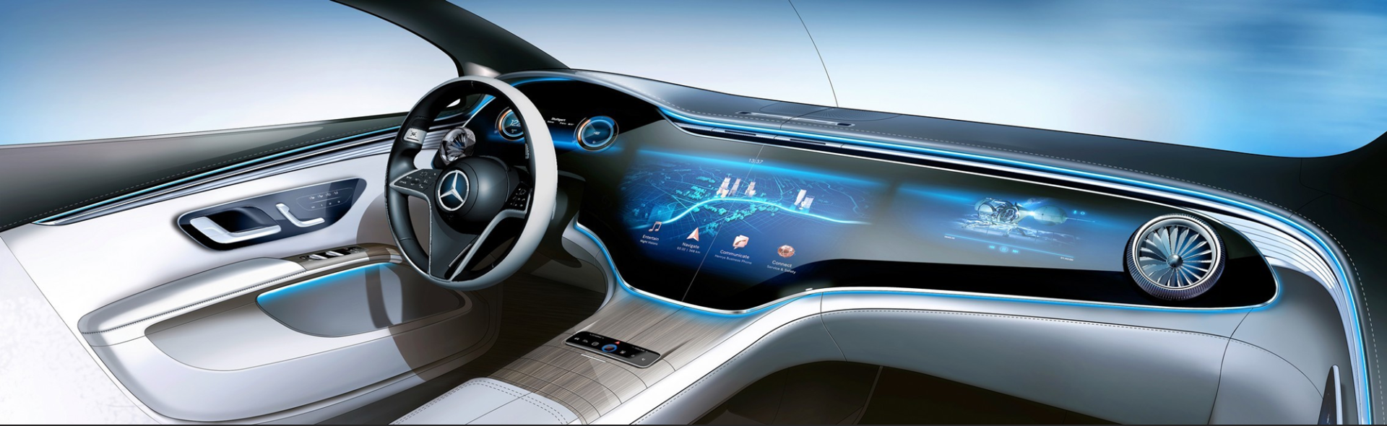
Ego Lane Estimation Net: ELE-Net
Sourav Patel, Sarvani Mathigetta, Hitul Desai
Localization & Mapping
RD-IA
E4-vertical: Maps, Localization, Perception & Fusion

Slide 2


Preliminary Information
Carline : All Carlines
NOVUS portal Reference ID: xxxx (Fill up the last 4 digits)
1) Category of the invention (Tick any one)
Product
Process/Method
Business
AI/ML
2) Project Details
Yes
No
Does the idea belong to an ongoing project?
If yes, please provide project details NA
3) Strategic topic details
Is the idea related to any Strategic Topics listed on right?
If yes, which one from the list of topics on the right? – Electric Motors
Yes
No
4) Lead Inventor : Hitul Desai (RD/IA)
5) Co-inventor/’s :
Sarvani Mathigetta(RD/IA), Sourav Patel(RD/IA), Biswaraj Sahu(RD/IA), Bharath Bhat (RD/IA), Laxmi Kant Sahoo(RD/IA)
6) Name’s of first time inventor’s in this patent application: Sarvani Mathigetta(RD/IA), Sourav Patel(RD/IA)
*You may use this tick symbol to tick boxes
*You may read notes included with each slide for better understanding

Slide 3
Preliminary Information
Carline : All Carlines
7) Implementation Stage (Tick any one)
Design/Concept
Prototyping
Testing
Implemented
8) Is Proof of Concept (PoC) planned?
What is the plan for PoC?
POC Done and results available
Yes
No
9) Collaboration with other department/vertical, if Yes, name of dept. : RD/IA
*You may use this tick symbol to tick boxes
*You may read notes included with each slide for better understanding

Slide 4
Current zone of invention
Problem statement
Idea description
Basic design calculations
Feasibility check
Uniqueness or claim
Prior art comparison
Zone of invention:
Advanced driver assistance system (ADAS)
Level 2 and Level 3 automated driving functions
Lane level localization will be used by the following functions:
System Initiated Lane Change
DTR
DTQ
Automatic Lane Change
Lane planner modules

Slide 5
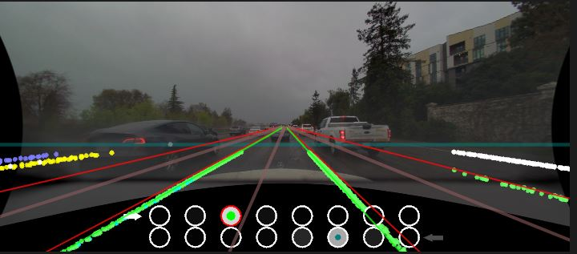
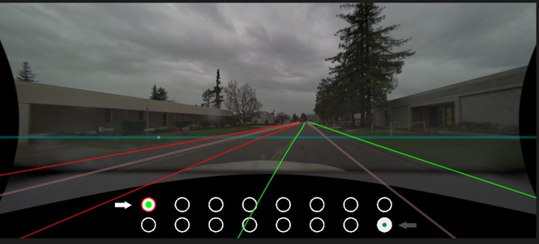
Current zone of invention
Problem statement
Idea description
Basic design calculations
Feasibility check
Uniqueness or claim
Prior art comparison
Problem Statement:
Traditional methods for Ego lane estimation are based on state space filters, which often rely on hand-crafted features and rule-based systems, struggle with the diversity of driving scenarios such as:
Dynamic Road Conditions: Adapt to varying road conditions, including changes in lane markings, weather conditions, and road types.
Infrastructure Variability: Inaccuracies due to varying road infrastructures requiring constant tuning and updates.
Sensor Inaccuracies: Classical approaches are sensitive to sensor inaccuracies , occlusions.
Our proposal:
Identification of ego lane index that can adapt to varying driving road scenario by taking into account temporal information modelling changes in lane markings, varying road configuration, scenario changes and sensor inaccuracies such as occlusion and false positive detections
Sensor & Map
Ego lane index
Bayesian filter
Sensor & Map
Ego lane index
Deep Learning Network

Slide 6
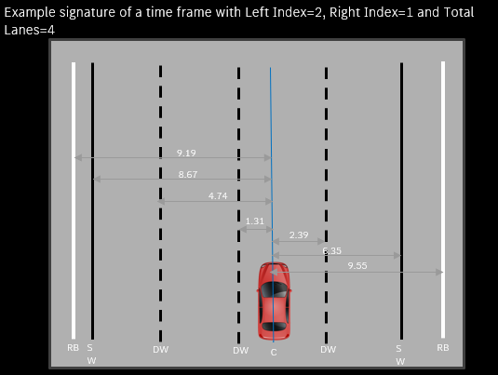
Current zone of invention
Problem statement
Idea description
Basic design calculations
Feasibility check
Uniqueness or claim
Prior art comparison
Input signal description
Road lane signatures
Lane marking types
Distances of lane markings from ego vehicle
Relative distance
Relative distance travelled by ego vehicle in between time frames
Six different types of lane markings present
Road Boundary – ‘RB’
Dashed White – ‘DW’
Dashed Yellow – ‘DY’
Solid White – ‘SW’
Solid Yellow – ‘SY’
Ego Vehicle Position – ‘C’ (By default 0 distance)
(RB,9.19) (SW,8.67) (DW,4.74) (DW,1.31) C (DW,-2.39) (SW,-6.35) (RB,-9.55)

Slide 7
Current zone of invention
Problem statement
Idea description
Basic design calculations
Feasibility check
Uniqueness or claim
Prior art comparison
Flowchart
Distances to Lane Markings
Novel
Road Signature feature extraction network
Derive Signature Types
Nested OnexD-Hot Encoding
Context-aware sequence generation Module*
ELE-Net
Camera Sensor Data
Left
Ego
Right
Distinct representation for each lane type
Variable number of lane markings can be handled
Similar lanes next to each other can be encoded
Distances of every lane-marking correctly encoded with associated lane type
No loss of information, perfect reconstruction of signal from encoding
All above information presented as one floating point vector
A context of +15m to –x m from ego vehicle is provided to take care of sensor errors and signature misalignments due to poor visibility
Encoding stabilizing module
Calculate normalized distances based on total road width and lane marking distances
Add stabilizing values to encoding calculated as c1*tanh(c2*[D/RW])

Slide 8
Nested OnexD-Hot Encoding
Lane Marking + Distance
Encode the Lane marking type using One-Hot Encoding
Modify distances on top of one-hot vectors (OnexD)
Convert 0’s in one hot encoding to ± ∞
Convert ± ∞ into ± 1000 (practical)
Encoding for a singular timeframe
Add required number of dummy encodings to fit max lanes
Stack encodings together in order (Nested Encoding)
Repeat above process for all markings in the signature
Add random variables sampled from Encoding Stabilizing Module
Stack Multiple such encodings corresponding to past time frames (Context Aware Sequence Generation Module)
Sequence of encodings to be processed by ELE-Net

Slide 9
Nested OnexD-Hot Encoding
Create a vector format of the text information of lane markings and associated distances
Step 1: Lane marking (eg RB, DW, etc) is converted into a one-hot encoding format
Step 2: One hot encodings vectors are modified to encode distances of lane markings along with lane types
Step 3: Rest of elements in the one hot vector (other than the distances) are converted into ± 1000 (these values were earlier 0). This is done because ‘0’ would indicate the presence of all other lane markings (other than the actual marking) to be present at distance 0 from ego. By setting the value at ±1000 we remove them from the context of the road.
Step 4: X ~ G(0, c1*tanh(c2*(D/RW))) X is added to all Non lane marking types inside embedding vector to stabilize the encodings.
Step 5: All previous steps encode the information of only one lane marking and distance into a vector. We repeat the process for all lane markings and distances of a time frame.
Step 6: Stack encodings to create a vector of all lane markings and associated distances in a time frame
Step 7: Dummy encodings maybe added to maintain fixed dimensions of input vector
The vector thus generated is a Nested OnexD-Hot encoding of lane markings and distances of a time frame.

Slide 10
Context Aware Sequence Generation Module
t=N, D=+15m
t=N-1, D=+14.9m
t=N-2, D=+14.7m
Example Sequence where N<120 with continuity maintained
Collect all frame encodings of 15m ahead and 15m behind EGO
Current frame encoding
t=0, D= -15m
Dummy
Dummy
If number of such frames N ≥120
If number of such frames N <120
Stack only latest 120 frames provided continuity
Stack all N frames provided continuity
Add dummy frame encodings to make total frames 120
Context Aware Sequence
If continuity broken select frames only until continuity maintained

Slide 11
Context Aware Sequence Generation Module
Create a sequence of multiple encoded feature vectors each of which corresponds to a time frame
Step 1: So far, we’ve created vector encodings of one-time frame, now we add spatial context to it by stacking multiple vector encodings. This is important to account for sensor inaccuracies, lane markings obstructed by vehicles, occlusions.
Step 2: We look15m ahead and 15m behind the EGO vehicle. This data is captured as the ego vehicles moves across the road. At each time step, lane marking and distance data is captured. Between two such consecutive time frames, the vehicle moves across spatially ahead. We collect all frames required to move from 30m behind the current position to current position. (The EGO vehicle by default looks 15m ahead)
Step 3: Since vehicles move at different speeds, different number of frames can be required to cover 30m distance. We put a limit of 120 frames as a practical upper limit.
Step 4: If we require more number of frames than 120, we cap the sequence to 15m front and x m behind until 120 frames are covered where x<15. If we require lesser number of frames than 120, we add dummy vectors to create a sequence of 120 frames.
Step 5: This is assuming continuity is maintained across time, all consecutive time frames are valid. If they are not for several reasons, then we consider only the continuous stream of data, discard all the data from point of discontinuity.
The sequence of 120 feature vectors thus generated is a context aware sequence

Slide 12
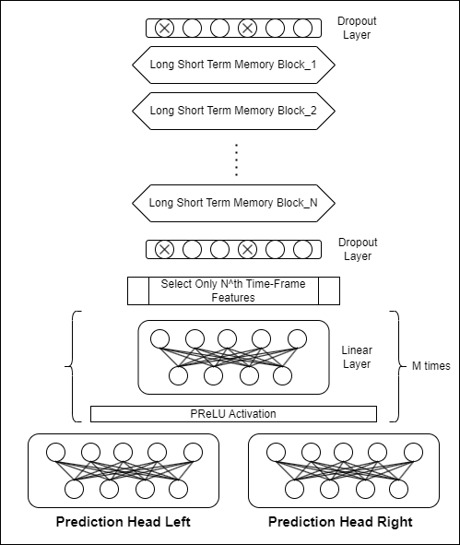
Current zone of invention
Problem statement
Idea description
Basic design calculations
Feasibility check
Uniqueness or claim
Prior art comparison
Features of ELE-Net Architecture
LSTM based network for capturing sequential dependencies in input data.
Dropout layers to prevent overfitting.
Linear layer to map the selected N^{th} time frame features to a lower dimensional space.
Parametric Rectified Linear Unit (PReLU) activation function to introduce non-linearity.
Dual Linear Heads to predict the both left and right lane indexes.
Number of LSTM layers: 4
Optimizer: Adam
Loss function: Cross Entropy
ELE-Net Architecture

Slide 13
Current zone of invention
Problem statement
Idea description
Basic design calculations
Feasibility check
Uniqueness or claim
Prior art comparison
Implementation status:
POC implemented
Accuracy found to be above classical approaches
Trained and validated on 5+ hours (225km, 630k data points) of data from Germany, USA and Spain
 | Train Left | Train Right
Accuracy | 97.31 | 98.88
Precision | 97.33 | 98.87
Recall | 97.31 | 98.88
F1 | 97.29 | 98.88
 | Val Left | Val Right
Accuracy | 96.52 | 98.5
Precision | 96.54 | 98.49
Recall | 96.52 | 98.5
F1 | 96.5 | 98.5
Extensive experiments conducted checking the impact of each block, hyperparameters and training algorithms
Reduced number of parameters per for computation of ego lane estimation when compared to state of art ( end to end approaches)

Slide 14
Current zone of invention
Problem statement
Idea description
Basic design calculations
Feasibility check
Uniqueness or claim
Prior art comparison
Novelty & Advantages:
Novel Nested OnexD-Hot Encoding mechanism
One-hot encoding cannot encode multiple lane markings of different types (nested)
Distances would be required to be encoded separately
Variable number of lane markings on either side of ego can be handled
Encoding stabilization component
s = Scaled Hyperbolic tangent of normalized lane-marking distance [c1*tanh(c2*(d/RW))]
N ~ G(0, s) where G is gaussian distribution, added to each non-distance element in an encoding
Helps in speeding and stabilization of training with better performance
Future and past spatial contexts encoded with temporal continuity constraints
Reason: Sensor aberrations, reading errors get reduced with multiple readings
Poor visibility of lane markings in situations
Y = c1*tanh(c2*x)

Slide 15
Current zone of invention
Problem statement
Idea description
Basic design calculations
Feasibility check
Uniqueness or claim
Prior art comparison
Literature survey:
DE102022004774A1 - System for lane determination of an ego vehicle using lane attributes and method thereof
US20120150437A1 - Systems and Methods for Precise Sub-Lane Vehicle Positioning
IN202111059756A - SYSTEM FOR LANE DETERMINATION OF EGO VEHICLE USING LANE ATTRIBUTES AND METHOD THEREOF
DE102022004633A1 - System and method for lane determination of ego vehicles
KR20180080828A | - METHOD FOR RECOGNIZING LANE-LEVEL VEHICLE POSITIONING INFORMATION BASED ON LIDAR MAP MATCHING, RECORDING MEDIUM AND DEVICE FOR PERFORMING THE METHOD
Ego‐lane index‐aware vehicular localisation using the DeepRoad Network for urban environments - Lee - 2021 - IET Intelligent Transport Systems - Wiley Online Library

Slide 16
Current zone of invention
Problem statement
Idea description
Basic design calculations
Feasibility check
Uniqueness or claim
Prior art comparison
Existing Solutions | Our proposition
Kalman, Bayesian Filtering approaches | Learning based LSTM approach
Among learning-based approaches, most do lane marking detection. Many use HD maps, lidar data etc. | Only processed camera data used. Direct index output without intermediate processing steps
Poor temporal processing | Very rich spatio-temporal context information encoded
Very heavy models (feature extraction models) | Extremely light (~140k parameters)
High Latency | Low latency
Poor performance (problem statements very similar to ours) Gen6(~80%) | Very high performance (96.5%)

Slide 17

Thank you
Thank you

Slide 18
Nested OnexD-Hot Encoding
RB DW DY C SW SY
Step 1: Encoding of one lane marking
path and its recent trajectory. This furnishes a holistic perspective of the vehicle’s environment, encapsulating the evolving road conditions and lane configurations encountered along its journey.
Signature Convention
(RB, 9.19)
[1, 0, 0, 0, 0, 0]
[9.19, 0, 0, 0, 0, 0]
[9.19, ∞, ∞, ∞, ∞, ∞]
[9.19, 1000, 1000, 1000, 1000, 1000]
[9.19, 1001.24, 999.46, 998.79, 1000.33, 1000.89]
Lane marking Signature
One Hot Encoding of lane-type ‘RB’ according to convention
Encoding distance on top of lane-type encoding
Each number in the vector now represents distance to EGO
Since ‘0’ now means at the EGO vehicle, we substitute the remaining numbers with ±∞. Positive for left of C, Negative for the right
The ±∞ indicates the other lane types are absent/ at infinity
For practical purposes, since road widths are around ~30m on either side, we replace ±∞ with ± 1000, maintaining the concept of highlighting only the lane marking ‘RB’
Add stabilizing values to the ± 1000 values, this helps in stabilizing the training process and stopping the optimization of model parameters from getting stuck at local minima
Some additional examples
(SW, -6.35)
[0, 0, 0, 0, 1, 0]
[0, 0, 0, 0, -6.35, 0]
[-∞, -∞, -∞, -∞, -6.35, -∞]
[-1000, -1000, -1000, -1000, -6.35, -1000]
[-1000.78, -998.25, -1000.27, -1000.79, -6.35, -999.22]
(C, 0)
[0, 0, 0, 1, 0, 0]
[0, 0, 0, 0, -0, 0]
[∞, ∞, ∞, 0, -∞, -∞]
[1000, 1000, 1000, 0, -1000, -1000]
[1000.54, 999.78, 998.26, -0, -1001.50, -1002.31]

Slide 19
Nested OnexD-Hot Encoding
RB DW DY C SW SY
Assumptions:
We can have a maximum of only 8 lane markings on either side of EGO, ML model needs fixed sizes
If there are lesser lane markings, consider all lane markings and pad the remaining markings with a dummy lane marking encoding
For example, in the current example, there are 4 lane markings on the left and 3 on the right of C, therefore 8-4 = 4 dummy lane encodings to the left of (RB, 9.19) encoding and 8-3= 5 dummy lane encodings to the right of (RB, -9.55) encoding
Step 2: Tying encodings of all lane markings together
path and its recent trajectory. This furnishes a holistic perspective of the vehicle’s environment, encapsulating the evolving road conditions and lane configurations encountered along its journey.
Signature Convention
(RB,9.19) (SW,8.67) (DW,4.74) (DW,1.31) C (DW,-2.39) (SW,-6.35) (RB,-9.55)
[9.19, 1001.24, 999.46, 998.79, 1000.33, 1000.89]
[1000.14, 999.91, 1001.79, 1002.03, 8.67, 998.25]
…
…
1000.54, 999.78, 998.26, 0, -1001.5, -1002.31]
[-1000.78, -998.25, -1000.27, -1000.79, -6.35, -999.22]
[-9.55, -1001.24, -999.46, -998.79, -1000.33, -1000.89]
Stack together + add dummy encodings
Left Dummy Encoding
Right Dummy Encoding
[1000+n, 1000+n, 1000+n, 1000+n, 1000+n, 1000+n]
[-1000+n, -1000+n, -1000+n, -1000+n, -1000+n, -1000+n]
102 Dimension Encoding Feature Vector
where n is randomly drawn from ~ Gaussian(0, s)
8 Lane markings on left of C, 8 lane markings on right of C, and one encoding of C = 17 total lane markings. Each marking requires 6 dimensions to represent => 6*17=102

Slide 20
Sequence Generation
i – j = vf[i] – vf[j] max no of frames = 120, Distance <= 30
I – current frame
vf[i] – current video frame no
J – previous frame
vf[j] - previous video frame no
Add the sequences
Generated sequences of frames based on the distance traveled.
Each sequence comprises frames where the cumulative distance between consecutive frames sums up to 30 meters.
Ensured that each sequence contains a maximum of N frames.
Addressed the continuity issues when merging the datasets with a sanity check using the video frame numbers.
Terminate sequence generation
No of frames = 120
Stop
Terminate sequence generation

Slide 21
Ablation Study With Num_Layers=2
Max epochs: 200, Metric: Accuracy
Max Frames | 60 | 80 | 100 | 120 | 150 | 180 | 200 | 250
Context
30m | Train Left: 98.81 Train Right: 98.84 Val Left: 96.67 Val Right: 98.34 | Train Left: 98.73 Train Right: 99.09 Val Left: 96.47 Val Right: 98.41 | Train Left: 98.86 Train Right: 99.17 Val Left: 97.37 Val Right: 98.57 | Train Left: 98.87 Train Right: 99.07 Val Left: 97.58 Val Right: 98.45 | Train Left: 99.16 Train Right: 99.18 Val Left: 98.05 Val Right: 98.77 | Train Left: 97.42 Train Right: 98.13 Val Left: 90.74 Val Right: 98.75 | Train Left: 98.99 Train Right: 98.96 Val Left: 94.47 Val Right: 97.43 | Train Left: 98.67 Train Right: 98.73 Val Left: 96.49 Val Right: 98.43
40m | Train Left: 98.39 Train Right: 99.06 Val Left: 96.69 Val Right: 98.05 | Train Left: 98.59 Train Right: 99.18 Val Left: 97.52 Val Right: 98.11 | Train Left: 99.07 Train Right: 99.31 Val Left: 97.6 Val Right: 98.91 | Train Left: 99.21 Train Right: 99.18 Val Left: 97.42 Val Right: 98.63 | Train Left: 99.33 Train Right: 99.3 Val Left: 97.26 Val Right: 98.33 | Train Left: 99.35 Train Right: 99.3 Val Left: 97.27 Val Right: 96.96 | Train Left: 99.28 Train Right: 99.25 Val Left: 93.32 Val Right: 96.39 | Train Left: 99.25 Train Right: 99.21 Val Left: 96.56 Val Right: 98.91
50m | Train Left: 98.24 Train Right: 99.23 Val Left: 95.15 Val Right: 97.55 | Train Left: 98.59 Train Right: 99.2 Val Left: 97.89 Val Right: 97.12 | Train Left: 99.21 Train Right: 99.34 Val Left: 97.07 Val Right: 98.91 | Train Left: 99.33 Train Right: 99.44 Val Left: 96.72 Val Right: 98.12 | Train Left: 99.43 Train Right: 99.53 Val Left: 97.31 Val Right: 99.1 | Train Left: 99.46 Train Right: 99.52 Val Left: 97.52 Val Right: 98.6 | Train Left: 99.44 Train Right: 99.45 Val Left: 98.1 Val Right: 96.57 | Train Left: 99.38 Train Right: 99.48 Val Left: 98.1 Val Right: 98.43

Slide 22
Ablation Study With Num_Layers=2
Max epochs: 200, Metric: Accuracy
Max Frames | 60 | 80 | 100 | 120 | 150 | 180 | 200 | 250
Context
10m | Train Left: 97.17 Train Right: 97.75 Val Left: 95.71 Val Right: 97.83 | Train Left: 97.07 Train Right: 97.59 Val Left: 96.26 Val Right: 96.31 | Train Left: 97.05 Train Right: 97.48 Val Left: 95.9 Val Right: 97.7 | Train Left: 97.15 Train Right: 97.47 Val Left: 95.59 Val Right: 96.29 | Train Left: 97.38 Train Right: 97.57 Val Left: 96.09 Val Right: 97.32 | Train Left: 97.43 Train Right: 97.56 Val Left: 97.43 Val Right: 97.76 | Train Left: 97.22 Train Right: 97.41 Val Left: 96.57 Val Right: 97 | Train Left: 97.14 Train Right: 98.91 Val Left: 90.01 Val Right: 97.7
20m | Train Left: 98.39 Train Right: 98.91 Val Left: 95.54 Val Right: 97.53 | Train Left: 98.54 Train Right: 98.83 Val Left: 96.95 Val Right: 98.05 | Train Left: 98.63 Train Right: 98.83 Val Left: 96.29 Val Right: 96.14 | Train Left: 98.66 Train Right: 98.75 Val Left: 96.93 Val Right: 97.63 | Train Left: 98.65 Train Right: 98.64 Val Left: 95.99 Val Right: 98.06 | Train Left: 98.68 Train Right: 98.71 Val Left: 97.91 Val Right: 97.92 | Train Left: 98.44 Train Right: 98.51 Val Left: 97.47 Val Right: 98.51 | Train Left: 98.53 Train Right: 98.67 Val Left: 96.91 Val Right: 97.52
25m | Train Left: 98.08 Train Right: 98.73 Val Left: 96.62 Val Right: 98.58 | Train Left: 98.73 Train Right: 99.03 Val Left: 96.14 Val Right: 98.37 | Train Left: 98.78 Train Right: 99.03 Val Left: 97.76 Val Right: 98.43 | Train Left: 98.84 Train Right: 99.04 Val Left: 97.05 Val Right: 97.38 | Train Left: 98.97 Train Right: 98.98 Val Left: 98.04 Val Right: 98.44 | Train Left: 98.86 Train Right: 98.89 Val Left: 96.8 Val Right: 98.53 | Train Left: 98.86 Train Right: 98.86 Val Left: 96.34 Val Right: 96.65 | Train Left: 98.72 Train Right: 98.81 Val Left: 97.03 Val Right: 98.56

Slide 23
Ablation Study With Num_Layers=2
Dataset | Accuracy
3bd_dataset | Train Left: 95.73 Train Right: 97.43 Val Left: 95 Val Right: 97.3
3a_dataset | Train Left: 99.62 Train Right: 99.53 Val Left: 98.95 Val Right: 99.58
7a_dataset | Train Left: 99.49 Train Right: 99.54 Val Left: 98.99 Val Right: 99.28
56_dataset | Train Left: 99.16 Train Right: 99.18 Val Left: 98.05 Val Right: 98.77
560_dataset | Train Left: 99.09 Train Right: 98.97 Val Left: 98.24 Val Right: 98.27
625_dataset | Train Left: 96.28 Train Right: 98.95 Val Left: 94.85 Val Right: 98.47
b47_dataset | Train Left: 98.83 Train Right: 99.06 Val Left: 98.39 Val Right: 98.26
42d_dataset | Train Left: 97.68 Train Right: 97.27 Val Left: 95.39 Val Right: 94.02
Max epochs: 200, Metric: Accuracy
Context: 30m, Max Frames: 150

