Slide 1
Session on Resume Building
Sourav Nandi
ABOUT.ME/SOURAV.NANDI
Symphony AI, IIT Kanpur
Social Handles- @souravstat

Slide 2

What is a Resume

Slide 3
Keep It Brief, and to the Point Capture Reader’s Attention Quickly
A Resume is NOT a CV (Don’t write Life Story)
Use Active Voice. Try to Quantify Achievements
Less is more. 1 page is great. >3 page= Red Alert!
No one is going to take an hour to go through all those achievements (Probably a ~20 sec skimming)
Consistent Format & Fonts. 1-2 line Bullet Points
It’s like a Movie Trailer: Only keep the Best part

Slide 4
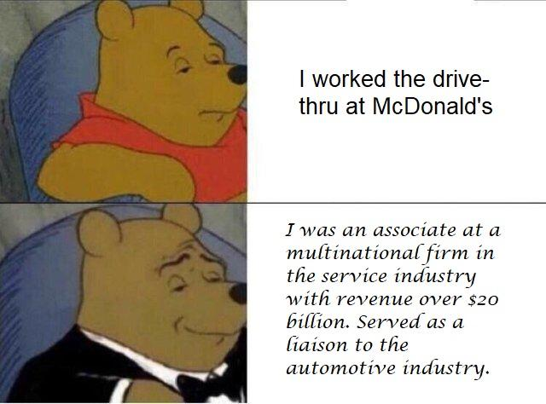
Brag, But Don’t Lie

Slide 5
You need Attractive & Unique Content
Reverse Chronological Order, Relevant Courses & Projects/ Awards
Don’t Copy- Paste from Senior’s Resume (!)
Do Cool Stuff in that adds Value towards others, and Write about them (Better than Competitive Achievements)
Online Portfolio- Quora, Medium, LinkedIn, GitHub, Behance
Better yet- Go Build Something (App, Community, NGO…)
You can take Inspiration from Projects shared by others Online
But always add some Unique Flavor that sets yourself apart from those hundred other Resumes that look exactly same & Boring
Websites for Reference Templates (Customize): https://www.resume.com/, https://novoresume.com/

Slide 6
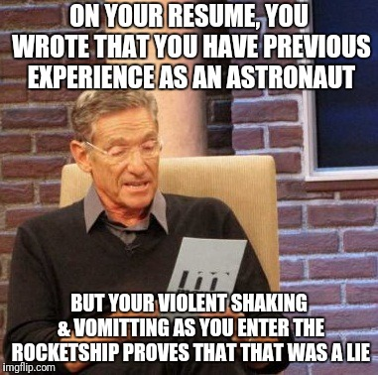
It must be Consistent with your Personality Be ready to Defend every line

Slide 7
Remove Unnecessary Parts, like-->
That Quiz Competition you won in 7th Grade
"References available upon request"
Long Objective Section, detailed home address
Words like Hardworking/Ambitious etc which are very Generic and hard to Defend
Irrelevant details like DOB, Race, Sex, Religion, Political Affiliation, Photograph

Slide 8
Online Courses & Websites
Online Courses: (Content is free in all cases)
https://www.coursera.org/ (Certificates for Free: Financial Aid)
https://www.udemy.com/ (Some Free courses)
https://nptel.ac.in/ (Nominal Fees, Offline Exam)
www.datacamp.com (Can get 2 Month Free account)
‌edx.org , udacity.com (High Quality, Paid)
Host Projects On (& Link to them in Resume)-
https://github.com/ (Coding Projects/ Blogging/ File Hosting)
https://www.behance.net/ (Design Portfolio)
https://about.me/ (Make a Free Webpage)

Slide 9
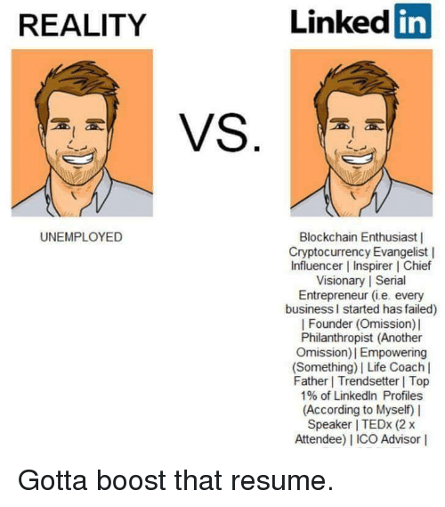
Add Relevant Keywords (ATS) Can find in the Job Description

Slide 10
Other Important tips
Use the Whitespace properly, so that Most Important achievements becomes easy to find at a glance
List Accomplishments (What you actually Did) rather than Responsibilities
Use lots of Action verbs (improved, led, managed, accomplished, organized, built, designed, optimized etc) and Industry specific Keywords
Remove the Objective Section - Space is Valuable (Unless you want to convey something important not obvious from resume, e.g. Change in Industry)
Use tables with divided columns (eg, for adding Skills/ Courses)
Quantify Achievements: Led a team of n people to conduct a workshop. Ran xx model to increase accuracy by yy%, which enabled a revenue growth of zz%
Always double-check Spelling & Grammar before sending
Include awards, open source contribution/ Blog Articles & Volunteer Experiences, showing leadership and a well-rounded Personality and Initiative

Slide 11
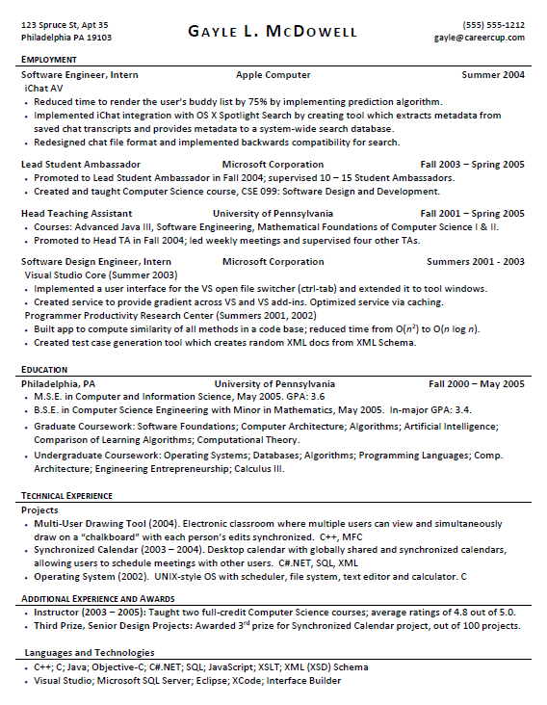
Putting It All Together

Slide 12
Notes on Job Searching & Cover Letter
Applying online vs Reaching Out to Hiring Manager Directly
Importance of Following up (& Not Spamming!)
Cover Letter (A coherent journey consistent with the Job)
‘Tell me something about yourself’ (Don’t Repeat Resume)
Upload to an Online folder, & share the link (eg Gdrive)
Try to send the PDF version while applying (& not DOC)
But MS Word Resumes are better for ATS parsing
Try to keep the size <0.5 MB. Use URL Shortening: bit.ly

Slide 13
Yeah, all that is Great! But… WHAT IF THESE DON’T WORK FOR ME ??

Slide 14
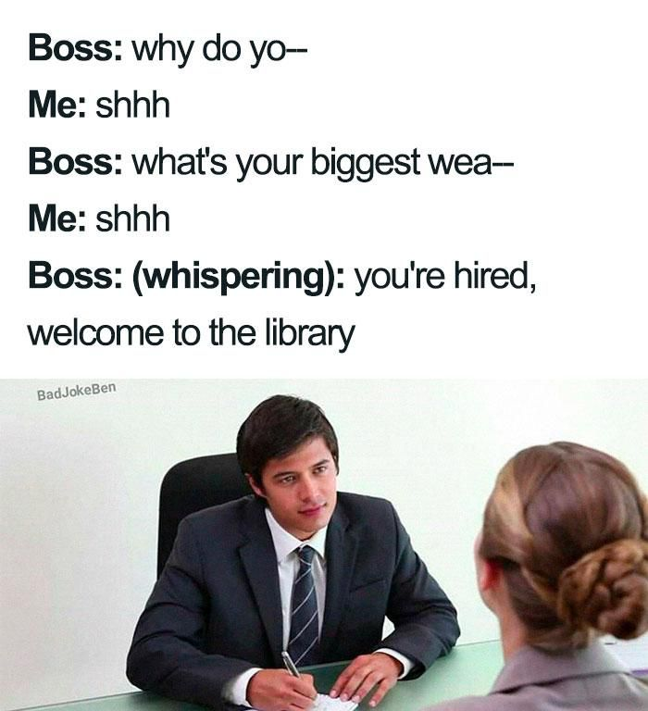
Always adjust these Tips towards the Specific Role & Situation

Slide 15
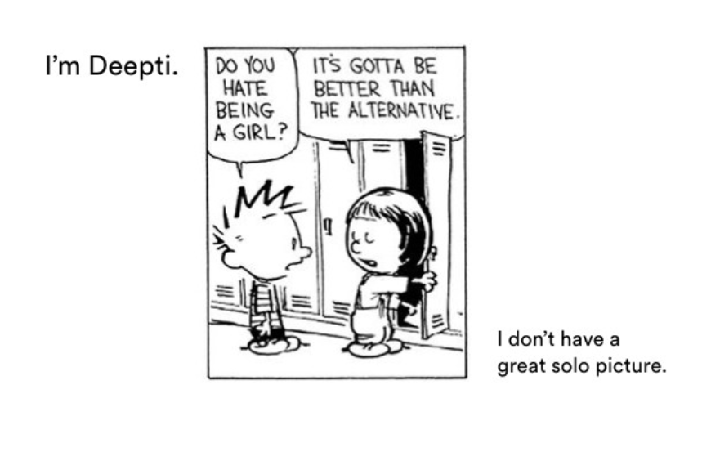
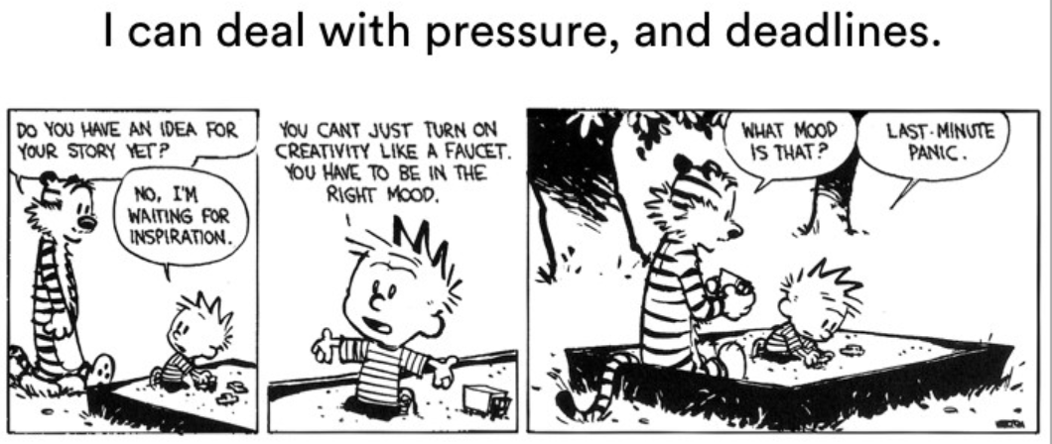
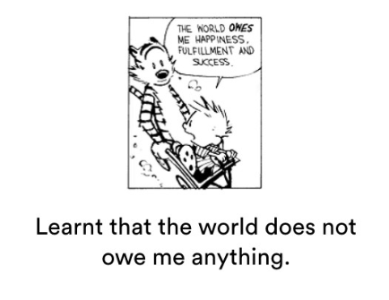
Go Crazy & Experiment! Especially for Creative/Design Jobs

Slide 16
Thanks & References Used
Stuti Dutta and Adore India: https://adoreindia.org/
Careercup.com and Gayle McDowell
My LinkedIn Community who gave Imp feedback on Resume Building Tips
Download Updated Version Of this PPT (& Resume Templates): https://github.com/souravstat/My-Infographics
Please feel free to reach out anytime for a discussion: https://about.me/sourav.nandi , souravsijna@gmail.com
Image Credit: Greg Consulta, Reddit, SlideShare, me.me, Imgflip
https://blog.usejournal.com/this-calvin-hobbes-resume-got-me-interviews-at-21-24-tech-startups-i-applied-to-cc52fdce562e

