Slide 1

HR Attrition Intelligence & Risk Analytics
Data-Driven Workforce Retention Strategy

Slide 2
The Business Challenge
Cost & Productivity Impact
Reactive HR Reporting
Strategic Intelligence Gap
Employee attrition directly affects operational costs, productivity loss, and knowledge retention across the organization.
Traditional HR reporting identifies exits after they occur rather than predicting and preventing them proactively.
Organizations need predictive analytics and early risk detection to enable data-driven workforce retention decisions.
Project Objectives
01
02
Analyze Attrition Trends
Identify Key Drivers
Examine workforce patterns across departments, roles, and demographics to identify at-risk segments.
Determine primary factors contributing to employee exits through statistical analysis and correlation studies.
03
04
Detect High-Risk Employees
Enable Strategic Decisions
Develop predictive models to flag individuals likely to leave before resignation occurs.
Provide actionable insights to HR leadership for targeted retention interventions and policy adjustments.

Slide 3
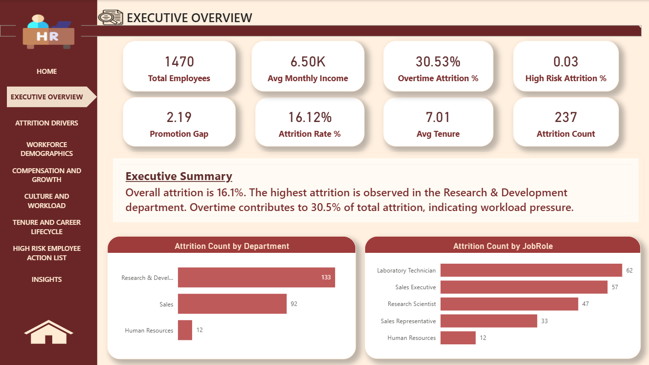
Executive Overview
Critical Findings
Research & Development department shows highest attrition rates
Overtime contributes to 30.53% of total attrition cases
Early-career employees face elevated exit probability
Promotion gaps significantly increase resignation likelihood

Slide 4
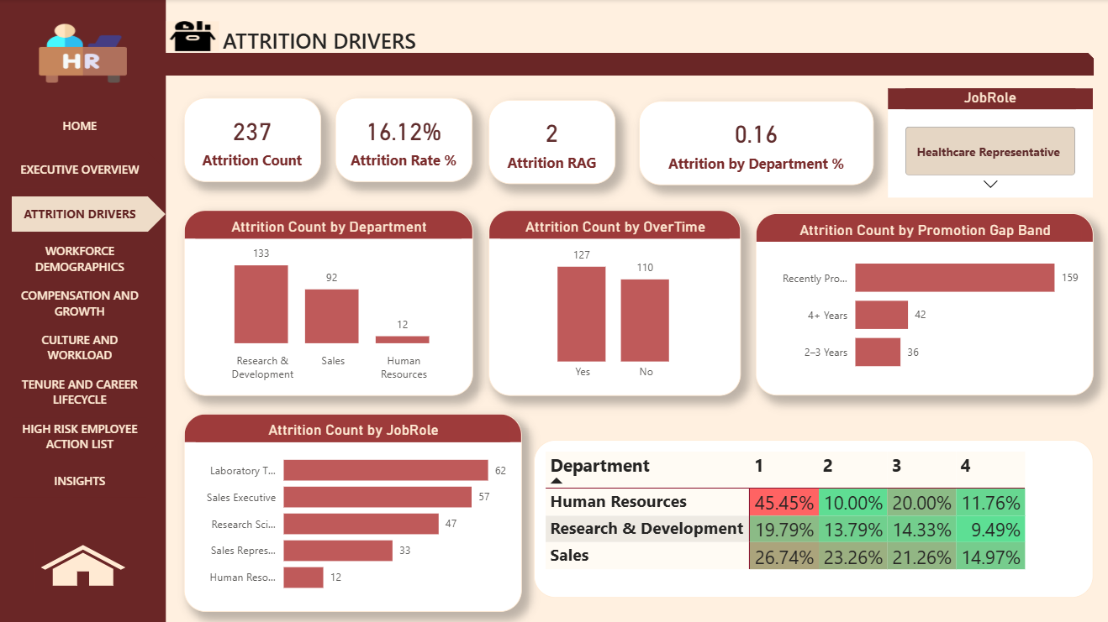
Attrition
Drivers
Overtime Dependency
Promotion Gaps
Employees working overtime show 30.53% higher attrition compared to standard hours. Work-life balance emerges as critical factor.
Lack of career advancement opportunities strongly correlates with increased exit probability, particularly in mid-tenure employees.
Departmental Risk
Job Role Concentration
Sales and R&D departments exhibit elevated attrition patterns, driven by role-specific stress factors and compensation dynamics.
Certain positions drive majority of exits, revealing structural issues in role design, workload distribution, or growth pathways.

Slide 5
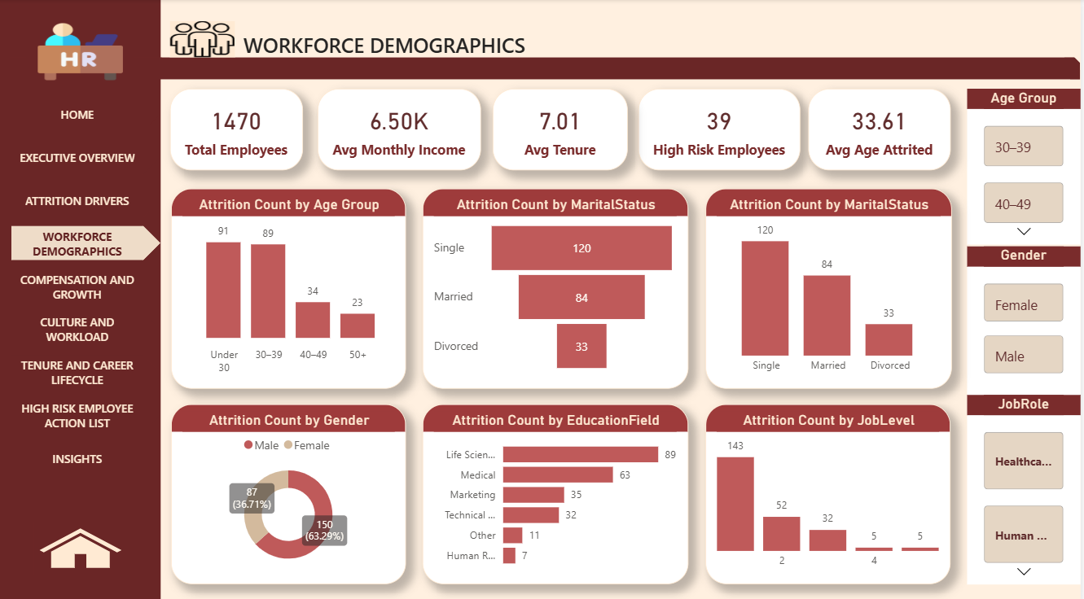




Workforce Demographics Impact
Age Distribution
Marital Status
Highest attrition concentrated in 30-39 age group, representing critical mid-career transition phase with elevated mobility.
Single employees demonstrate higher attrition rates compared to married counterparts, suggesting life-stage considerations influence stability.
Gender Patterns
Education Field
Male employees show slightly elevated attrition versus female colleagues, though gap remains relatively narrow across organization.
Specific educational backgrounds correlate with exit patterns, revealing alignment mismatches between training and role expectations.

Slide 6
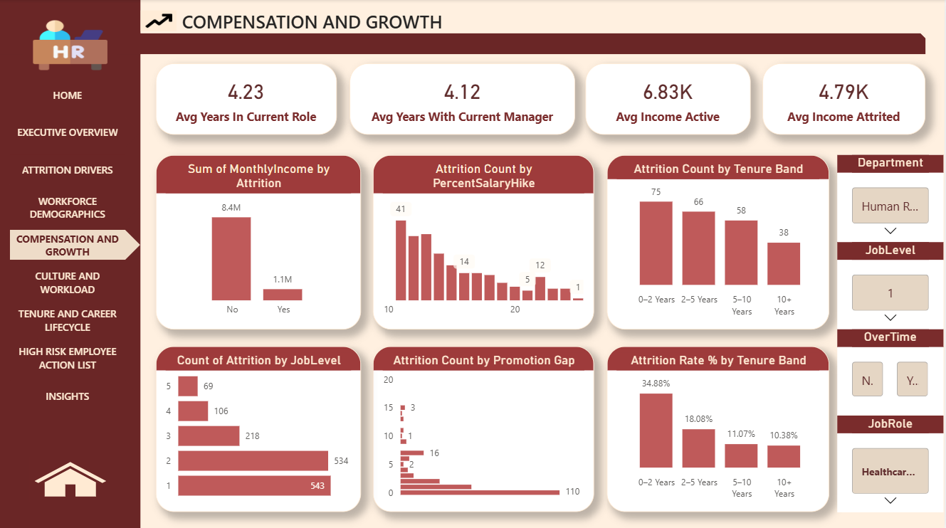
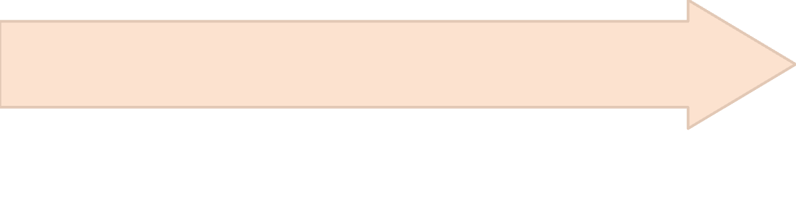
Compensation, Growth & Culture
Job Satisfaction
Work-Life Balance
Promotion Impact
Poor work-life balance demonstrates strongest correlation with attrition, amplified when combined with overtime requirements.
Promotion delays influence attrition more significantly than salary levels alone, highlighting career growth as primary motivator.
Low satisfaction scores strongly predict resignation likelihood, serving as early warning indicator for intervention.

Slide 7
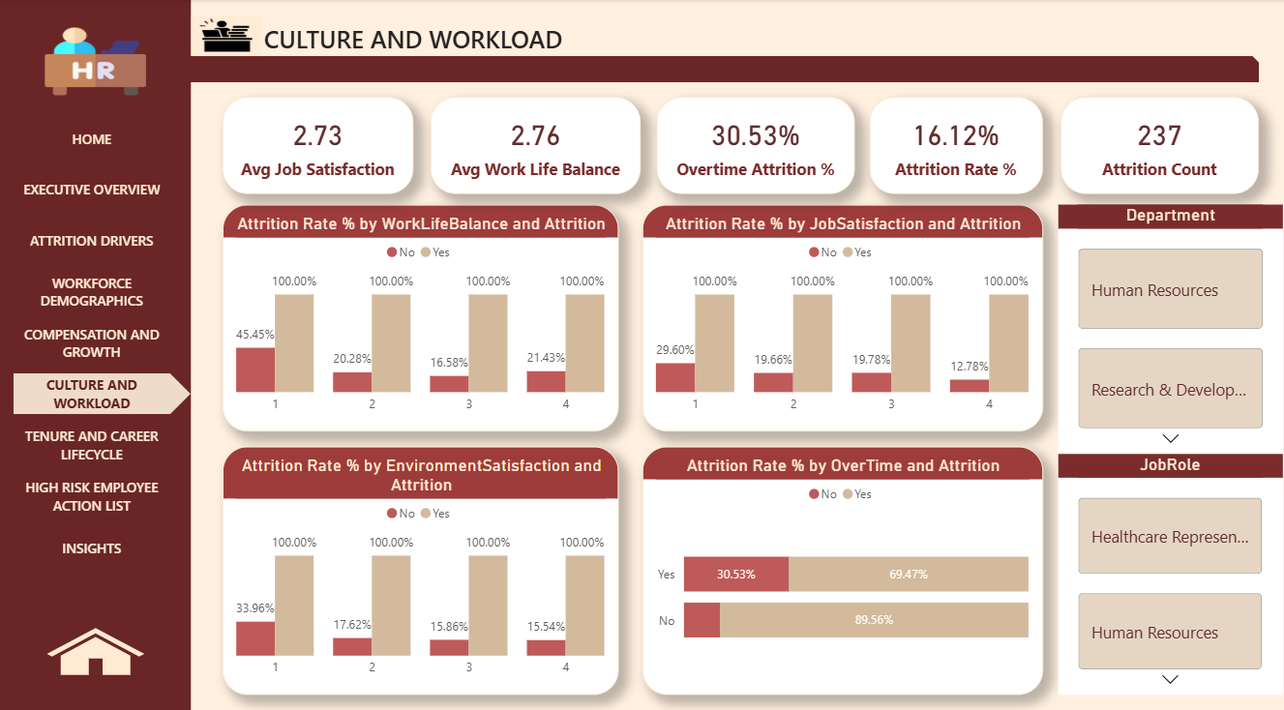
Culture And Workload

Slide 8
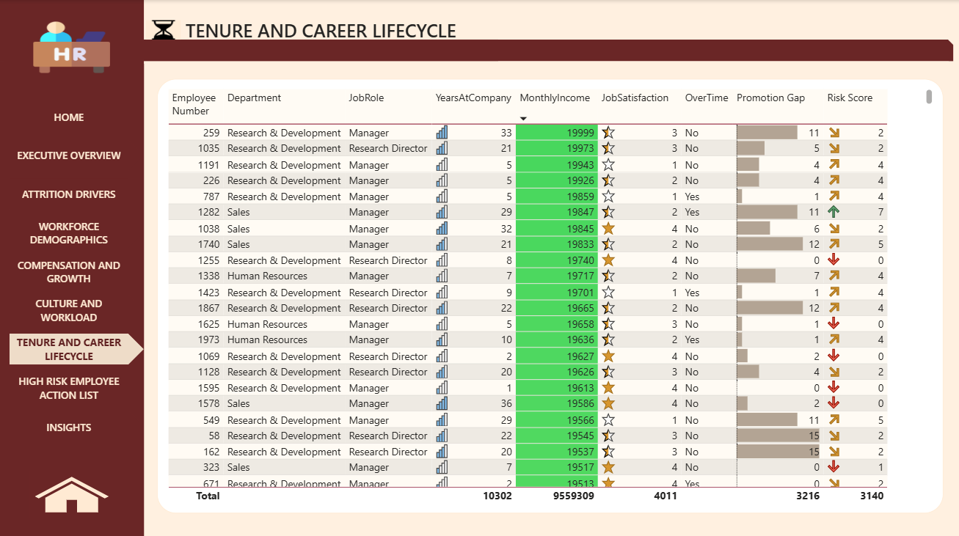
Tenure And Career Lifecycle

Slide 9
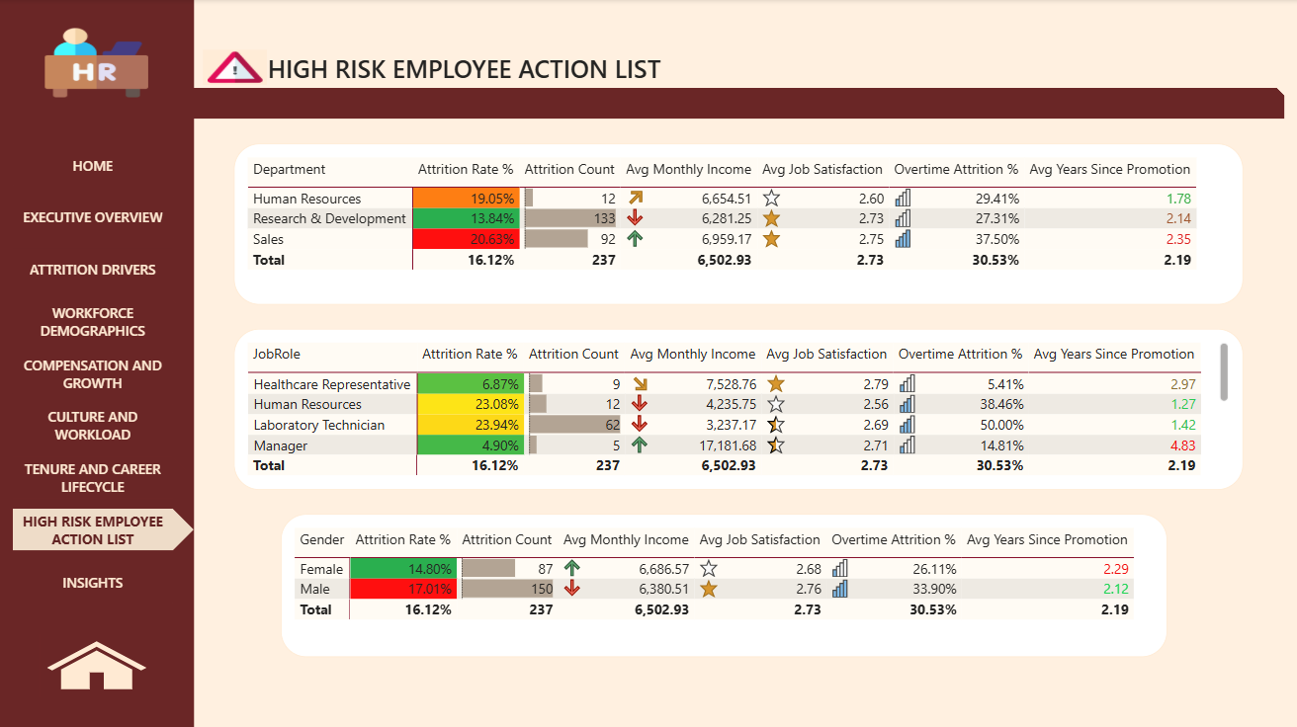
High-Risk Employee Identification
Risk Scoring Methodology
Active employees evaluated using predictive analytics incorporating tenure, satisfaction, overtime, and promotion history.
Key Segments
Department: R&D and Sales show highest concentration
Job Role: Technical and customer-facing positions at elevated risk
Gender: Male employees in early-career phase most vulnerable

Slide 10
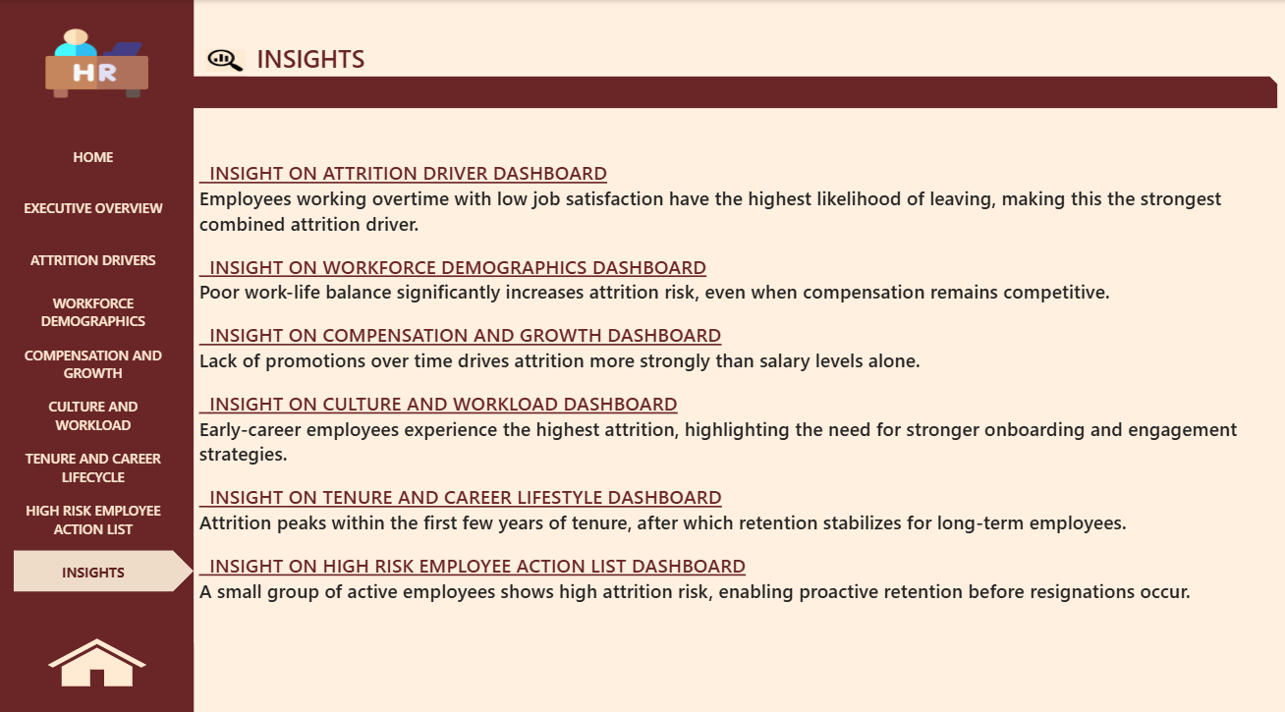
Insights

Slide 11
Strategic Insights & Action Plan
Critical Insight
Overtime combined with low satisfaction represents strongest attrition driver, requiring immediate operational changes.
Strategic Window
Early tenure period (first 1-2 years) constitutes most vulnerable phase, demanding enhanced onboarding and engagement programs.
Career Stagnation
Lack of promotion opportunities drives exits more than compensation, necessitating clear advancement pathways.
Recommended Actions
1
Reduce Overtime Dependency
2
Improve Promotion Planning
Implement workload redistribution and hire strategically to eliminate chronic overtime in high-risk departments.
Establish transparent career ladders with regular advancement reviews and clear eligibility criteria.
3
Strengthen Onboarding & Engagement
4
Deploy Predictive Analytics
Launch targeted programs for early-tenure employees with monthly check-ins and mentorship pairing.
Integrate risk scoring into HR operations for quarterly proactive retention interventions before resignation occurs.

Slide 12
Thank You

