Slide 1

Hospital Intelligence:
Clinical Operations & Revenue Analytics
Power BI End-to-End Analytics Project delivering executive-ready insights across doctors, patients, treatments, and billing performance
Presented By : SOURAV THAKUR

Slide 2
Business Problem Statement
The Challenge
Project Objective
Hospitals face significant operational visibility gaps that impact financial performance and patient care quality.
To create a comprehensive analytics ecosystem that transforms raw data into strategic decision-making tools for hospital leadership.
Revenue leakage from incomplete billing cycles
Difficulty measuring doctor efficiency and productivity
High appointment no-show and cancellation rates
Unclear treatment profitability analysis
Provide 360° operational visibility
Enable data-driven revenue optimization
Improve resource allocation and patient outcomes

Slide 3
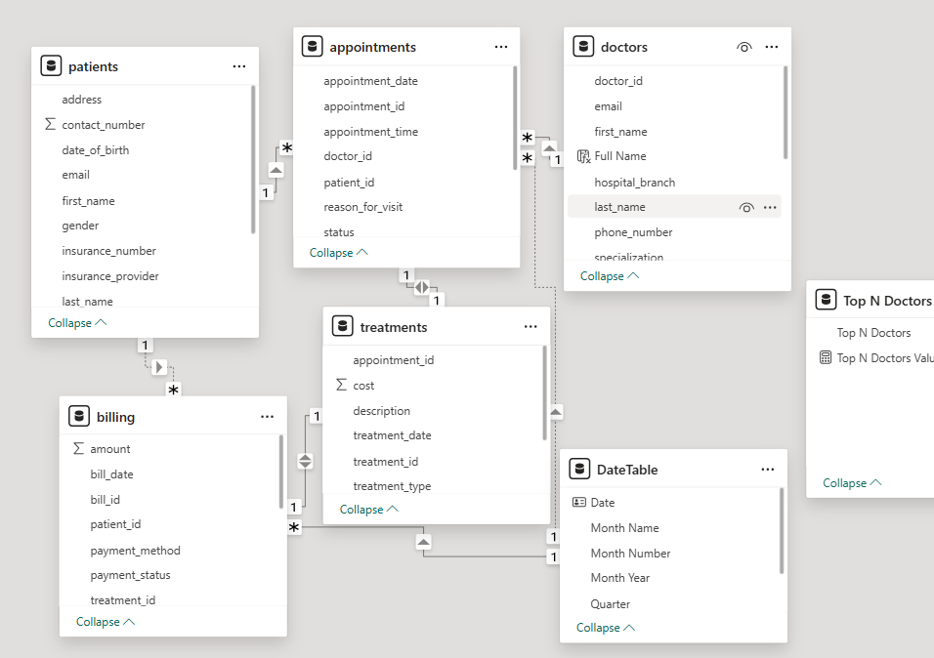






Data Overview & Modeling Strategy
Comprehensive Dataset
Key Metrics
Doctors, patients, appointments, treatments, billing, and payments integrated into single source of truth
Total revenue, MoM growth, valid appointments, paid vs pending revenue tracking
Star Schema Design
Fact tables for appointments and billing with dimension tables for doctors, patients, treatments, and time

Slide 4
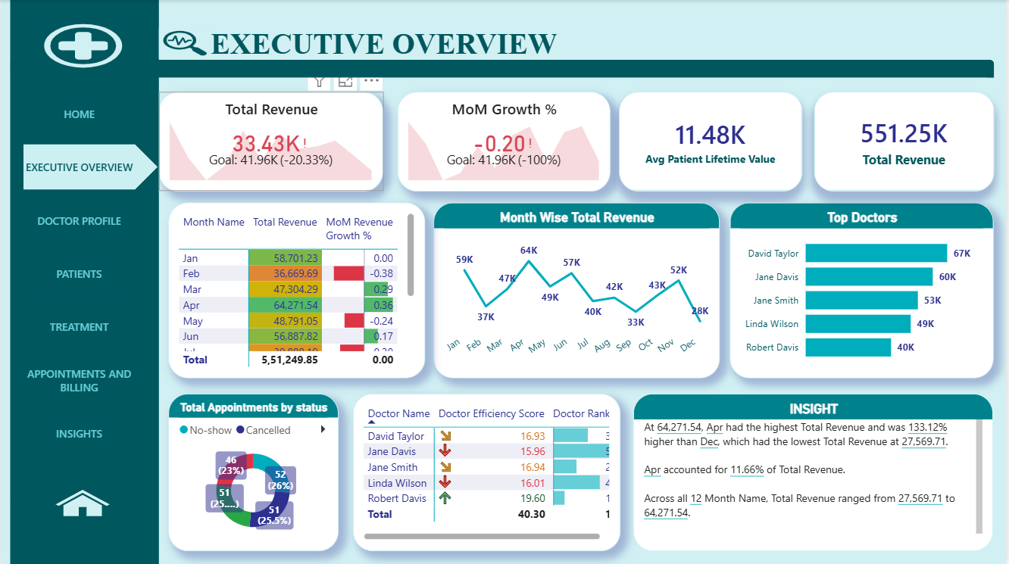
Executive Overview Dashboard

Slide 5
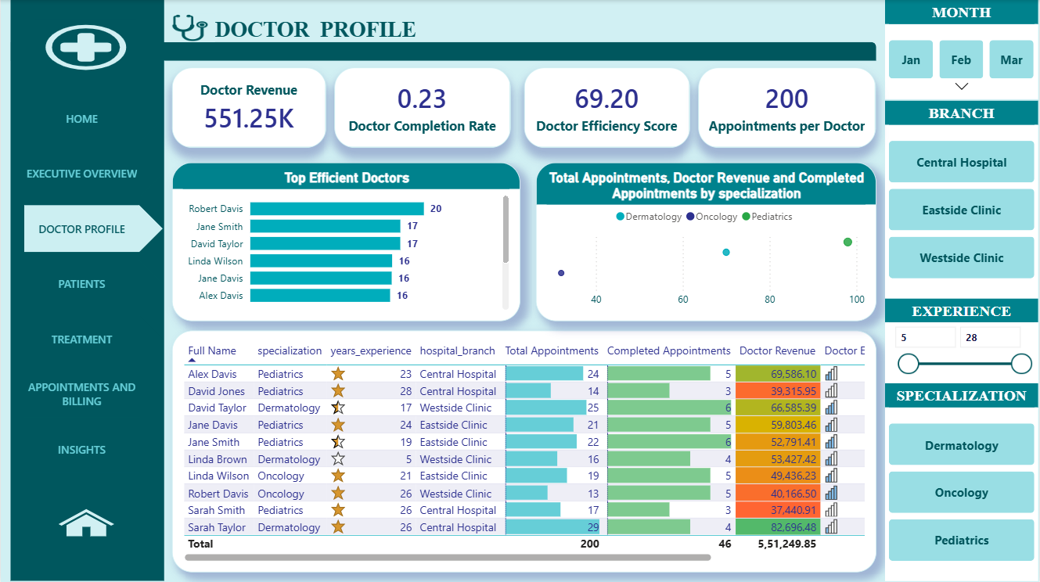

Doctor Profile Analytics
Business Impact: Identifies high-performing physicians, highlights training needs, and reveals optimization opportunities in scheduling and resource allocation.

Slide 6
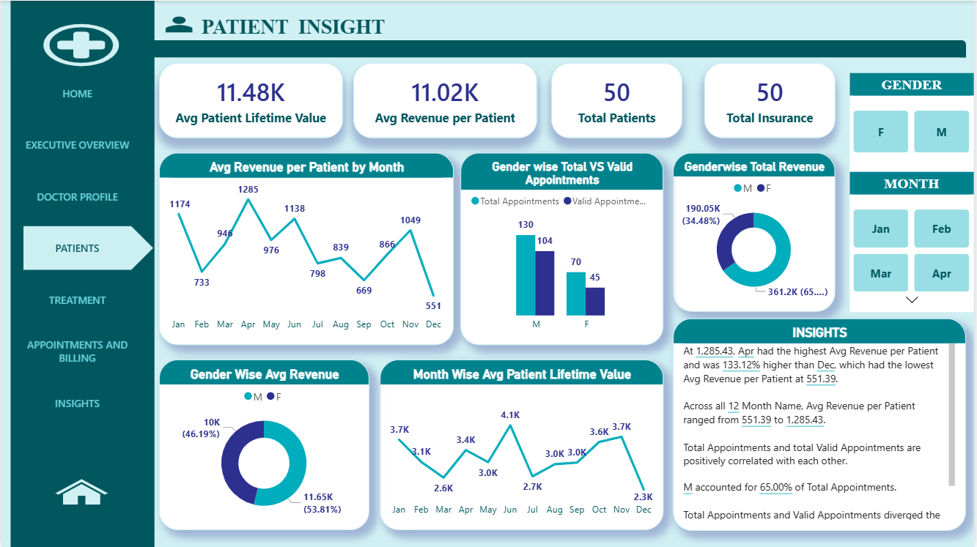
Patient Behavior & Revenue Insights

Slide 7
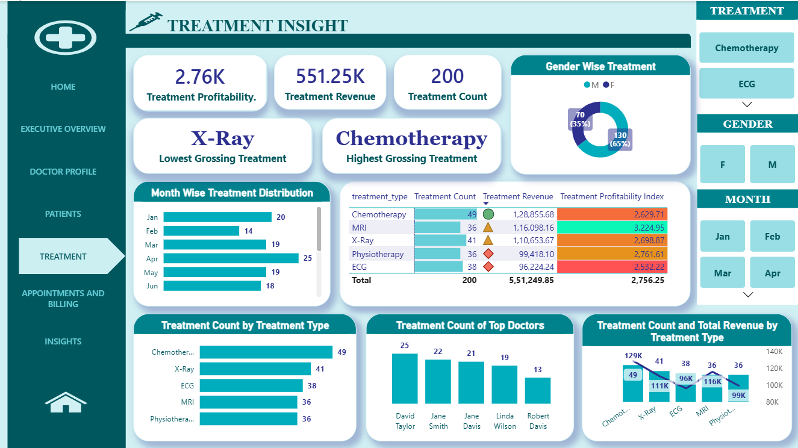
Treatment Intelligence

Slide 8
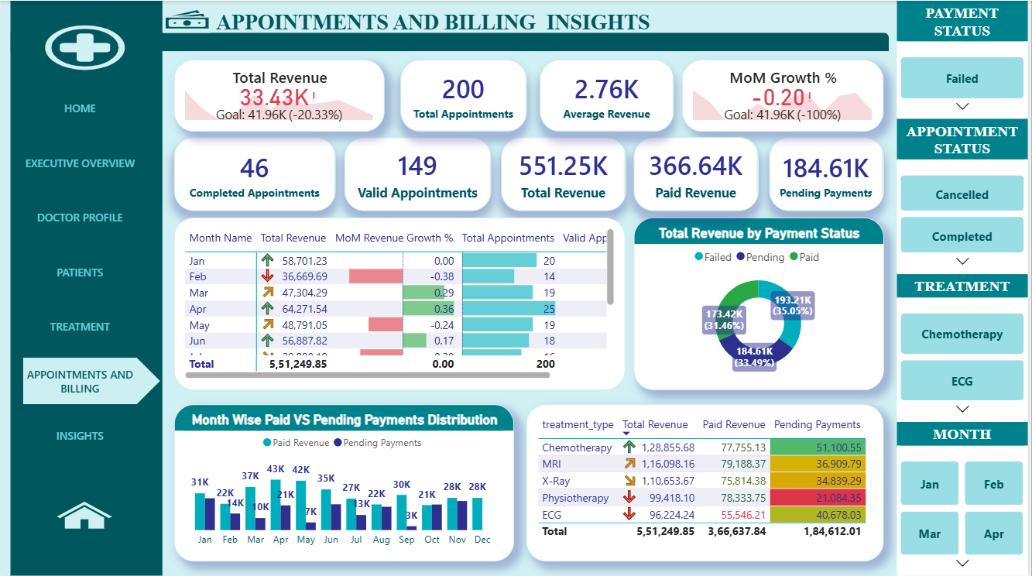
Appointments & Billing Performance

Slide 9
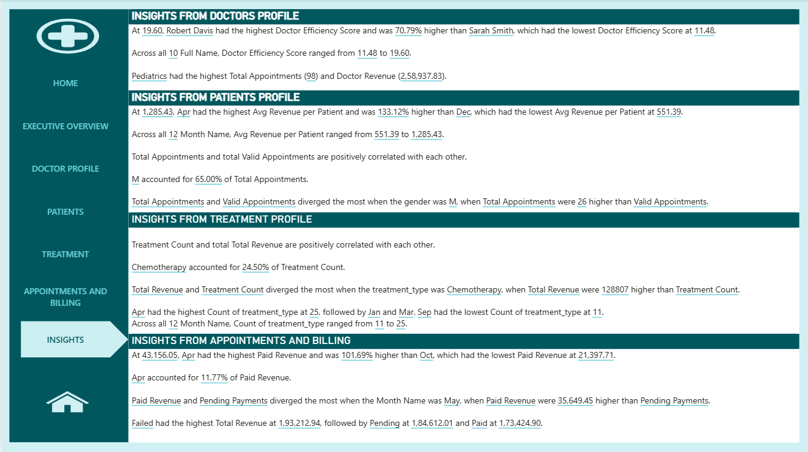
Insights

Slide 10








Key Insights & Strategic Recommendations
Actionable Intelligence from Data
April Revenue Peak
Chemotherapy Leader
Highest revenue generation across multiple dashboards - analyze contributing factors
Most profitable treatment category - consider resource expansion
Payment Delays
Male Patient Volume
Certain months show elevated pending payments - improve follow-up protocols
Higher appointment volume from male patients - tailor marketing accordingly
Strategic Recommendations
1
Enhance Payment Collection
2
Reduce No-Shows
3
Reward Excellence
Implement automated follow-up system for pending payments to reduce revenue leakage
Deploy SMS and email reminders 48 hours prior to appointments
Recognize high-efficiency doctors with bonuses and career advancement opportunities

Slide 11
THANK YOU

