Slide 1
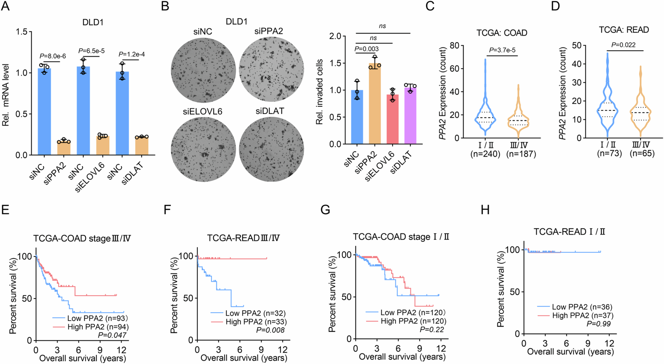
SIRT5-mediated desuccinylation of PPA2 enhances HIF-1alpha-dependent adaptation to hypoxic stress and colorectal cancer metastasis
The EMBO Journal, First published: 31 March 2025, DOI: (10.1038/s44318-025-00416-1)
Notes:
(A) qRT-PCR validated the efficiency of PPA2, ELOVL6 and DLAT knockdown in DLD1 cells. (B) Cells in (A) were used for transwell invasion assay. (C, D) TCGA RNA-seq data of patients with COAD (C) and READ (D) were analyzed. PPA2 mRNA levels were compared between different stages. (E–H) Kaplan‒Meier analysis of survival durations based on the PPA2 expression status at advanced stages (E, F) or early stages (G, H) from TCGA-COAD (E, G) or TCGA-READ (F, H) datasets. Data information: Data are mean ± SD from three biological replicates (A, B). Statistics: unpaired two-tailed student’s t-test (A, C, D); one-way ANOVA (B); log-rank test (E–H). Source data are available online for this figure.

