Slide 1
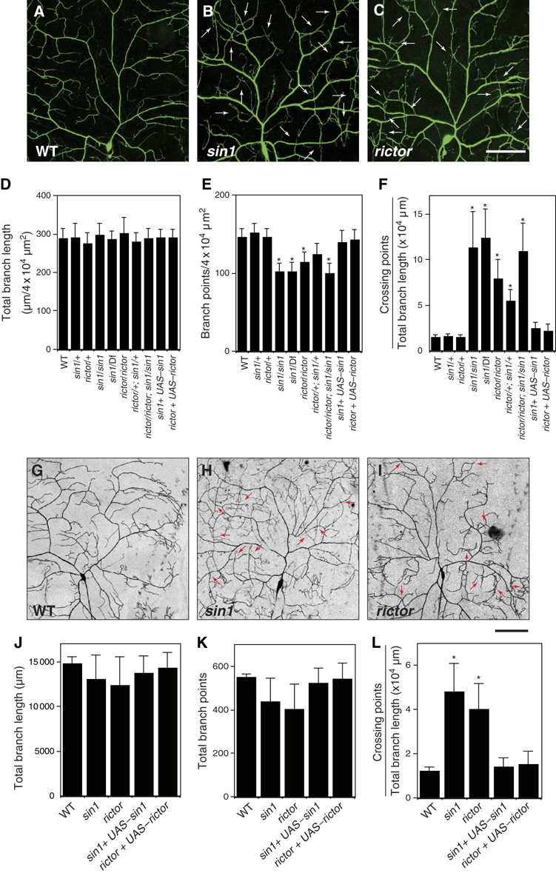
The target of rapamycin complex 2 controls dendritic tiling of Drosophila sensory neurons through the Tricornered kinase signalling pathway
The EMBO Journal, Volume: 28, Issue: 24, Pages: 3879-3892, First published: 29 October 2009, DOI: (10.1038/emboj.2009.312)
Notes:
Figure 1sin1 and rictor function cell‐autonomously in regulation of dendritic tiling in class IV neurons. (A–C) Live images of ddaC dendrites visualized by the pickpocket‐EGFP (ppk‐EGFP) reporter in wild‐type (WT) (A), sin1PBac homozygote (B), rictorΔ2 homozygote (C). Anterior is left and dorsal is up. Arrows indicate crossing points of dendritic branches. Scale bar=50 μm. (D–F) Quantification of the total branch length (D), the branch number (E), and the crossing points (F) of WT and mutant ddaC dendrites. Error bars indicate mean±s.d. (WT, n=15; others, n=25), *P<0.01 (Student's t‐test). Note that larvae heterozygous for sin1PBac over a deletion [Df(2R)BSC11] uncovering the sin1 gene show dendritic tiling defects identical to those of sin1 homozygotes. Genotypes: (A) yw; +/+; ppk‐EGFP/ppk‐EGFP, (B) yw; sin1PBac/sin1PBac; ppk‐EGFP/ppk‐EGFP, and (C) yw, rictor Δ2/yw, rictorΔ2; +/+; ppk‐EGFP/ppk‐EGFP. (G–I) MARCM clones of WT (G), sin1 (H), and rictor (J) are shown. Arrows indicate the crossing points of the dendrites. Scale bar=50 μm. (J–L) Quantification of the branch length (J), the branch points (K), and the crossing points (L) of MARCM clones. (WT, n=5; sin1, n=11; rictor, n=9) Clone genotypes: (G) hsFLP, elav‐Gal4, UAS‐mCD8‐GFP/+; FRT42D, (H) hsFLP, elav‐Gal4, UAS‐mCD8‐GFP/+; FRT42D, sin1PBac, AND (I) FRT19A, rictorΔ2; UAS‐Gal4[109(2)80], UAS‐mCD8GFP/hsFLP. Error bars indicate mean±s.d., *P<0.01 (Student's t‐test).

