Slide 1
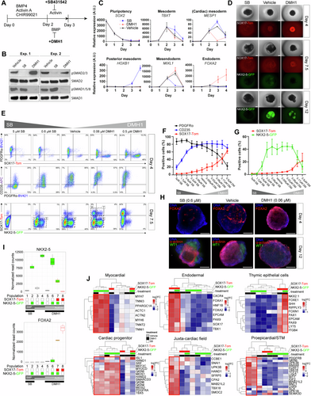
HAND1 level controls the specification of multipotent cardiac and extraembryonic progenitors from human pluripotent stem cells
The EMBO Journal, First published: 31 March 2025, DOI: (10.1038/s44318-025-00409-0)
Notes:
(A) Schematic of hESC 3D EB differentiation protocol with pathway inhibitors introduced at day 2 to promote cellular diversity. All factors were removed at day 3. (B) Western blots of receptor-SMADs 6 h after small molecule addition following the protocol in (A). (C) RT-qPCR analysis of marker gene expression in a differentiation time-course following the protocol in (A). (D) Live imaging of SOX17-Tom and NKX2-5-GFP at 3 timepoints of differentiation. (E) Representative flow cytometric analyses of surface markers PDGFRα and CD235, together with SOX17-Tom and NKX2-5-GFP at 2 timepoints of differentiation with the indicated concentrations of SB and DMH1. (F) Positive cell proportions for day 4 and (G) for day 7.5. (H) Immunostaining of whole mount EBs stained for FOXA2 (red) at day 4, and α-actinin (red) and WT1 (green) at day 12. (I) RNA-seq quantifications of NKX2-5 and FOXA2 after the sorting of 8 populations at day 7.5 based on SOX17-Tom and NKX2-5-GFP. The boxplots follow standard Tukey representations (n = 3 independent biological experiments) and are coloured by the lineage markers. The top and bottom edges of the boxplots represent the upper (75th percentile) and lower (25th percentile) quartiles. Horizontal lines within each box represent the median. Whiskers extend to 1.5 times the interquartile range. Typical population sorting gates are indicated in (E). (J) Hierarchical clustering of cell type and lineage markers based on RNA-seq data from the 8 populations. Expression levels are represented as Z-score normalized log2 FC differences. Data are represented as mean ± SEM (n = 3–4) independent biological experiments for (C, F, G). Scale bars represent 300 μm. A.U. arbitrary units, EB embryoid body, Exp. experiment, FC fold change, SEM standard error of the mean, STM septum transversum mesenchyme. See also Appendix Fig. S1. Source data are available online for this figure.

