Slide 1
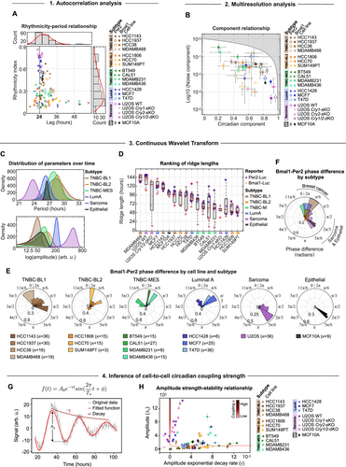
Circadian clock features define novel subtypes among breast cancer cells and shape drug sensitivity
Molecular Systems Biology, Volume: 21, Issue: 4, Pages: 315-340, First published: 24 February 2025, DOI: (10.1038/s44320-025-00092-7)
Notes:
(A) Relationship between rhythmicity indices and periods for various cell line models, distinguished by markers and colored by subtype (n = 141 samples represented as individual measurements). Dashed line at period = 24 h. Gamma distribution of periods and rhythmicity indices shown in histograms in the top and left panel, respectively. (B) Relationship between normalized noise and circadian components across cell line models, determined by multiresolution analysis. Cell models are color-coded by subtype and distinguished by markers. Shaded area covers unattainable range. Data represents the mean ± s.d. of 6 samples per reporter (n = 2 biological replicates á technical triplicates or duplicates [HCC1806 Per2-Luc, n = 5]). n = 3 for MCF10A and MDAMB468-Per2-Luc (single experiment). (C) Normal distribution of subtype-averaged and time-resolved periods (top panel) and amplitudes (bottom panel) (n = 1–4 cell lines models per subtype, see legends of (A) and (B) for exact numbers). Before calculating subtype averages, all available replicates per cell model were averaged (n = 3–6, see (B) for exact numbers) and used as input. (D) Boxplot of CWT ridge lengths from Bmal1- and Per2-signals of specified cell models, with the bottom and top edges of the boxes representing the 25th and 75th percentiles, respectively. Extending whiskers represent data points within 1.5 times the interquartile range from lower and upper quartile. Median values are marked by red horizontal lines, and outliers by red crosses. n = 4–12 samples per cell line (see (B) for exact numbers). (E) Subtype-specific polar histograms of Bmal1-Per2 phase differences over time, averaged across multiple replicates and color-coded by cell line. The number n of Bmal1-Per2-combinations per cell line is indicated next to the cell line name. Polar histograms were normalized by probability. (F) Polar histogram of Bmal1-Per2 phase differences over time, averaged and colored by subtype (n = 1–4 cell line models, see (E) for exact numbers). In the polar histograms in (E) and (F) 2π corresponds to one full circadian cycle. (G) Example of fitting signals to an exponentially decaying sinusoidal model with constant periods to deduce initial amplitudes (A0) and amplitude decay rates (γ). Dark red amplitude decay trace is sketched for illustration purposes. (H) Relationship between initial signal amplitudes and amplitude decay rates across samples of different cell line models (n = 117 samples). Cell models are color-coded by subtype and distinguished by markers. Error bars represent the standard deviation of the fitted parameters, reflecting their uncertainty as determined by the fitting process. The L-shaped line represents the simulated coupling strength (κ). Source data are available online for this figure.

