Slide 1
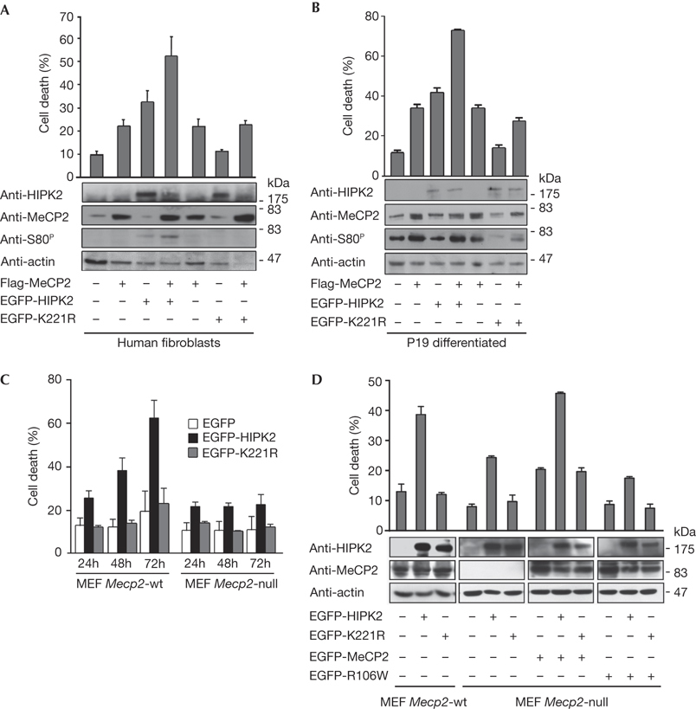
Methyl‐CpG‐binding protein 2 is phosphorylated by homeodomain‐interacting protein kinase 2 and contributes to apoptosis
EMBO Reports, Volume: 10, Issue: 12, Pages: 1327-1333, First published: 9 October 2009, DOI: (10.1038/embor.2009.217)
Notes:
Figure 4MeCP2 contributes to HIPK2‐induced apoptosis. (A) Human fibroblasts expressing Flag‐MeCP2 with EGFP‐HIPK2 or EGFP‐K221R were analysed 24 h after transfection for cell death by Trypan blue exclusion. Mean±s.d. of three independent experiments is reported. wbs on TCE (HIPK2, actin) or immunoprecipitates (MeCP2, S80P) were performed. (B) P19 cells were induced to differentiate as in Fig 3D, transfected and TCEs were analysed by wb as indicated. (C) Mecp2‐wt and Mecp2‐null MEFs were transfected with EGFP‐HIPK2, EGFP‐K221R or the EGFP control vector. Cell death was evaluated as described in part (A) at the indicated time points. Mean±s.d. of three experiments is reported. (D) Mecp2‐wt and Mecp2‐null MEFs were transfected with the indicated proteins and analysed 40 h after transfection for cell death and protein expression. EGFP, enhanced green fluorescent protein; HIPK2, homeodomain‐interacting protein kinase 2; MeCP2, methyl‐CpG‐binding protein 2; MEF, mouse embryonic fibroblast; TCE, total cell extract; wb, western blot; wt, wild type.

