Slide 1
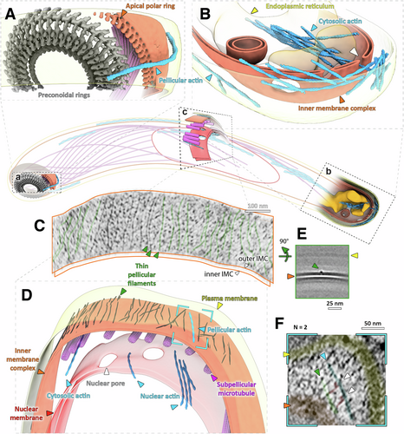
Molecular architecture of glideosome and nuclear F-actin in Plasmodium falciparum
EMBO Reports, First published: 24 March 2025, DOI: (10.1038/s44319-025-00415-7)
Notes:
Central cartoon represents the approximate position of volumes (A–C) within a cell. (A) Apical end of showing a single actin filament being nucleated at the pre-conoidal rings (grey). (B) Basal end of a sporozoite, showing cytoplasmic actin bundles as well as a build-up of pellicular actin. White arrowhead indicates an actin filament going through a basal pore. Shown is also an invagination of the IMC (observed in three cells). See slice through this tomogram in Fig. EV4C. (D) A lateral section showing nuclear, cytosolic and pellicular F-actin. Dark lines on the outer surface of the IMC represent thin pellicular filaments (TPFs). (C) A slice along the surface of the outer leaflet of the outer IMC membrane. Some filaments have been highlighted in green. (E) A slice through the average volume of TPFs showing their position relative to the IMC membranes. Orthogonal sections through this volume also shown in Fig. 3C. (F) A slice through the tomogram (position shown in D) showing a pellicular actin filament (blue) connected to a TPF by two densities (red, white arrows) consistent with myosin dimensions (observed in two different locations). Source data are available online for this figure.

