Slide 1
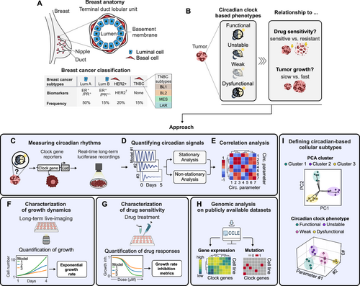
Circadian clock features define novel subtypes among breast cancer cells and shape drug sensitivity
Molecular Systems Biology, Volume: 21, Issue: 4, Pages: 315-340, First published: 24 February 2025, DOI: (10.1038/s44320-025-00092-7)
Notes:
(A) Classification of breast cancer based on cancer cell phenotype and biomarker expression status. Approximate frequency among all breast cancer cases indicated in percentage. −, negative; +, positive; ER, estrogen receptor; PR, progesterone receptor; HER, human epidermal growth factor receptor 2; LumA/B, Luminal A/B; TNBC, triple-negative breast cancer, BL1/2, basal-like 1/2; MES, mesenchymal-like; LAR, luminal androgen receptor. (B) Aim of our study to identify circadian-based phenotypes in breast cancer cell models and investigate the role of circadian clock features for tumor growth and drug sensitivity. (C) Cellular circadian rhythms are measured by long-term luciferase (Luc) recordings of clock gene reporter cell lines. (D) Circadian signals are quantified by stationary and non-stationary analysis approaches. (E) Circadian parameters are related to each other by correlation analysis to define a set of representative circadian metrics. (F) Long-term live imaging is employed to capture growth dynamics across various cell line models. (G) Characterization of drug sensitivities across various cell line models, followed by the parametrization of growth rate inhibition metrics. (H) Characterization of genomic circadian profiles of the cell models tested, utilizing publicly available datasets. (I) Definition of circadian-based cellular subtypes through the integration of multiple cellular parameters.

