Slide 1
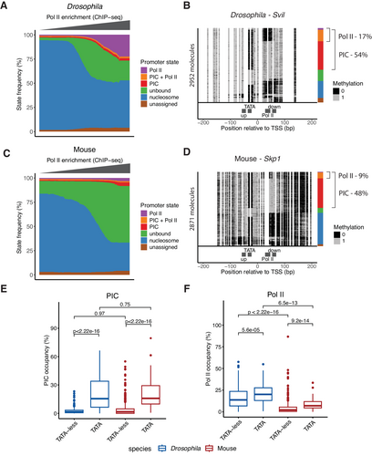
Mouse promoters are characterised by low occupancy and high turnover of RNA polymerase II
Molecular Systems Biology, First published: 31 March 2025, DOI: (10.1038/s44320-025-00094-5)
Notes:
(A) Distribution of SMF-derived promoter state frequencies as a function of Pol II ChIP-seq level in Drosophila promoters (n = 5912 promoters). Promoters were first binned based on their log2 Pol II ChIP-seq signal. Within each bin, the median frequency of each of the promoter state was calculated. Each bar in the plot represents the median state frequencies of the promoters in the bin. Colour code represents each state as follows: purple—Pol II, orange—PIC + Pol II, red—PIC, green—unbound, blue—nucleosome, and brown—unassigned. (B) Single-locus example showing single-molecule sorting of a highly active, TATA-box containing Drosophila promoter (Svil, 94th percentile by Pol II ChIP-seq). Each row in the single-molecule stack denotes a single DNA molecule and the methylation status of each cytosine in that molecule (methylated, accessible—light grey; unmethylated, protected—black). The positions of the four bins (upstream, TATA, Pol II, downstream) used for promoter state decomposition are shown below the single-molecule stack (see Methods for details). The vertical sidebars on the right of the plot depict the frequency of each promoter state determined by single-molecule decomposition. The percentages of molecules harbouring footprints for the engaged Pol II and PIC are indicated on the right side of the plot. (C) Distribution of SMF-derived state frequencies as a function of Pol II ChIP-seq level in mouse promoters (n = 6122 promoters). Same representation as (A). (D) Single-locus example of a single-molecule sorting of a highly active, TATA-box containing mouse promoter (Skp1, 97th percentile by Pol II ChIP-seq). Same representation as (B). (E) Comparison of PIC state frequency between mouse (TATA-less n = 572 promoters; TATA-containing n = 64 promoters) and Drosophila (TATA-less n = 422 promoters; TATA-containing n = 71 promoters) promoters. Boxplots represent the distribution of the frequency of PIC-bound molecules (PIC and PIC + Pol II states) at highly active promoters (top 5% Pol II ChIP-seq level). The middle line of the box represents the median. The box displays the interquartile range (IQR), 25th to 75th percentile. Whiskers represent a distance of 1.5 × IQR. (F) Comparison of Pol II state frequency between mouse (TATA-less n = 572 promoters; TATA-containing n = 64 promoters) and Drosophila (TATA-less n = 422 promoters; TATA-containing n = 71 promoters) promoters. Boxplots represent the distribution of the frequency of Pol II-bound molecules (Pol II and PIC + Pol II states) at highly active promoters (top 5% Pol II ChIP-seq level). The middle line of the box represents the median. The box displays the interquartile range (IQR), 25th to 75th percentile. Whiskers represent a distance of 1.5 × IQR. The analysis is stratified by the presence of a TATA-box at the promoter. The statistical comparisons between groups were performed using the Wilcoxon rank-sum test.

