Slide 1
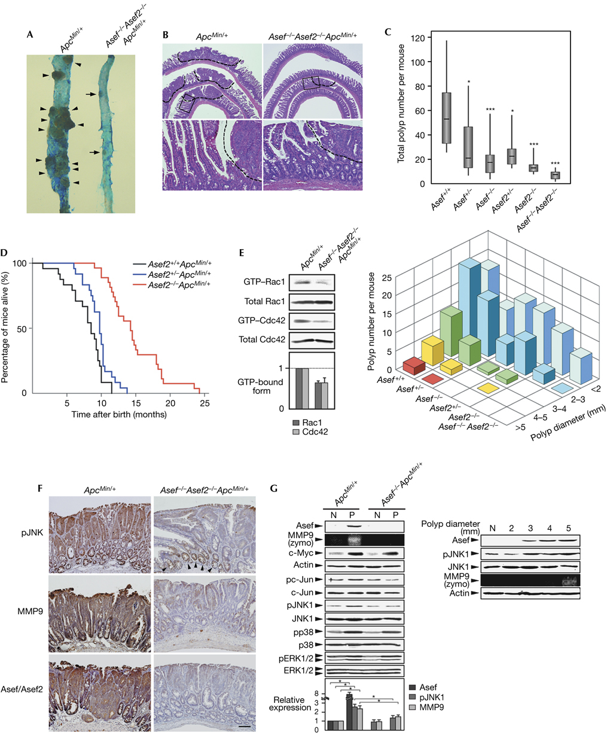
The adenomatous polyposis coli‐associated exchange factors Asef and Asef2 are required for adenoma formation in ApcMin/+mice
EMBO Reports, Volume: 10, Issue: 12, Pages: 1355-1362, First published: 6 November 2009, DOI: (10.1038/embor.2009.233)
Notes:
Figure 2Absence of Asef and/or Asef2 impairs intestinal adenoma formation in ApcMin/+ mice. (A) Macroscopic comparison of the small intestine of ApcMin/+ (left) and Asef−/−Asef2−/−ApcMin/+ (right) mice at 4 months of age. Arrowheads and arrows indicate large and small adenomatous polyps, respectively. (B) Haematoxylin and eosin staining of intestinal ‘Swiss roll’ sections from ApcMin/+ and Asef−/−Asef2−/−ApcMin/+ mice at 4 months of age. The regions in boxes are magnified and shown in the lower panels. The dashed lines depict the boundary between normal and adenoma tissues. (C) The mean numbers and sizes of intestinal polyps in ApcMin/+ mice with different Asef and Asef2 genotypes at 4 months of age (n=8–18 per genotype). *P<0.05; ***P<0.001. (D) Kaplan–Meier survival curves of Asef2+/+ApcMin/+, Asef2+/−ApcMin/+ and Asef2−/−ApcMin/+ mice (n=24–27 per genotype). (E) The amounts of GTP‐bound Rac1 and Cdc42 in polyps of ApcMin/+ and Asef−/−Asef2−/−ApcMin/+ mice. GTP‐bound GTPases were precipitated using GST–PAK CRIB coupled to glutathione–Sepharose beads and detected by immunoblotting with the indicated antibodies (for Rac1 and Cdc42). The total amount of GTPases in the lysates before pulldown assays were also analysed. (F) Immunohistochemical analysis of pJNK, MMP9 and Asef/Asef2 in intestinal sections from ApcMin/+ and Asef−/−Asef2−/−ApcMin/+ mice. Arrowheads indicate pJNK staining in intestinal crypts (also see supplementary Fig S12 online). Scale bar, 100 μm. (G) Immunoblotting analysis and zymography of the normal intestinal mucosa (N) and polyps (P) of ApcMin/+ and Asef−/−ApcMin/+ mice. Tissue lysates were subjected to immunoblotting with antibodies specific for the indicated proteins. Polyps of similar sizes of ApcMin/+ and Asef−/−ApcMin/+ mice were used for experiments. As pJNK2 showed no change in abundance, only the bands of pJNK1 and JNK1 are shown in this figure. Actin and c‐Myc were used as a loading control and a marker of β‐catenin–TCF‐mediated activation, respectively. MMP9 gelatinolytic activities were examined by gelatin zymography. CRIB, Cdc42/Rac interactive binding; GST, glutathione S‐transferase; GTP, guanosine triphosphate; MMP9, matrix metalloproteinase 9; PAK, p21‐activated kinase; pJNK, phosphorylated c‐Jun N‐terminal kinase; TCF, T‐cell factor; zymo, gelatin zymography.

