Slide 1
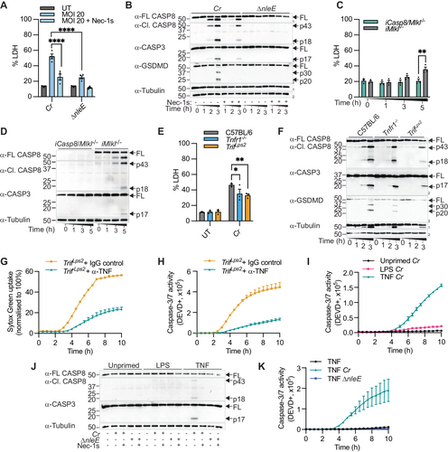
A bacterial network of T3SS effectors counteracts host pro-inflammatory responses and cell death to promote infection
The EMBO Journal, First published: 24 March 2025, DOI: (10.1038/s44318-025-00412-5)
Notes:
(A, B) Unprimed primary BMDMs, (C, D) immortalised BMDMs or (E–H) unprimed primary BMDMs were infected with log-phase C. rodentium (Cr) and/or ΔnleE for (A, E) 5 h or (B–D, F–H) the indicated time points. (G, H) BMDMs were treated with 100 μg/ml α-TNF neutralising antibody or IgG isotype control for 30 min before Cr infection. (I–K) CMT-93 cells were unprimed or primed with LPS (100 ng/ml) or TNF (100 ng/ml) for 3 h and infected with Cr and ΔnleE over time (I, K) or for (J) 5 h. (A, C, E) LDH release was quantified. (B, D, F, J) Mixed supernatant and lysates were examined by immunoblotting. (G) SYTOX Green uptake and (H, I, K) caspase-3/7 activity (DEVD-positive) were quantified using IncuCyte. Where indicated, cells were treated with Nec-1s (100 μM) for 30 min before infection. (A) Pooled data are mean ± SEM of four independent experiments (P ≤ 0.0001 for both conditions). (C) Pooled data are mean ± SEM of three independent experiments (P = 0.0010). (E) Pooled data are mean ± SEM of three independent experiments (P = 0.0257 for Tnfr1−/− and P = 0.0094 for TrifLps2). Data are mean ± SD of technical (G, H) duplicates and (I, K) triplicates representative of three independent experiments. All P values were calculated with two-way ANOVA test. Data are considered significant when P ≤ 0.05, with *P ≤ 0.05, **P ≤ 0.01 or ****P ≤ 0.0001. Source data are available online for this figure.

