Slide 1
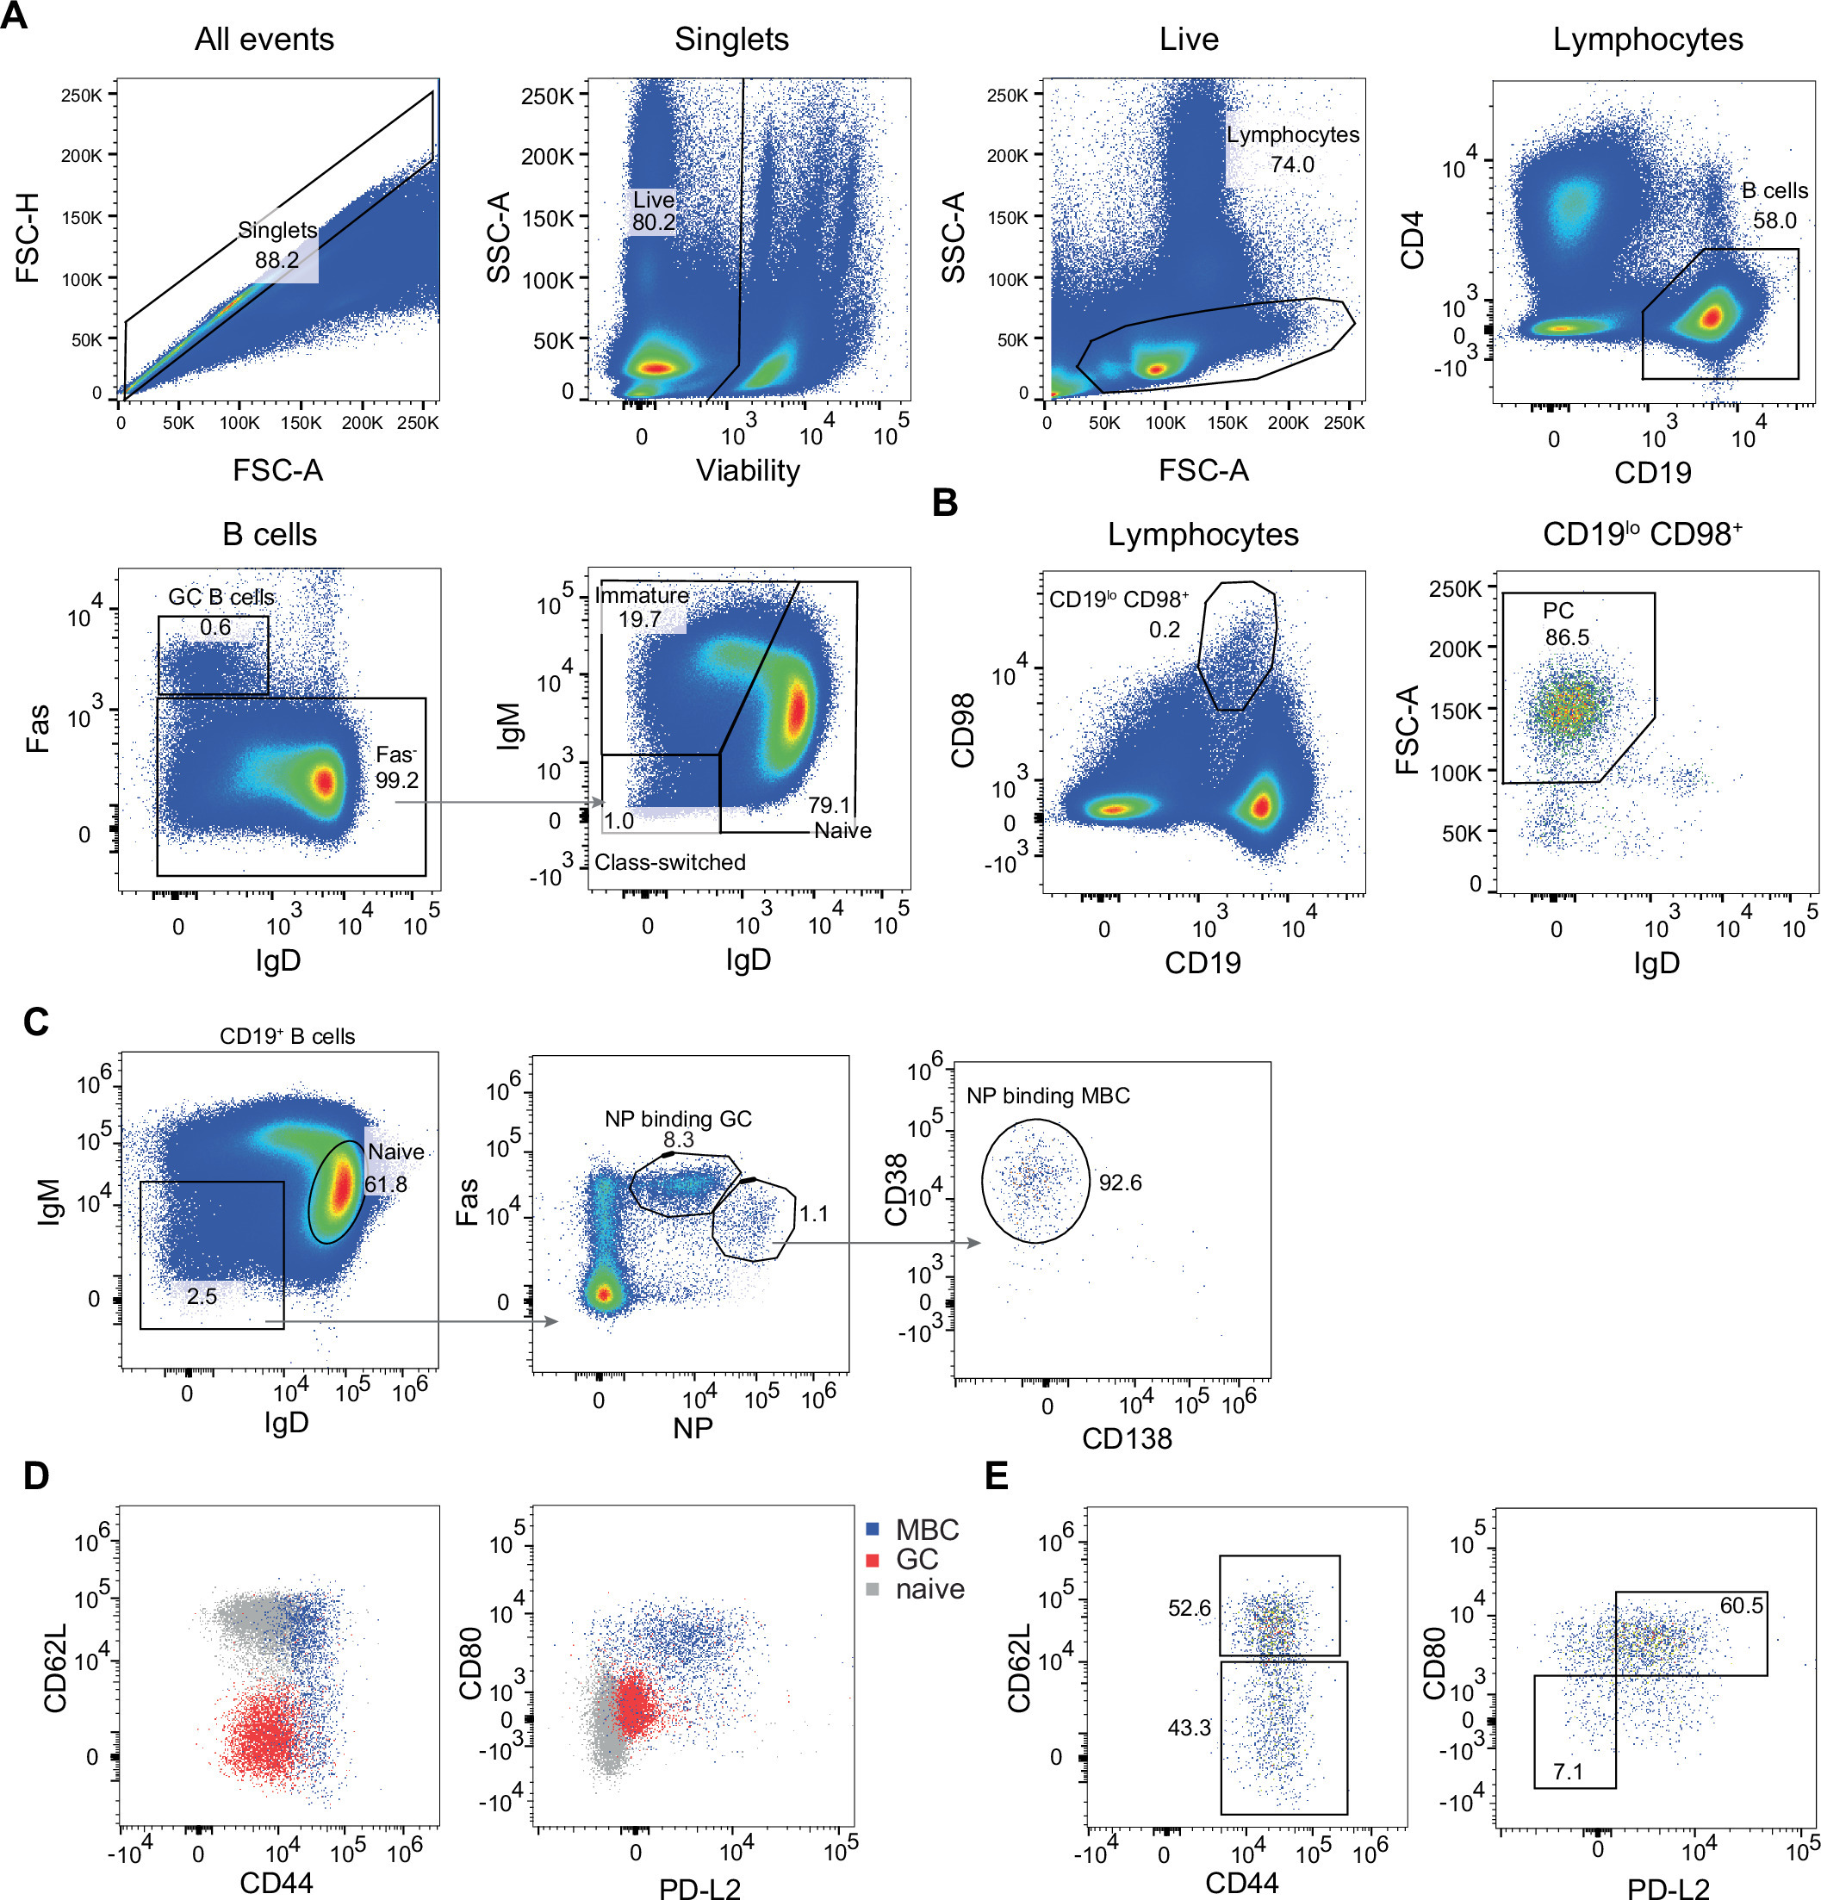
Syndecans and glycosaminoglycans influence B-cell development and activation
EMBO Reports, First published: 28 March 2025, DOI: (10.1038/s44319-025-00432-6)
Notes:
(A, B) Representative flow cytometric plots for the identification of (A) B cells and B-cell subsets and (B) PC. (C–E) Analysis of antigen (NP)-specific germinal center (GC) and MBC 3 weeks post NP-KLH immunization. (C) MBC gating strategy, (D) color-coded overlay of indicated population showing expression of cell surface molecules with MBC subsets. (E) MBC subset gating.

