Slide 1
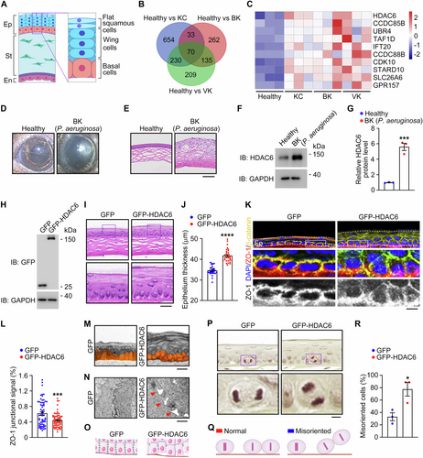
HDAC6 deacetylates ENKD1 to regulate mitotic spindle behavior and corneal epithelial homeostasis
EMBO Reports, First published: 28 March 2025, DOI: (10.1038/s44319-025-00438-0)
Notes:
(A) Schematic illustration of the corneal epithelium (Ep), stroma (St), and endothelium (En). (B) Venn diagram showing the number of genes differentially regulated in the pairwise comparison of healthy, keratoconus (KC), bacterial keratitis (BK), and viral keratitis (VK) corneas. The mRNA microarray dataset GSE241715 from the GEO database was used in the comparison. (C) Heatmap showing genes differentially regulated in the centrosome (P < 0.05, log2foldchange > +1). (D) Representative images of corneas from healthy and BK (P. aeruginosa) mice. (E) H&E staining images of corneas from healthy and BK (P. aeruginosa) mice. Scale bar, 70 µm. (F, G) Immunoblotting (F) and quantification (G, n = 3 independent experiments) showing the level of HDAC6 in corneas from healthy and BK (P. aeruginosa) mice. The intensity of the HDAC6 band was normalized to that of the GAPDH band. P = 0.0006. (H) Immunoblot analysis of GFP and GAPDH in corneas from control GFP or GFP-HDAC6 adenovirus-injected mice. (I, J) H&E staining images (I) and quantification of the thickness of the epithelium (J, n = 30 images from three independent experiments) from control or HDAC6 adenovirus-injected mice. Scale bar, 15 µm. P < 0.0001. (K, L) Immunofluorescence images (K) and quantification of the ZO-1 junctional signals (L, n = 60 cells from three independent experiments) of the cornea from control or HDAC6 adenovirus-injected mice, stained with antibodies against β-catenin and ZO-1 and DAPI. Scale bar, 30 µm. P = 0.0004. (M, N) Transmission electron microscopy images of the longitudinal sections of corneal epithelial cells (M) and cell junctions at the base of the corneal epithelium (N) in control and HDAC6 adenovirus-injected mice. Scale bars, 15 μm (M) and 500 nm (N). (O) Schematic illustration of basal cell junctions in the corneal epithelium from control or HDAC6 adenovirus-injected mice. (P) H&E staining images of the corneal epithelium from control or HDAC6 adenovirus-injected mice. Scale bar, 4 µm. (Q, R) Schematic illustration (Q) and quantification (R, n = 15 mitotic cells from three independent experiments) of normal and misoriented cell division in the corneal epithelium from control or HDAC6 adenovirus-injected mice. P = 0.0257. Data are presented as mean ± SEM. Unpaired two-tailed Student’s t test was performed. *P < 0.05; ***P < 0.001; ****P < 0.0001. Source data are available online for this figure.

