Slide 1
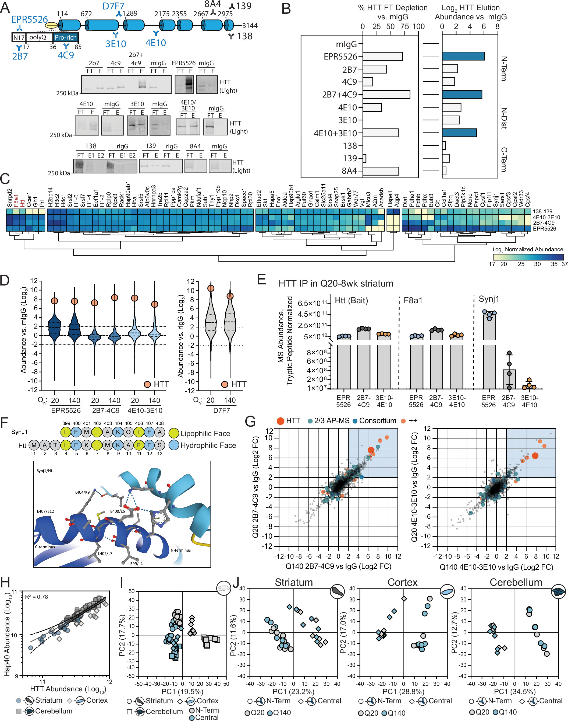
Multi-epitope immunocapture of huntingtin reveals striatum-selective molecular signatures
Molecular Systems Biology, First published: 1 April 2025, DOI: (10.1038/s44320-025-00096-3)
Notes:
(A) Domain map of HTT with IP antibodies marking their approximate epitope regions (see Materials and Methods). Blue cylinders represent the 7 HEAT repeat domains of HTT. Antibody IP efficiency was evaluated in Q20-8 weeks whole brain by western blotting using Odyssey Infrared detection (bottom). Antibodies in blue text had sufficient IP efficiency for further evaluation. FT = flow-through fraction, E = eluted fractions. (B) Western blot densitometry quantification of percent of HTT depleted from the flow-through (FT) vs. mIgG control lanes, and amount of HTT recovered from the elution (E) vs. mIgG control lanes. Antibodies are ordered (top to bottom) by epitope location (N-terminal to C-terminal). (C) Heatmap of the top 5% most abundant HTT interacting proteins (n = 79) isolated and quantified by IP-MS from whole brain using different HTT antibodies (EPR5526, 2B7-4C9, 4E10-3E10, 138-129). Raw MS protein abundances were normalized by their respective replicate medians and theoretical number of tryptic peptides and expressed as the log2 average of two biological replicates in Q20 and Q140-8 weeks conditions. Normalized protein abundances were analyzed by hierarchical clustering (distance metric: Euclidean and method: Ward) with no additional normalization or scaling. Missing values were imputed with the minimum quantified value. (D) Violin plot of log2 enrichment ratio (HTT IP vs mIgG IP) distribution for proteins co-isolated with HTT Q20 or Q140 from the striatum (8 weeks) using antibodies EPR5526, 2B7-4C9 pair, 4E10-3E10 pair, and D7F7. Enrichment ratio of HTT bait is indicated by orange circle. (E) Comparison of Htt, Hap40 (F8a1), and Synj1 levels in IPs of HTT Q20 from the striatum of 8 weeks old mice using EPR5526, 2B7-4C9, or 4E10-3E10 antibodies (n = 4, mean ± SD). Protein abundances were calculated as in (C). (F) Sequence alignment of Htt N17, corresponding to the EPR5526 epitope region, and Synj1 (aa. 399–408). The predicted crystal structure (AlphaFold 2.0) is shown, labeled with selected aligned amino acids of Synj1/HTT in an alpha-helix (dark blue), which forms hydrogen bond contacts with a proximal alpha-helix (light blue). (G) Scatterplot comparisons of co-isolated (prey) protein log2 enrichment ratios (HTT vs mIgG IP) in Q20 vs Q140 for N-terminal (left) and Central (right) antibody sets. Bait HTT and selected positive control interactions are denoted in red and orange circles, respectively. HTT interactions that were annotated in at least 2/3 of the previously reported HTT IP-MS studies from mouse brain are indicated in light blue circles. (H) Scatterplot of log10 abundance (MS summed intensity) for HTT vs. HAP40 showing high correlation in all individual IP-MS experiments by tissue. (I) Principal component analysis of all co-isolated log2 protein abundances stratified by antibody set (N-terminal and Central) and tissue. Abundances were median normalized. (J) Same as (I), except stratified by antibody set and polyQ length, for striatum (left), cortex (middle), and cerebellum (right).

