Slide 1
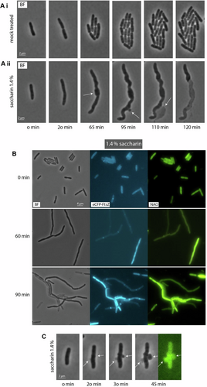
Saccharin disrupts bacterial cell envelope stability and interferes with DNA replication dynamics
EMBO Mol Med, First published: 1 April 2025, DOI: (10.1038/s44321-025-00219-1)
Notes:
(Ai–ii) Phase contrast images of a time lapse of E. coli MG1655 cells mock-treated (i) and treated with 1.4% saccharin (ii). An environmental chamber was used to maintain a constant temperature of 37 °C, and cells were imaged for 120 min. The images shown highlight the formation of a membrane bulge, which quickly becomes so extensive that it ruptures, leaving a “ghost” cell behind. (B) Phase contrast and fluorescent images of E. coli cells following treatment with saccharin. Cells were grown in LB broth (Miller) to the early exponential growth phase. Aliquots were transferred to pre-warmed culture tubes, and saccharin was added at the concentration indicated. Samples were taken at the time shown. The membrane was visualised by staining with 10-nonyl acridine orange (NAO) for 5 min before visualisation (see “Methods” for details). Z-ring formation was visualised by expressing a FtsZ allele fused to CFP (see “Methods” for details). The strain used was JD1709. (C) Time lapse of 1.4% saccharin-induced cell envelope bulging, with NAO staining the bulge. The images shown are representative examples from a minimum of three biological replicates. White arrows indicate cell regions experiencing membrane bulging. Source data are available online for this figure.

