Slide 1
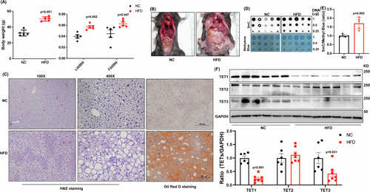
Liver TET1 promotes metabolic dysfunction-associated steatotic liver disease
EMBO Mol Med, First published: 31 March 2025, DOI: (10.1038/s44321-025-00224-4)
Notes:
(A) Body weight, liver weight over body weight (LW/BW), and visceral fat weight over BW (FW/BW) were examined in male C57/BL6 mice fed with either a normal chow (NC) or high-fat diet (HFD) for 16 weeks, n = 5 in NC; n = 5 in HFD. The representative (B) gross images, (C) 100X H&E, 400X H&E, and 400X Oil Red O staining images of NC and HFD fed mice. (D) 5mC dot blot and methylene blue staining were done using the genomic DNA of liver samples derived from NC and HFD mice. (E) Quantification results of 5mC/methylene blue, n = 5 in NC; n = 5 in HFD (F) TET1, TET2, and TET3 protein expression levels were determined in NC and HFD treated mice. Bottom panel: The relative ratios of TET1, TET2, TET3 over GAPDH, n = 6 in NC; n = 7 in HFD Data are presented as mean ± S.D. in (A, E), and (F). P values were determined using unpaired two-tailed Student’s T test. Exact p values were as indicated. Source data are available online for this figure.

