Slide 1

Docker

Slide 2
Ready!

Slide 3
Problem
1
Some problem that you can meet when depoly/ operation an application

Slide 4
Too many steps to install new software!

Slide 5
Different environments!

Slide 6
Increase/decrease the number of instance in your environment manually!

Slide 7
Table Of Contents
Docker introduce
Docker architecture
Docker componets
Demo

Slide 8
Docker introduce

Slide 9
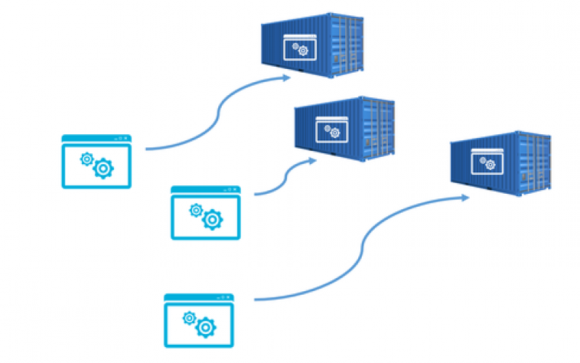
Docker is a container management service
The keywords of Docker are build, ship and run anywhere

Slide 10
Docker architecture

Slide 11
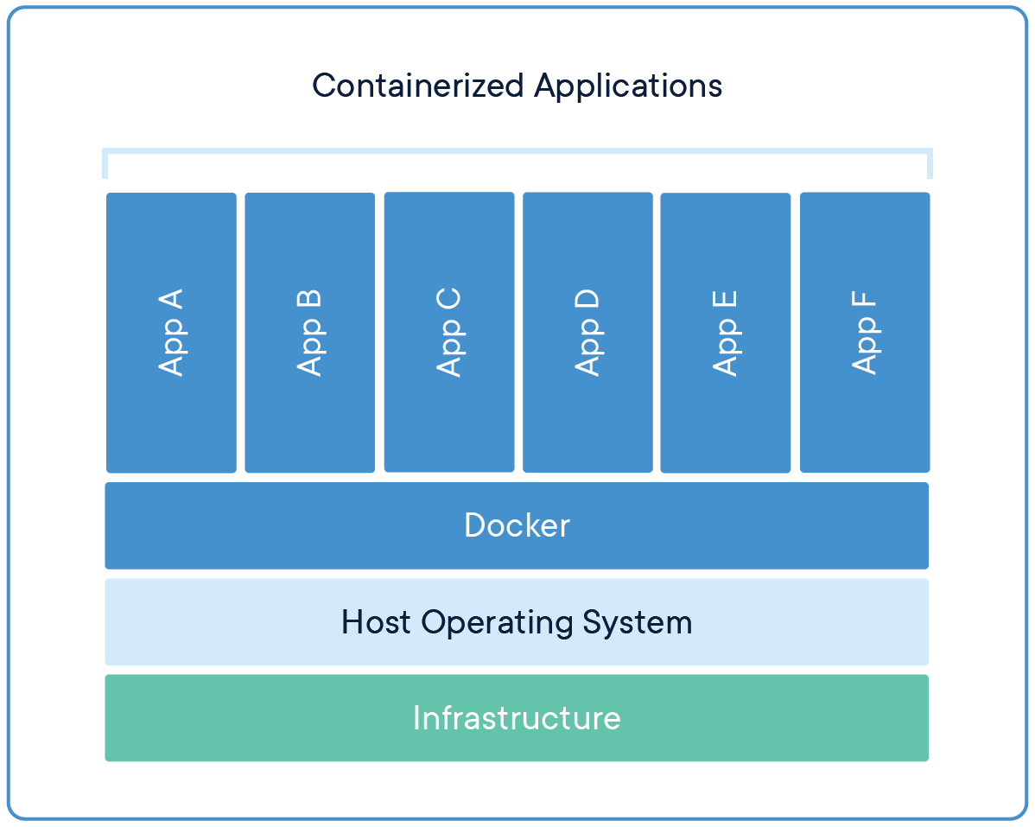

Slide 12
Docker componets

Slide 13
Docker File
A Dockerfile is a text document that contains all the commands a user could call on the command line which is gathered together in one place for make out of an image.

Slide 14
FROM openjdk:8-jre
RUN curl "https://archive.apache.org/dist/activemq/$ACTIVEMQ_VERSION/$ACTIVEMQ-bin.tar.gz" -o $ACTIVEMQ-bin.tar.gz
RUN tar xzf $ACTIVEMQ-bin.tar.gz -C /opt && \ ln -s /opt/$ACTIVEMQ $ACTIVEMQ_HOME && \ useradd -r -M -d $ACTIVEMQ_HOME activemq && \ chown -R activemq:activemq /opt/$ACTIVEMQ && \ chown -h activemq:activemq $ACTIVEMQ_HOME
CMD ["/bin/sh", "-c", "bin/activemq console"]

Slide 15
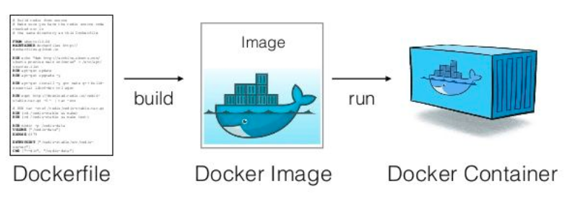
Image/ container

Slide 16
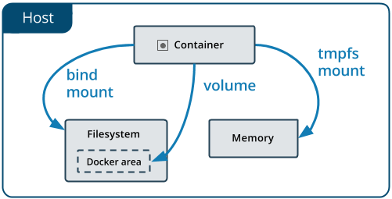
Docker storage

Slide 17
Docker storage
Volumes
are stored in a part of the host filesystem (/var/lib/docker/volumes/ on Linux)
Non-Docker processes should not modify this part of the filesystem
Bind mounts
may be stored anywhere on the host system
Non-Docker processes on the Docker host or a Docker container can modify them at any time.
Tmpfs mounts
are stored in the host system’s memory only
are never written to the host system’s filesystem.

Slide 18
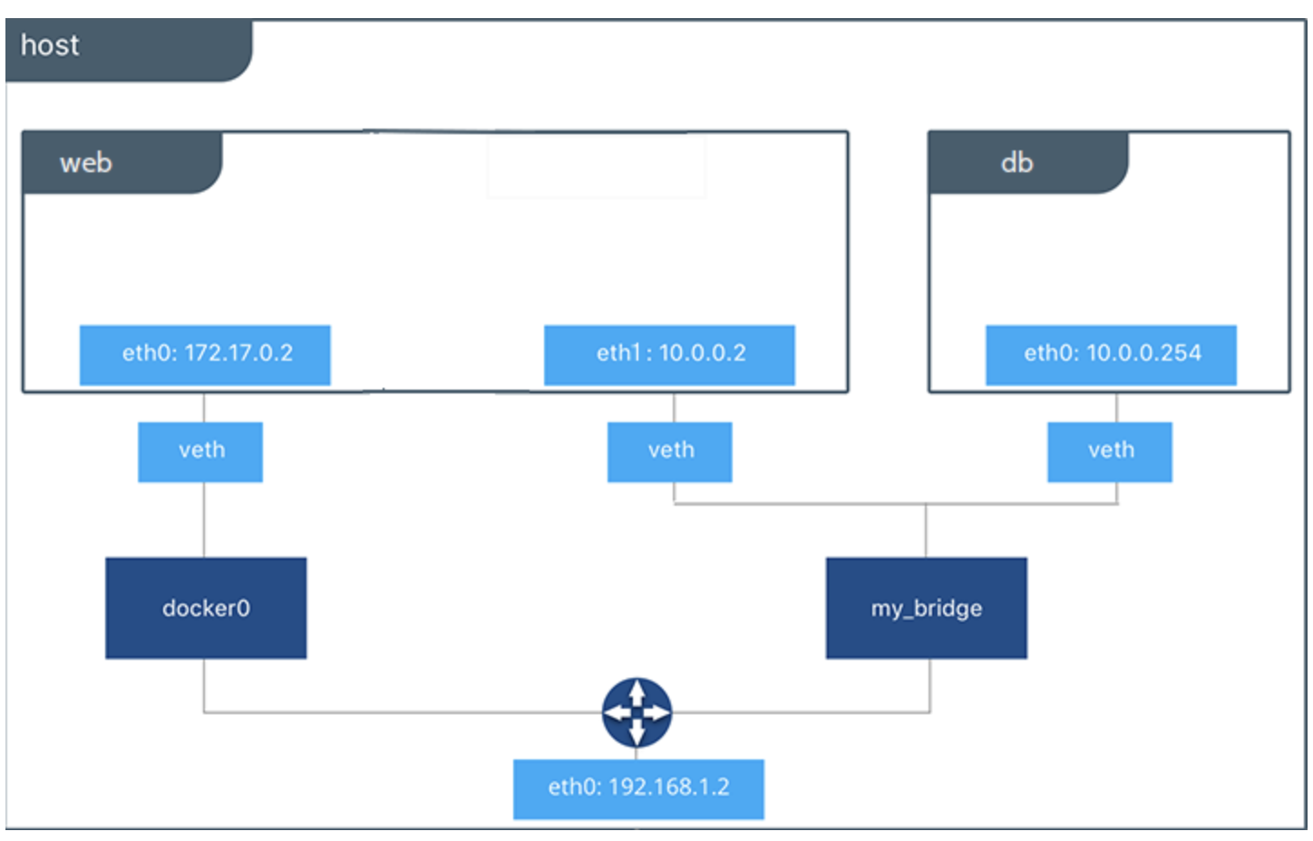
Docker networking

Slide 19
Network drivers
Bridge
Bridge networks are usually used when your applications run in standalone containers that need to communicate
Host
For standalone containers, remove network isolation between the container and the Docker host, and use the host’s networking directly

Slide 20
Network drivers
Overlay
Connect two standalone containers on different Docker daemons
Macvlan
Macvlan networks allow you to assign a MAC address to a container
making it appear as a physical device on your network

Slide 21
Withdraw service and docker
ActiveMQ
Withdraw client
Active MQ
Transfer core
Withdraw provider
ActiveMQ

Slide 22
Thanks!
Q&A
Any questions?

Slide 23
SlidesCarnival icons are editable shapes.
This means that you can:
Resize them without losing quality.
Change fill color and opacity.
Change line color, width and style.
Isn’t that nice? :)
Examples:

