Slide 1
●
KalevaShorts
KALEVA MEDIA HACKATHON · OULU · 2026
The newsroom
that speaks
your language.
SEVEN LANGUAGES
English
Suomi
Svenska
العربية
Davvisámegiella
Українська
A multilingual, agent-run newsroom for the people local media reaches least. Built in Oulu, with a named human behind every published story.
Русский
FRONTEND / BACKEND / AGENTIC NEWSROOM
Notes:
KalevaShorts is a multilingual newsroom for communities local media reaches least. The deck follows the three systems: the frontend people touch, the backend that serves it, and the agentic newsroom that does the reporting work. Everything published has a named human behind it.

Slide 2
THE GAP
Local news misses the people
who need it most.
IN THE PRODUCT
01
Newcomers in Oulu
7
Permits, work, housing and language, explained in the language they read.
02
Seasonal workers
Contracts, staff housing and winter safety, without a translation delay.
languages, every story
03
North Sámi speakers
10 communities
News in Davvisámegiella, reviewed by a person, not machine text.
22 topics, 11 links
The news exists. The language
and the trust are missing.
KalevaShorts · the gap
02 / 12
Notes:
Local media does not fail because there is no news. It fails because the news is not in the language people read, and because newcomers and seasonal workers are not in the room when stories are chosen. The product starts from those three groups: newcomers in Oulu, seasonal workers, and North Sámi speakers.

Slide 3
WHAT WE BUILT
One story. Seven languages.
One accountable newsroom.
01 Collect
02 Cluster
03 Explain
04 Translate
05 Review
06 Publish
feeds + officials
same news → one event
what happened + what it means
all seven languages
named humans by role
dashboard + community
AGENTS DO THE WORK
PEOPLE HOLD THE GATE
READERS SEE WHY
Monitor, cluster, investigate,
write, translate, check.
A named editor, language reviewer
or subject expert approves.
Sources, reasons, corrections and
the name behind every approval.
Nothing publishes without a named person.
KalevaShorts · the product
03 / 12
Notes:
The product is one loop: collect real reporting, cluster the same news into one event, explain it, translate it, put it through a human gate, and publish per channel. Agents do the routine work; people make every publication decision.

Slide 4
SYSTEMS
Three systems, one loop.
Next.js 16
FastAPI
Agentic
newsroom
Browser
React 19
Server Components + Actions
Clerk 7 session
GSAP / Lenis
7 languages
/api/v1 · async Motor
Clerk RS256 bearer
reader / editor / admin
feeds · library · related
NewsroomSync
LangGraph
9 agents
human gate
Gemini
Reader · Editor · Community
Clerk owns sign-in.
The browser sends a Bearer token.
Every route checks it.
MongoDB · multilingual_news (reader) + agentic_newsroom (tree, reviews, audit)
published stories → NewsroomSync
The browser never sees the newsroom key. Authorization happens on the server, on every render.
KalevaShorts · architecture
04 / 12
Notes:
The frontend talks only to the FastAPI backend. FastAPI verifies the Clerk bearer token, enforces roles, and whether the call is a reader, editor or admin request. The backend talks server-to-server to the agentic newsroom with an API key the browser never sees. Published stories sync back into the reader collections.

Slide 5
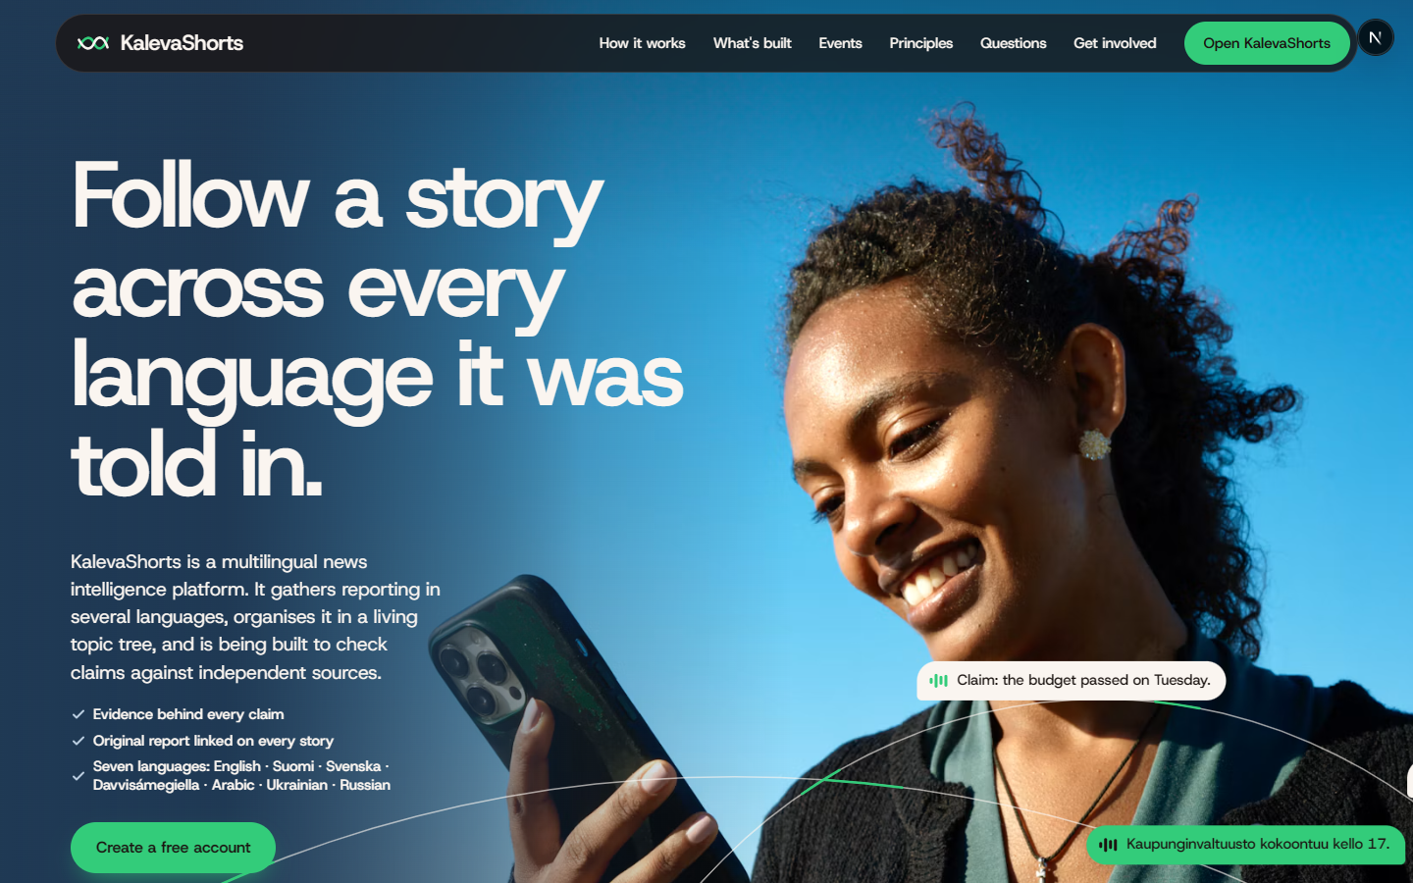
FRONTEND
A public face and
a working desk.
Next.js 16 + React 19 Server Components, Server Actions, partial prerender.
Clerk 7 Sign-in, session, roles; authorization checked server-side on every render.
GSAP 3 + Lenis Scroll scenes, SplitText, reduced-motion safe, clean teardown.
One design language Tokens from the landing page carried into the dashboard.
Public landing page · live screenshot
Seven languages Reader, editor and community surfaces; Arabic is right-to-left.
The same tokens, type and restraint run from the first screen into the editor.
/dashboard /editor /dashboard/community
KalevaShorts · frontend
05 / 12
Notes:
The frontend has two jobs: earn attention in public and disappear in the newsroom. The landing page is the brand surface. The dashboard, editor and community pages use the same tokens. Clerk handles sign-in, but every page and action re-checks the role on the server. The language switch changes the edition, not the story.

Slide 6
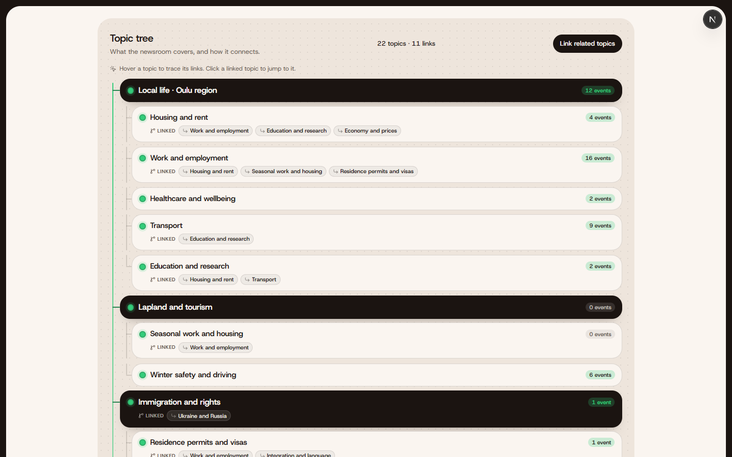
EDITOR
The story tree,
not a feed.
22
topics
11 branch links
45 live events in the last 7 days
Events, not articles Articles attach to one event; the same news from several outlets becomes one row.
Symmetric branches The Connector links related topics both ways; the tree is a graph, not a folder.
Trace and jump Hover a topic to trace its links; click a linked topic to jump to it.
Live editor data · real topic counts
Drawn, then settled GSAP grows the trunk and branches, then hands the surface back.
A topic tree is how a newsroom explains its own judgement: what it covers, what it links, what it leaves empty.
KalevaShorts · editor
06 / 12
Notes:
This is the surface we redesigned for the editor. A flat list of topics became a tree with a trunk, nested branches, event counts and link chips. The hover state shows the connected topics; clicking a link jumps to the other node. The counts in this screenshot come from the live agentic database.

Slide 7
BACKEND
The quiet engine.
01
FastAPI /api/v1
Async Motor, Pydantic v2, typed errors, OpenAPI.
RELATED NEWS, SCORED
score =
02
Clerk resource server
RS256 verification, roles, lazy profile sync.
6
same event, another outlet
03
Ingestion
RSS, trafilatura, language detection, URL dedupe.
3
shared topic
1.5
branch topic
04
Per-language store
articles_en … articles_ru; one collection per edition.
4 ×
embedding cosine
+
popularity × freshness
05
Related news
Event, topic, branch, meaning, popularity, freshness.
Every result carries its reasons.
76 backend tests · Ruff + format CI · no live services needed.
The browser asks for a language; the server returns one collection. No client-side data joins.
KalevaShorts · backend
07 / 12
Notes:
The backend is deliberately boring: typed routes, Clerk verification, repositories, one collection per language, and deterministic indexes. The interesting part is related news: it scores candidates by the event tree first, then meaning, then popularity and freshness, and returns the reason for every item.

Slide 8
AGENTIC NEWSROOM
Agents do the work.
People hold the gate.
Monitor
Architect
Editor
Investigator
Explainer
Translator
Standards
HUMAN GATE
Distributor
9
newsroom roles
LangGraph
checkpointed workflow
Every step
audited with a reason
Bounded
investigation + revision
Guarded
untrusted text, prompt injection
Human-only
Sámi text + the final publish
Only a named person can publish. The agents can propose; they can never approve.
KalevaShorts · agentic newsroom
08 / 12
Notes:
The agentic newsroom copies a real newsroom's roles. The monitor watches feeds, the architect clusters the same news into events, the editor pitches, the investigator gathers evidence, the explainer writes, the translator drafts, and standards checks risk. Then the graph stops at a checkpointed human gate. A distributor will not publish without the approvals the policy requires.

Slide 9
TRUST
Trust is a workflow,
not a banner.
01
Named approvals
Editor-in-chief, language reviewer, community reviewer, subject expert. A name, not a role label.
02
Risk tiers
Permits, health, work and legal rights need extra reviewers by policy.
03
Corrections
Public, named and attached to the story; the JSN guidelines become code checks.
04
Sourcing
Official references labelled; Kaleva metadata only; no paywall bypass.
Agents propose. Code validates. People decide.
KalevaShorts · trust
09 / 12
Notes:
This is the line we do not cross. Agents can collect, cluster and draft; they cannot approve. Every approval is a named person with a role. High-risk stories need more roles. Corrections are public. Kaleva is metadata-only because it is paywalled, and official sources are labelled.

Slide 10
REACH
Seven languages, one edition each.
English
46
46
322
45
Suomi
46
real stories
editions
events
Svenska
46
العربية
46
5
22
10
Davvisámegiella
46
Oulu sources
topics
communities
Українська
46
Русский
46
Live data in the current databases: the last seven days of real Oulu reporting, each story in all seven editions.
KalevaShorts · reach
10 / 12
Notes:
Every story exists in all seven app languages: English, Finnish, Swedish, Arabic, Davvisámegiella, Ukrainian and Russian. The counts here are live: 46 real Oulu stories from the last seven days, 322 editions, 45 events. The point is not a demo translation; it is the same story switchable mid-read.

Slide 11
TODAY
The demo is the product.
READER
EDITOR
COMMUNITY
/dashboard
/editor
/dashboard/community
For-you feed in the chosen language
Topic tree and source health
Follow communities and official sources
Related stories with reasons
Run a cycle; review queue
Ask, tip, share local knowledge
Save, history, follow sources
Named approvals and corrections
Trusted voices and moderation
46 real Oulu stories · 322 editions · 45 events
last 7 days · every story in 7 languages
One platform, three systems, live data.
KalevaShorts · what works
11 / 12
Notes:
The demo is end to end. A reader can switch language and see the same story in another edition. An editor sees the topic tree, source health, the review queue and named approvals. A community member can follow a community or official source, send a tip, question or correction, and see a trusted voice review it.

Slide 12
●
KalevaShorts
Local news that
reaches everyone.
Ask us for a demo. Bring a story in any of the seven languages.
FRONTEND / BACKEND / AGENTIC NEWSROOM
Kaleva Media Hackathon
Next.js 16 · FastAPI · LangGraph · Gemini · MongoDB
Oulu · 2026
Notes:
Close on the promise: local news that reaches everyone. The three systems are ready to demo: the frontend surfaces, the backend contracts, and the agentic newsroom tree. Ask for a story and a language.

