Slide 1
Course Registration
Ali Arshad, Nick Brisson, Mat Kallada, Greg Mailman, Dan Parsons, Pascha Protter, Samath Scott

Slide 2



Overview
Development tools
Android Studio
Firestore database
Gitlab

Slide 3
Overview - Main User Stories
Originally planned for 17 user stories
Login screen
Course list
Register for course
Course details page
Drop a class
View schedule
Notify user when there is a time conflict
Filter courses by program
Reset password
View course
Restrict registering for a course twice

Slide 4
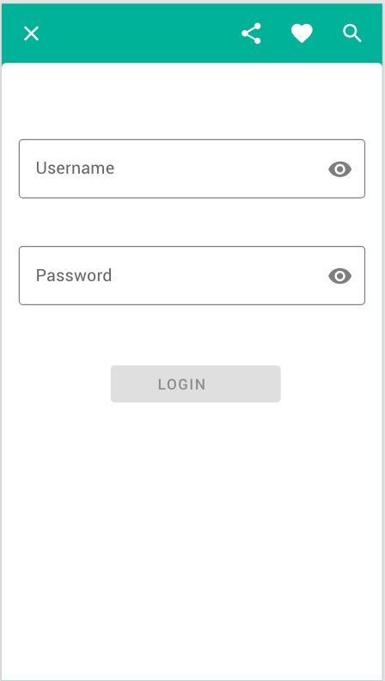
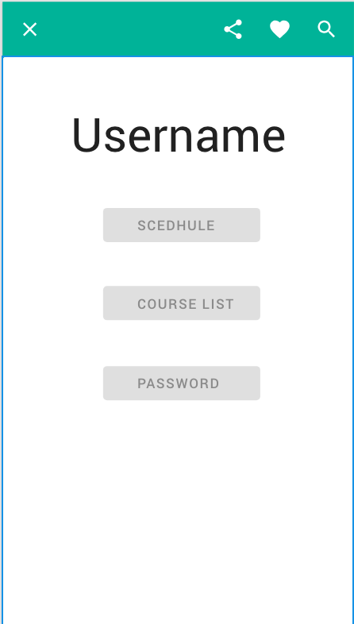
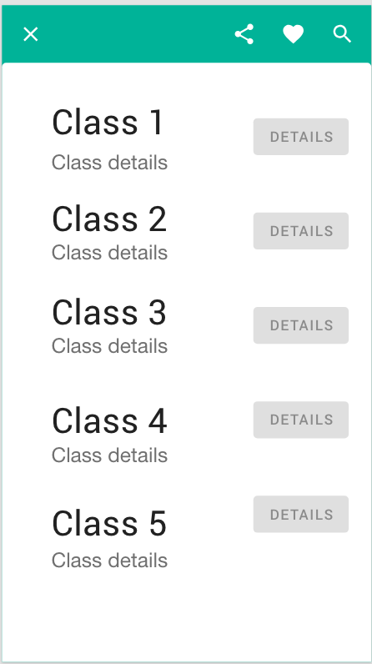
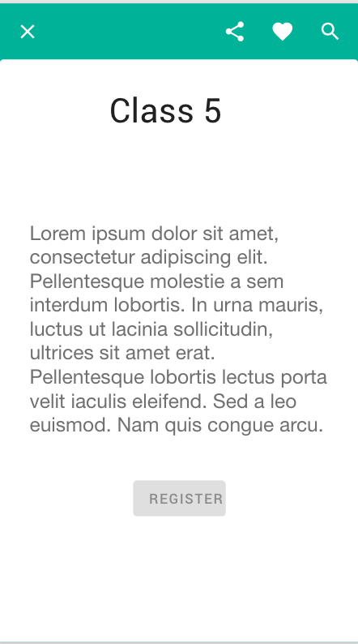
Overview - Wireframes and Design

Slide 5
Final Outcome
Completed a total of 11 user stories
8 user stories were required functionality
Course list, Course Description, Schedule, Adding and Dropping Course
3 were bonus functionality
Password reset, prerequisites and waitlist
Process
Pair Programming
TDD
Planning and Collaboration

Slide 6
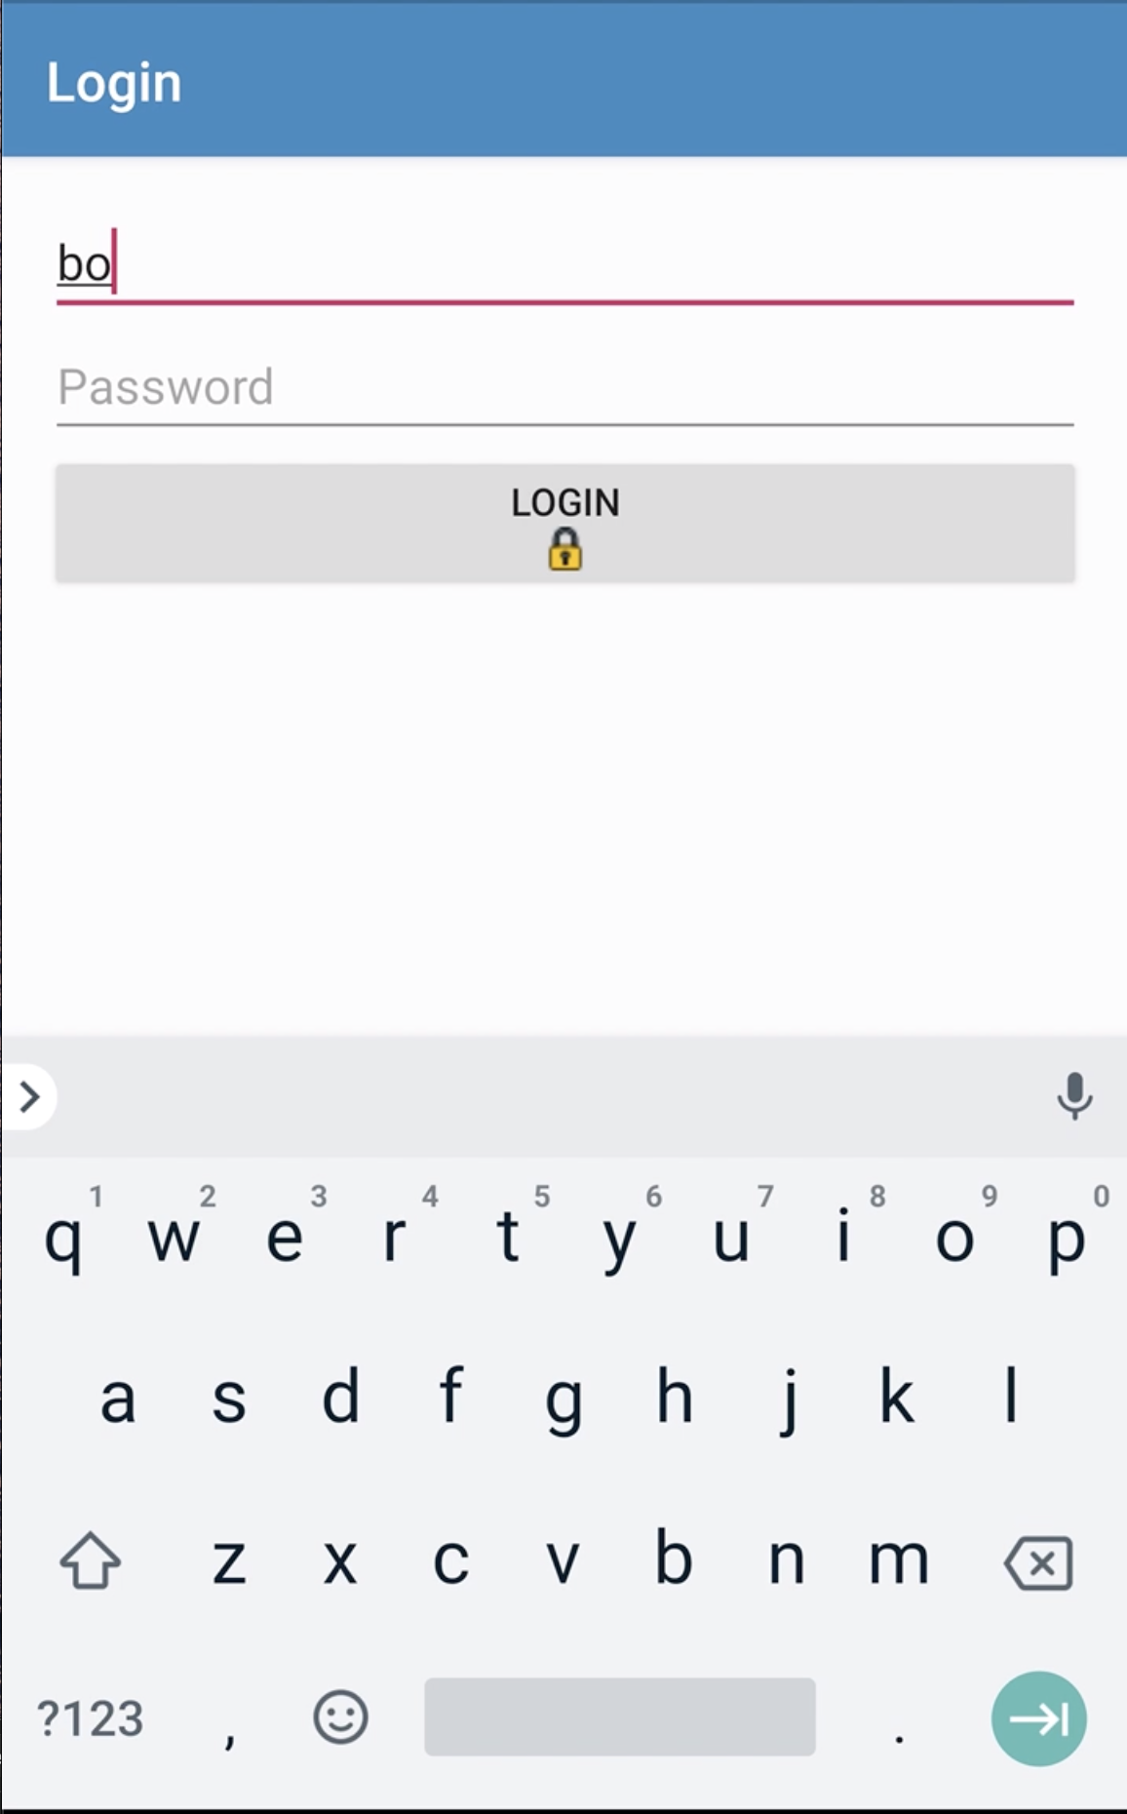
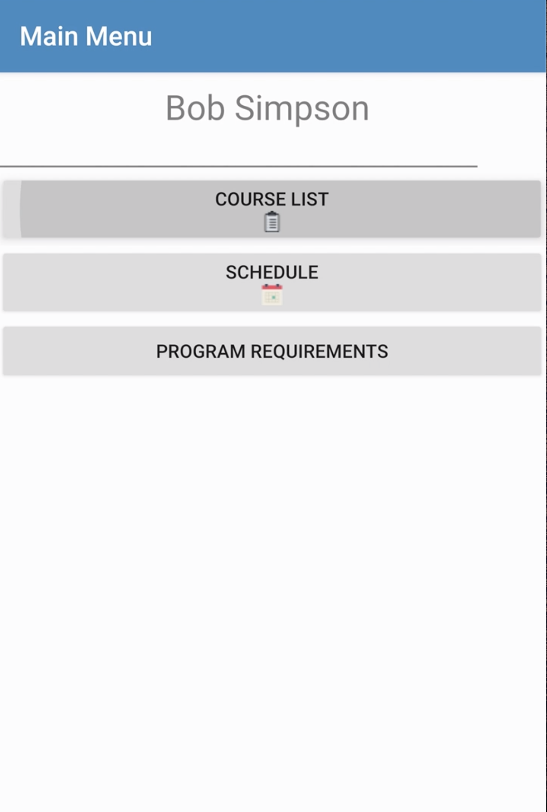
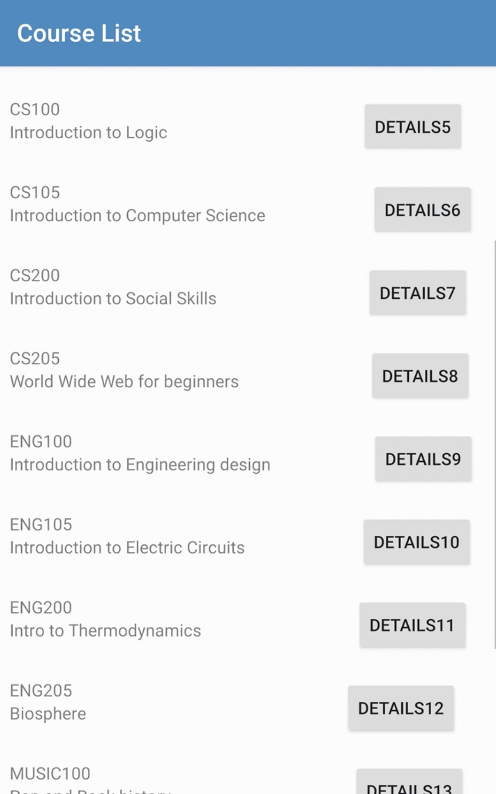
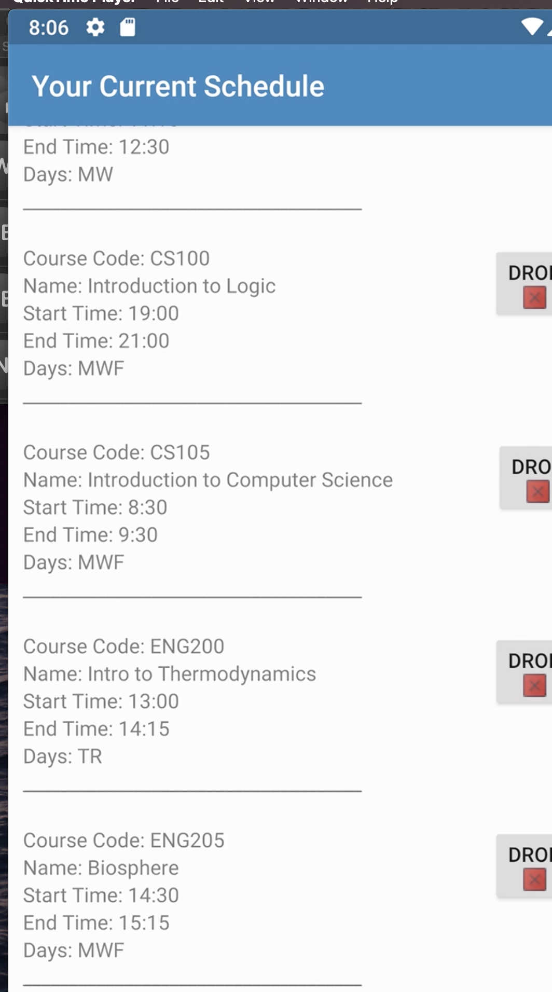
Final Outcome

Slide 7
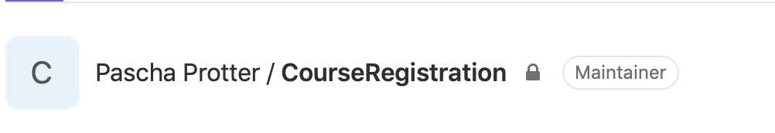

Implementation
Challenges
Gitlab and our conflicts in merging and maintainer privileges
Success
Properly implementing unit, espresso tests, and documentation before implementing the actual functionality post iteration 1

Slide 8
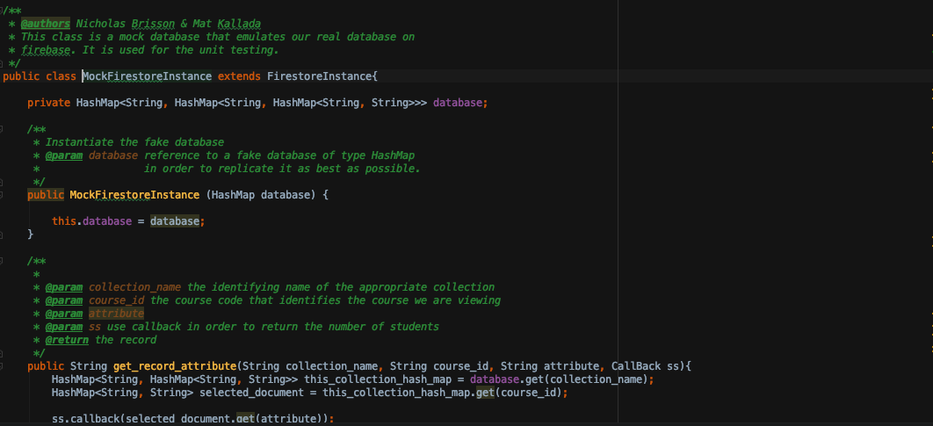
Software
Challenges
Implementing a schedule that displays all of a student’s current course times
Using values queried from the database due to asynchronous querying with firestore
Success
Creating a mock database for user testing

Slide 9
Questions?

Slide 10
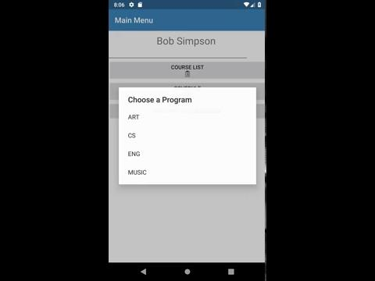
Demo

