Slide 1
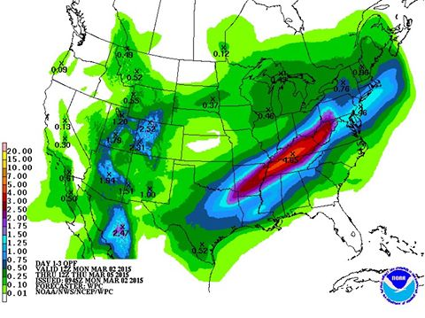
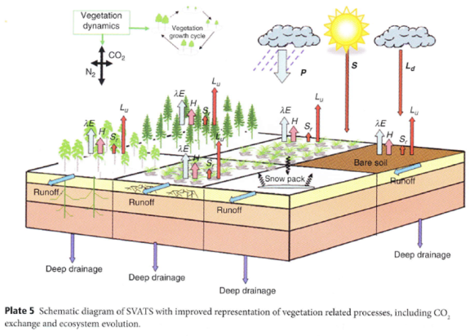
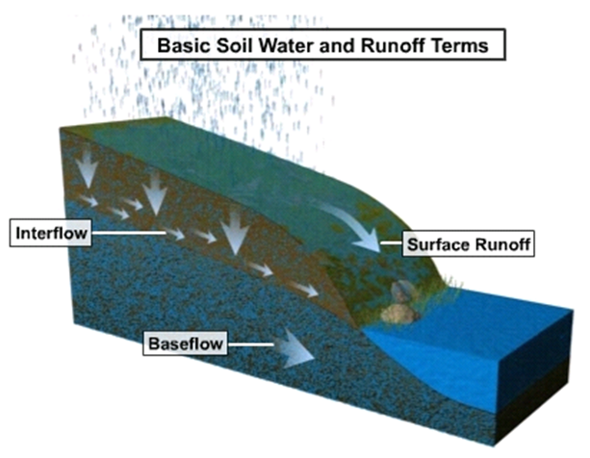
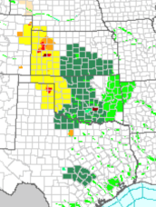
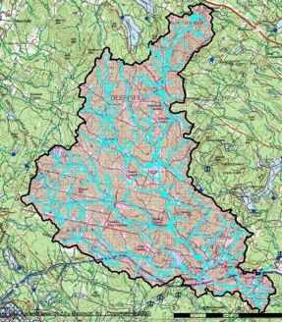
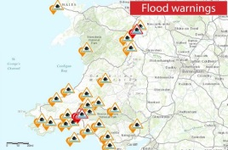
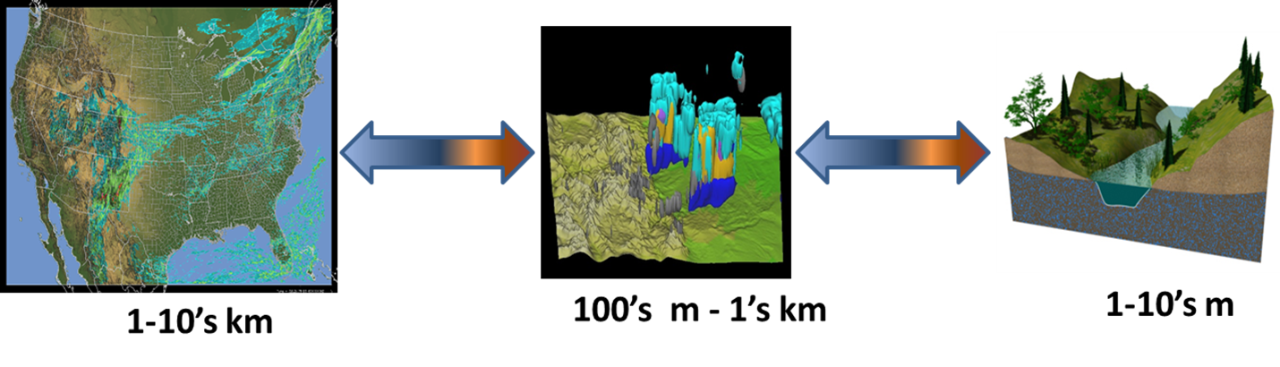
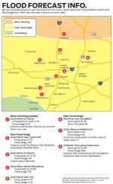
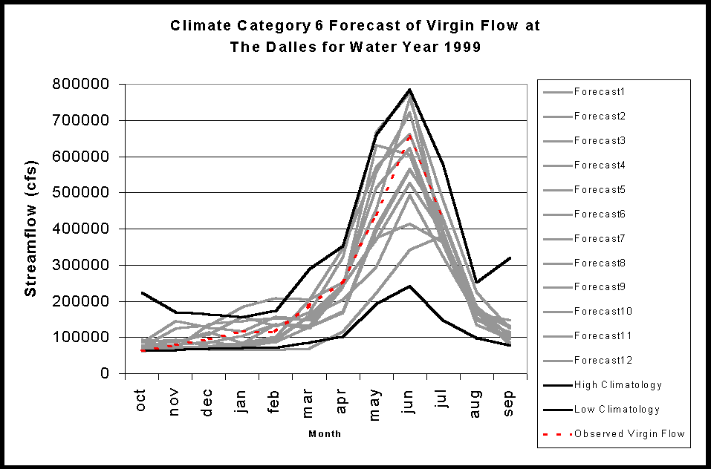
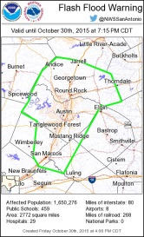
Coarray Fortran (CAF) Teams: Ensemble members run using CAF teams
Message Passing Interface (MPI) and CAF mix: WRF-Hydro Model Chain
(example of NOAA’s National Water Model Implementation)
a. NWM Forcing
(1 km grid)
b. NoahMP LSM
(1 km grid)
c. Terrain Routing
Module
(250 m grid)
2-way coupling
d. NHDPlus Catchment
Aggregation
(2.6M unique
catchments and
river reaches)
e. Channel &
Reservoir
Routing
Modules,
Nudging Data
Assimilation
Model Outputs
&
Forecast Products
# of teams

