Slide 1
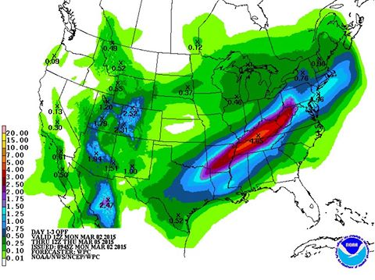
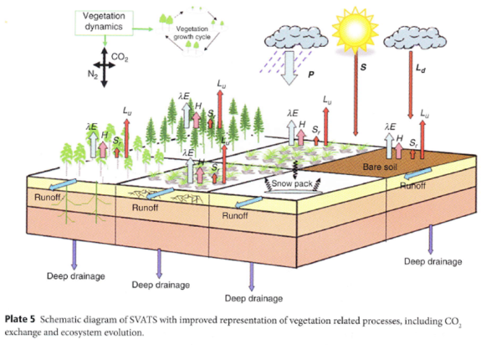
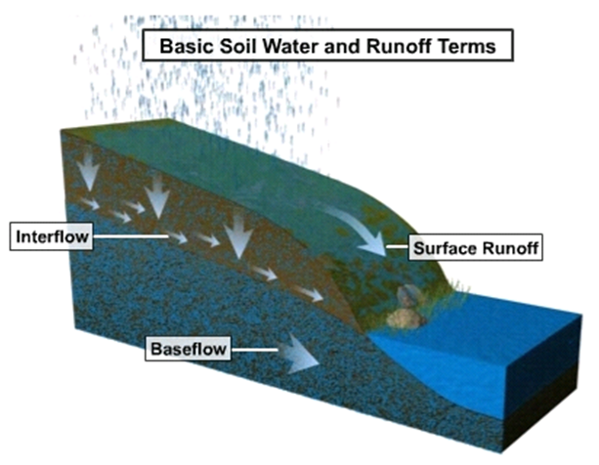
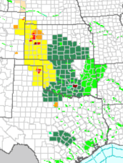
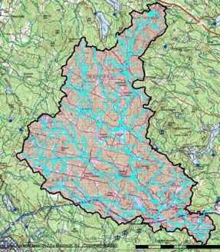
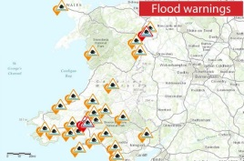
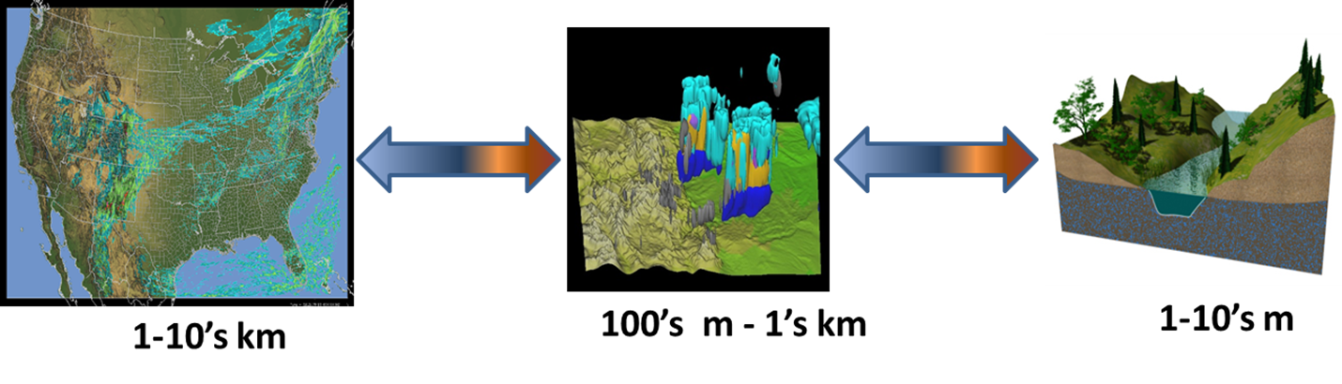
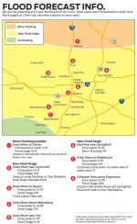
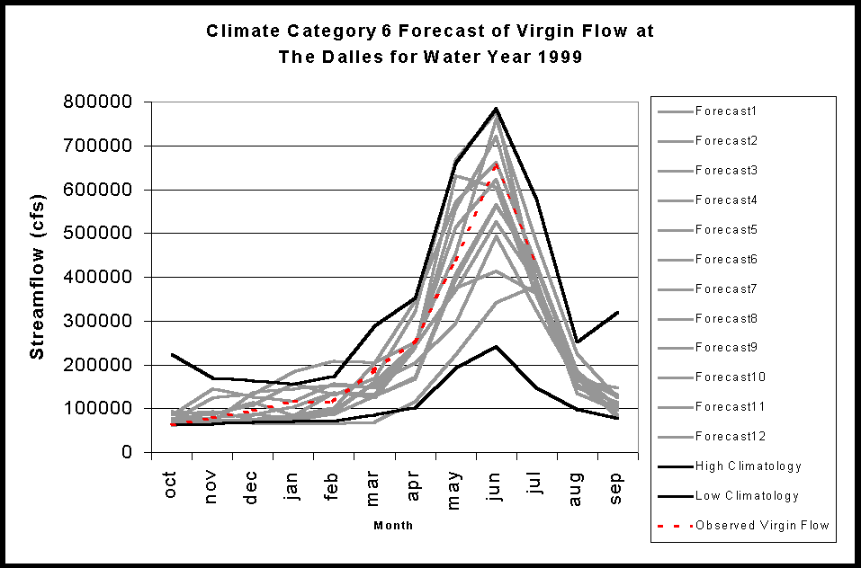
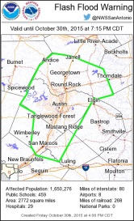
Incremental Caffeination of NCAR’s Community WRF-Hydro Model
CAF: Ensemble members run via coarray fortran teams
MPI: Model Chain (example of NOAA’s National Water Model Implementation)
1. NWM Forcing Engine
(1 km grid)
2. NoahMP LSM
(1 km grid)
3. Terrain Routing
Module
(250 m grid)
2-way coupling
4. NHDPlus Catchment
Aggregation
(2.6M unique
catchments and
river reaches)
5. Channel &
Reservoir
Routing
Modules,
Nudging Data
Assimilation
Forecast
Products
WRF-Hydro: https://www.ral.ucar.edu/projects/wrf_hydro

