Slide 1

Workflow and Progress: Implementing MLFFs/MLIPs on Molten Cu-In Nanoparticle Systems to Model Growth of Carbon Nanotubes
Supervised by: Dr. Vishal Agarwal Department of Chemical Engineering IIT Kanpur
Anmol Bansal
Sourish Das

Slide 2
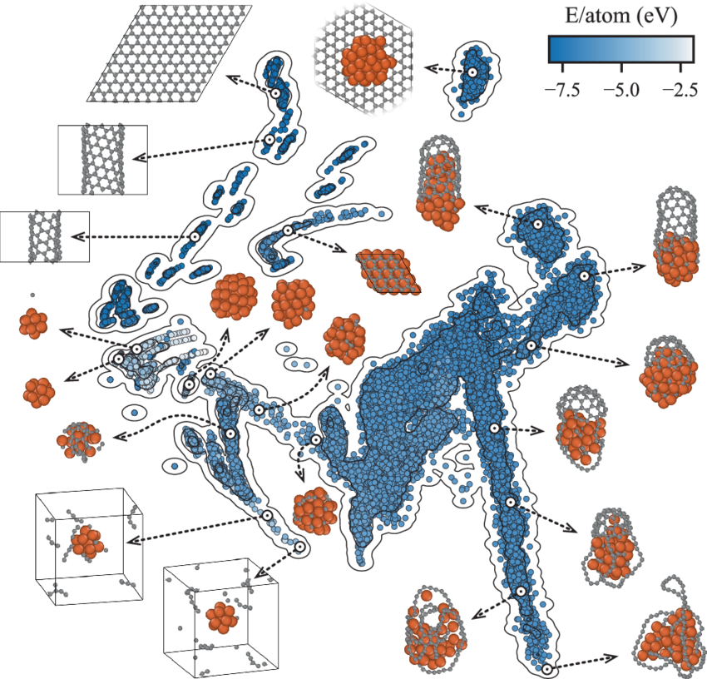
State Space Visualisation of the Training Dataset: DeepCNT-22

Slide 3
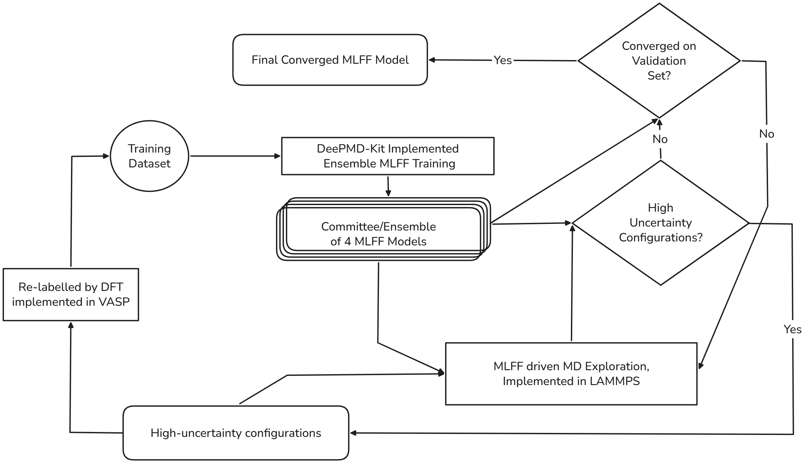
MLIP Versions planned for our system: Molten Cu-In + CNT

Slide 4
Index
What are MLFFs/MLIPs?
Review of Literature on MLFF implementations on similar systems – Hedman, Parinello
State Space Visualisation of the DeepCNT-22 Dataset configurations
State Space Coverage Scheme for Molten Cu-In Catalyst System
MLFF Versions Planned
Representative Schematic Flow Diagram of the MLIP Development
Preliminary Training Run
Phase 1: Initial Dataset Generation (AIMD Short Burst)
Phase 2: Transition Manifold Coverage (AL-NEB, PLUMED + OPES)
Phase 3: MLIP setup and training (DeePMD Kit)
Phase 4: Initial Validation and Testing
Active Learning Training Loop
Uncertainty Criteria
Phase 1: High Uncertainty Set Formation
Phase 2: Exploration around High Uncertainty Set (LAMMPS, AL-NEB, PLUMED + OPES)
Phase 3: Single Point DFT Relabelling (VASP)
Phase 4: Recursive Training Loop (DP GEN, DeePMD Kit)
Phase 5: Intermittent Validation and Testing
Termination Criteria
Final Model Benchmarking and Applications
Differences in development methods across the literature
Rare Event Sampling
Role of Delta Learning
Role of Reduction and Farthest Point Sampling
Important Questions and Nuances
Toy Problems on Methane and Water Systems

Slide 5
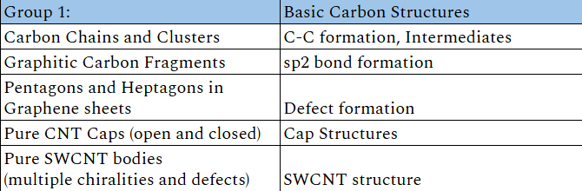
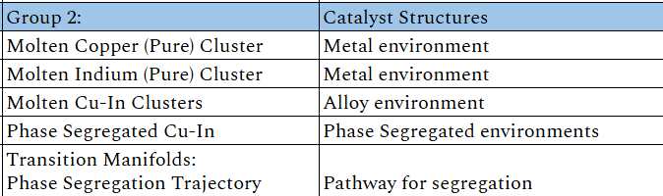
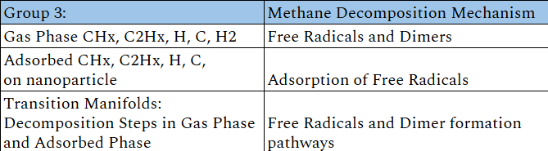
State Space Coverage for Molten Cu-In Catalyst System

Slide 6
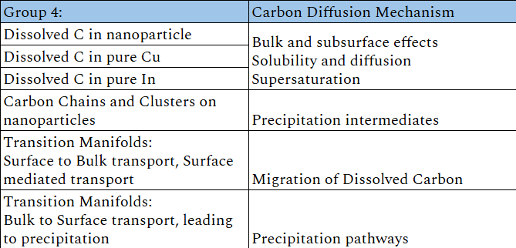
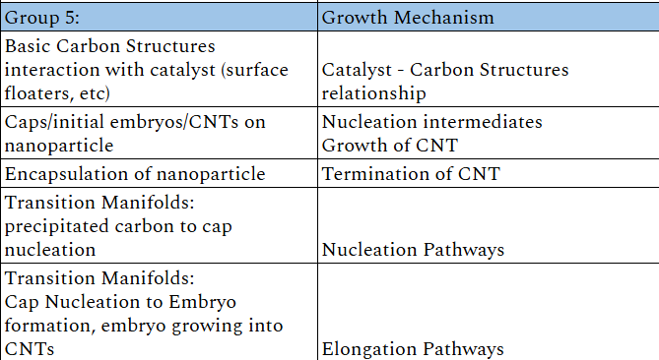
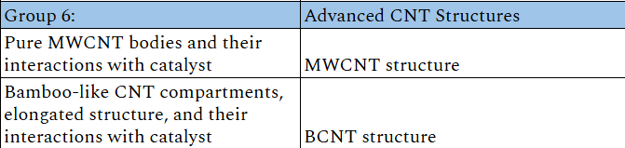
State Space Coverage for Molten Cu-In Catalyst System

Slide 7
Representative Schematic Flow Diagram of the MLIP Development
Preliminary MLFF Training Run
Exploration and Labelling using Short AIMD Trajectories [x,y,z,E,F,V]
Enhanced Sampling of Transition Manifolds
Configurations [POSCARs]
MLFF Model Ensemble
Training
[ASE]
[DeePMD-kit]
[OPES + PLUMED]
[VASP]
Preliminary Trained MLFF

Slide 8
Representative Schematic Flow Diagram of the MLIP Development
Recursive MLFF Training Run
[VASP]
High Deviation Configurations
Single Point DFT Re-labelling [x,y,z,E,F,V]
Partially Trained MLFF
Ensemble
[DeePMD-kit]
Enhanced Sampling of Transition Manifolds
[OPES + PLUMED]
MLFF Model Ensemble
Training
Classical MD Exploration
[LAMMPS]

Slide 9
Representative Schematic Flow Diagram of the MLIP Development
Validation, Testing, and Benchmarking Runs
Classical MD
Fully Trained MLFF Model
[LAMMPS]
Validation Dataset
Test Dataset
Validate results from theory and physical sense
Test results by benchmarking against DFT

Slide 10
Stage 1: Configuration Geometry Generation
Use of ASE and database CIF files.
Stage 2: First Principles Chemistry Sampling
Use of VASP for running short burst AIMD trajectories for all configurations from Stage 1
Identifying rare events
NVT Ensemble AIMD conditions?
Barostat configuration = ?
Thermostat configuration = ?
Equilibriation Duration of AIMD short burst = ?
Timesteps = ?
Plane Wave Cutoff energy = ?

Slide 11
Stage 3: Enhanced Reactive Chemistry Sampling
Use of OPES and PLUMED for enhanced sampling of the reactive states
Anchoring of the reaction pathway in the training dataset
PLUMED for the collective variable calculations. Explain?
OPES for bias potentials. Explain?
What might be the suitable collective variables for our system?
How is this enhanced sampling step implemented?

Slide 12
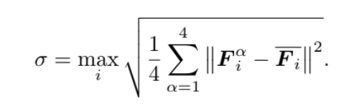
Stage 4: Model IP Training and Exploration
Use of DeePMD-kit for MLIP development
Formatting by dpdata
Potential Model = Deep Potential Molecular Dynamics Smooth Edition Scheme
Ensemble of four MLIPs for calculation of deviation
Embedding Network?
Descriptor = se_e2_a
Fitting Network = ener
Ensemble Standard Deviation of Forces
Criteria for selecting high deviation configurations
Relabelling done similar as Stage 2 and Stage 3
Use of LAMMPS for exploration around the high deviation configurations
Use of DP-GEN for the active learning loop? How is this implemented?

Slide 13
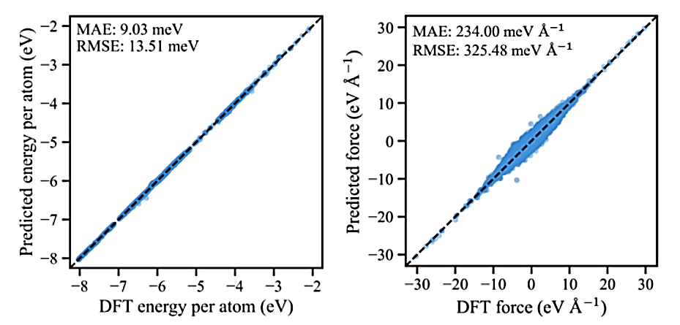
Stage 5: MLIP Validation, Testing, and Benchmarking
Validation using the validation dataset against theory and physical sense
Testing using the test dataset by benchmarking against AIMD and PLUMED for crucial calculations
Tuning of the model if needed?

