Slide 1

Implementing MLFFs/MLIPs on
Molten Cu-In Nanoparticle Systems to
Model Growth of Carbon Nanotubes
Supervised by:
Dr. Vishal Agarwal
Department of Chemical Engineering
IIT Kanpur
Anmol Bansal
Sourish Das
Shreshth Gupta

Slide 2
Part 1:
Introduction to
Machine-Learned Force Fields (MLFFs)
/ Interatomic Potentials (MLIPs)

Slide 3
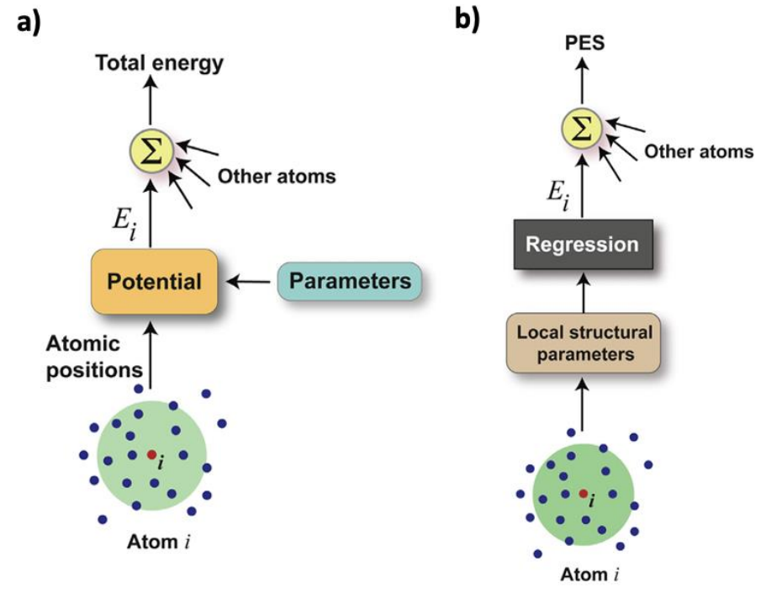
What are MLFFs/MLIPs?
Introduction
Atomic configurations → Potential Energy Surface
Input: Coordinates/vectors + element types
Output: Spatial derivatives of PES
Atomistic Simulations:
- AIMD
- PBP
MLIPs are the Bridge!

Slide 4
What are MLFFs/MLIPs?
Motivation and Need
Computational infeasibility of AIMD in large chemical systems and longer timescales.
Less accuracy of PBP-based MD for materials.
MLIPs can be supplemented with physics functionals for extrapolating complicated energy profiles.
MLIPs: Best of Both Worlds.
Training Dataset (AIMD)
Physical Parameters (PBP)
Machine Learned Interatomic Potential

Slide 5
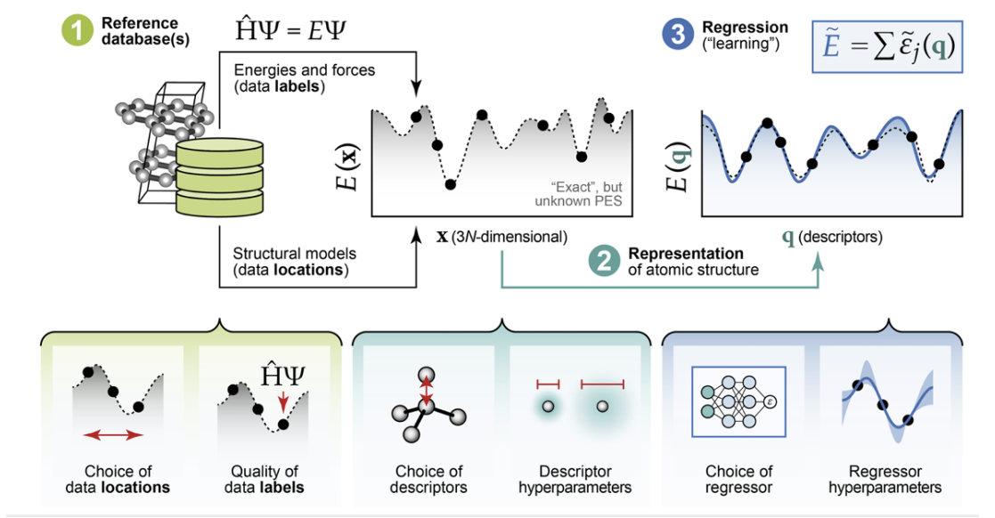
What are MLFFs/MLIPs?
Basic Principles
Atomic Environment Featurization
Descriptors
Symmetrical Invariance
Unification of Explicit and Implicit AEF

Slide 6
Part 2:
Scope of Study
&
Literature Review on Applied MLFFs

Slide 7
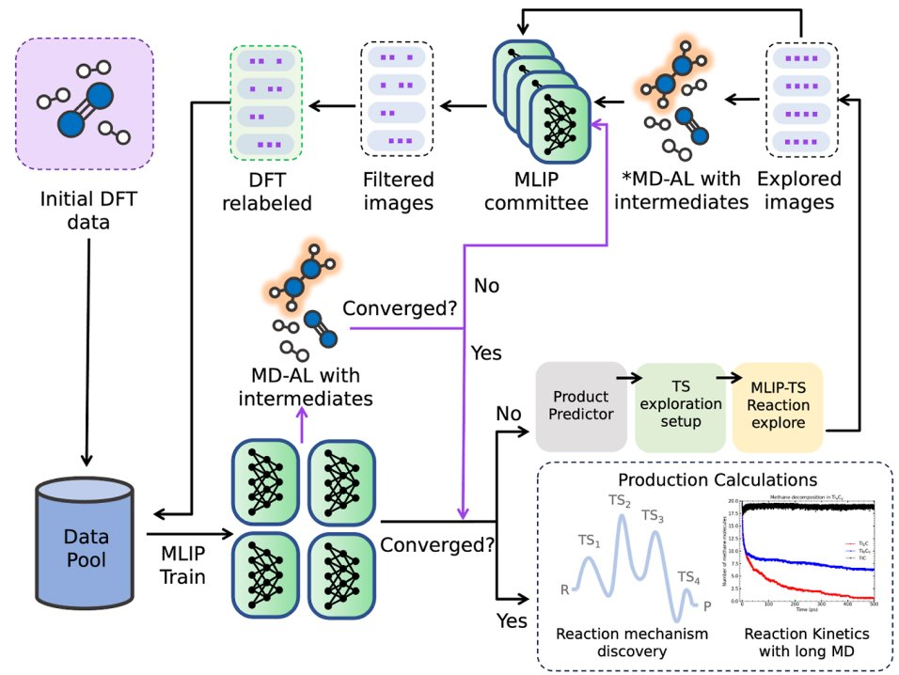
Literature on MLFFs – Molten Systems, Nanomaterials, CNT Growth, etc.
Reactive Active Learning
Traditional MLIP training paradigms ill-equipped to handle rare events.
Workflow:
- Automated Reaction Exploration
- Uncertainty Driven Active Learning
- Transition State Sampling
Benchmarking:
- Gas Phase
- Solution Phase
- Heterogeneous

Slide 8
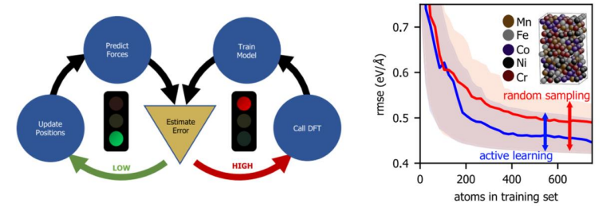
Literature on MLFFs – Molten Systems, Nanomaterials, CNT Growth, etc.
Reactive Active Learning

Slide 9
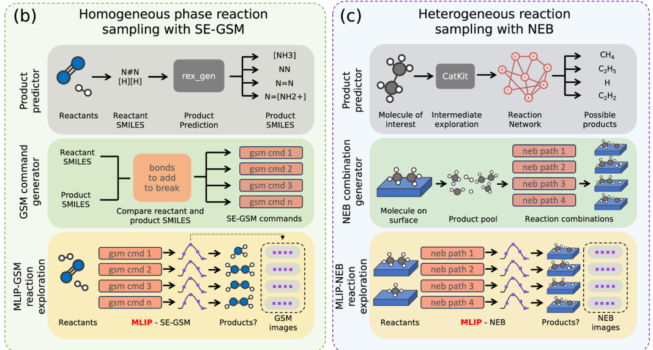
Literature on MLFFs – Molten Systems, Nanomaterials, CNT Growth, etc.
Reactive Active Learning
Methodology:
- Initial molecules for bootstrap dataset.
- Short AIMD
- MLIP training
- Configuration filtering
Committee of MLIPs:
- Product prediction from reactant SMILES.
- TS/Intermediates setup through SE-GSM and/or NEB.
- MLIP driven reaction exploration.

Slide 10
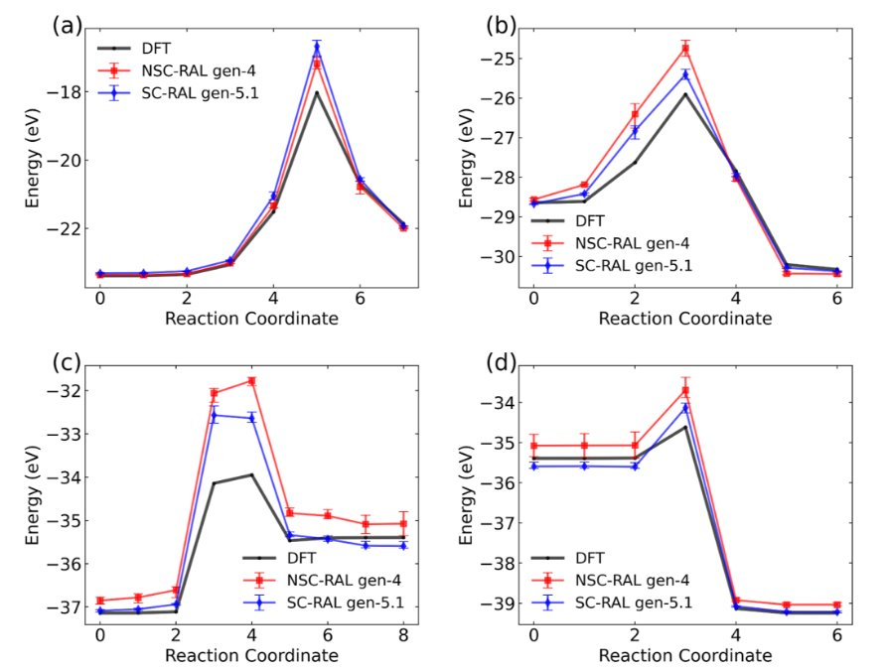
Literature on MLFFs – Molten Systems, Nanomaterials, CNT Growth, etc.
Reactive Active Learning
Uncatalyzed Gas-Phase Ammonia Synthesis
Reactions:
- N2 + H2 → cis− HNNH
- cis− HNNH + H2 → H2NNH2
- H2NNH2 + H2 → HNNH3 + H2
- HNNH3+H2 → NH3+NH3.
Both NSC-RAL and SC-RAL MLIPs show significant errors in predicting the forward and reverse barriers, indicating poor performance in estimating the transition state energy.

Slide 11
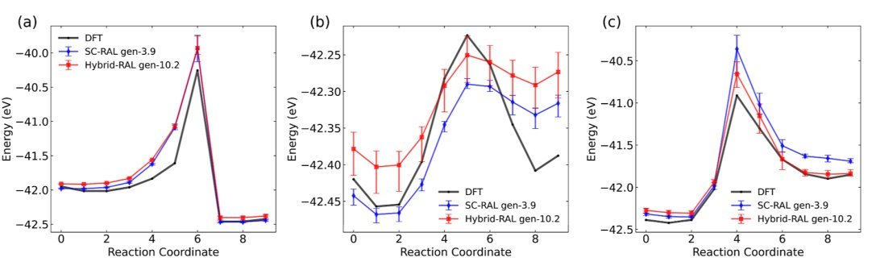
Literature on MLFFs – Molten Systems, Nanomaterials, CNT Growth, etc.
Reactive Active Learning
Hydrolysis of Methanamine
Reactions:
- CH2NH + H2O → NH2CH2OH
- NH2CH2OH → NH2CH2OH
- NH2CH2OH → CH2O + NH3
Both MLIPs predict similar reaction PES as well as forward and reverse barriers. Although the absolute error is small for this reaction, the reaction barrier itself is very low, which may result in large a percentage error.

Slide 12
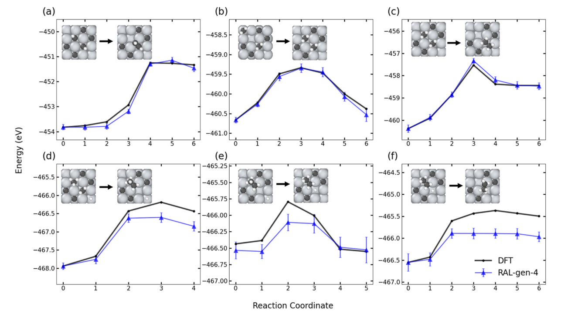
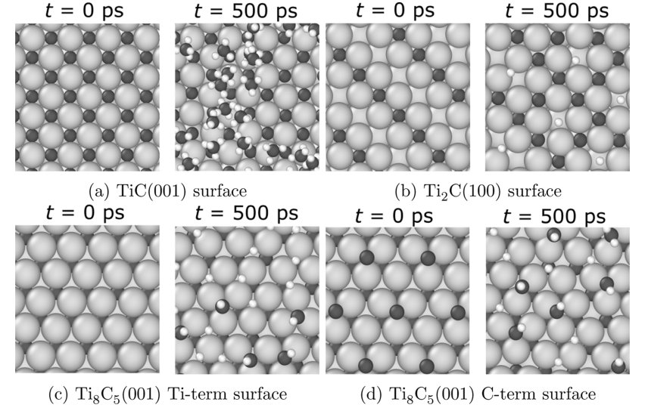
Literature on MLFFs – Molten Systems, Nanomaterials, CNT Growth, etc.
Reactive Active Learning
Snapshots of TixCy surfaces before (t = 0 ps) and after (t = 500 ps) T = 1200 K NVT-MD simulations initialized with 20 CH4 molecules. Ti atoms shown in light gray, C in dark gray, H in white.
Methane Activation and C−C Coupling Surface Catalysis Reaction on Titanium Carbide

Slide 13
Literature on MLFFs – Molten Systems, Nanomaterials, CNT Growth, etc.
Reactive Active Learning
Snapshots of TixCy surfaces before (t = 0 ps) and after (t = 500 ps) T = 1200 K NVT-MD simulations initialized with 20 CH4 molecules. Ti atoms shown in light gray, C in dark gray, H in white.
Methane Activation and C−C Coupling Surface Catalysis Reaction on Titanium Carbide

Slide 14
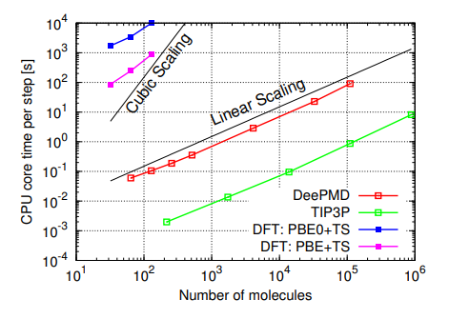
Implementation Toolkit
DeePMD-kit
Deep neural networks for MD.
Local reference frame and local environment assigned to each atom.
Bypassing auxiliary quantities for preserving symmetries.
Flexible family of loss functions.
Computational cost scales linearly with the number of atoms.
Can be parallelized due to local decomposition and the near-neighbor dependence of its “atomic energies”.

Slide 15
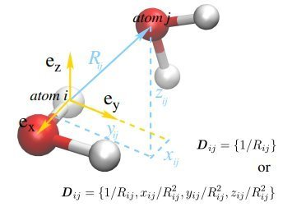
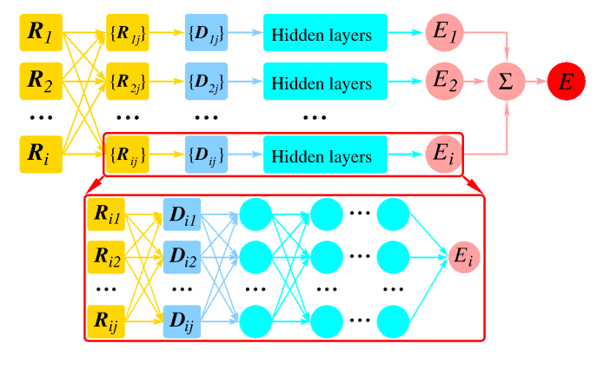
Implementation Toolkit
DeePMD-kit
Local coordinate frame (Dij) is set up for every atom a neighbors inside Rc. This preserves translational, rotational, and permutational symmetries. Dij contains radial and angular information of neighbouring atom.
Dij is the FF-DNN input. A linear transformation is applied to the input data, followed by activation with hyperbolic tangent function. There are three hidden layers in our network. We use SGD with the Adam optimizer.

Slide 16
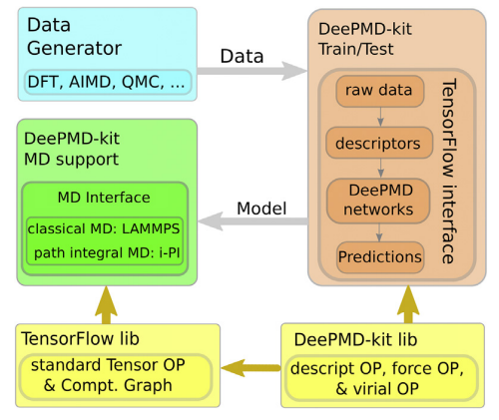
Implementation Toolkit
DeePMD-kit

Slide 17
Implementation Toolkit
DeePMD-kit

Slide 18
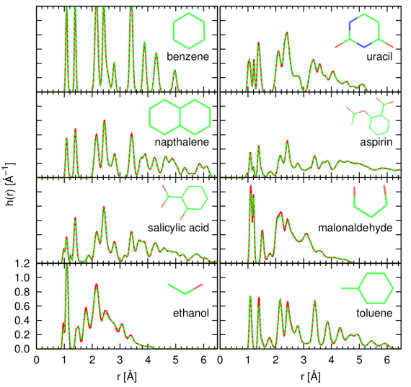
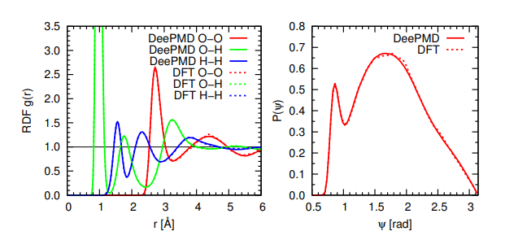
Implementation Toolkit
DeePMD-kit

Slide 19
Part 3:
Method
Developing MLFF for a specific chemical system

Slide 20
Types of Data
Anmol & Sourish

Slide 21
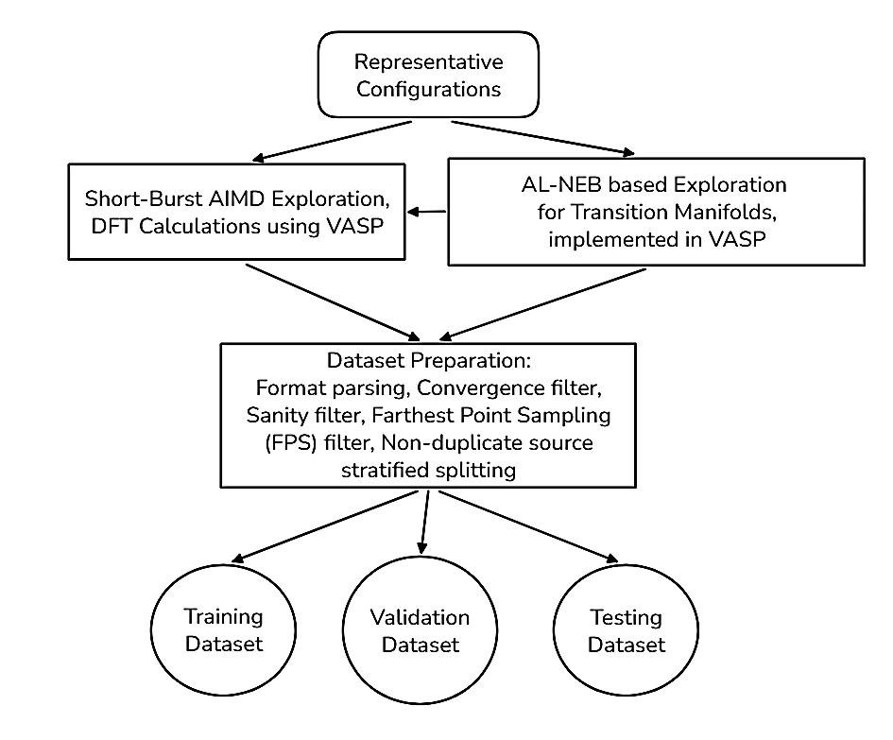
Data Generation
Anmol

Slide 22
Idea of an “ALNEB-guided Swarm AIMD”
Using exploration-exploitation phase of AL-NEB.
Collecting data points at regions of most uncertainty.
No need for renunciation phase.
Avoiding seeds from unnecessary regions.
P
[Final Point]
Reactive Pathway
R
[Initial Point]

Slide 23
Idea of an “ALNEB-guided Swarm AIMD”
Seeds lying along the
transition manifold
(Reactive Pathway)
P
[Final Point]
R
[Initial Point]

Slide 24
Idea of an “ALNEB-guided Swarm AIMD”
Short AIMD trajectories running with different initial velocity states covering the configurations around the seeds like a swarm.
All seeds from the ALNEB run are used and data from the transition manifold is covered.
P
[Final Point]
R
[Initial Point]

Slide 25
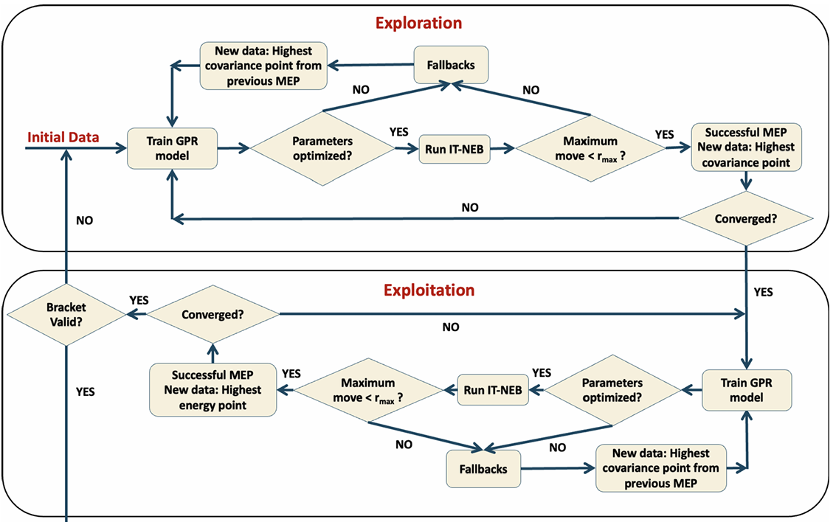
How does ALNEB work in our favour?
Active learning framework using GPR.
Constructs surrogate PES.
Selects training points in two phases.
Reduces expensive QM evaluations.

Slide 26
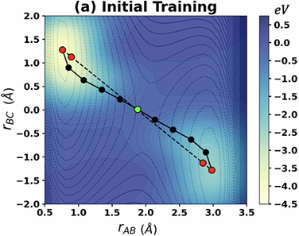
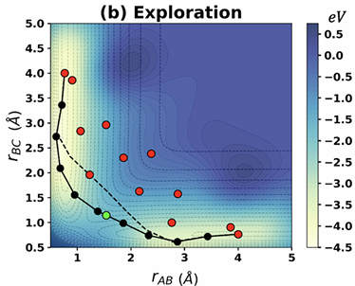
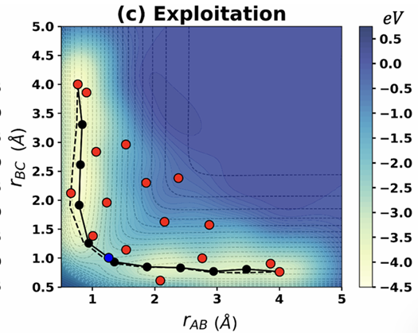
How does ALNEB work in our favour?

Slide 27
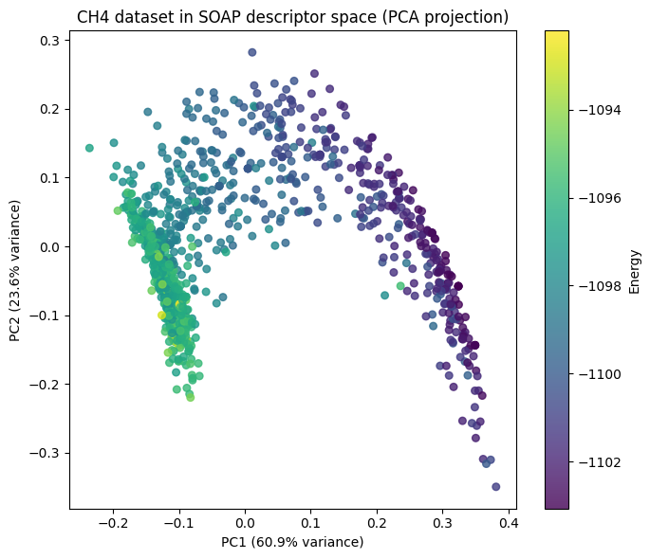
Descriptor Space Visualisation of a Toy Dataset: CH₄ → CH₃ + H
Generated by random perturbations of the CH₄ bonds.
psi4 based DFT labelling.

Slide 28
Descriptor Space Visualisation of a Toy Dataset: CH₄ → CH₃ + H
Generated by random perturbations of the CH₄ bonds.
psi4 based DFT labelling.
CH₄ cluster
CH₃ cluster
Transition manifold
(irrespective of the presence of a defined TS)

Slide 29
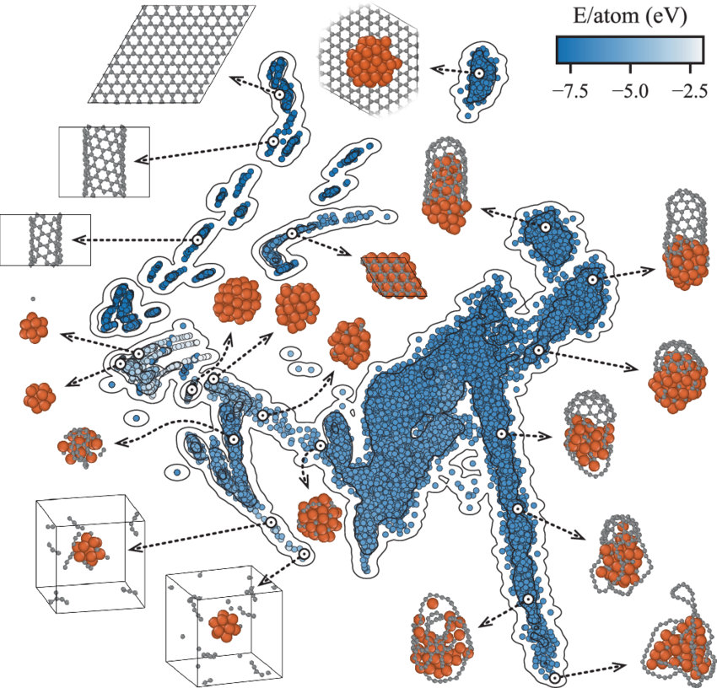
Descriptor Space Visualisation of the Training Dataset: DeepCNT-22

Slide 30
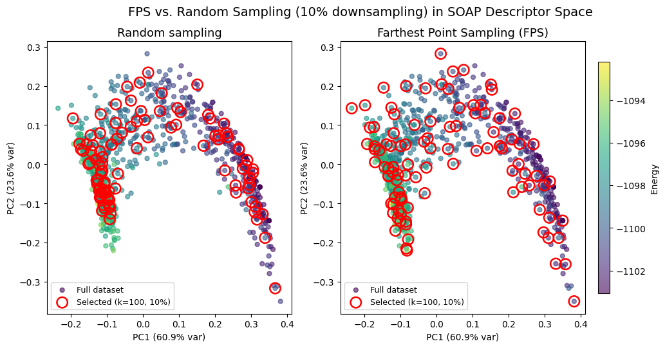
Data Processing: Farthest Point Sampling

Slide 31
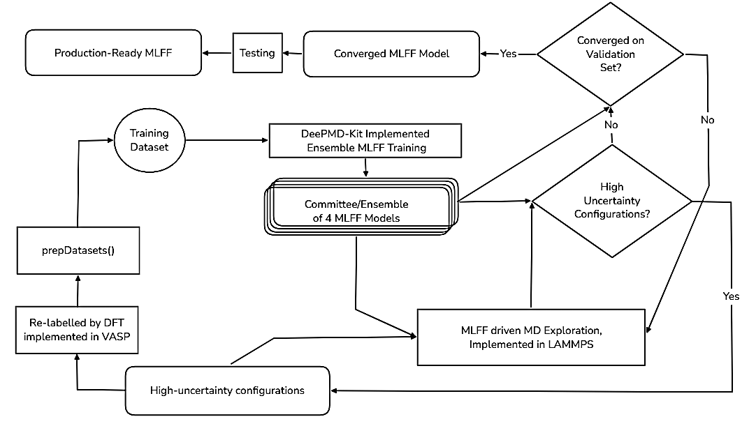
MLFF Model Ensemble Training

Slide 32
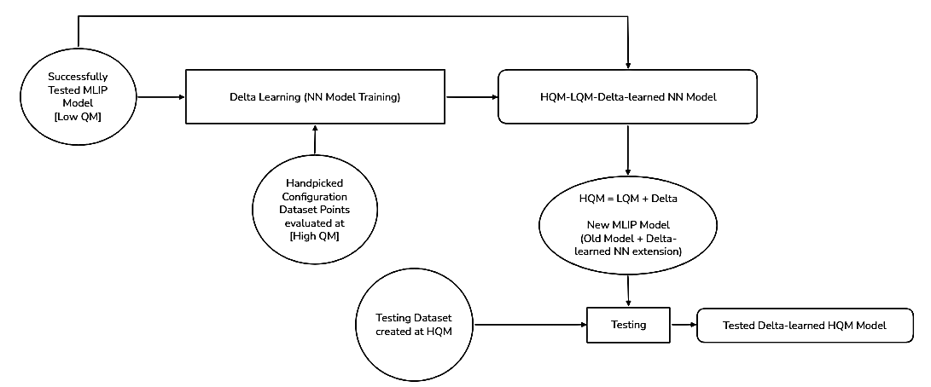
Implementation of Delta Learning in MLIP Development
Anmol

Slide 33
Development Milestones
Toy Problem: HCN ←→ HNC Isomerisation.
  Randomly generated data + single-pass training
  ALNEB seed data + single-pass training
  ALNEB seed data + AL loop training
  ALNEB guided swarm AIMD data + single-pass training
  ALNEB guided swarm AIMD data + AL loop training
  Generalisation and HPC-compatible script preparation
Toy Problem: CH₄ → CH₃ + H
  Similar milestones as the HCN toy problem
Result Benchmarking: GAP-20
Result Benchmarking: DeepCNT-22
Production: Pure Metal + Alloy (Cu-In) MLIP
Production: CNT Growth on Molten Alloy Nanoparticle MLIP
Anmol

Slide 34
Part 4:
Toy Problems
HCN ←→ HNC Isomerisation
CH₄ Dissociation

Slide 35
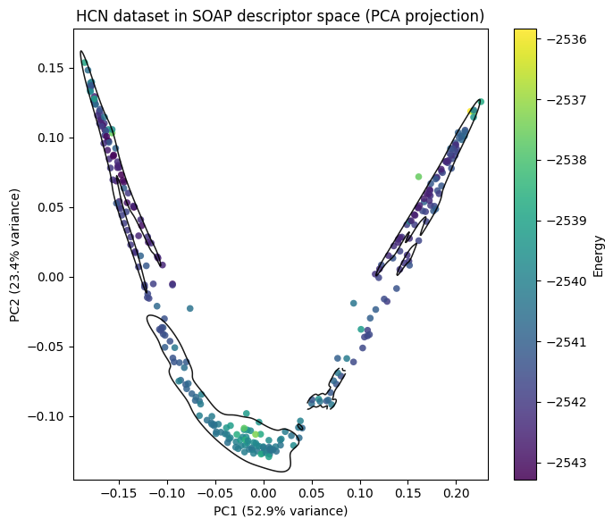
Toy Problem: HCN ←→ HNC Isomerisation
Generated by random perturbations of the HCN bonds.
psi4 based DFT labelling.

Slide 36
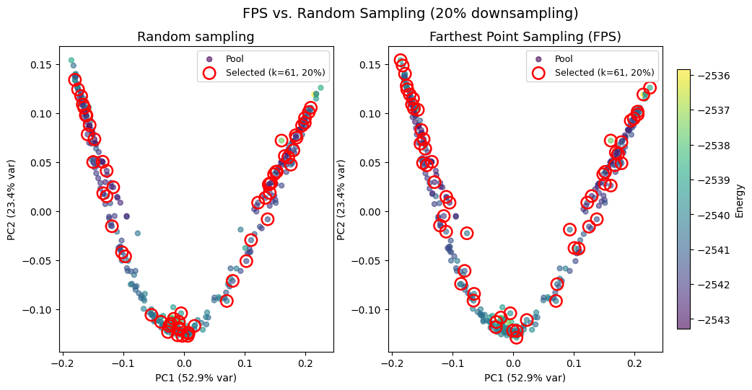
Toy Problem: HCN ←→ HNC Isomerisation

Slide 37
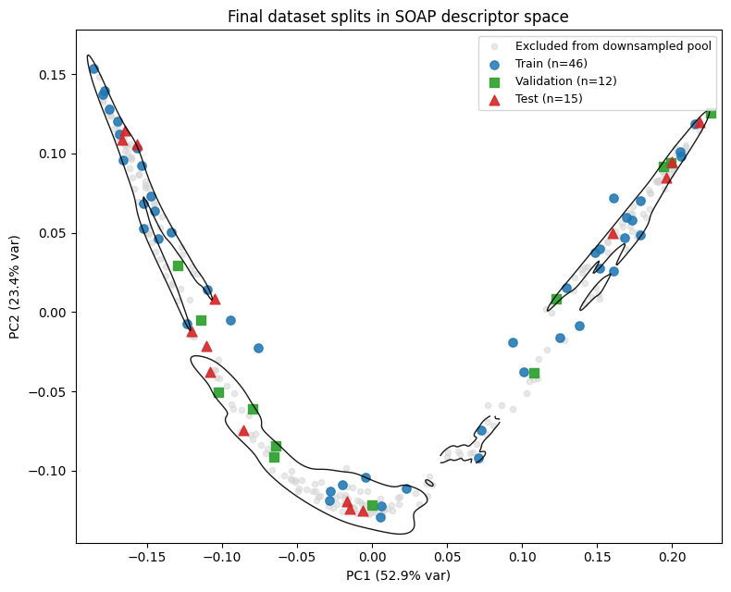
Toy Problem: HCN ←→ HNC Isomerisation

Slide 38
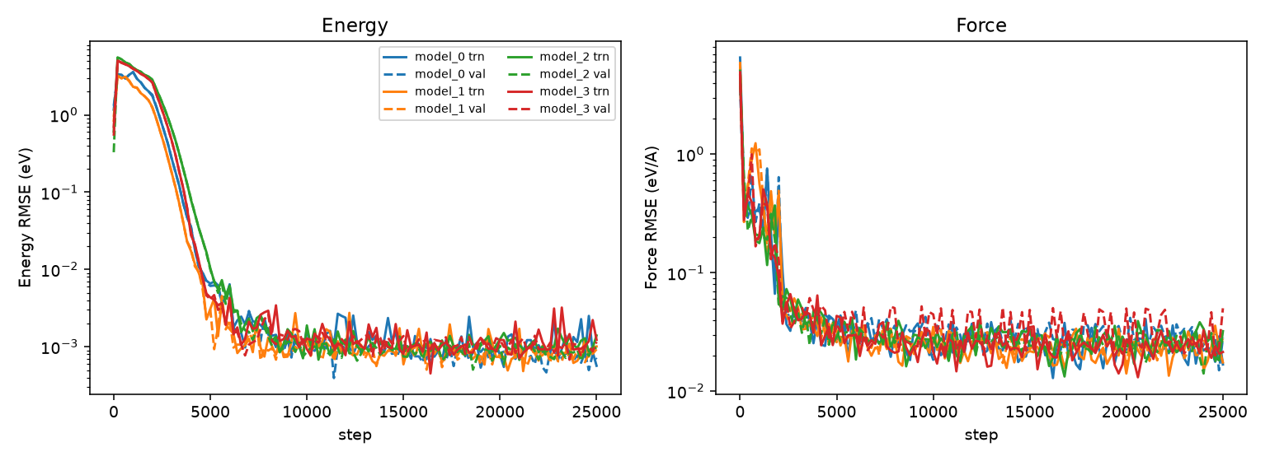
Toy Problem: HCN ←→ HNC Isomerisation
Learning Curves & RMSE values

Slide 39
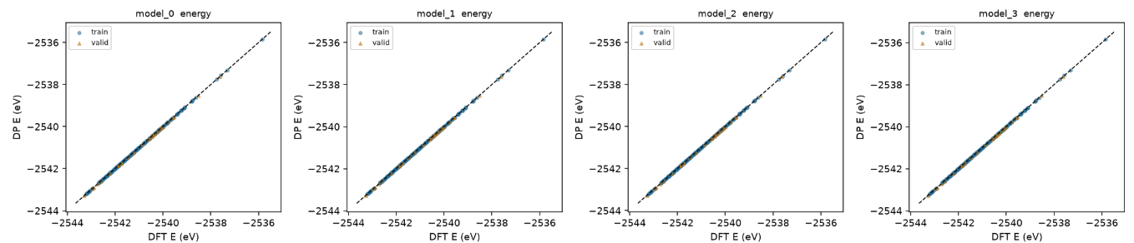
Toy Problem: HCN ←→ HNC Isomerisation
Energy Parity Plots: Training and Validation

Slide 40
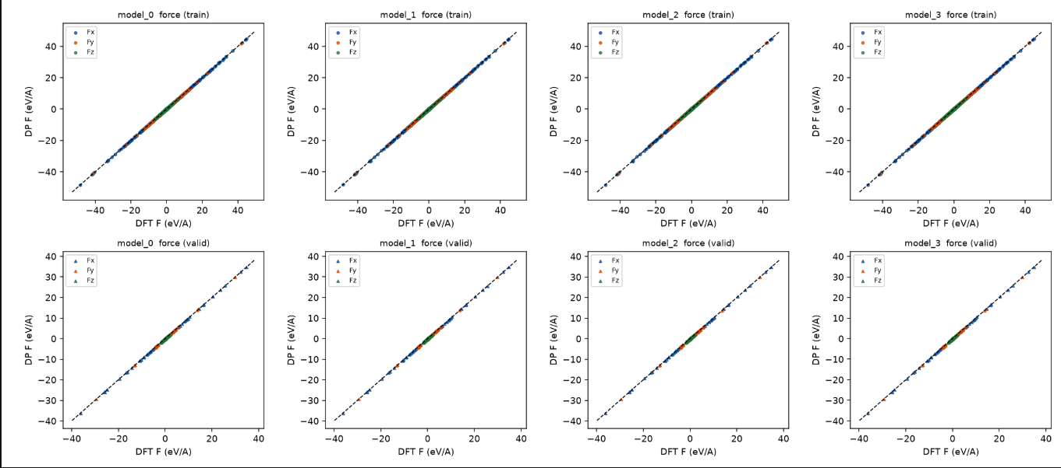
Toy Problem: HCN ←→ HNC Isomerisation
Force Parity Plots: Training and Validation

Slide 41
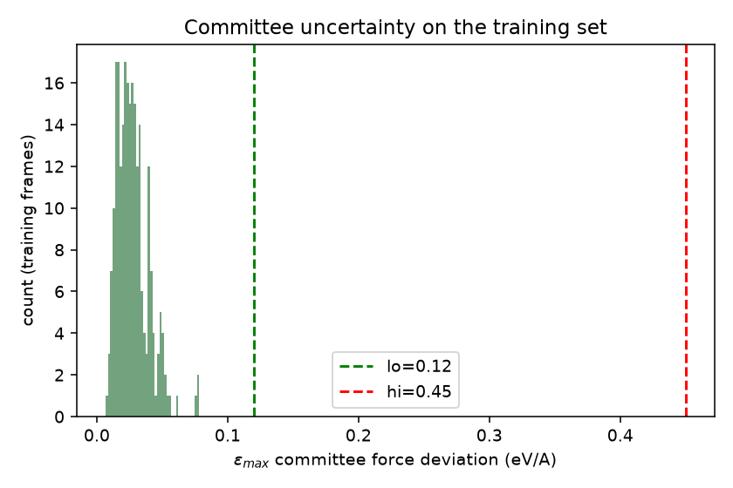
Toy Problem: HCN ←→ HNC Isomerisation
Committee Uncertainty Histogram

Slide 42
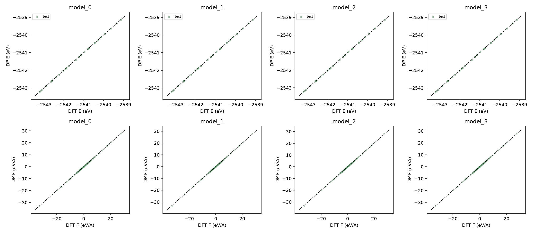
Toy Problem: HCN ←→ HNC Isomerisation
Parity Plots: Testing

Slide 43
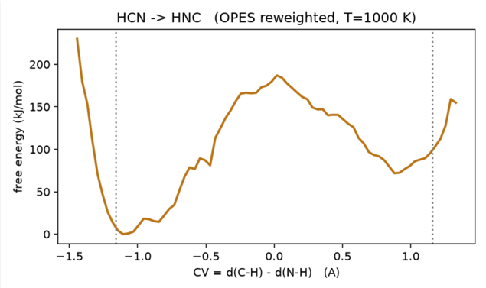
Toy Problem: HCN ←→ HNC Isomerisation
Metadynamics Run
The MLIP reports the activation energy barrier for the forward reaction as 187 kJ/mol. This matches the literature benchmarked value which lies in the range of 180 kJ/mol - 190 kJ/mol.

Slide 44
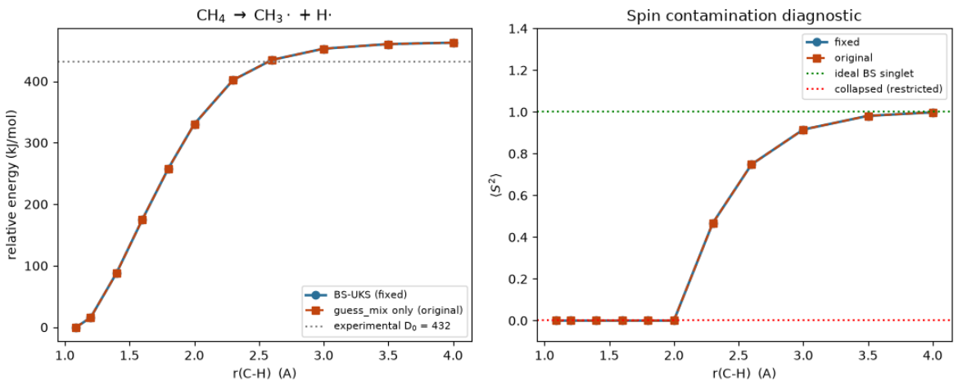

Slide 45
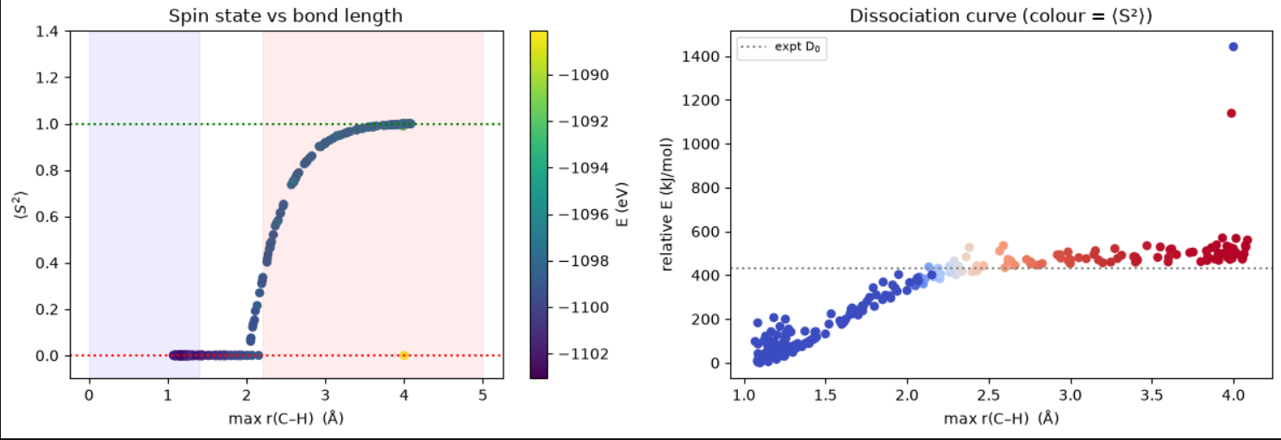

Slide 46
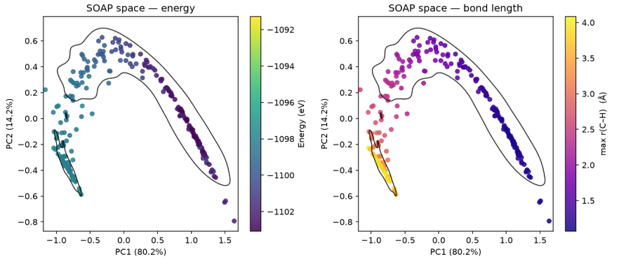
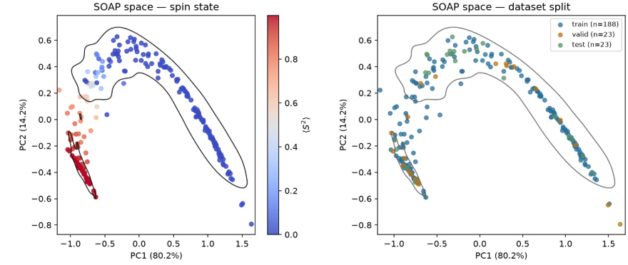

Slide 47
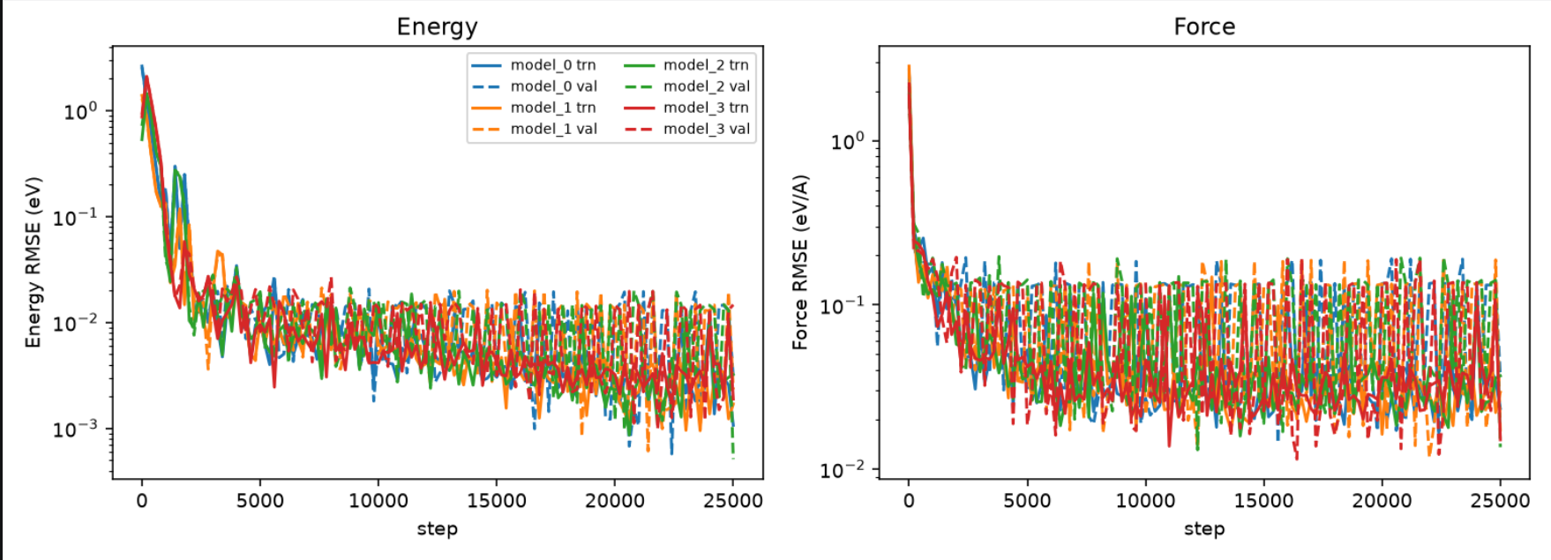

Slide 48
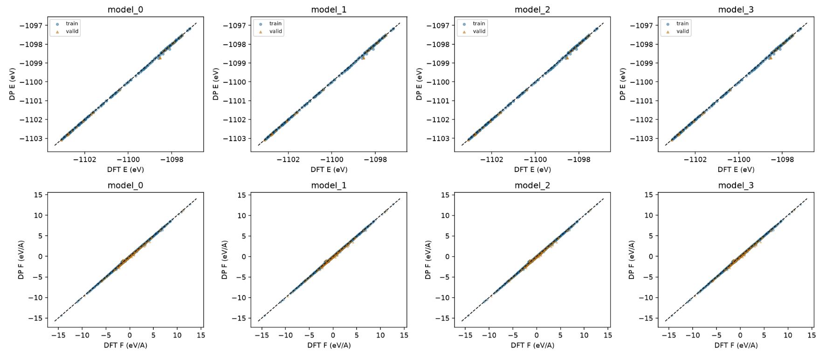

Slide 49
