Slide 1
Classification for Human Activity Recognition using Smart Phone Dataset
Group Members- Sourish Dhekane (1601020) G. Dillesh Kumar (1601023)
Guide- Shounak Chakraborty & MOUMITA ROY

Slide 2
Problem Definition
Human Activity Recognition (HAR) based on data obtained by Sensors in Smartphone (Samsung Galaxy S-II)
Time-Series Data
Dataset Description
30 Volunteers (19-48 age)
6 Activities (Walking / Walking-Upstairs / Walking-Downstairs / Sitting / Standing / Laying)
3 Signals (Body Acceleration / Body Gyroscope / Total Acceleration)
70% Volunteers for Training Data & 30% Volunteers for Testing Data
Training Data- 7352 rows and Testing Data- 2947 rows with each row has 128 observations
Sensor signal preprocessed using Noise Filter and then sampled in sliding window of 2.56s
Identifier of subject also provided

Slide 3
Data Insight
Class | Number of Samples | Percentage
1 | 1226 (Train) 496 (Test) | 16.6 16.8
2 | 1073 (Train) 471 (Test) | 14.5 15.9
3 | 986 (Train) 420 (Test) | 13.4 14.2
4 | 1286 (Train) 491 (Test) | 17.4 16.6
5 | 1374 (Train) 532 (Test) | 18.6 18
6 | 1407 (Train) 537 (Test) | 19.1 18.22

Slide 4
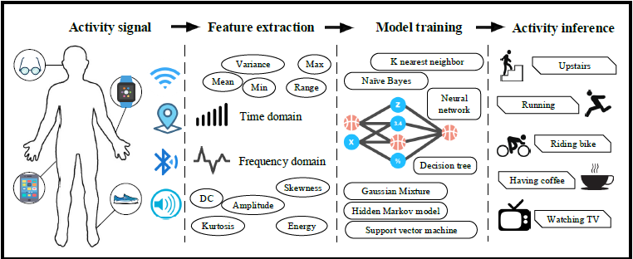
Problem Overview
Sensor-based activity recognition:- high-level knowledge about human activities from multitudes of low-level sensor readings [1].
Conventional Approaches:- heuristic hand-crafted feature extraction (hinders performance)
Deep learning Approaches:- automatic high-level feature extraction (improves performance) [1].
[1]- Wang, Jindong et al. “Deep Learning for Sensor-Based Activity Recognition: A Survey.” Pattern Recognition Letters 119 (2019): 3–11. Crossref. Web.

Slide 5
Applications of HAR
[2]- Vepakomma, P., De, D., Das, S.K., Bhansali, S., 2015. A-wristocracy: Deep learning on wrist-worn sensing for recognition of user complex activities, in: 2015 IEEE 12th International Conference on Wearable and Implantable Body Sensor Networks (BSN), IEEE. pp. 1–6.
[3]- Qin, J., Liu, L., Zhang, Z., Wang, Y., Shao, L., 2016. Compressive sequential learning for action similarity labeling. IEEE Transactions on Image Processing 25, 756–769.
[4]- Hammerla, N.Y., Halloran, S., Ploetz, T., 2016. Deep, convolutional, and recurrent models for human activity recognition using wearables, in: IJCAI.
[5]- Kim, Y., Toomajian, B., 2016. Hand gesture recognition using micro-Doppler signatures with convolutional neural network. IEEE Access .
Home Behavior Analysis [2]
Gait Analysis [4]
Gesture Recognition [5]
Video Surveillance [3]

Slide 6
Literature Survey
Human Activity Recognition on Smartphones Using a Multiclass Hardware-Friendly Support Vector Machine [6]
OVA Strategy used in SVM to extend to multi-class problem
Normalization procedure before output
β vector introduced in SVM framework for fixed-point arithmetic
Laplacian kernel instead of Gaussian kernel
Output of SVM passed through sigmoid function
Due to fixed-point arithmetic approach Look-up Table used for sigmoid function
[6]- Davide Anguita, Alessandro Ghio, Luca Oneto, Xavier Parra and Jorge L. Reyes-Ortiz. Human Activity Recognition on Smartphones using a Multiclass Hardware-Friendly Support Vector Machine. International Workshop of Ambient Assisted Living (IWAAL 2012). Vitoria-Gasteiz, Spain. Dec 2012

Slide 7
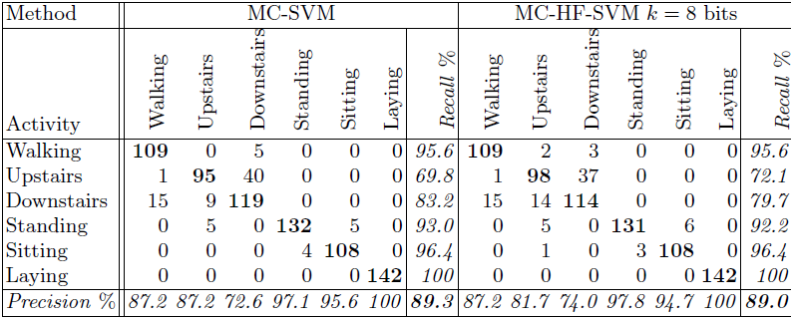
Literature Survey
Focus on making the algorithm Hardware Friendly
Comparable results with standard SVM

Slide 8
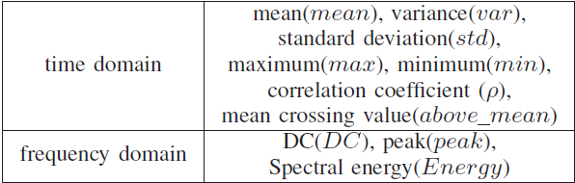
Literature Survey
A Feature Set for the Similar Activity Recognition Using Smartphone [7]
5 element feature vector construction
MLP is used as classifier
[7]- Yan, Na & Chen, Jianxin & Yu, Tao. (2018). A Feature Set for the Similar Activity Recognition Using Smartphone. 1-6. 10.1109/WCSP.2018.8555704.

Slide 9
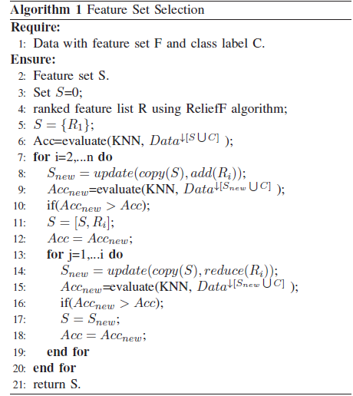
Literature Survey
Relief algorithm to evaluate candidate features
SFFS algorithm to construct feature inclusion matrix
KNN classifier to evaluate the quality of features

Slide 10
Literature Survey
Effect of Dynamic Feature for Human Activity Recognition using Smartphone Sensors [8]
Dynamic feature extraction
Time series signal embedded as a sequence of time-delay coordinate vectors
Stacking of 9 available time series vectors
CNNs used for classification
Results compared with static feature plus traditional ML approaches
[8]- K. Nakano and B. Chakraborty, "Effect of dynamic feature for human activity recognition using smartphone sensors," 2017 IEEE 8th International Conference on Awareness Science and Technology (iCAST), Taichung, 2017, pp. 539-543.

Slide 11
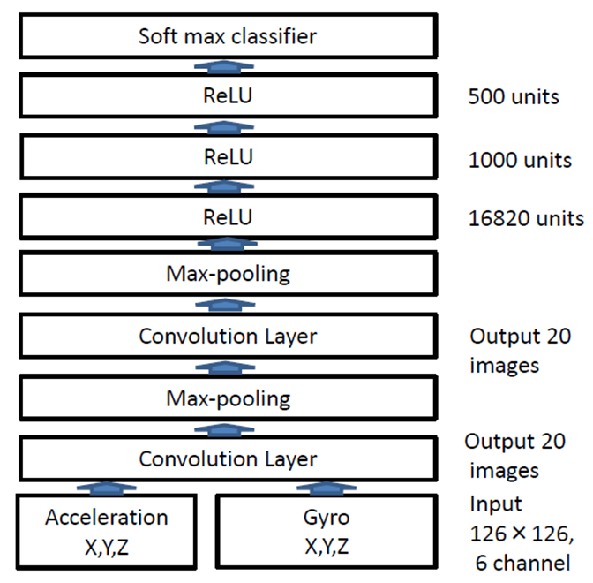
Literature Survey
Proposed CNN Architecture

Slide 12
Literature Survey (Implementation 1)
Human Activity Recognition using Sensors by Deep Convolutional Neural Networks [9]
DCNN used for classification
All 3 types of sensor information is used
Conversion of 9 signal channels to Signal Image (SI)
Conversion of SI to Activity Image (AI)
DCNN applied on AI of every reading
OVA-SVM applied where confusion in DCNN
[9]- Wenchao Jiang and Zhaozheng Yin. 2015. Human Activity Recognition Using Wearable Sensors by Deep Convolutional Neural Networks. In Proceedings of the 23rd ACM international conference on Multimedia (MM '15). ACM, New York, NY, USA, 1307-1310. DOI: https://doi.org/10.1145/2733373.2806333

Slide 13
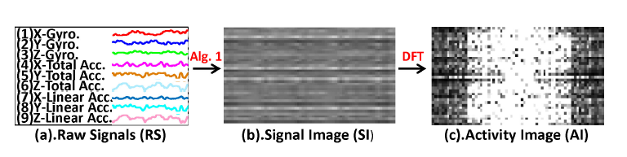
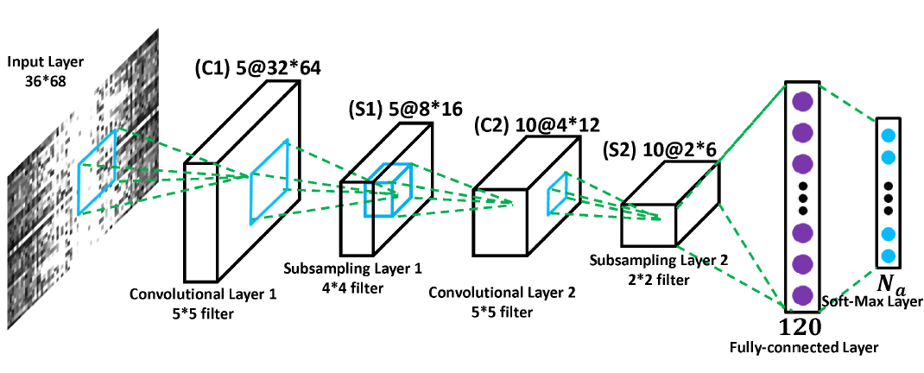
Literature Survey (Implementation 1)

Slide 14
Literature Survey (Implementation 1)
Results
Without OVA-SVM – 88.62%
With OVA-SVM (proposed) – 95.18%
Analysis
Lower Accuracy compared to traditional models (without OVA-SVM)
Not judicious to use OVA-SVM
Idea to construct Activity Image good but improvement needed
Proper use of CNN as spatial dependence considered

Slide 15
Literature Survey (Implementation 1)
Future Work
Merging of x-y-z components in magnitude calculation
Use of this magnitude vector in Activity Image
Reversing the directions of signals while calculating the SI
Not much attention to accuracy improvement (coming slides)
Focus on real time results (SI must be compact as well as spatially mixed)

Slide 16
Literature Survey (Implementation 2)
Deep Learning for Sensor-based Activity Recognition: A Survey [1]
Transaction and Survey paper
Problem definition
Why Deep Learning
Hand-crafted vs. Automatic features
Shallow features not good for high-level (complicated) activities
Static data vs. Streaming data
[1]- Wang, Jindong et al. “Deep Learning for Sensor-Based Activity Recognition: A Survey.” Pattern Recognition Letters 119 (2019): 3–11. Crossref. Web.

Slide 17
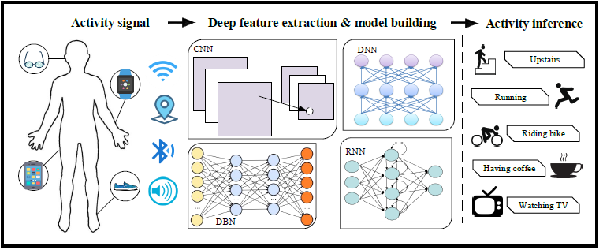
Literature Survey (Implementation 2)

Slide 18
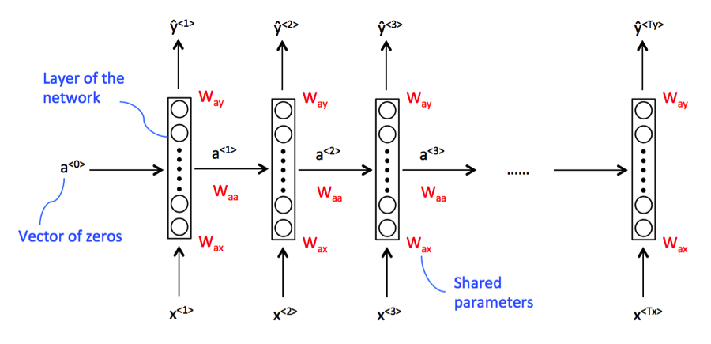
Literature Survey (Implementation 2)
RNNs
Problem of Vanishing/Exploding Gradient (Error Function Derivatives very large or zero)

Slide 19
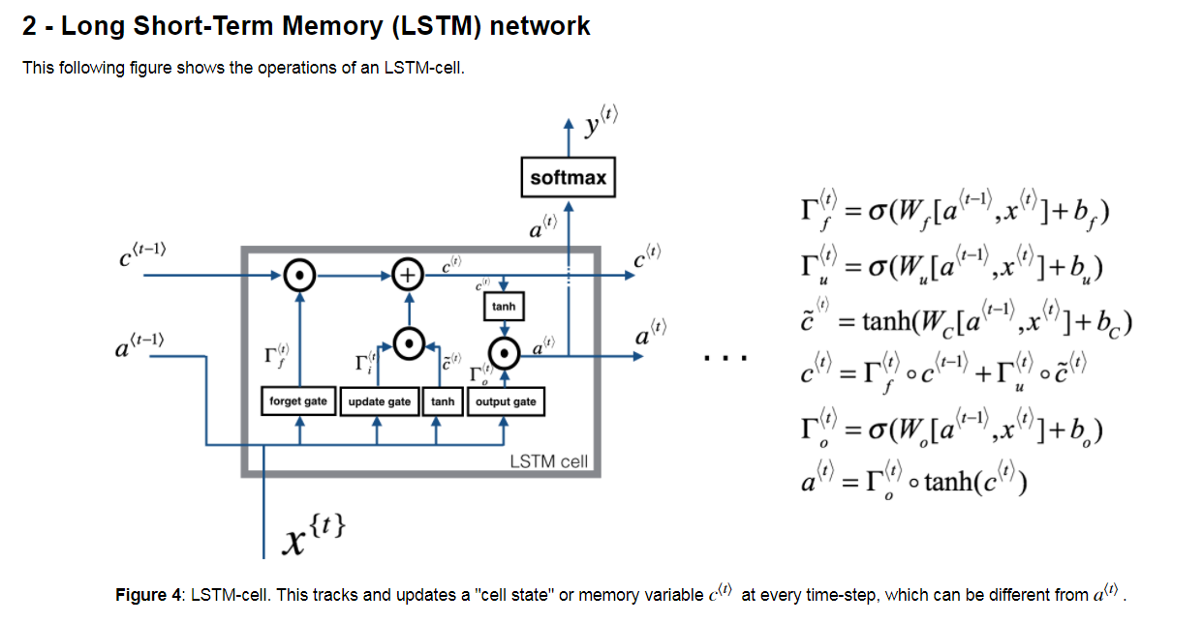
Literature Survey (Implementation 2)
LSTMs

Slide 20
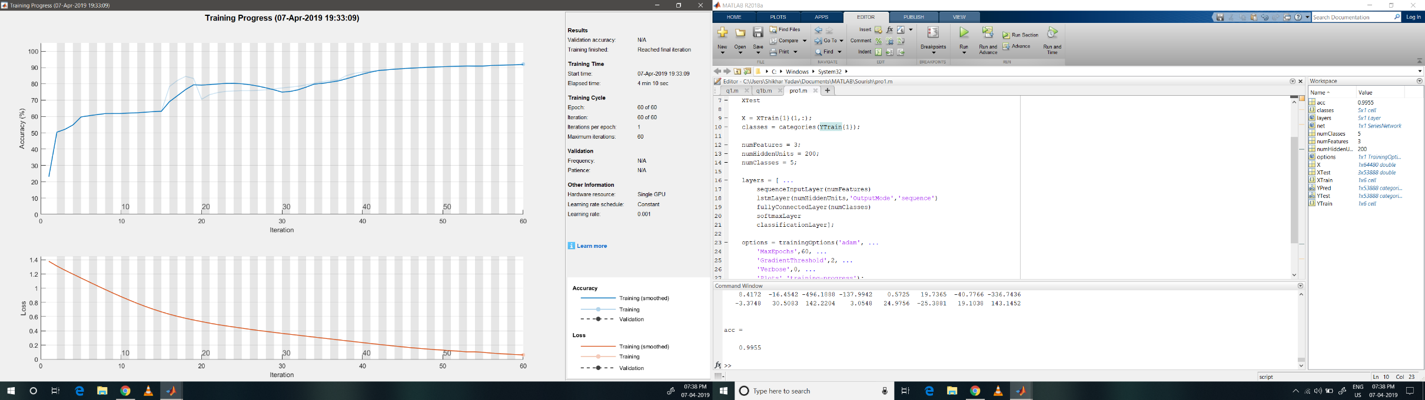
Literature Survey (Implementation 2)
Results

Slide 21
Literature Survey (Implementation 2)
Analysis
Not much to look at accuracy improvement
LSTMs seem to capture time-series relation very well
Computationally very expensive
Future Work
Making the model real time

Slide 22
Proposed Work (Implemented as failed_model.m )
Combination of x-y-z directions into a single magnitude vectors
Such 3 magnitude vectors
Concatenation into a single 384x1 input vector or 128x3 vector
LSTM as classifier
Focus on reducing the size and dimensionality of input matrix to LSTM
Accuracy Improvement needed
Person Recognition (As information about the subject also provided but never used in any work)

Slide 23
References
[1]- Wang, Jindong et al. “Deep Learning for Sensor-Based Activity Recognition: A Survey.” Pattern Recognition Letters 119 (2019): 3–11. Crossref. Web.
[2]- Vepakomma, P., De, D., Das, S.K., Bhansali, S., 2015. A-wristocracy: Deep learning on wrist-worn sensing for recognition of user complex activities, in: 2015 IEEE 12th International Conference on Wearable and Implantable Body Sensor Networks (BSN), IEEE. pp. 1–6.
[3]- Qin, J., Liu, L., Zhang, Z., Wang, Y., Shao, L., 2016. Compressive sequential learning for action similarity labeling. IEEE Transactions on Image Processing 25, 756–769.
[4]- Hammerla, N.Y., Halloran, S., Ploetz, T., 2016. Deep, convolutional, and recurrent models for human activity recognition using wearables, in: IJCAI.
[5]- Kim, Y., Toomajian, B., 2016. Hand gesture recognition using micro-Doppler signatures with convolutional neural network. IEEE Access .

Slide 24
References
[6]- Davide Anguita, Alessandro Ghio, Luca Oneto, Xavier Parra and Jorge L. Reyes-Ortiz. Human Activity Recognition on Smartphones using a Multiclass Hardware-Friendly Support Vector Machine. International Workshop of Ambient Assisted Living (IWAAL 2012). Vitoria-Gasteiz, Spain. Dec 2012
[7]- Yan, Na & Chen, Jianxin & Yu, Tao. (2018). A Feature Set for the Similar Activity Recognition Using Smartphone. 1-6. 10.1109/WCSP.2018.8555704.
[8]- K. Nakano and B. Chakraborty, "Effect of dynamic feature for human activity recognition using smartphone sensors," 2017 IEEE 8th International Conference on Awareness Science and Technology (iCAST), Taichung, 2017, pp. 539-543.
[9]- Wenchao Jiang and Zhaozheng Yin. 2015. Human Activity Recognition Using Wearable Sensors by Deep Convolutional Neural Networks. In Proceedings of the 23rd ACM international conference on Multimedia (MM '15). ACM, New York, NY, USA, 1307-1310. DOI: https://doi.org/10.1145/2733373.2806333

