Slide 1
STUDY TITLE
Probabilistic analysis between saliency map and user gaze data

Slide 2
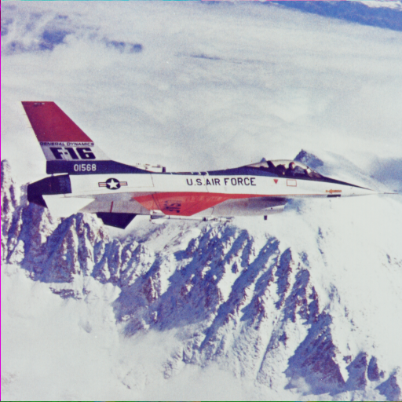
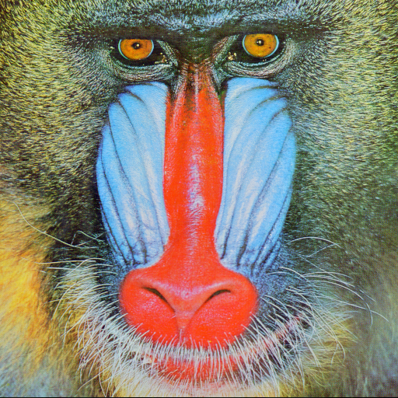

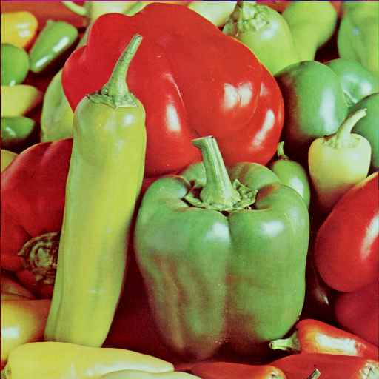
Data Collection
Data was collected from two different eye trackers:
Specifications | Tobii Pro X2 | Tobii Pro Glasses 2
Mounting System | System mounted | Head mounted
Frequency | 30 Hz | 25Hz
Image resolution | 1440x900 | 1960x1080
Both devices had to be calibrated before data collection.
Some standard images were used as subjects.

Slide 3
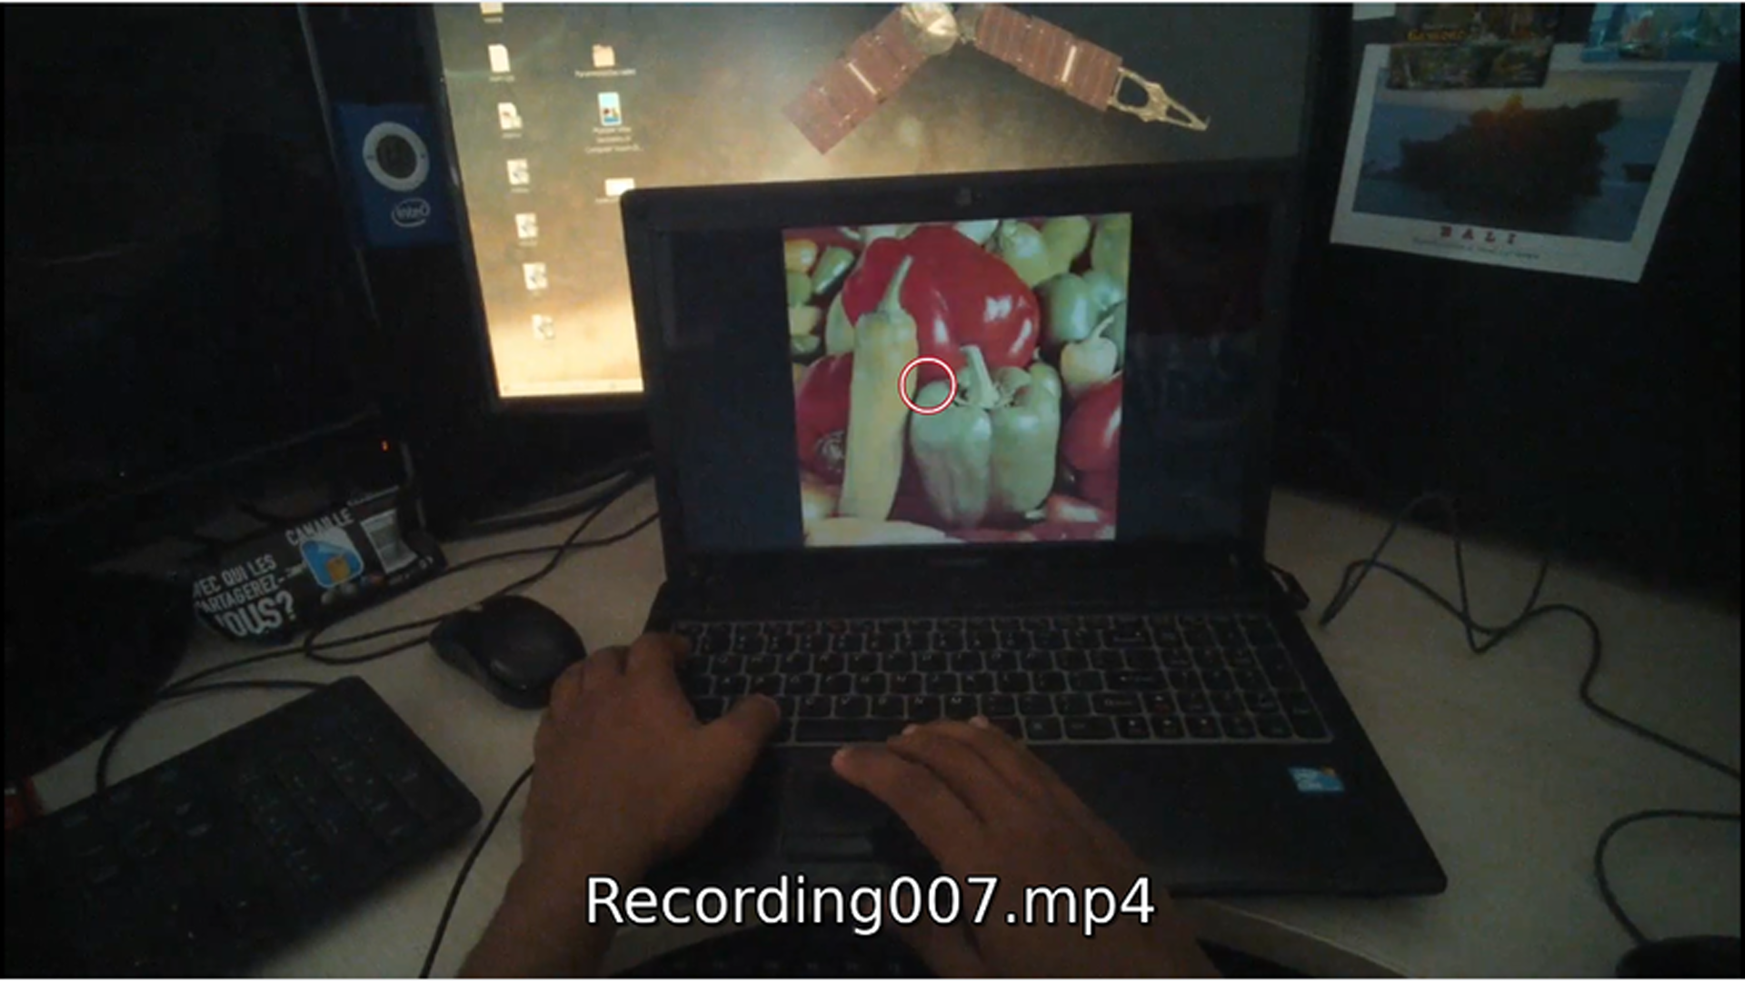

Data Preprocessing
The gaze data from the Tobii Pro X2 was extracted in different excel sheets using Ogama software.
The data from Tobii Pro Glasses 2 was in a single json file. This was because the output data was recorded in mp4 format. The json file had to be appropriately parsed to extract 2D gaze points and timestamps.
The timestamps were used to assign the gaze data from the json file to the corresponding image.
Since the video frame included the background as well as the images, a bounding box was manually found and the coordinates were adjusted accordingly such that the background data can be ignored.
Original resolution: 1960x1080
Resized resolution: 389x389

Slide 4
Saliency map and Statistical test
In order to obtain a saliency map as a reference for the analysis, R. Achanta, S. Hemami, F. Estrada, and S. Süsstrunk, ‘‘Frequency-tunedsalient region detection,’’ was implemented. It makes use of colour and luminance data to build the saliency map.
The statistical test used for the probabilistic analysis is the Kolmogorov-Smirnov Test for Spatial Image Data Comparison (KS 2D Test) which is a generalized variant of the conventional one dimensional approach. The test returns a probability value p which denotes the probability of both distributions belonging to the same underlying distribution. The test was conducted between the saliency map points and gaze data from both the eye tracking devices.

Slide 5
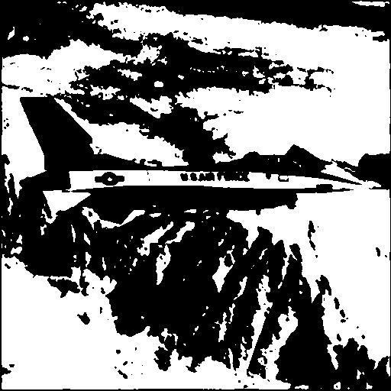
Test Results and Observational Inference as a means of Justification
Image 1: airplane.png
Tobii Pro X2 pA | Tobii Pro Glasses 2 pB
0.9999 | 0.0214
The test gives a high pA value due to the image containing a specific foreground object. However the low pB can be due to information loss due to dimension reduction required for preprocessing. Also the bounding box is not adjusted with the parallax error.

Slide 6
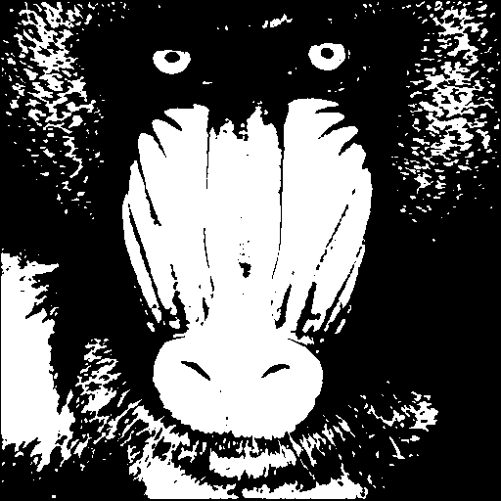
Image 2: baboon.png
Tobii Pro X2 pA | Tobii Pro Glasses 2 pB
0.9999 | 0.9999
In this case the object covers the entire image. Hence the saliency regions are well defined and large. Thus, the high values of both pA and pB.

Slide 7
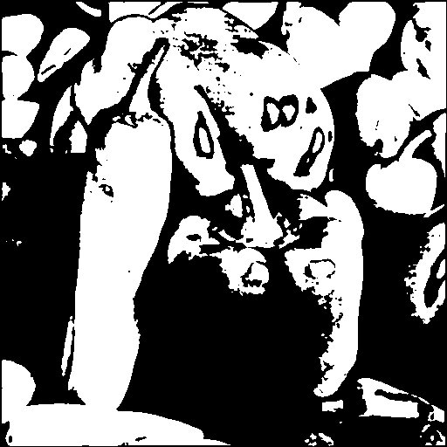
Image 3: peppers.png
Tobii Pro X2 pA | Tobii Pro Glasses 2 pB
0.0286 | 4.335e-05
An interesting observation here is that the image contains multiple objects and no defined background. However, the saliency map has marked specific salient regions which do not cover the entire object. Here, the psychovisual preferences of the viewer may differ greatly from the conventional salient regions. Hence the extremely low values of both pA and pB.

Slide 8

Image 4: tulips.png
Tobii Pro X2 pA | Tobii Pro Glasses 2 pB
0.1721 | 1.7925e-07
The apparent large difference in pA and pB values could be an indication of the parallax and resolution reduction issue again. Another interesting psychovisual implication of such an observation could be the fact that the objects (tulips) in the image are the same. Hence the viewer might not be interested in observing each and every object separately after peripheral viewing.

