Slide 1
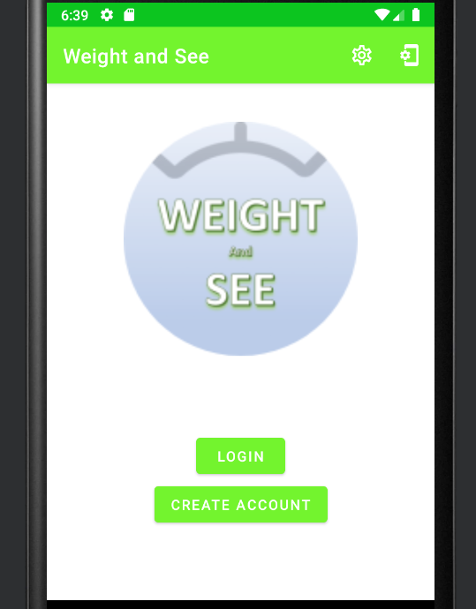
To Weight Progress
Weight Progress Screen
Starting Weight: 170
GOAL WEIGHT: 150
Change Goal Weight
Goal Weight: __
>> EDIT
Title Bar will stay consistent thru navigation.
Page title will change as needed
Options are:
Change Goal Weight
Update Profile
About
LOGOUT
Date | Weight
7/10/2022 | 170
7/13/2022 | 169
Add Goal Weight
Starting Weight: __
Goal Weight: __
>> ADD
INITIAL SCREEN
Register New User Screen
First Name: __
Last Name: __
Email: __
Username: __
Password: __
>> REGISTER
<< Enter UN/PWD
Enter New Weight Screen
Date: __
Weight: __
>> ADD
To Weight Progress
App Title and Logo
About Screen
<Content will include how app works, some FAQs, and a contact email>
Update Profile Screen
First Name: __
Last Name: __
Email: __
Username: __
Password: __
>> EDIT
To Weight Progress
Login
Enter Username and password
>> LOGIN
Proposed Design

Slide 2
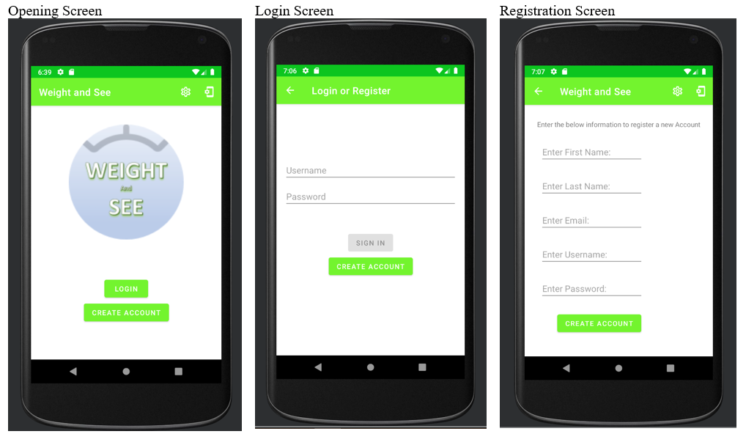

Slide 3
To Weight Progress
Weight Progress Screen
Change Daily Weight
Weight: __
>> EDIT
Title Bar will stay consistent thru navigation.
Page title will change as needed
Options are:
SMS Preference
About
LOGOUT
Date | Weight
7/10/2022 | 170
7/13/2022 | 169
INITIAL SCREEN
Register New User Screen
First Name: __
Last Name: __
Email: __
Username: __
Password: __
>> REGISTER
Enter New Weight Screen
Date: __
Weight: __
>> ADD
To Weight Progress
App Title and Logo
To Weight Progress
Delete this Weight Screen
>> DELETE
To Weight Progress
Login
Enter Username and password
>> LOGIN
Expected Design

Slide 4
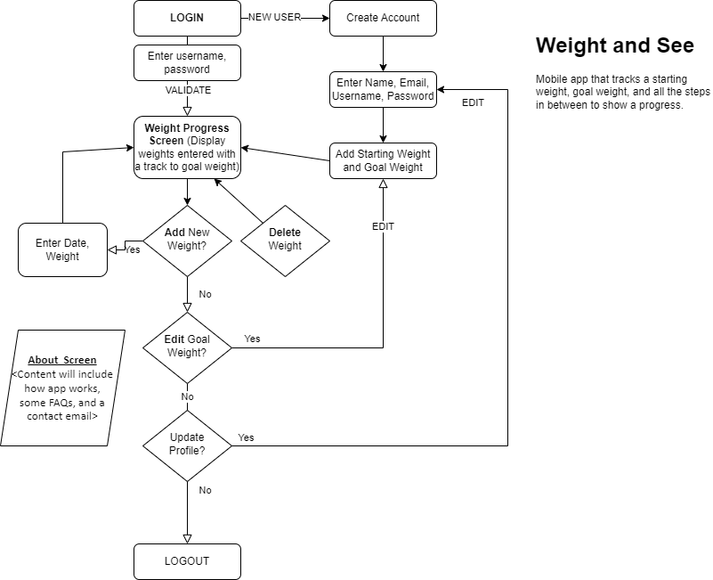

Slide 5
Registration Table
Weight Table
Column Name | Data Type
Unique ID | int
First name | String
Last name | String
Email address | String
Username | String
Password | String
Date registered | Date
SMS Flag | Bool
Column Name | Data Type
Foreign Key | int
Weight | Decimal
Date entered | Date
Weight Tracker Database
Goal Weight Table
Column Name | Data Type
Foreign Key | int
Goal Weight | Decimal
Starting Weight | Decimal
Date entered | Date

