Slide 1
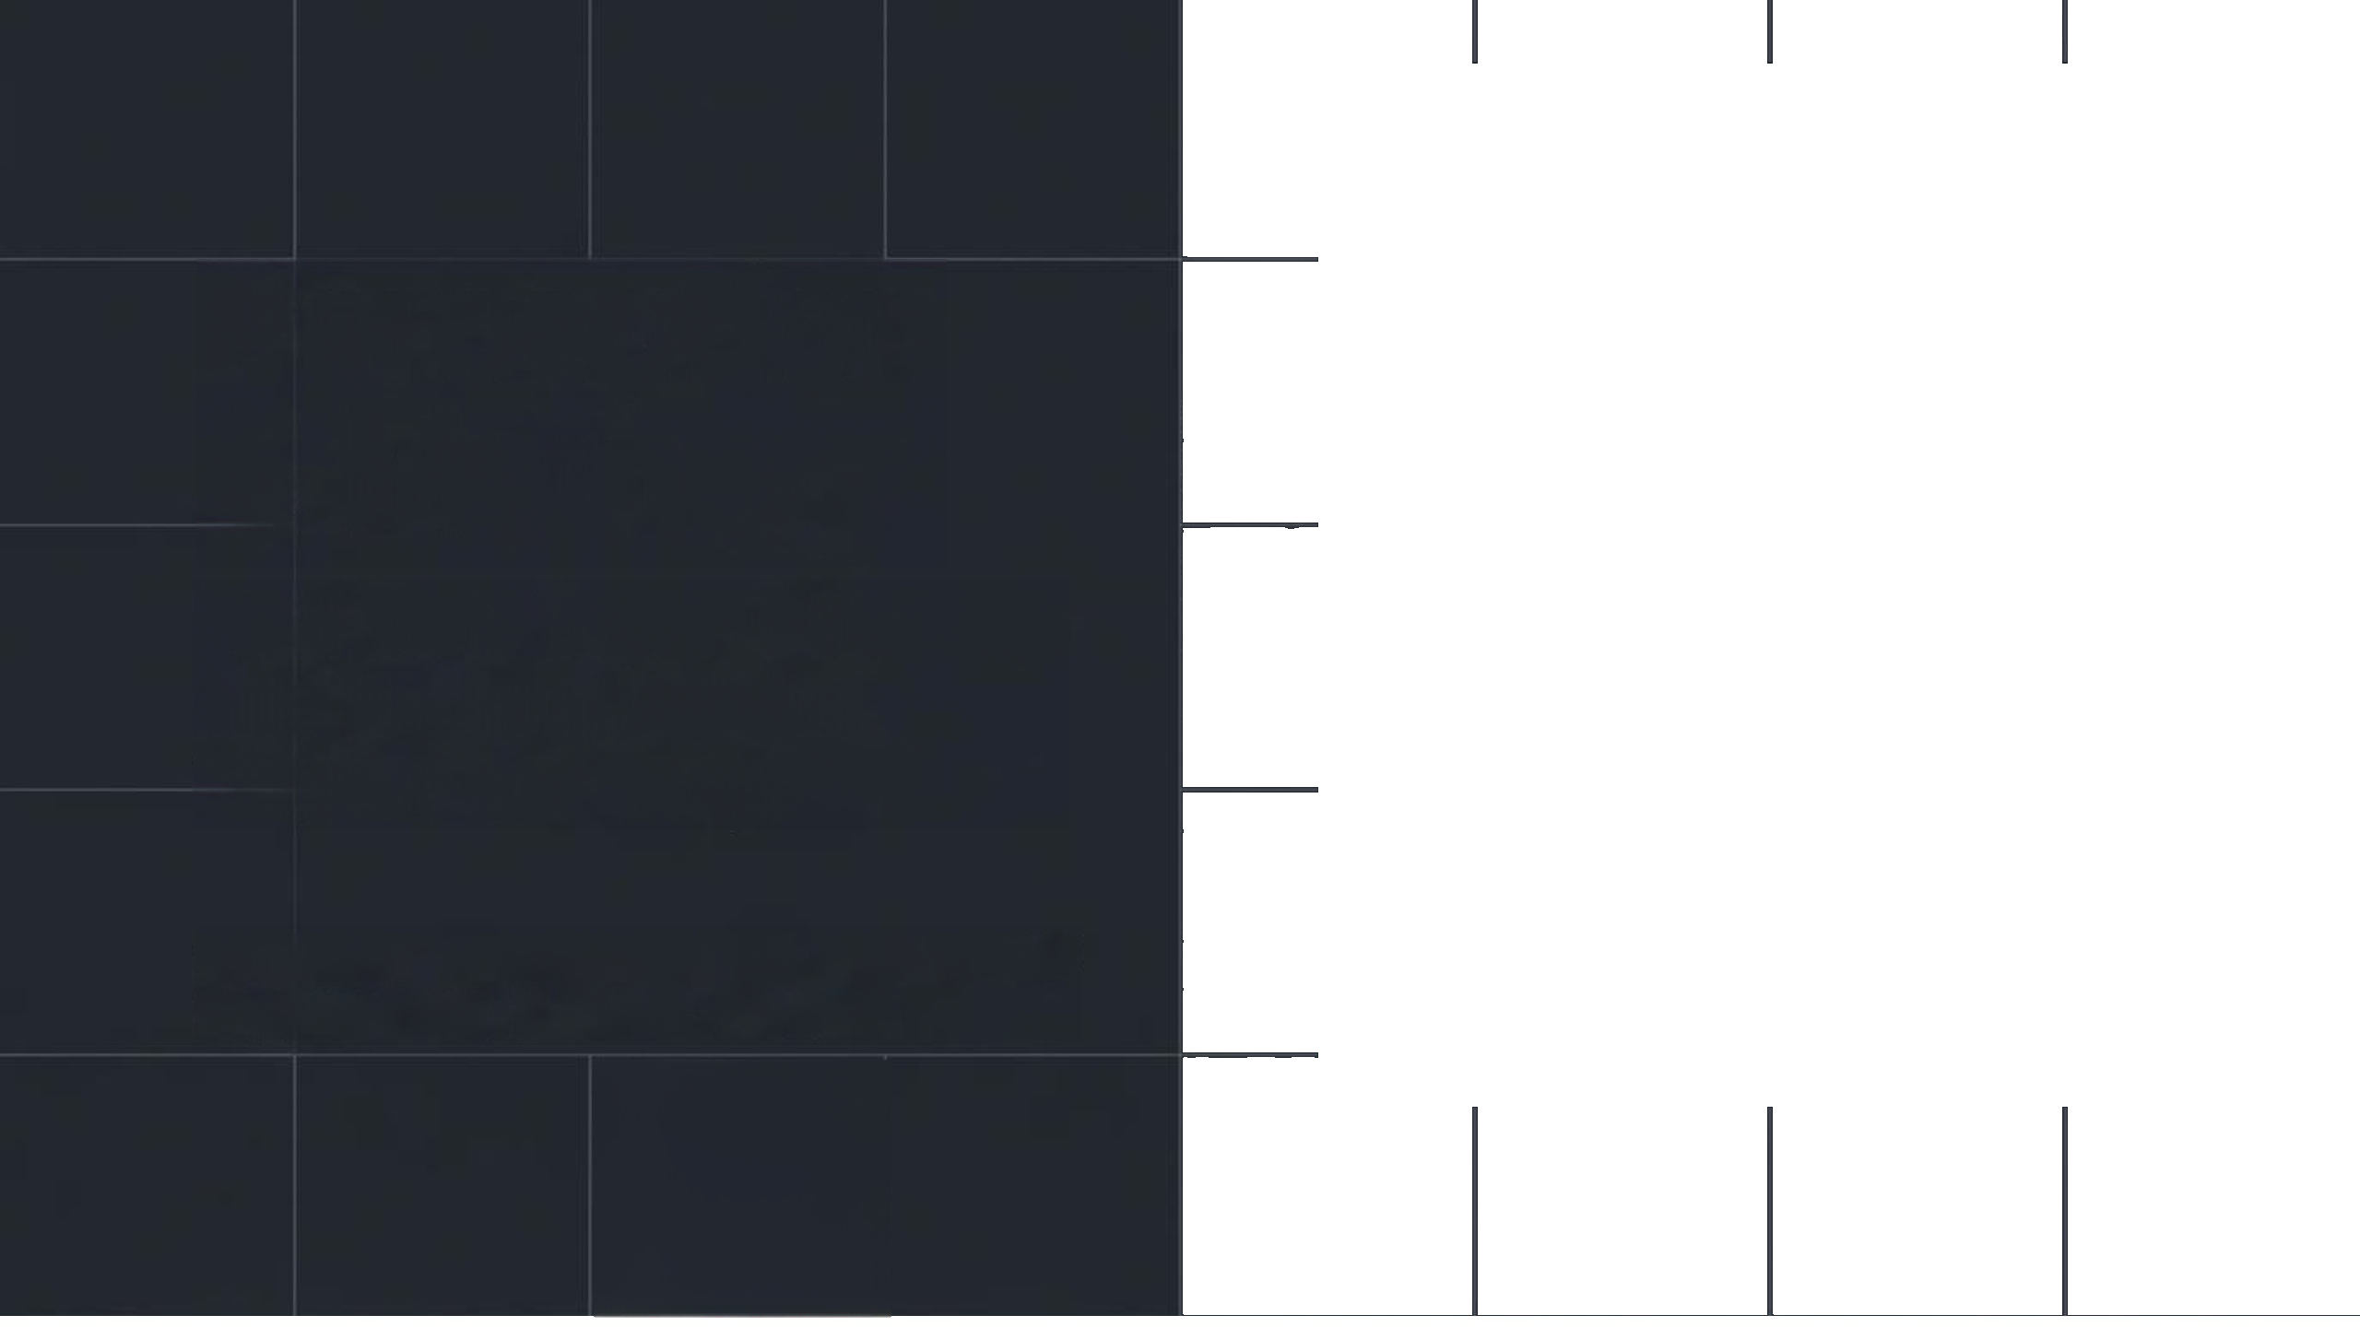

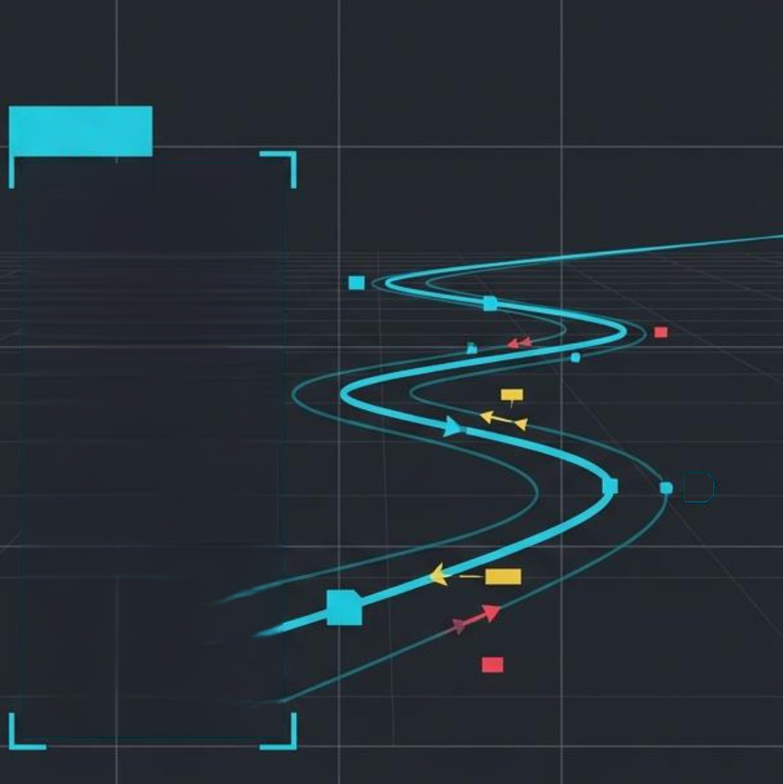



#ID_04
Perception
& Memory
Real-Time Object Detection
and Tracking utilizing
YOLOv8 and DeepSORT
Presented by: Sourour Hammoud
Supervised by: Pr. Mohamad KHALIL

Slide 2
Presentation Outline
1-
From Spatial Recognition to Temporal Persistence
2-
YOLOv8 Spatial Architecture
3-
Introducing DeepSORT
4-
Detection Meets Association
5-
Executing The Real-Time Pipeline Architecture
6-
System Configuration
7-
The Implementation Technology Stack
8-
Real-Time Tracking & Dynamic Annotation
9-
Navigating System Limitations And Edge Cases
10-
Deploying Tracking Into Real-World Environments
2

Slide 3


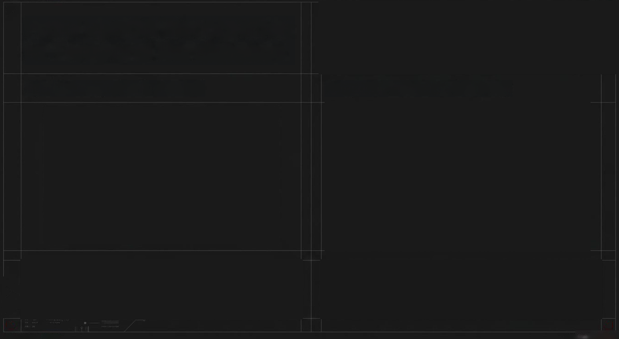
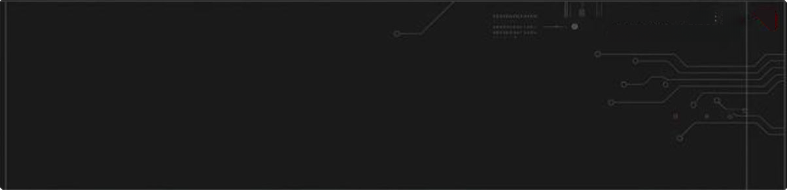


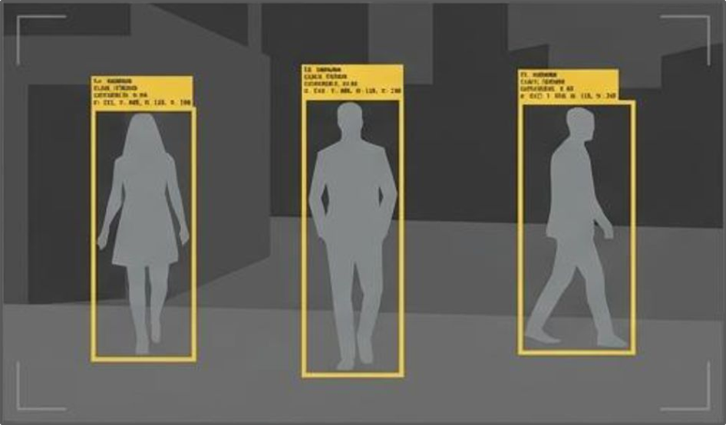
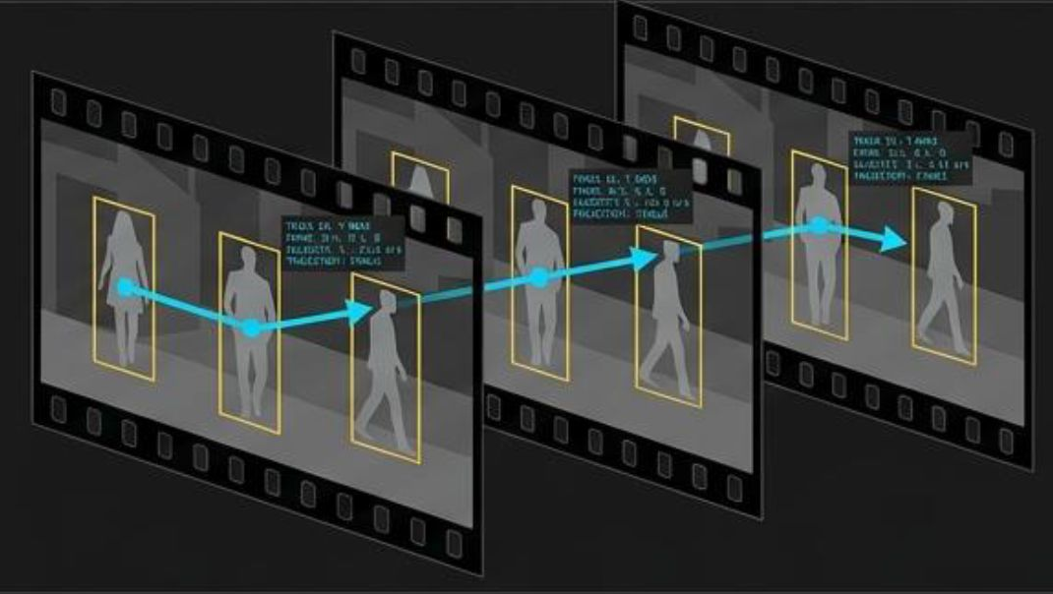
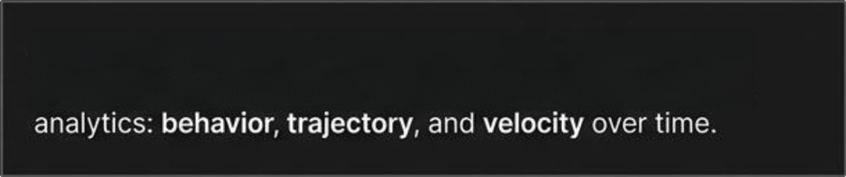



SYSTEM STATUS:
PNLENE
LATENCY:
<Ses
FPS
66
From Spatial Recognition
to Temporal Persistence
DATA FL0W:1.2Gbps
Spatial Recognition (Detection)
Temporal Persistence (Tracking)
Standard detection algorithms classify and localize objects in
2D space but treat sequential video frames as completely
independent images. A system with zero short-term memory.
Object tracking bridges the temporal gap. By linking
detections across frames, the system unlocks real-world
3
SYSTEN STATUS:
ONLINE

Slide 4
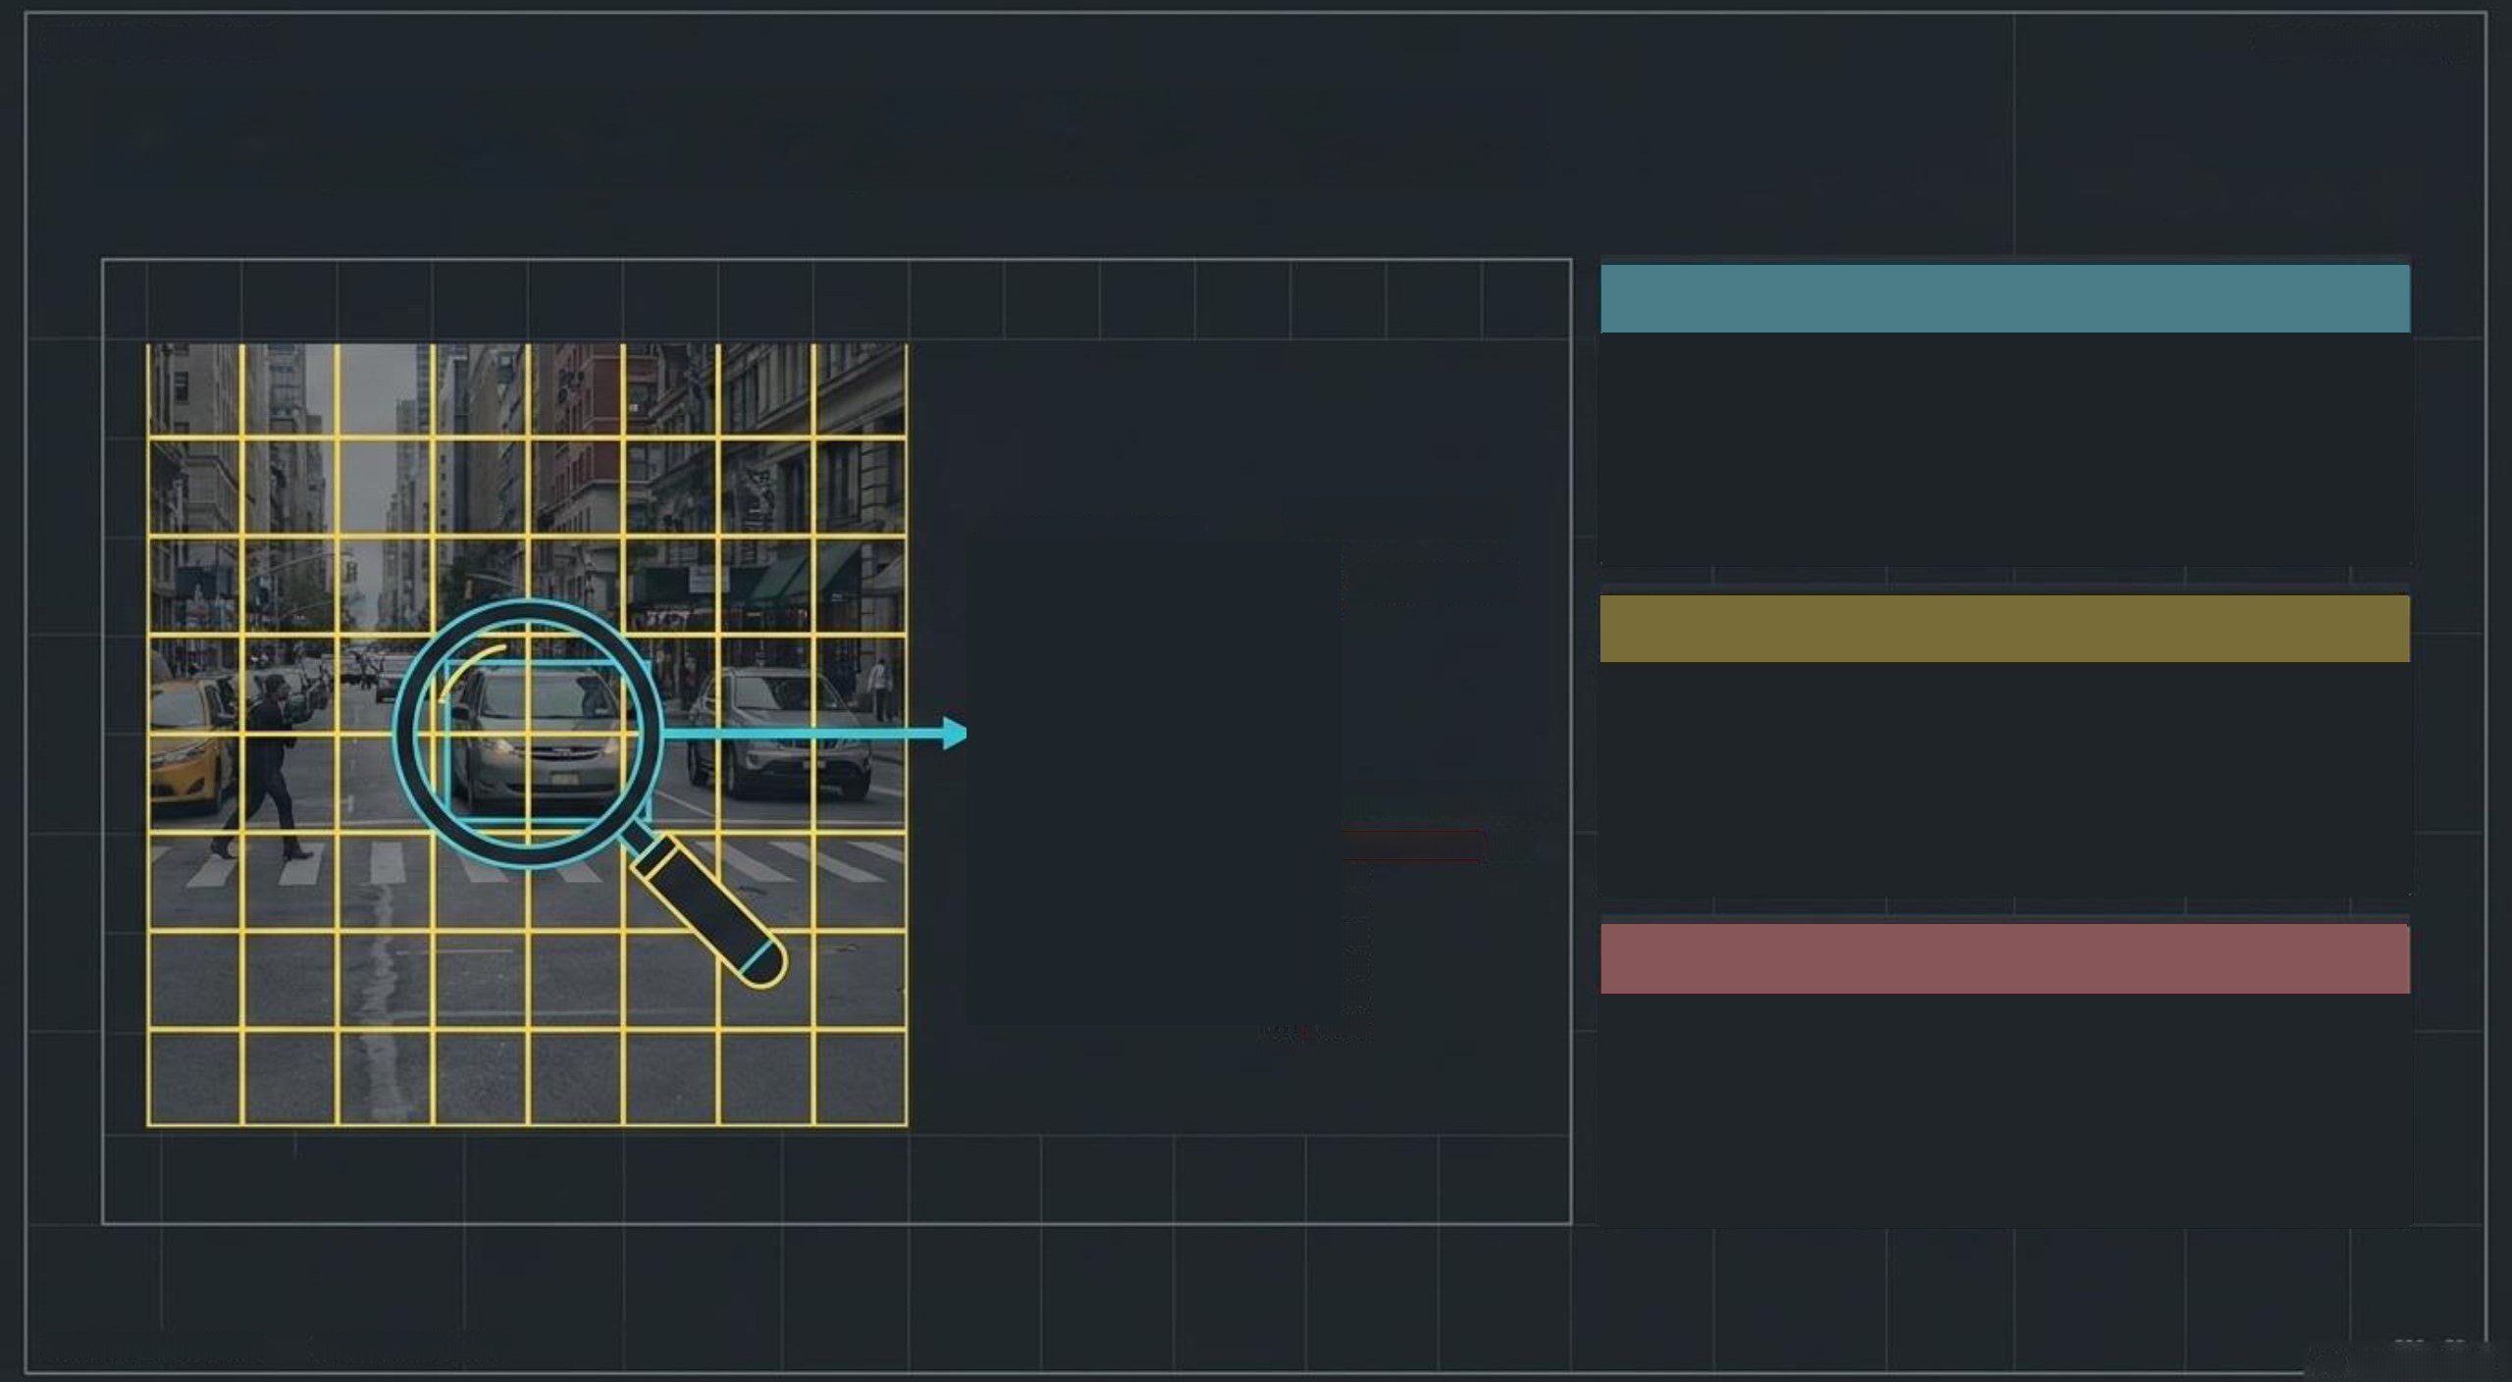
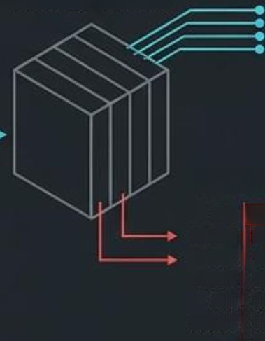
SYSTEN STATUS:ONLINE
BATA FL0N:1.46bps
The Eyes: YOLOv8 Spatial Architecture
Unified Pass
Processes entire images in a single
forward pass through the neural network,
bypassing slow multi-stage pipelines.
TENSOR BLOCK
BOUNDING BOX
x, y, w, h, c
Grid Division
Divides images into cells; if an object's
center falls in a cell, that cell is fully
responsible for the detection.
CLASS PROBABILITY
Caz
8.95
Person
0.82
Truck
0.01
Tzuck
0.01
Model Optimization
Caz
0.85
Pezson
8.05
0.03
Utilizes yolov8n.pt (the Nano variant)
to maximize FPS. Prioritizes real-time
speed while sacrificing a minimal
fraction of absolute precision.
4
SYSTEM STATUS:ONLZNE
DATA FLDN:1.4 6bps

Slide 5
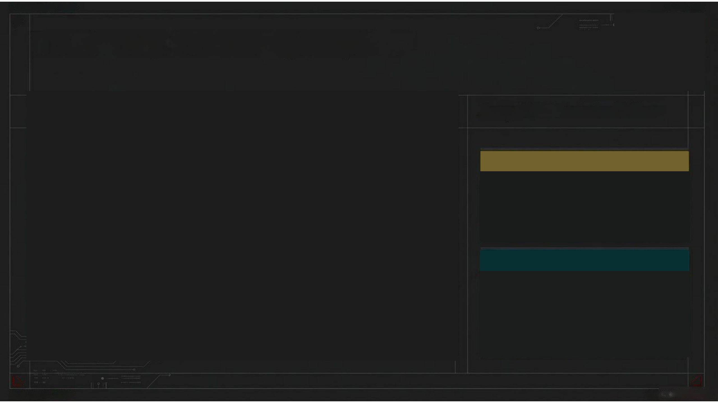

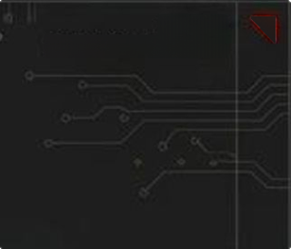
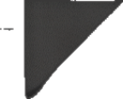

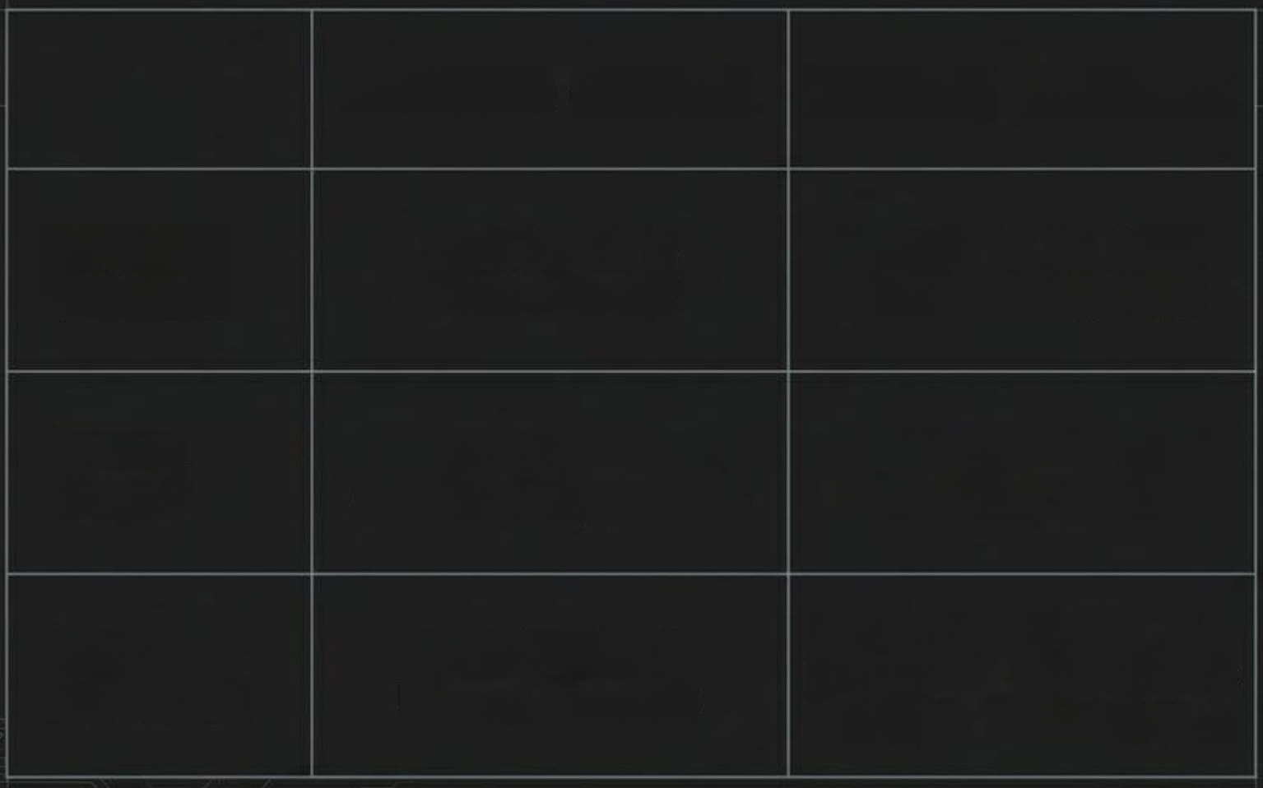


SYSTEH STATUS:
RNLINE
LATENCY:
<Ses
FPS:60
The Memory: Introducing DeepSORT
DATA FL0K:1.2Gbps
DeepSORT Technical Pillars
Detection (YOLOv8)
Tracking (DeepSORT)
Motion Prediction
Primary
Question
What is it &
Where is it?
Who is it & Where
is it going?
Uses Kalman filters to predict
the future mathematical
positions of existing tracks.
System
State
Stateless (Frame-
independent)
Stateful (Maintains
memory)
Visual Fingerprinting
Extracts a deep learning
appearance descriptor (using
MobileNet) for each box to
prevent identity switches when
objects overlap.
Core
Mechanism
Convolutional
Neural
Network
Kalman Filters +
Hungarian Algorithm +
Visual Embeddings
5
SYSTEN STATUS:
ONLIHE
DATA

Slide 6


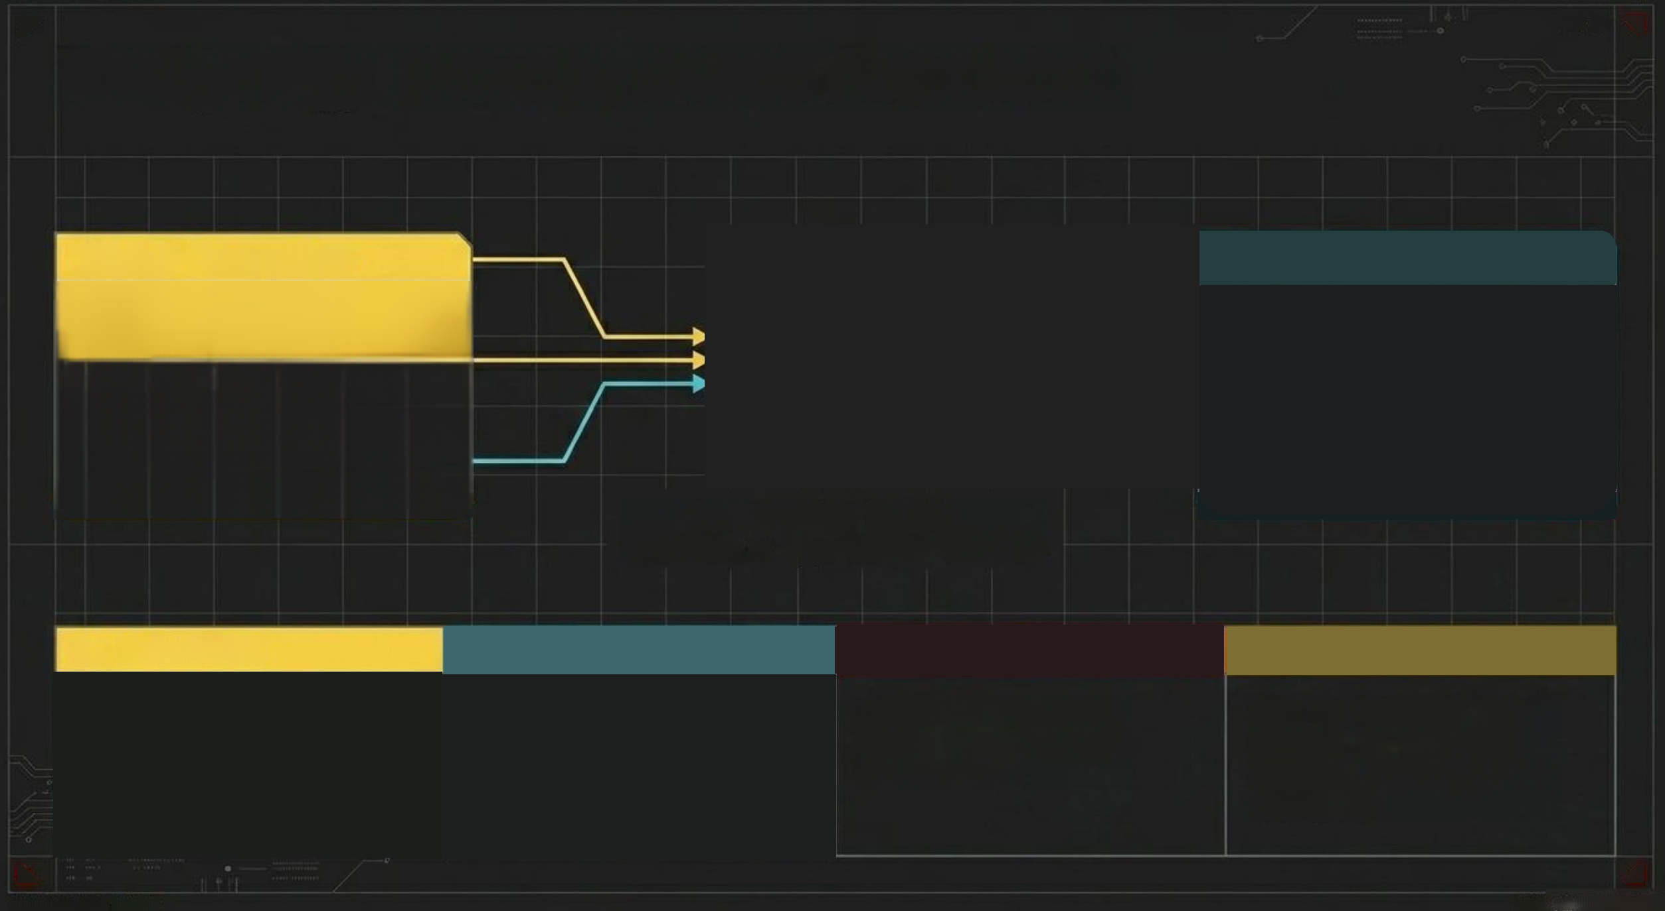
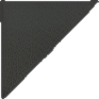

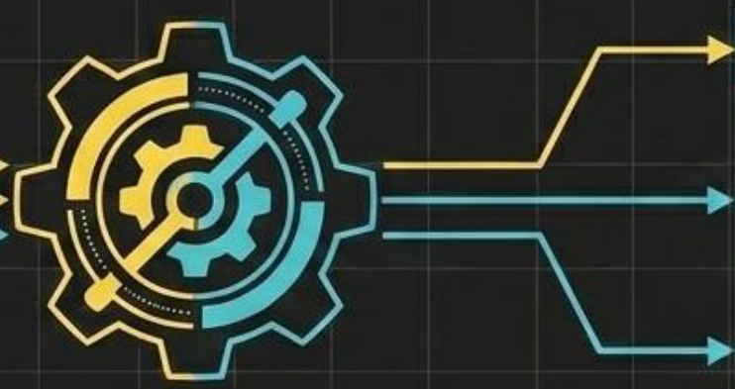



SYSTEH STATUS:
PNLINE
BATA FL00:1.36bps
FPS:
$5
The Synergy: Detection Meets Association
YOLOv8 Perception
DeepSORT Memory
YOLO Output Packet
DeepSORT Output Packet
Γ
[
[x,y, w, h].
Confidence,
Class
[x,y, w, h],
Track ID,
Class
]
]
Association Matrix: Distance +
Appearance Metrics
1.
Detection
2.Feature Extraction
3. State Prediction
4.Data Association
YOLO scans frame,
extracts bounding
boxes.
DeepSORT
evaluates visual
embeddings inside
each box.
DeepSORT predicts
where known tracks
should be.
New detections are
mapped to existing
tracks, locking in a
Track ID.
6
SYSTEN STATUS:
OKLIHE
OATA

Slide 7

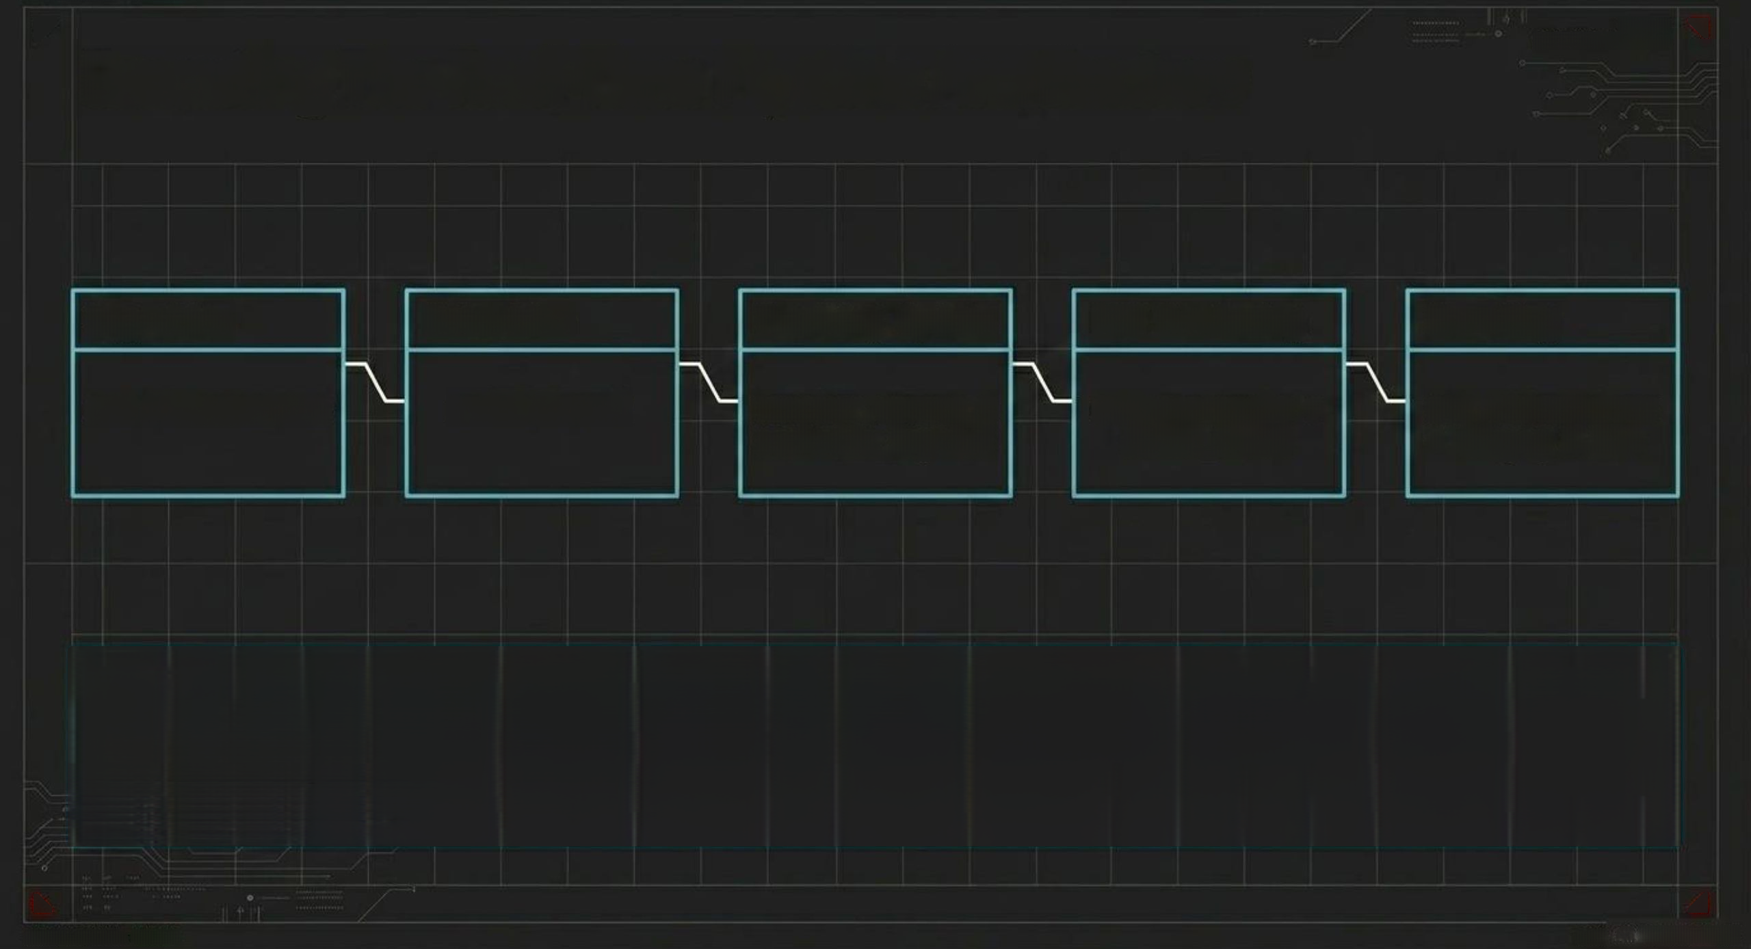
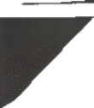






SYSTEH STATUS:
PULINE
FPS:60
Executing The Real-Time Pipeline Architecture
DATA FL0K:1.2Gops
Ingestion
Detection
Tracking Update
HUD Rendering
Encoding
cv2.VideoCapture
model(frame)
tracker.update_
tracks(ds_inputs)
cv2.rectangle
draw_counter
cv2.Videowriter
+ ffmpeg H.264
Operates in a while True loop,
processing individual frames
chronologically.
Tracks dynamically
verified via
track.is_confirmed()
before rendering.
Raw mp4v output
transcoded via FFmpeg into
browser-playable H.264.
7
SYSTEN STATUS:
OKLIHE
OATA

Slide 8

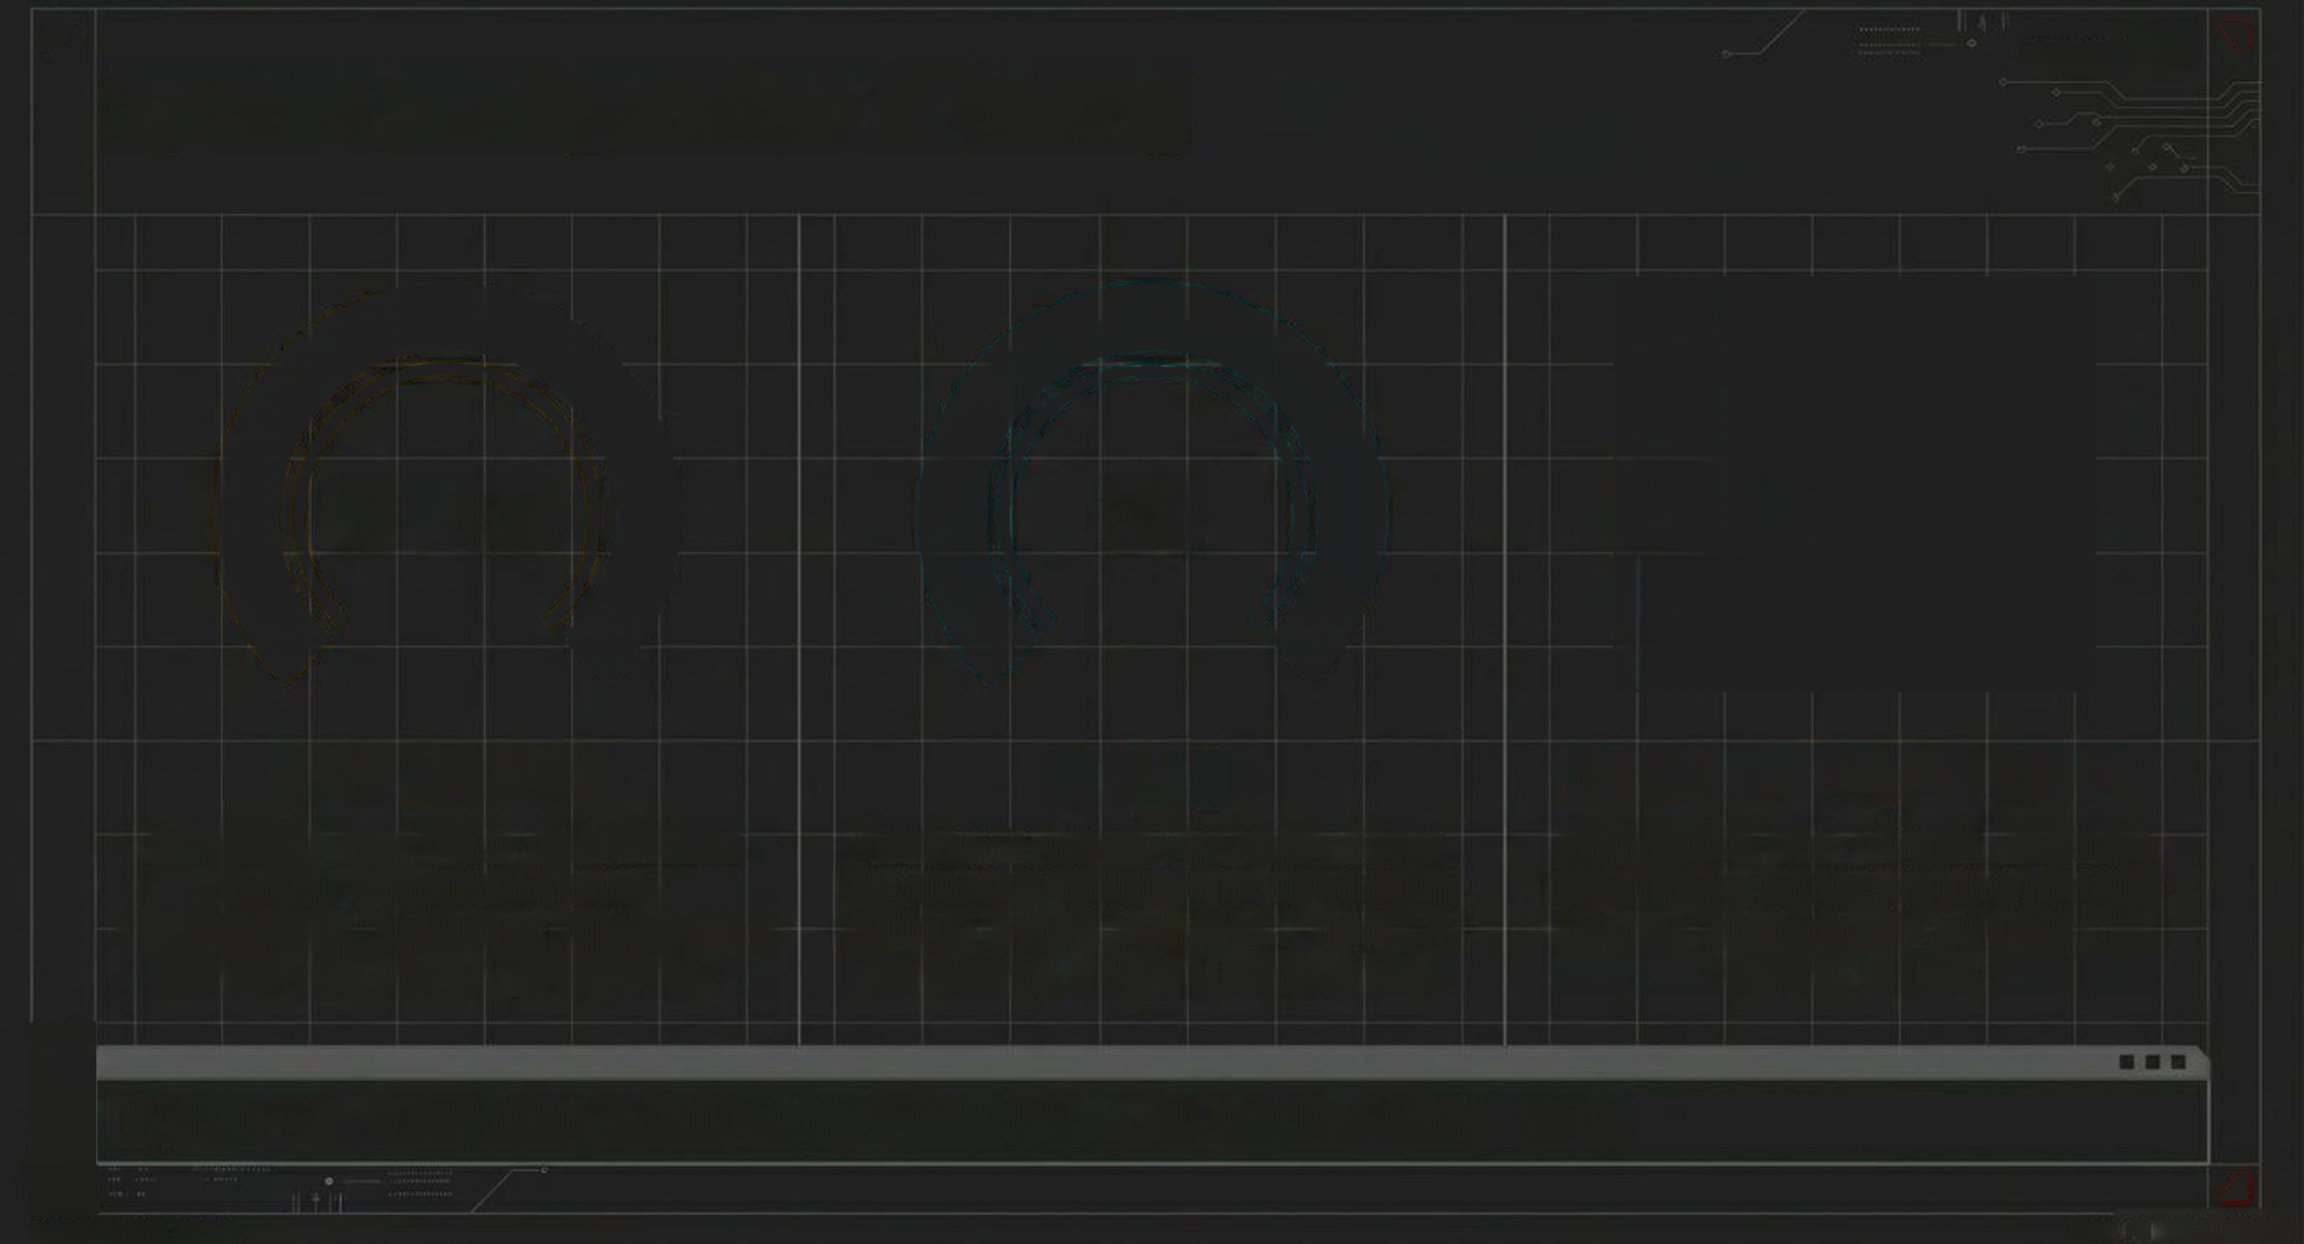
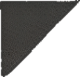

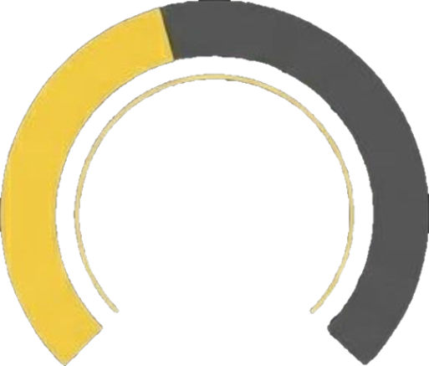



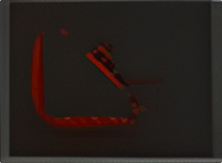
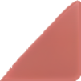

SYSTEH STATUS:
PHLUNE
FPS:60
System Configuration & Tuning
DATAFL0K:1.&6ops
0.40
30
0.3
CONF_THRESH
max_age
max_cosine_distance
Discards raw YoLo detections
below 40% confidence,
drastically reducing background
noise and false positives.
Frames a track is kept alive in
memory without a detection
before being deleted.Handles
temporary visual occlusion.
Threshold for visual feature
matching; lower values
demand closer appearance
matches to retain an ID.
n_init = 3 # Requires 3 consecutive detections to confirm a new track
8
SYSTEN STATUS:
OKLIHE
OATA

Slide 9

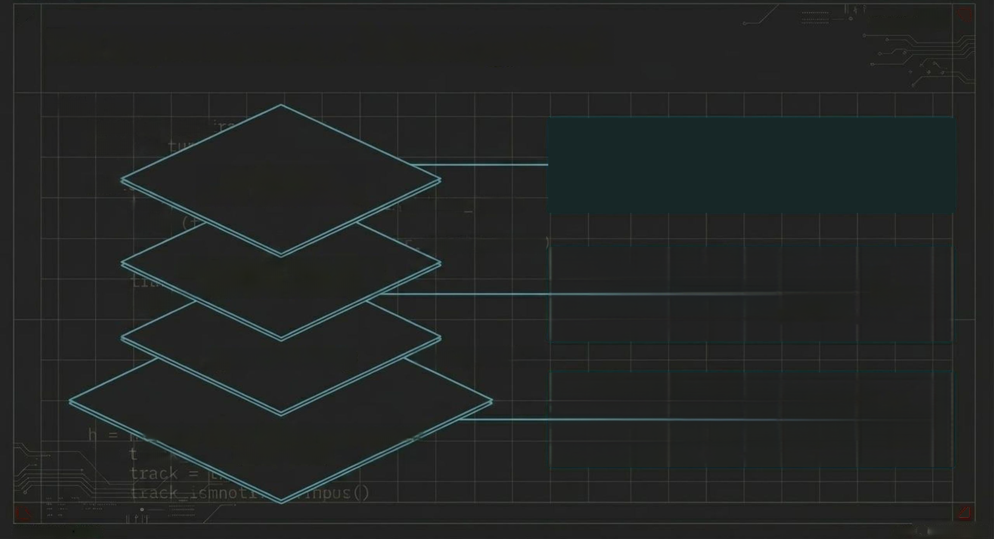
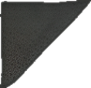
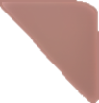


SYSTEH STATUS:
MILINE
PPS:60
The Implementation Technology Stack
DATA FL0M:1.36ops
while loop:
frame=
track=
cv2.f
OpenCV
handles matrix manipulations to draw
OpenCv (cv2)
Frame Manipulation
dynamic color palettes and alpha-blended
PNG assetsnatively on the videofeed.
whi.
trat
mod
el
onitor
PNG)
ragars_CLASS
Ultralytics YOLO API &
deep-sort-realtime
deep-sort-realtime
wrapper interfaces
while
directly with Ultralytics output tensors,
utilizing the MobileNet embedder.
Python 3 & NumPy
some_track)
Utilizes a dedicated T4 GPU instance to
ensure parallel processing speeds
(half=True) capable of real-time execution.
Google Colab T4 GPU
Environment rac↘
(half=True)
for
9
SVSTEN STATUS:
OKLIHE
OATA

Slide 10

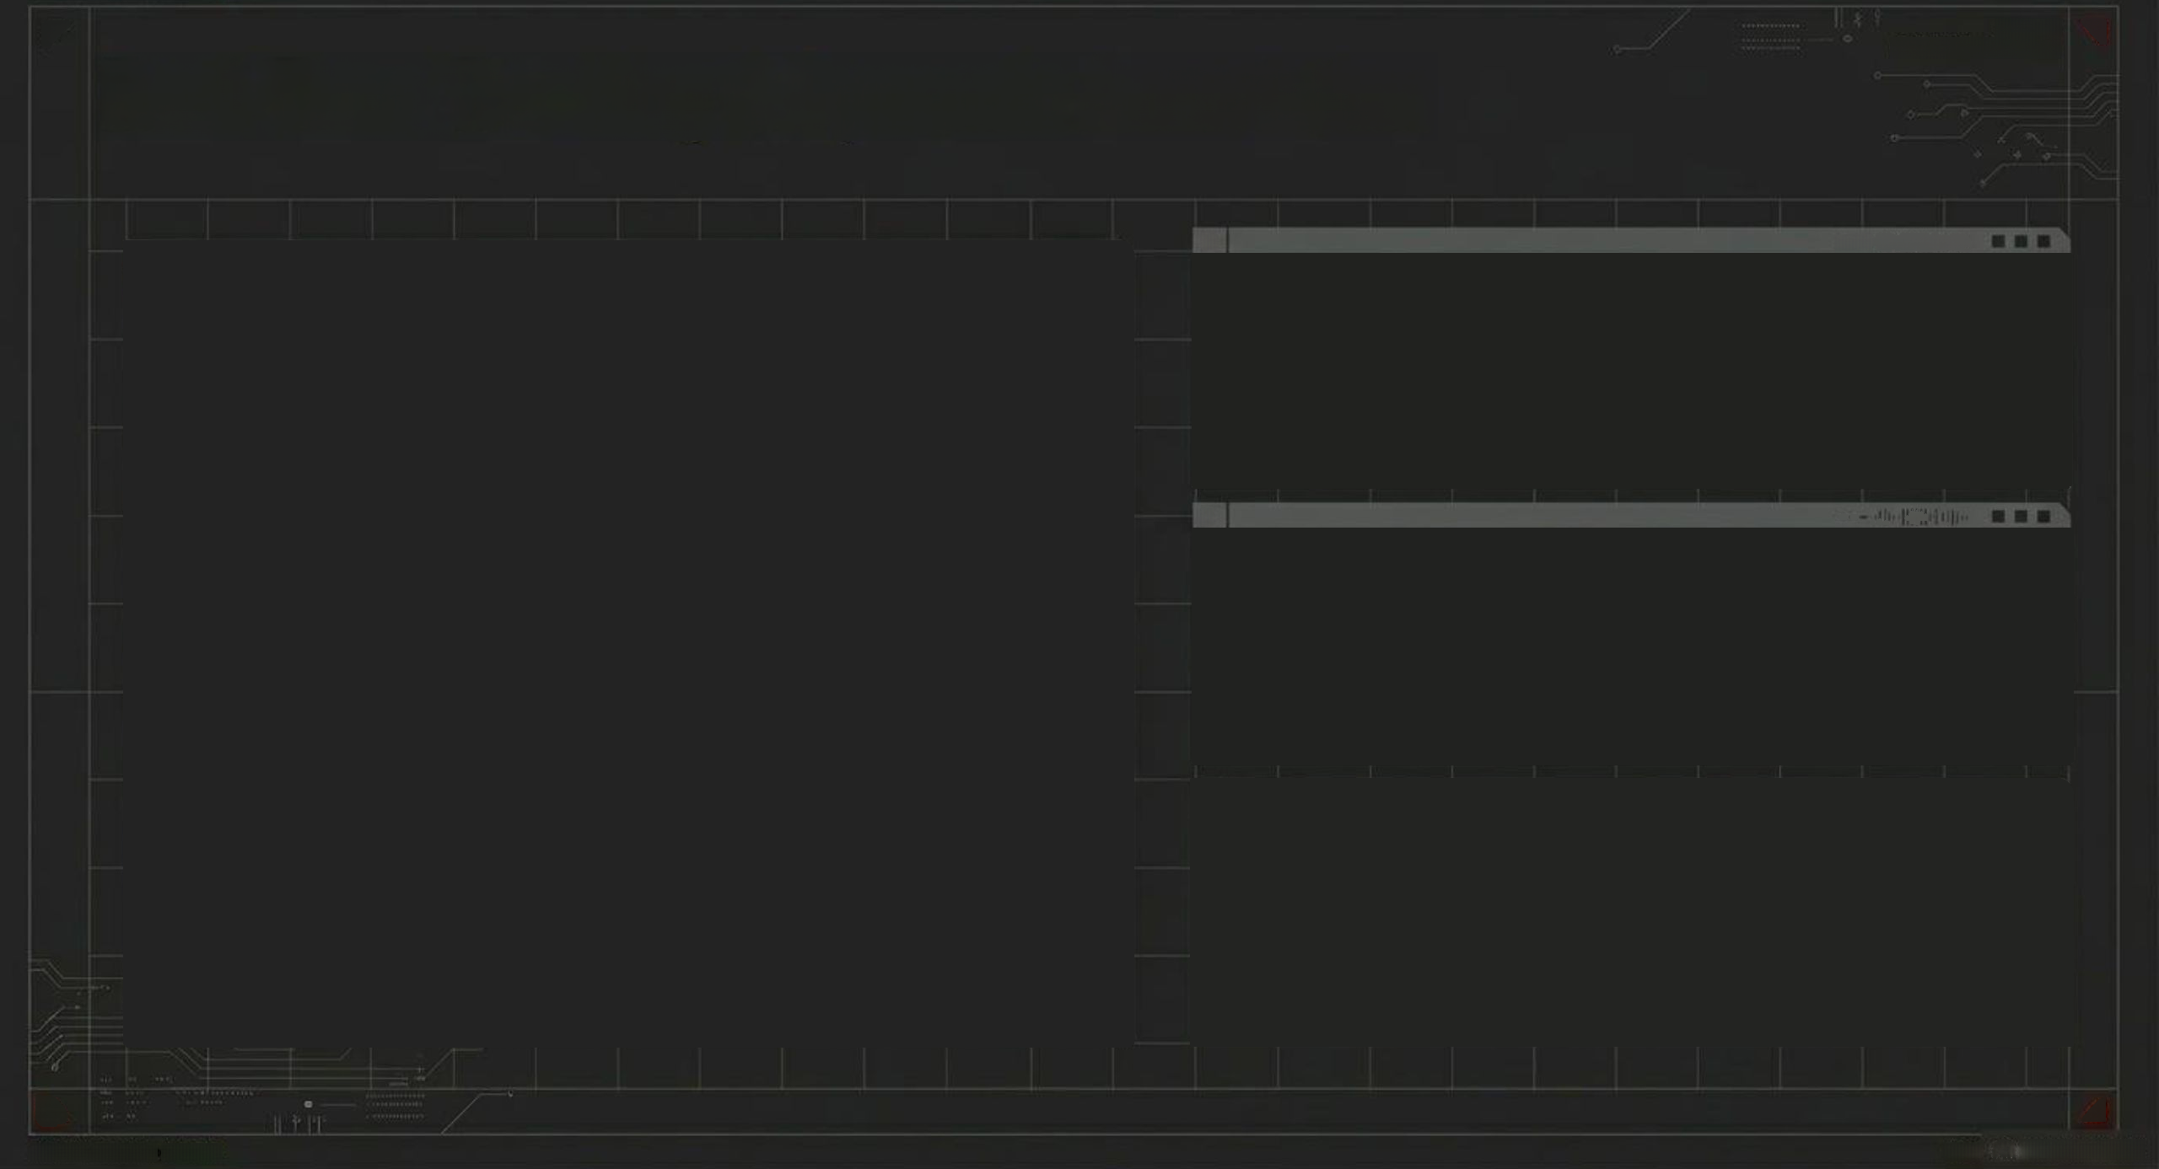
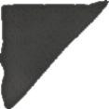
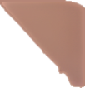
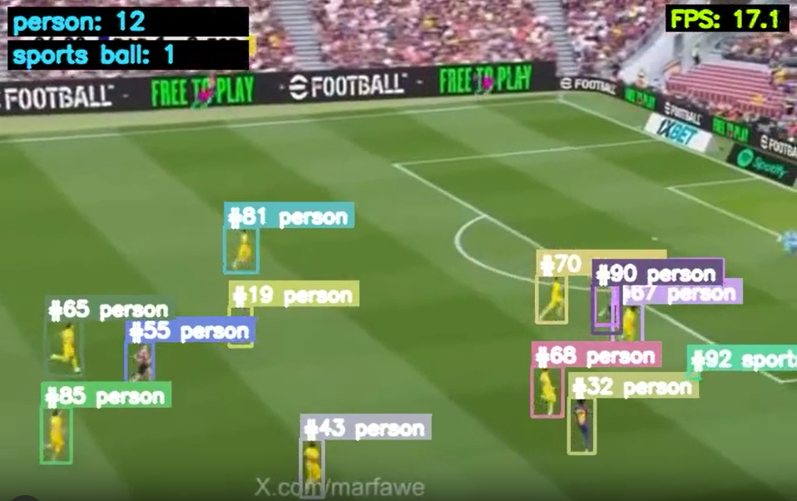


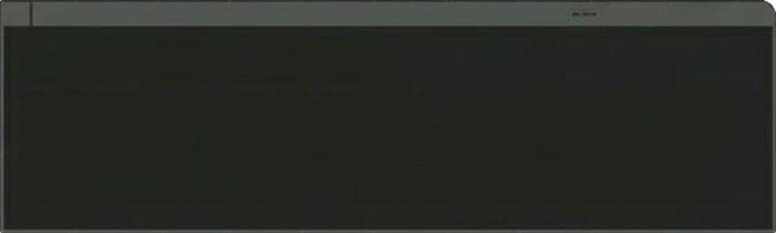




SYSTEH STATUS:
MILINE
PFS:60
Real-Time Tracking & Dynamic Annotation
DATAFL0K:1.46ops
VTDEO OUTPUT
1
...
Throughput
Processed 672x480 resolution input at an
average of 43.4 FPS usingthe Nano model,
achieving true real-time performance.
2
Dynamic Identity Palettes
Track IDs are mapped to unique RGB colors
generated dynamically via modulo indexing
3
DATA FL0W:1.4 Gbps
Automated Alerts
Successfully implemented conditional logic
triggering custom alpha-blended PNG alerts
when ALERT_CLASS ='person' is detected.
II
10
SVSTEN STATUS:
OKLIHE
OATA

Slide 11

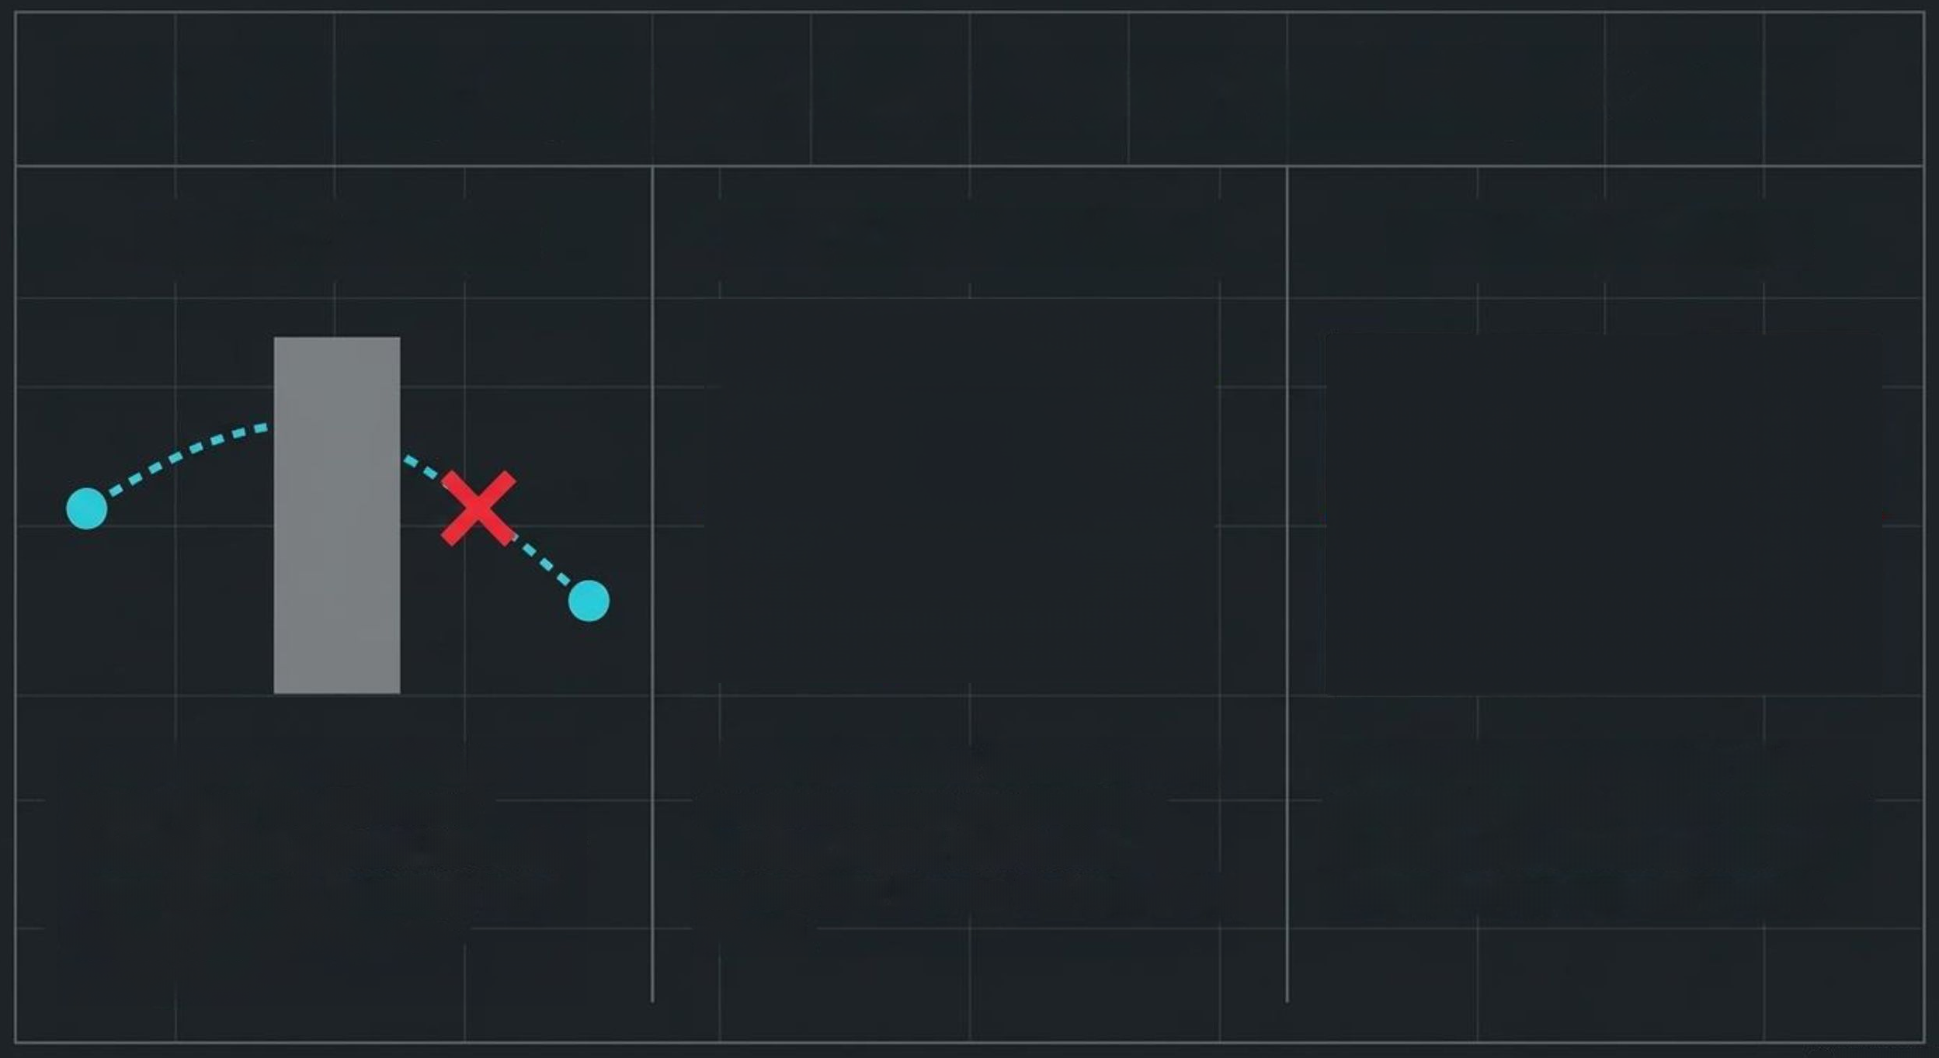
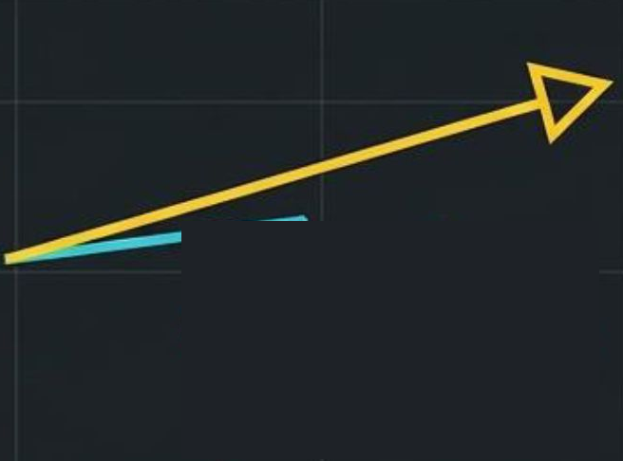
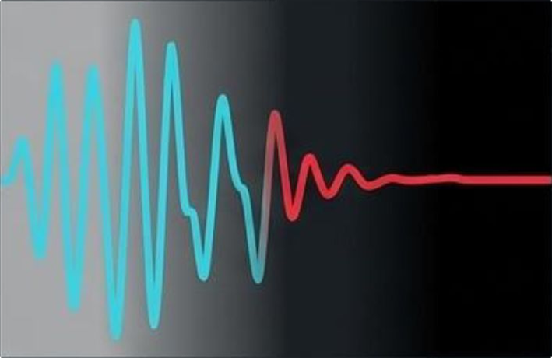

Navigating System Limitations And Edge Cases
Severe Occlusion
Fast & Erratic Motion
Illumination Shifts
If an object remains hidden
longer than the 30-frame
max_age, the system forcefully
drops the track, resulting in an
Identity Switch upon re-
emergence.
The Kalman filter fundamentally
assumes linear, predictable
velocity. Rapid, non-linear motion
blur breaks the trajectory model.
Drastic lighting changes alter
core pixel values, which can trick
the cosine distance metric into
failing the appearance match.
11

Slide 12
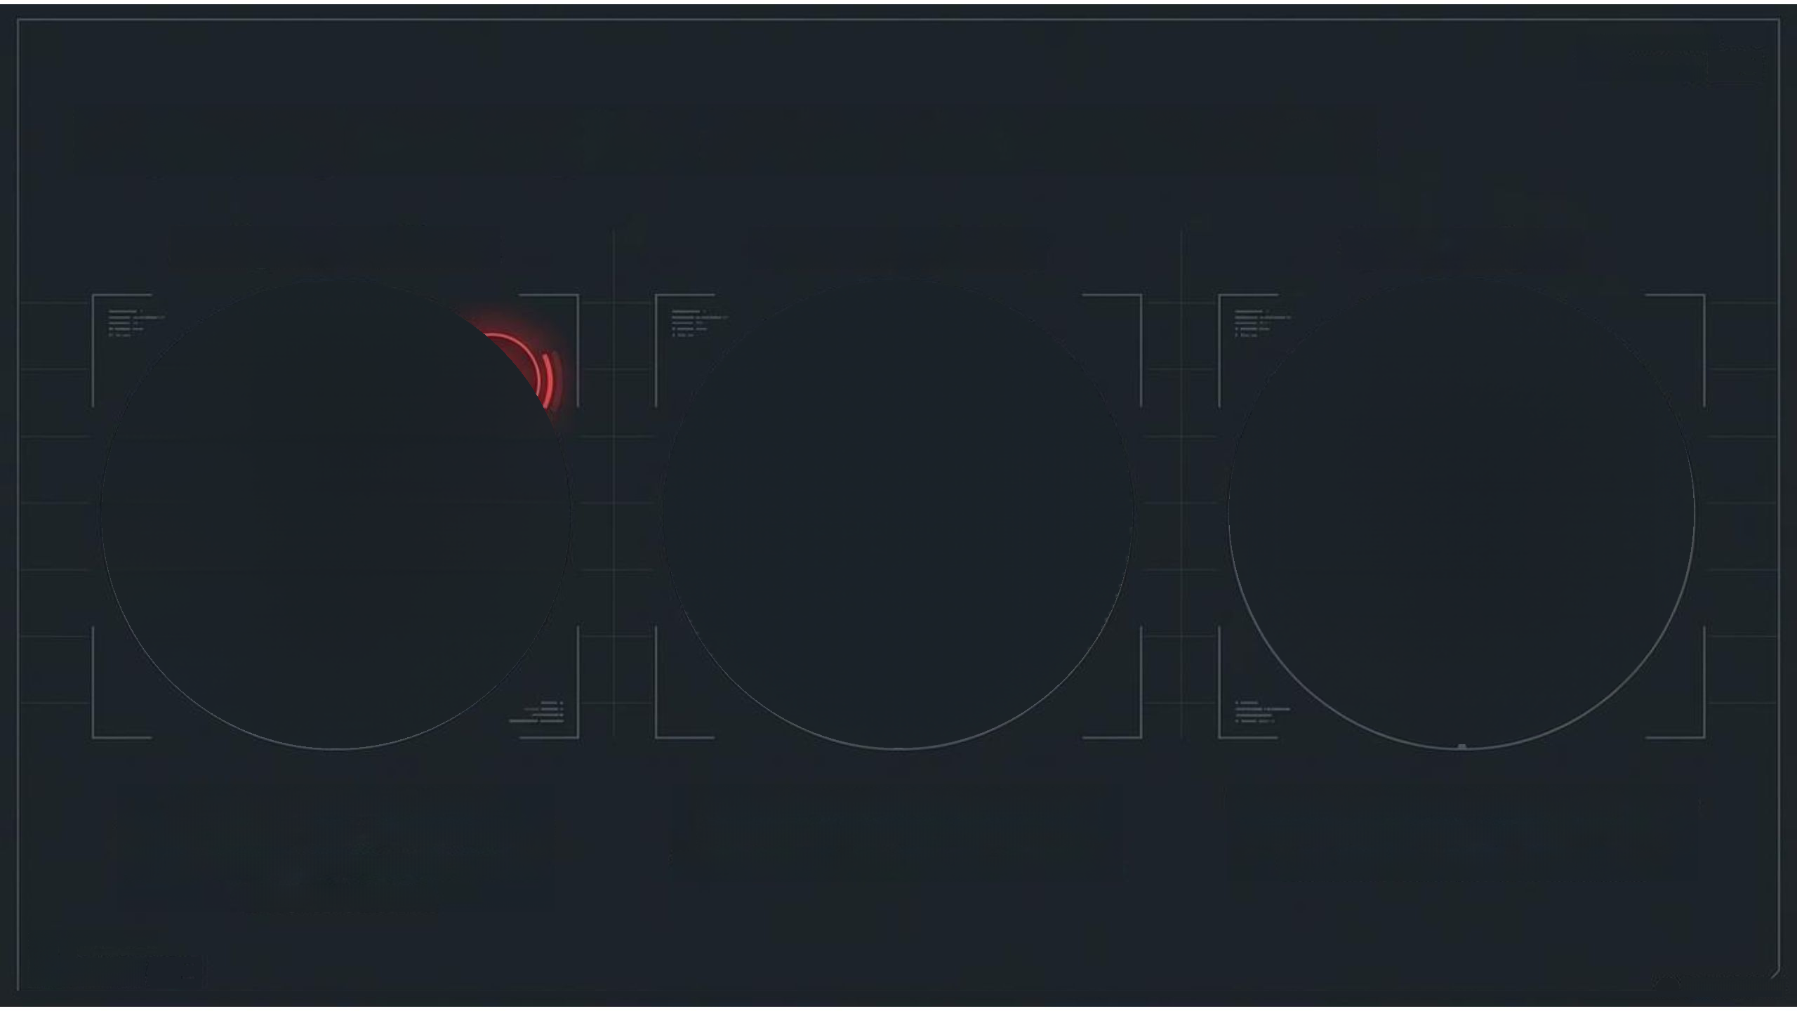

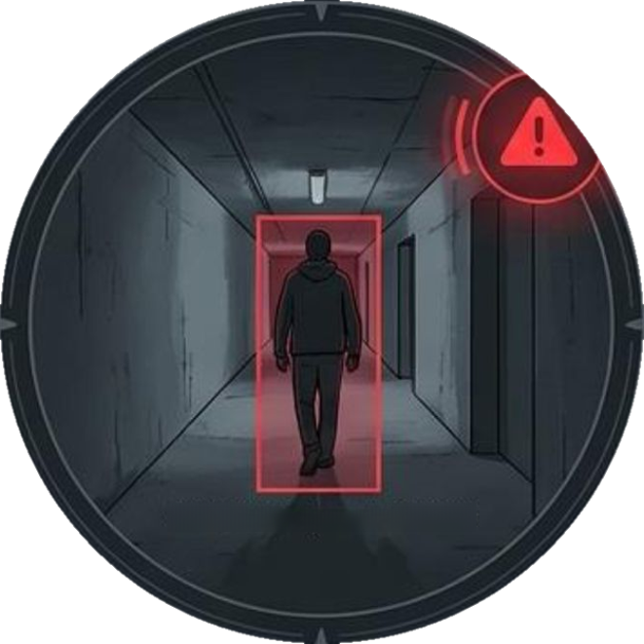
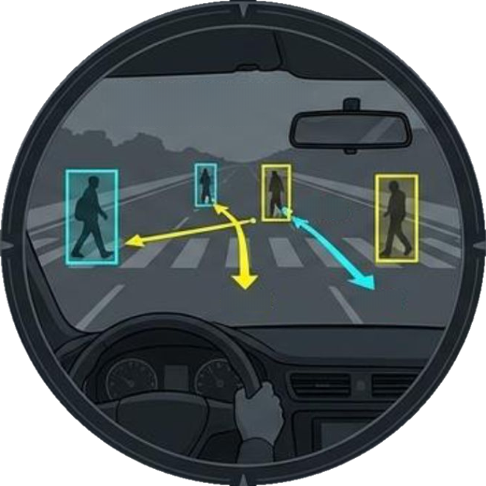
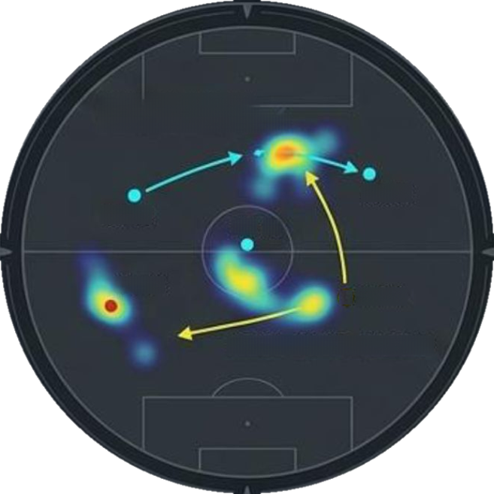

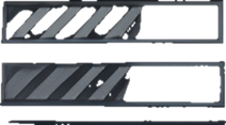
SVSTEH STATUS:ONLINE
PE5:68
DATAFL0N:1.4.6bps
Deploying Tracking Into Real-World Environments
Intelligent Surveillance
Autonomous Driving
Sports Analytics
TRAJECTORY
PATH:PREDZCTED
VELOCETY:1.4m/s
PLAYER 1D:TRACKINS
VELOCITY STATS:UPOATINS
+1.8s
ID:12
10:89
I0:
65
+0.5s
10:12
10:84
+1.8s
SPATIALHEATHAP:GENERATED
CLASS FILTER: 'person' DETECTED
Scaling the pipeline's custom
class-filtering logic to automatically
trigger security protocols for specific
object intrusions.
Utilizing temporal state memory to
calculate pedestrian trajectory and
velocity, critical for collision avoidance
Extracting persistent unique player IDs to
automatically generate complex velocity
statistics and spatial heatmaps
STSTEM STATOS:OHLTHE
12
PFSR
60
BATA FL08:1.4 Goos
B4TAT204:1-2 66ps

Slide 13
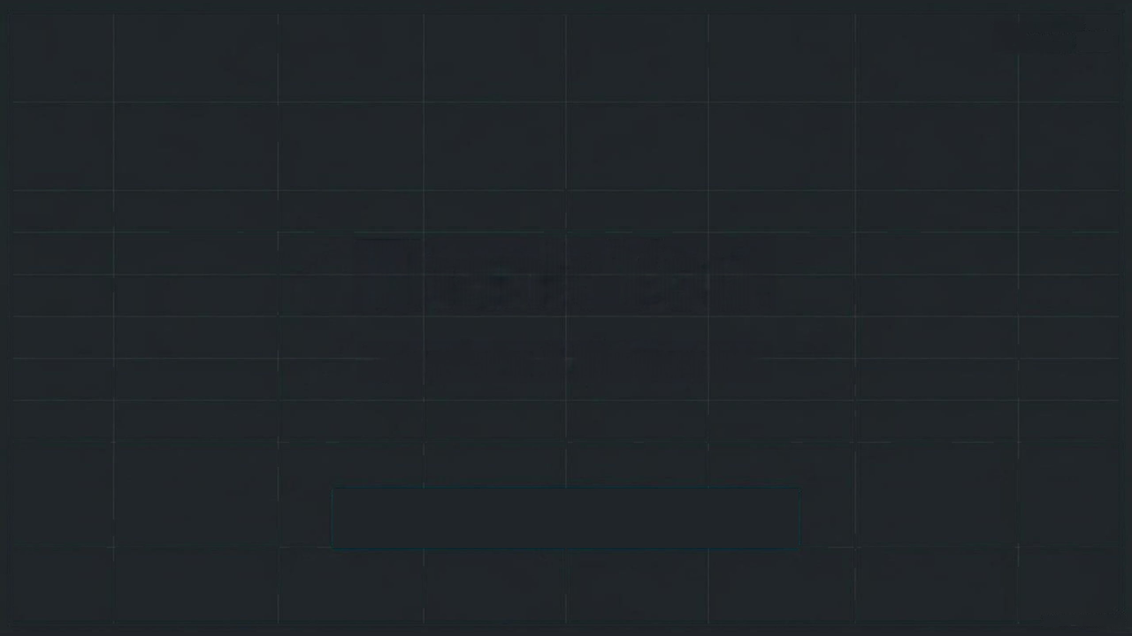
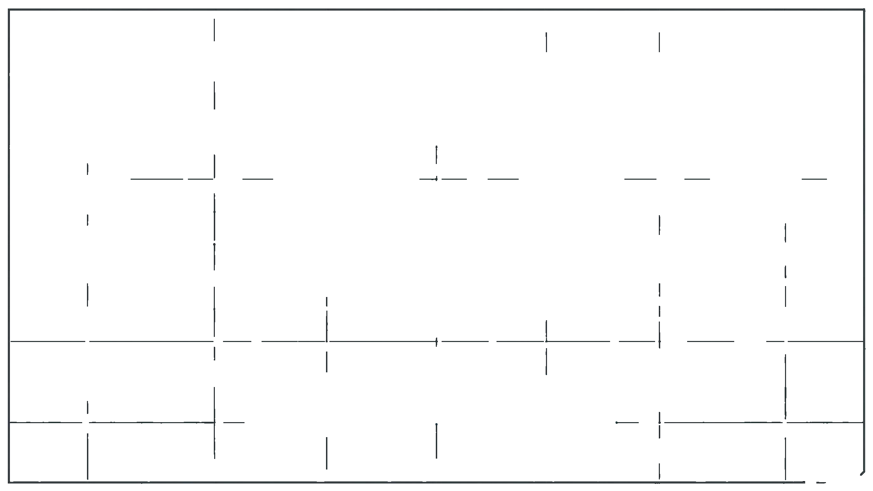
Thank You.

