Slide 1
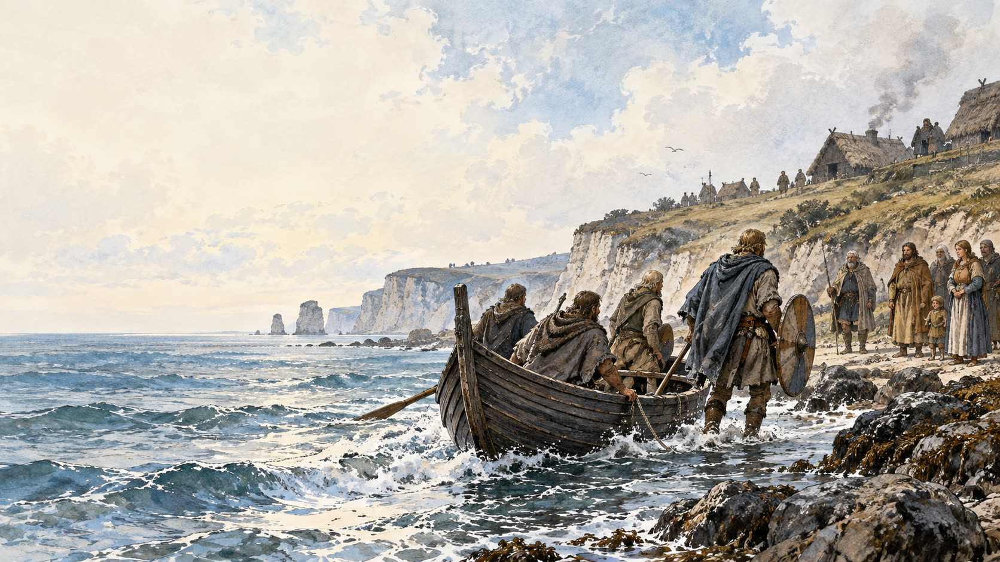
Where English
began
ENGLISH, POWER, ACCESS
01 / 12
Notes:
The opening image is an illustration. Settlement had no single language birth date.
Sources:
https://lrc.la.utexas.edu/eieol/engol/0
https://www.cambridge.org/core/books/cambridge-history-of-the-english-language/460EF4D4F89505464299A52DFF1BA4F6
Artwork on slide 1 is an imagined scene. It is not a historical record.

Slide 2
English has no birthday
Germanic settlers crossed the sea.
Their dialects shaped Old English.
Settlement began in the 400s.
A process, over generations.
ENGLISH / 02
Notes:
The fifth century gives an approximate settlement period. It is not a language birthday.
Sources:
https://lrc.la.utexas.edu/eieol/engol/0
https://www.cambridge.org/core/books/cambridge-history-of-the-english-language/460EF4D4F89505464299A52DFF1BA4F6
Artwork on slide 1 is an imagined scene. It is not a historical record.

Slide 3
Old English was Germanic
WEST GERMANIC
Old Frisian. Old Saxon.
These languages shared ancestry.
ENGLISH / 03
Notes:
The university lists West Germanic relatives. Related languages are not identical languages.
Sources:
https://lrc.la.utexas.edu/eieol/engol/0
Artwork on slide 1 is an imagined scene. It is not a historical record.

Slide 4
Some words stayed
OLD ENGLISH
TODAY
hand
hand
word
word
ENGLISH / 04
Notes:
These Old English examples appear in the University of Texas glossary. Spelling alone does not establish unchanged pronunciation.
Sources:
https://lrc.la.utexas.edu/eieol/engol/0
Artwork on slide 1 is an imagined scene. It is not a historical record.

Slide 5
Writing came later
Speech preceded surviving manuscripts.
Cædmon’s Hymn survives in copies.
One copy dates to 800–830.
Found in Rome in 2026.
ENGLISH / 05
Notes:
Trinity describes the Rome manuscript. It is the third oldest surviving copy. This is not the oldest surviving English text overall.
Sources:
https://www.tcd.ie/news_events/articles/2026/caedmons-hymn-discovery/
Artwork on slide 1 is an imagined scene. It is not a historical record.

Slide 6
No single dialect
WEST SAXON
KENTISH ANGLIAN
Surviving texts favor West Saxon.
Scribes varied their spelling.
ENGLISH / 06
Notes:
The University of Texas lists three dialect groupings. West Saxon is prominent in surviving texts.
Sources:
https://lrc.la.utexas.edu/eieol/engol/0
Artwork on slide 1 is an imagined scene. It is not a historical record.

Slide 7
French entered after conquest
1066
Normans conquered England.
French words entered English.
Change took time.
ENGLISH / 07
Notes:
University of Texas notes Norman conquest and later French borrowing. It does not describe instant replacement.
Sources:
https://lrc.la.utexas.edu/eieol/engol/0
Artwork on slide 1 is an imagined scene. It is not a historical record.

Slide 8
Sources and limits
Texas Linguistics Research Center
lrc.la.utexas.edu/eieol/engol/0
Trinity College Dublin
tcd.ie/news_events/articles/2026/caedmons-hymn-discovery/
Texts show survivors, not beginnings.
NEXT: Ancient Britain before English
ENGLISH / 08
Notes:
The last claim is an inference. Surviving records cannot show the first spoken exchange.
Sources:
https://lrc.la.utexas.edu/eieol/engol/0
https://www.tcd.ie/news_events/articles/2026/caedmons-hymn-discovery/
https://www.cambridge.org/core/books/cambridge-history-of-the-english-language/460EF4D4F89505464299A52DFF1BA4F6
Artwork on slide 1 is an imagined scene. It is not a historical record.

