Slide 1
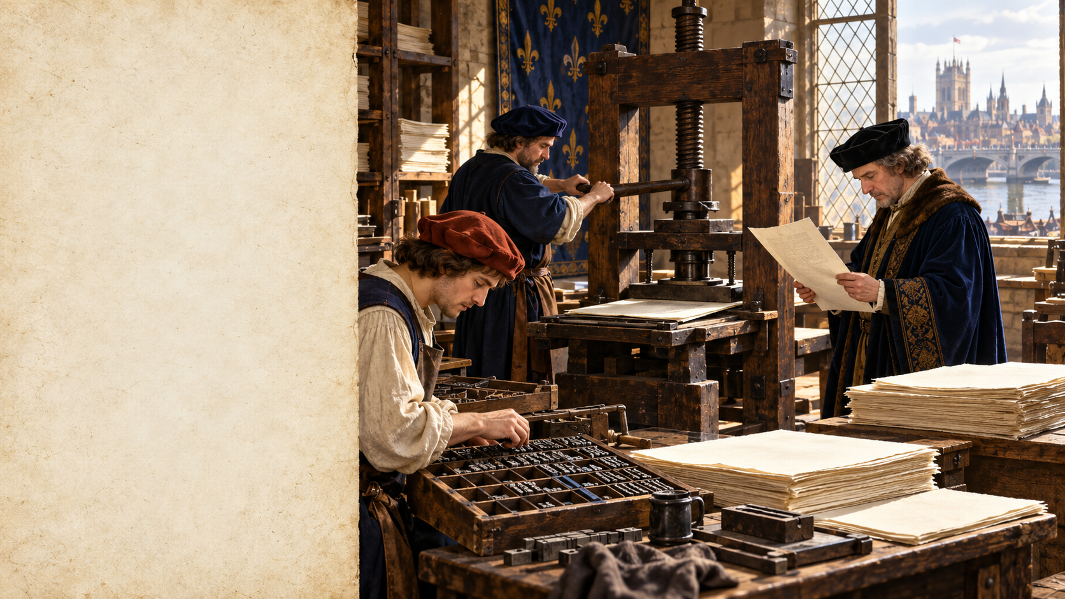
ENGLISH, POWER, ACCESS
Printing,
Rules,
Status
WHO SET THE STANDARD?
04 / 12
Notes:
Evidence: Caxton printed English.
Inference: Repetition strengthened choices.
Unproven: Printing acted alone.
Sources:
https://www.westminster-abbey.org/abbey-commemorations/commemorations/william-caxton
https://www.london.ac.uk/senate-house-library/news/senate-house-library-hosts-major-new-exhibition-mark-550th-anniversary-caxton-printing-press
Artwork is illustrative.

Slide 2
English varied before print
SPELLING
DIALECT
CONTROL
Many forms
Local words
No single ruler
Scribes made choices.
Regions sounded different.
Change stayed gradual.
Variation was normal.
ENGLISH / 04 / 02
Notes:
Evidence: Caxton described variation.
Inference: Scribes preserved diversity.
Unproven: England lacked patterns.
Sources:
https://universityofglasgowlibrary.wordpress.com/tag/caxtons-prefaces/
Artwork is illustrative.

Slide 3
Caxton's press repeated choices
1476
CHOICE
REACH
Press opened
Printers selected
Copies multiplied
Westminster became central.
Spellings became reusable.
Chosen forms travelled.
Printing accelerated selection.
ENGLISH / 04 / 03
Notes:
Evidence: Caxton printed there.
Evidence: Copies spread choices.
Inference: Markets rewarded consistency.
Sources:
https://www.westminster-abbey.org/abbey-commemorations/commemorations/william-caxton
https://www.london.ac.uk/senate-house-library/news/senate-house-library-hosts-major-new-exhibition-mark-550th-anniversary-caxton-printing-press
Artwork is illustrative.

Slide 4
Egges or eyren?
NORTHERN FORM
SOUTHERN FORM
egges
eyren
One shopper spoke.
One seller understood.
Caxton recorded this around 1490.
A standard remained unsettled.
ENGLISH / 04 / 04
Notes:
Evidence: Caxton told this.
Evidence: Forms caused confusion.
Inference: Printers faced choices.
Sources:
https://universityofglasgowlibrary.wordpress.com/tag/caxtons-prefaces/
Artwork is illustrative.

Slide 5
Dictionaries ranked choices
Selected spellings
Choices gained authority.
JOHNSON
1755
Quoted writers
Literature became evidence.
Two printed volumes.
Admitted change
English stayed alive.
Dictionaries record human choices.
ENGLISH / 04 / 05
Notes:
Evidence: Johnson selected forms.
Evidence: Johnson admitted change.
Inference: His choices gained prestige.
Sources:
https://www.gutenberg.org/cache/epub/5430/pg5430-images.html
https://library.usask.ca/uasc/rare-books/dictionary-of-the-english-language.php
Artwork is illustrative.

Slide 6
Schools spread written norms
1870
1880
LATER
School boards
Attendance rules
Shared lessons
More children met standards.
Schooling widened their reach.
ENGLISH / 04 / 06
Notes:
Evidence: 1870 created boards.
Evidence: 1880 strengthened attendance.
Inference: Schools spread norms.
Sources:
https://www.legislation.gov.uk/ukpga/Vict/33-34/75/contents/enacted
https://www.legislation.gov.uk/ukpga/Vict/43-44/23/contents/enacted
Artwork is illustrative.

Slide 7
Standard gained social power
POWER EFFECTS
LINGUISTIC LIMITS
Schools rewarded conformity.
Dialect rules still exist.
Editors copied common forms.
Regional speech remains meaningful.
Employers judged voices.
Prestige does not prove quality.
Standard never meant superior.
ENGLISH / 04 / 07
Notes:
Evidence: Accent stereotypes persist.
Inference: Standards enable gatekeeping.
Unproven: Dialects lack grammar.
Sources:
https://www.cam.ac.uk/research/news/brits-still-associate-working-class-accents-with-criminal-behaviour-study-warns-of-bias
https://www.frontiersin.org/journals/communication/articles/10.3389/fcomm.2024.1462013/full
Artwork is illustrative.

Slide 8
Sources and limits
Caxton collections
Printing and variation
Johnson, 1755
Dictionary preface
Education Acts
1870 and 1880
Accent research
Hierarchy persists
EVIDENCE
INFERENCE
UNPROVEN
NEXT: Empire and English
ENGLISH / 04 / 08
Notes:
Evidence: Sources appear above.
Inference: Claims stay labelled.
Unproven claims stay visible.
Sources:
https://www.westminster-abbey.org/abbey-commemorations/commemorations/william-caxton
https://www.london.ac.uk/senate-house-library/news/senate-house-library-hosts-major-new-exhibition-mark-550th-anniversary-caxton-printing-press
https://universityofglasgowlibrary.wordpress.com/tag/caxtons-prefaces/
https://www.gutenberg.org/cache/epub/5430/pg5430-images.html
https://library.usask.ca/uasc/rare-books/dictionary-of-the-english-language.php
https://www.legislation.gov.uk/ukpga/Vict/33-34/75/contents/enacted
https://www.legislation.gov.uk/ukpga/Vict/43-44/23/contents/enacted
https://www.cam.ac.uk/research/news/brits-still-associate-working-class-accents-with-criminal-behaviour-study-warns-of-bias
https://www.frontiersin.org/journals/communication/articles/10.3389/fcomm.2024.1462013/full
Artwork is illustrative.

