Slide 1
AI Explained Simply
What's an “AI Agent”?
Episode 1 — plain words, everyday analogies, one real product
(Mistral Studio) to anchor it all.
2–3 min lesson · script, slides & doodles by Sourov Deb · 2026-07-18
Notes:
Cold open. On screen: a stick figure staring at a glowing box labeled MODEL, box just answers ’42.’ Narration: You've probably heard 'AI model' and 'AI agent' used like they're the same thing. They're not. One answers. The other acts. Let's fix that in three minutes — using Mistral Studio as our example. User note: Model = answers. Agent = acts.

Slide 2
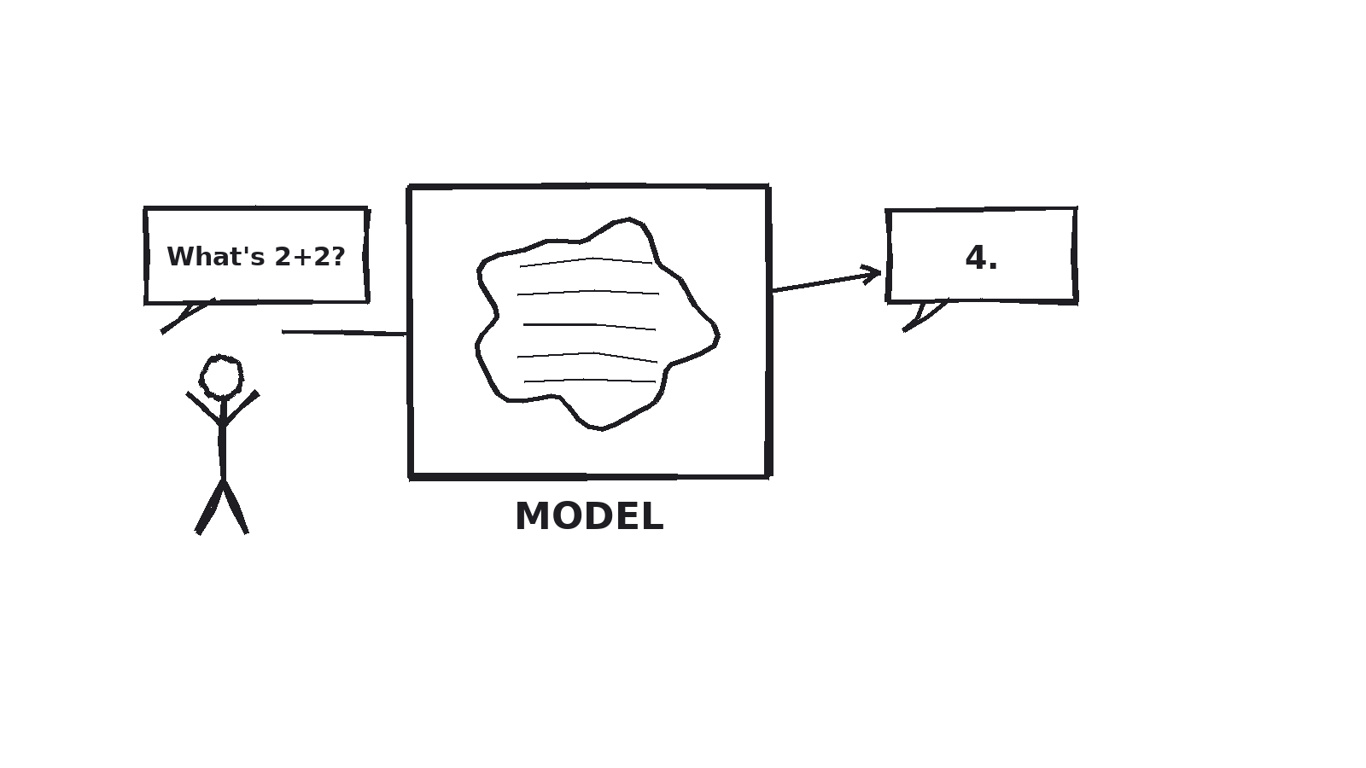
PART 1
The Model — answers when asked
A model is like a brilliant friend you can only reach by text: ask a question, get an answer.
Ask it to “find a cheaper flight and book it” — it can describe how, but it has no hands to actually do it.
Everyday version: typing a question into a blank Word document. It can hold the answer — it can't go look anything up for you.
Notes:
A model is like a brilliant friend you can only reach by text. Ask a question, get an answer. Ask it to 'find a cheaper flight and book it' — it can describe how, but it can't actually go do it. It has no hands. Everyday analogy: opening a blank Word document and typing 'what's the capital of France?' into it.

Slide 3
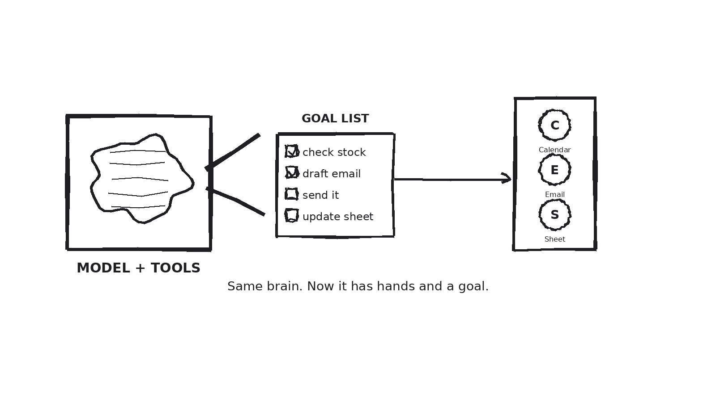
PART 2
The Agent — same brain, now with hands
An agent is that same model, wired up to tools and given a goal instead of a question.
Give it “find a cheaper flight and book it” and it checks a flights tool, compares prices, fills the form — and stops only when the ticket exists.
The tell: does it loop, decide, and act toward a goal without you clicking each step?
Notes:
An agent is that same model, wired up to tools and given a goal instead of a question. Give it 'find a cheaper flight and book it,' and it checks a flights tool, compares prices, fills the booking form, and stops only when the ticket exists — not when it's said something clever.

Slide 4
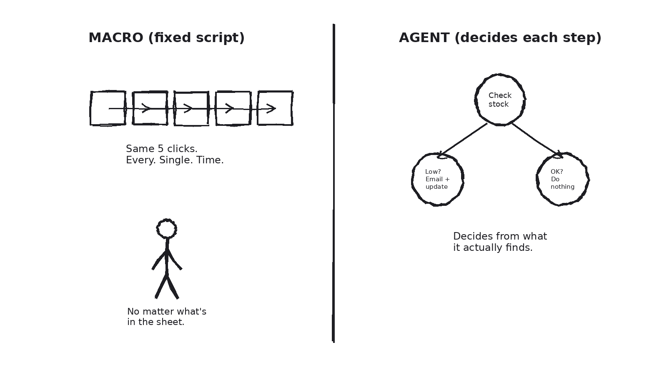
OFFICE SUITE ANALOGY
A macro repeats. An agent decides.
A recorded Excel macro clicks the same five cells every time. An agent is more like a new hire: “check the sheet, and if stock's low, draft the email, send it, update the tracker” — it adapts to what it actually finds.
Notes:
Office Suite analogy: think of an Excel macro you recorded once — it clicks the exact same five cells in the exact same order, every time, no matter what's actually in the sheet. That's a fixed script, not an agent. An agent is more like handing the job to a new hire and saying: 'Check the inventory sheet. If stock's below 10, draft the reorder email, send it, then update the tracker.' It decides each step from what it actually finds — and if row 12 looks different today, it adapts instead of blindly clicking the same five cells.

Slide 5
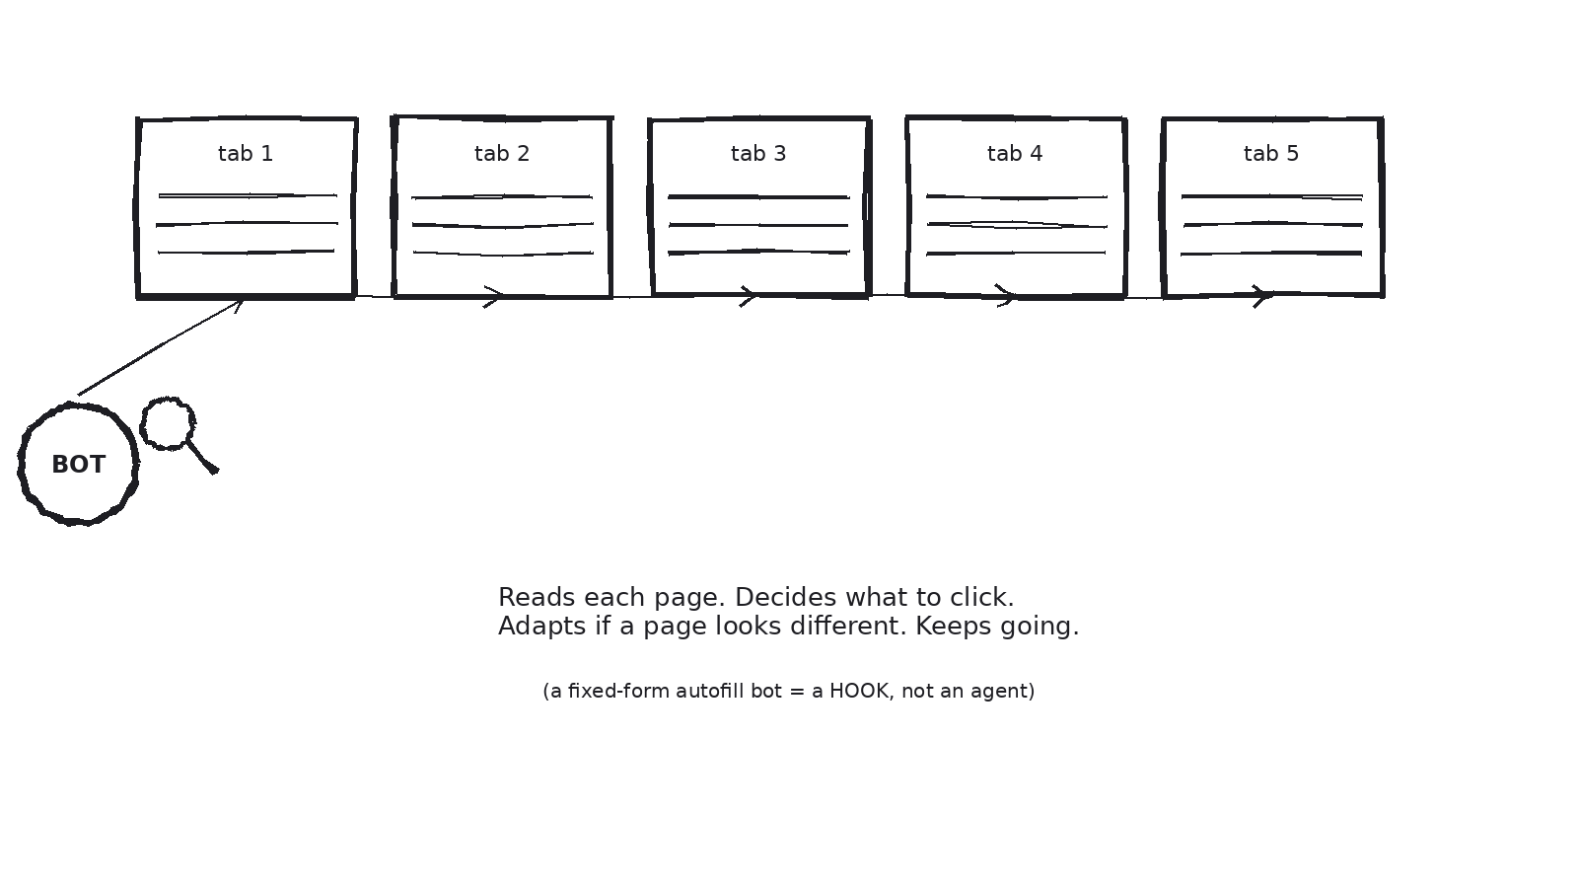
BROWSER ANALOGY
Autofill fills a form. An agent reads the room.
You clicking through ten tabs is a human deciding. A one-shot autofill bot is a “hook.” An agent reads each page as it loads, decides what to click, and adapts — across all ten tabs — until the task is done.
Notes:
Browser analogy: you, clicking through ten tabs by hand, is a human doing the deciding. An autofill bot that fills one fixed form is a hook (one trigger, one action — more on that in a future episode). An agent is the browser assistant that reads each page as it loads, decides what to click next based on what's actually there, and keeps going across all ten tabs until the task is done — retrying if a page didn't load right.

Slide 6
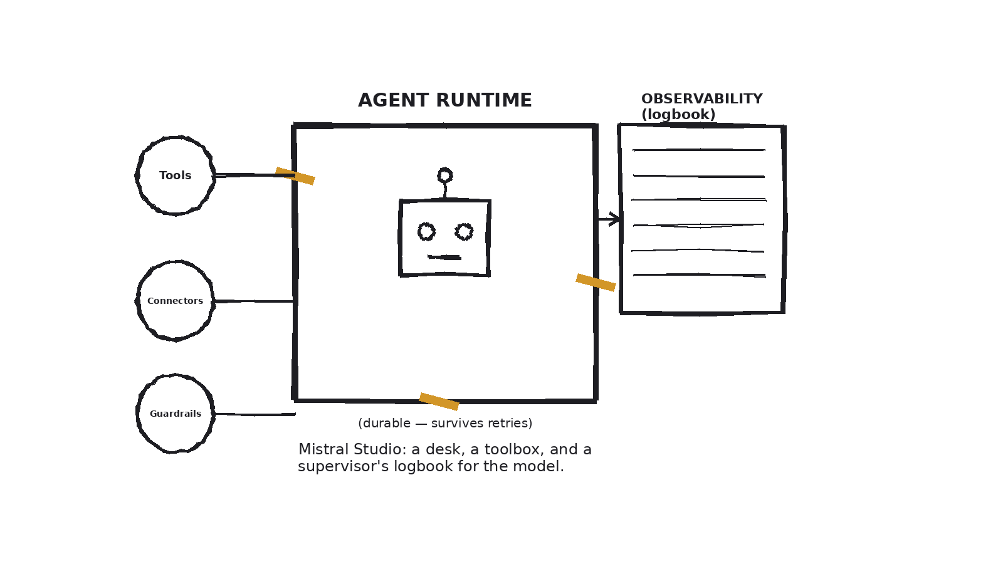
SEEING IT FOR REAL
Mistral Studio: a desk, a toolbox, a logbook
The Agent Runtime keeps a task alive through retries. Tools/Connectors are its hands. Observability is the logbook of everything it did — and why.
Source: Mistral Studio product page (mistral.ai/products/studio) and the Mistral AI Studio launch announcement (mistral.ai/news/ai-studio).
Notes:
Mistral Studio is a real place this happens. You don't just ask its model a question — you build an agent that runs inside what Mistral calls the Agent Runtime. That runtime is the glass box: it keeps the agent's task alive even through retries and multi-step jobs, so a hiccup halfway through doesn't lose the work. The pegs are the hands: tools and connectors the agent can reach for — a database, a calculator, a search function. And the clipboard is Observability — every action the agent takes gets logged, so you can trace exactly why it did what it did, the same way you'd want a new employee's work written in a logbook you can check. Everyday analogy: it's the difference between hiring someone and just leaving them a phone number.

Slide 7
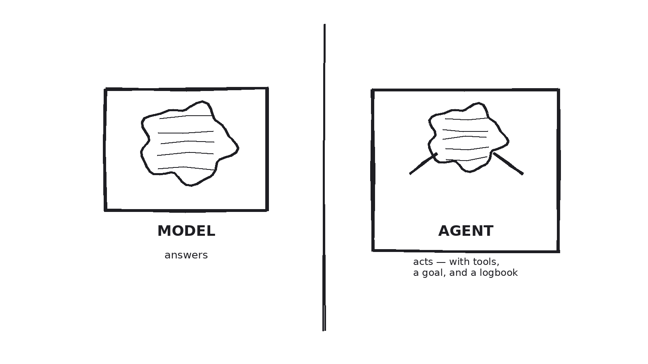
RECAP
Model talks. Agent walks —
and writes down where it went.
Notes:
So: a model answers. An agent takes that same model, adds tools, a goal, and a loop, and lets it act — with every step logged so a human can check its work. That's it. That's the whole term. User note — the one-line mnemonic: 'Model talks. Agent walks — and writes down where it went.'

Slide 8
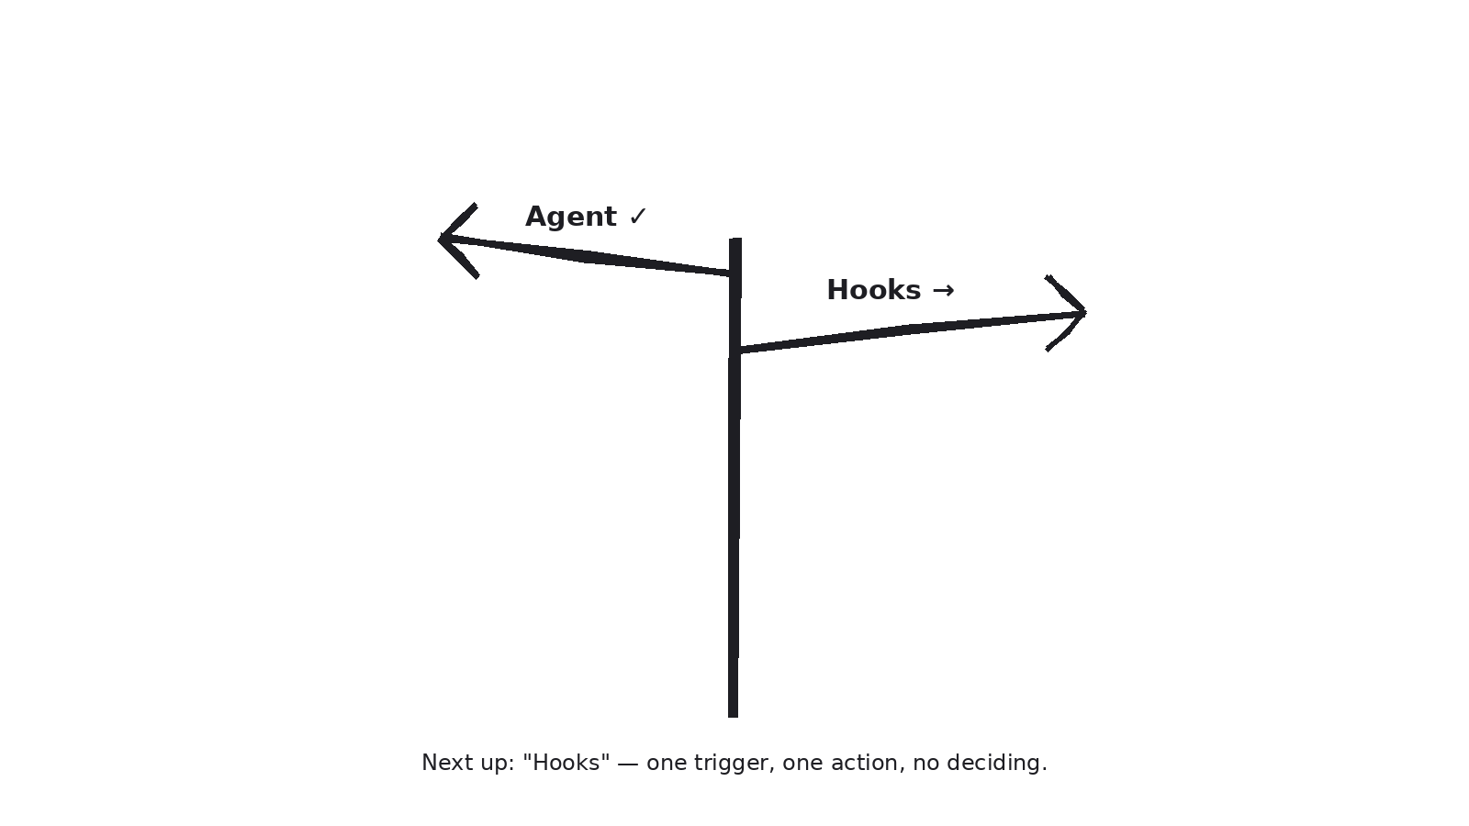
NEXT UP
Episode 2: “Hooks”
The AI equivalent of a doorbell: one trigger, one automatic action, no judgment involved. That's the piece that's NOT an agent — and knowing the difference is what makes the rest of this stuff click.
Topics covered so far: AI Agent (Ep. 1) · Coming next: Hook → Model → Skill → Memory → Tool/Connector → Prompt → Token → JSON → Fine-tuning → Guardrail
Notes:
Next episode, we'll cover Hooks — the AI equivalent of a doorbell: one trigger, one automatic action, no judgment involved. That's the piece that's not an agent, and knowing the difference is what makes the rest of this stuff click. On-screen text: AI Explained Simply — Episode 2: 'Hooks' — coming next.

