Slide 1
AI EXPLAINED, PLAIN AND SIMPLE
What Is “Memory”?
Lesson 3 of the series — plain-language AI concepts, explained with
Office Suite analogies and a live Mistral Studio example.
~2.5
MIN
Runtime
Notes:
Lesson 3 in the 'AI Explained, Plain and Simple' series, following Lesson 1 (Agent) and Lesson 2 (Model). Today's term: MEMORY — what lets an AI carry facts forward instead of forgetting everything the moment it answers.

Slide 2
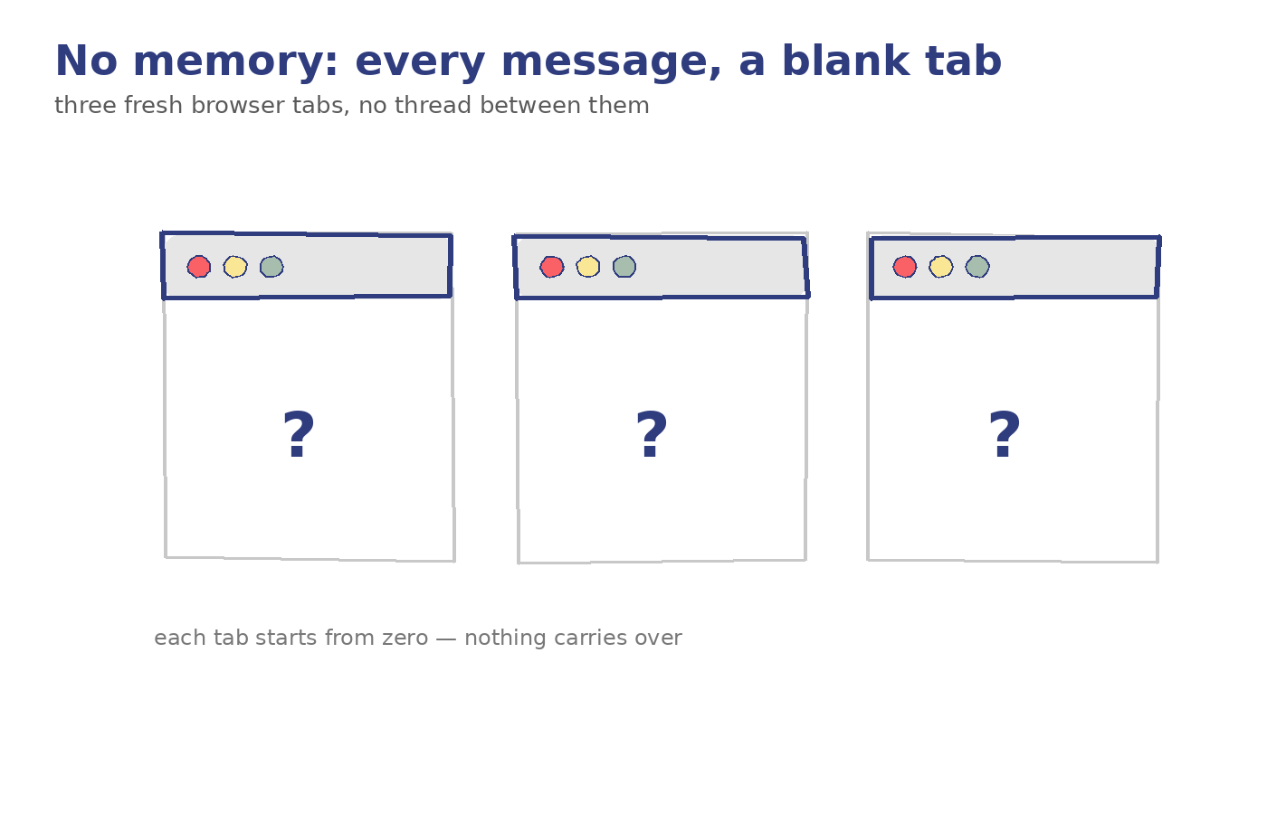
Notes:
Hook: Ever tell a chatbot your name, come back the next day, and it's forgotten everything — including your name? That's a memory problem. Let's talk about what 'memory' actually means for AI, and why some tools have it and some don't.

Slide 3
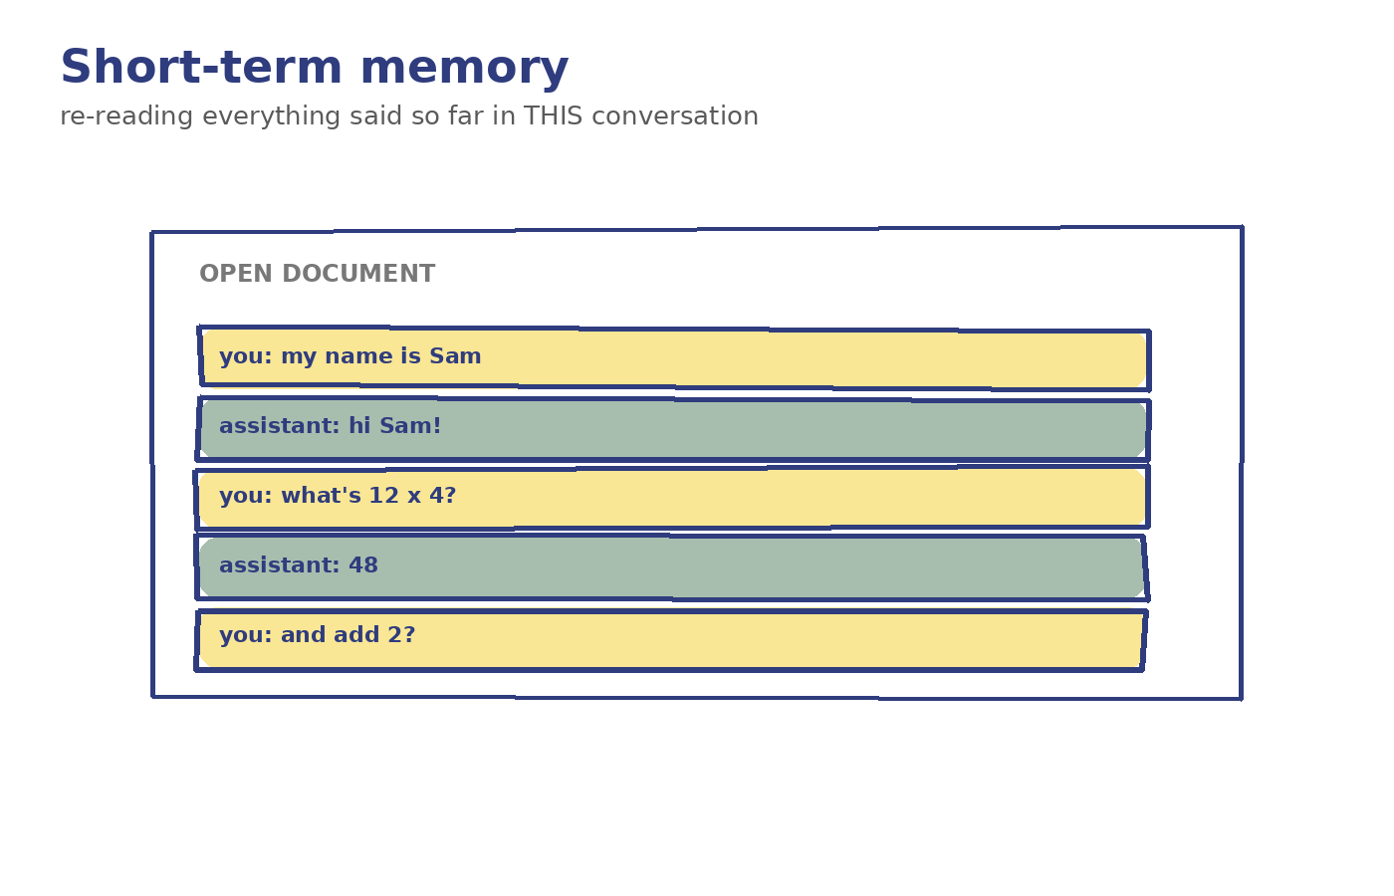
Notes:
Short-term memory is everything said earlier in the same conversation — like Word's Undo history, which only remembers what happened in the document you have open right now. Close the file, and that history is gone.

Slide 4
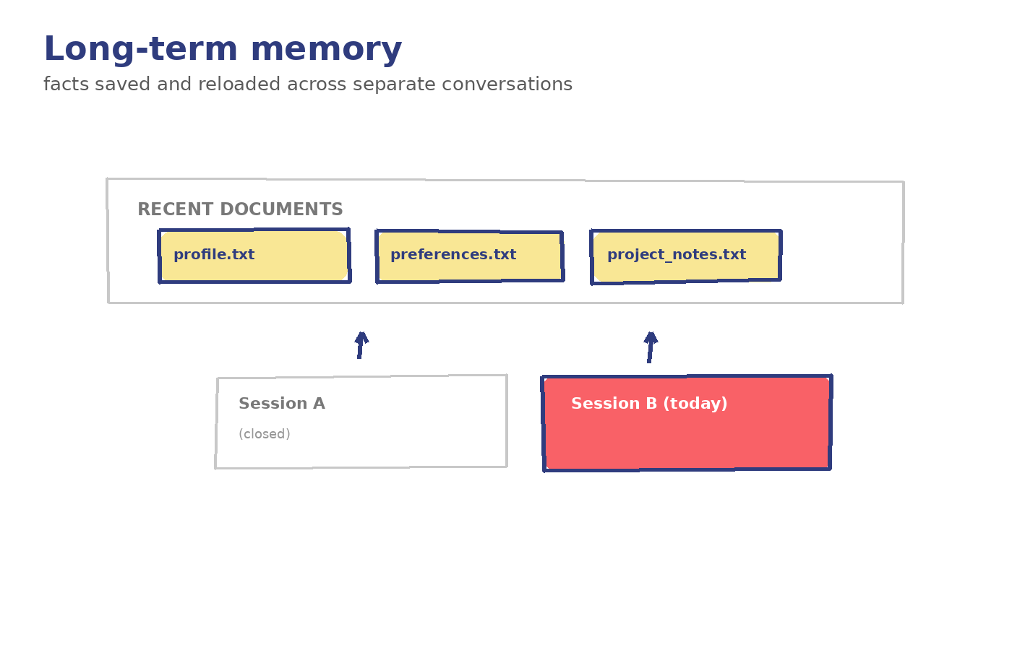
Notes:
Long-term memory is different: it's facts an AI keeps across separate conversations — like Word's 'recent documents' list, which is still there tomorrow even after you've quit and reopened the app.

Slide 5
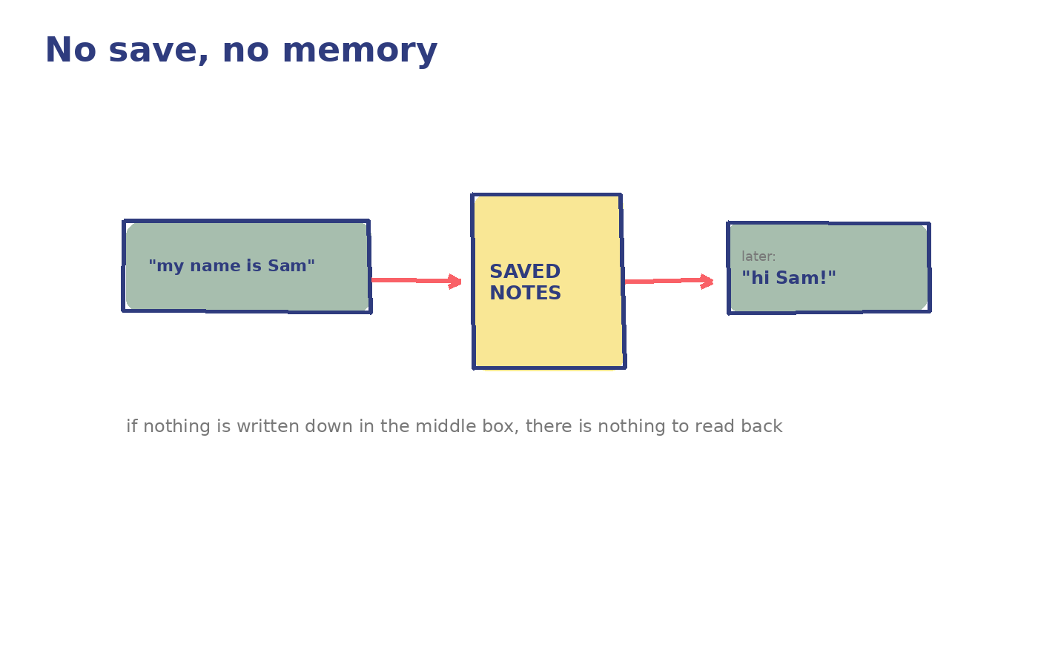
Notes:
Why this isn't free: short-term memory is really just re-reading the whole conversation so far every single time you send a new message. Long-term memory means something was deliberately written down and saved somewhere — a note, a profile, a database — to be read back in later. If nothing was saved, there's nothing to remember.

Slide 6
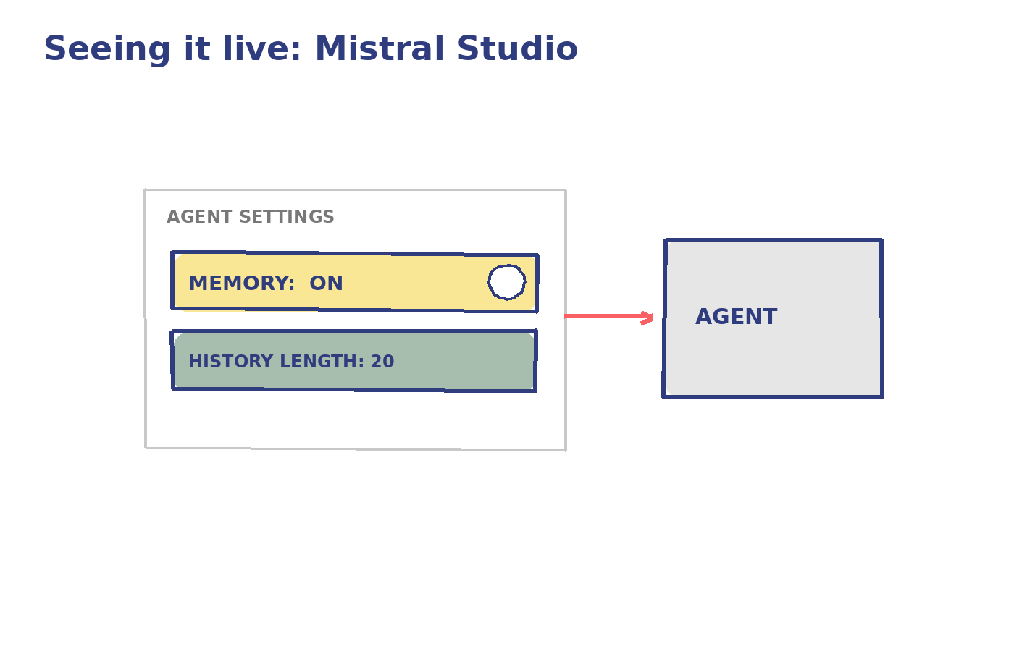
Notes:
Concrete example — Mistral Studio: when you build an agent, you configure how much conversation history it keeps in view and whether it has a memory store it can write facts to and read facts from across sessions. Turn memory off, and the agent behaves like a blank search tab, no matter how smart the underlying model is. USER NOTE — try it yourself: in Mistral Studio, open an agent's settings and toggle its memory/history length to see the effect directly.

Slide 7
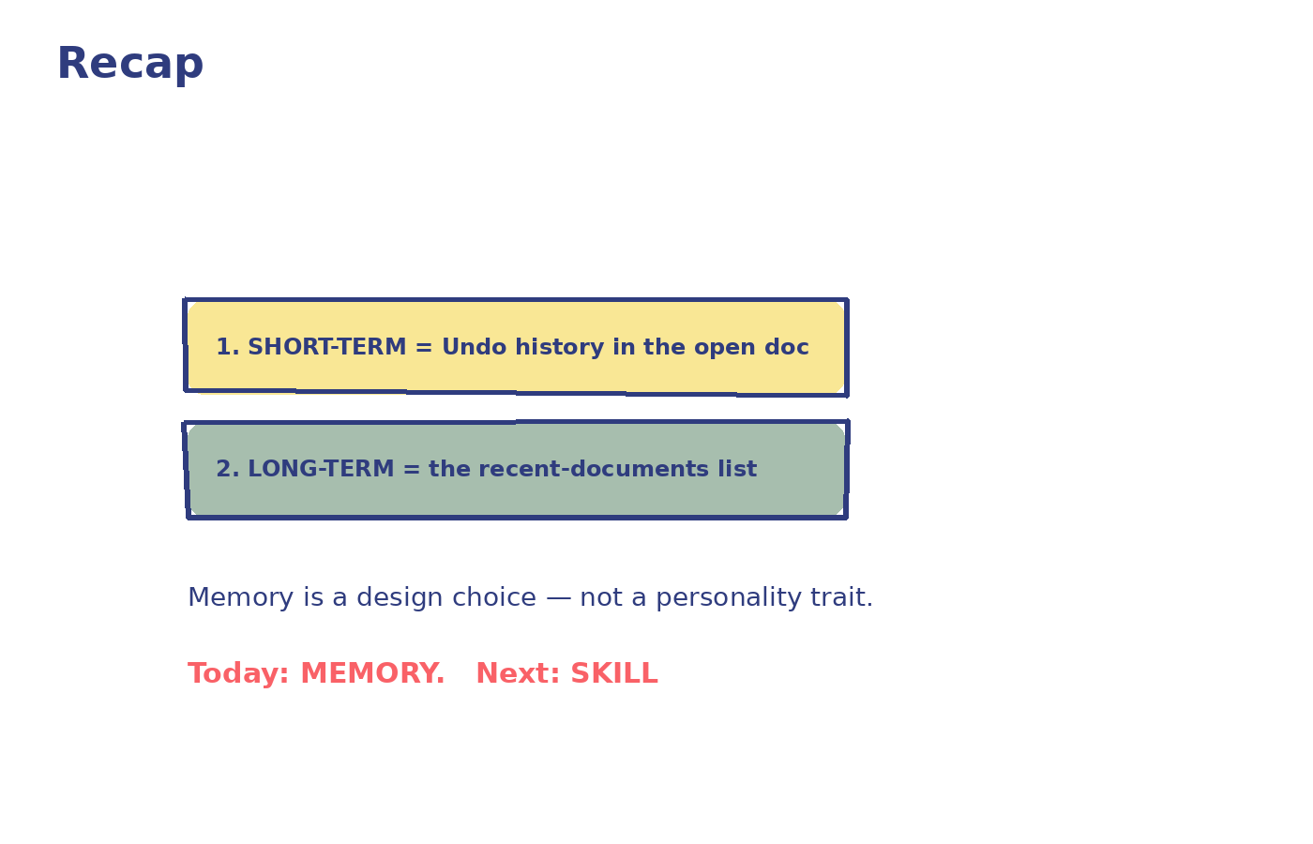
Notes:
Recap: memory isn't a personality trait an AI happens to have — it's a design choice. Short-term memory = re-reading the conversation so far, like Undo history inside one open document. Long-term memory = something explicitly saved and reloaded later, like a recent-documents list. No save, no memory — for either kind. Next time: how does an AI get a whole new reusable capability bolted on, instead of just remembering more? That's 'skill' — Lesson 4. Series tracker: Covered so far — Agent (L1), Model (L2), Memory (L3). Next: Skill → Hook → Workflow → JSON → Python.

